Slide 1

Data Science / SNA
Twitter Realtime API
Mark Stam, november 2014

Slide 2

Data Science

Slide 3
Data Science
The study of the extraction of knowledge from data
A.o.
creating datasets;
creating network graphs;
finding influencers;
textmining

Slide 4
Tools
R (statistical analysis software)
Python (scripting language)
Gephi (visualisation software)
Open Source, free software !

Slide 5
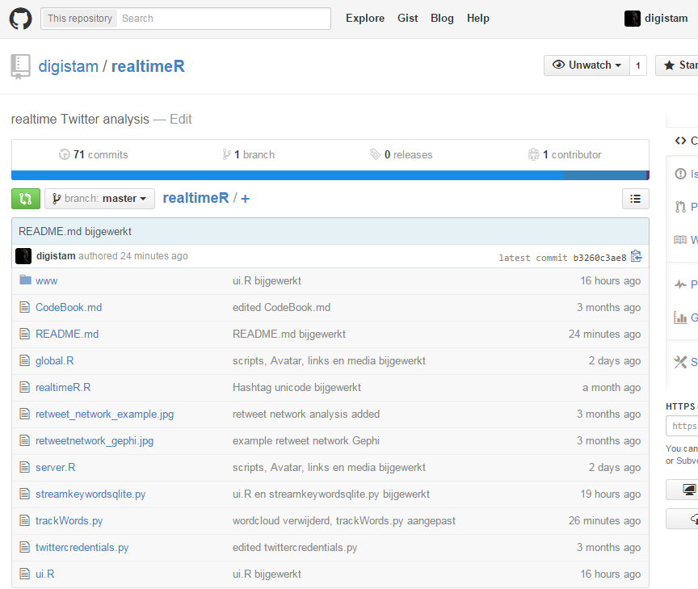
Scripts
Download scripts at:
https://github.com/digistam/realtimeR

