Slide 1
Baseball Exploratory Analysis
Project 1
Grace Palmer, Devin Trapp, Ryan Vasquez, Alec Banerji, Ashley Paillet

Slide 2
Proposal and Goals (Ryan)
What stats correlate most closely with scoring runs?
BA & OPS
What unexpected trends can we uncover?
HR & SB

Slide 3
Creating a Workable DataFrame (Alec)
Cleaning
Renaming & removing columns
Refining timeframe by removing rows
Creating columns
Calculating averages to compare stats
Calculating correlation
Identifying strong positive and negative correlations

Slide 4
ANOVA (Ashley)

Slide 5
Histogram (Ashley)

Slide 6
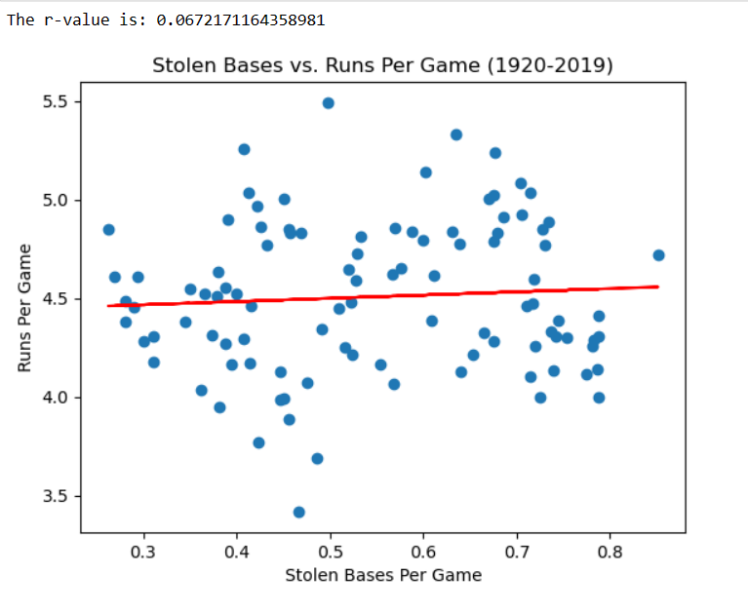
Stolen Bases vs. Runs Per Game (Ryan)

Slide 7
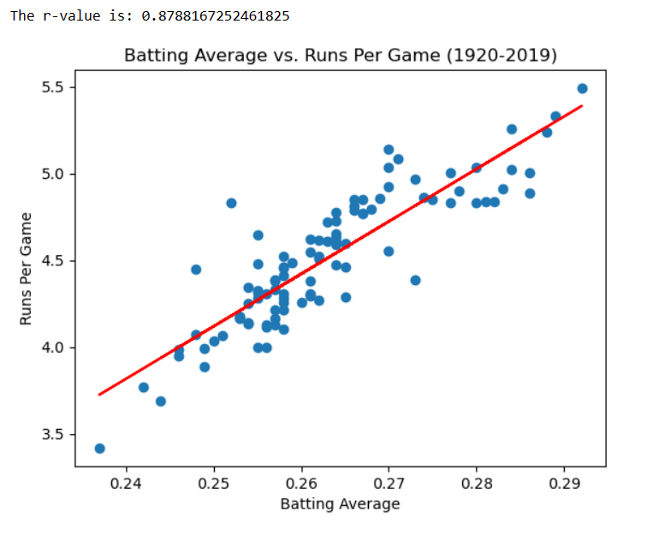
Batting Average vs. Runs Per Game (Ryan)

Slide 8
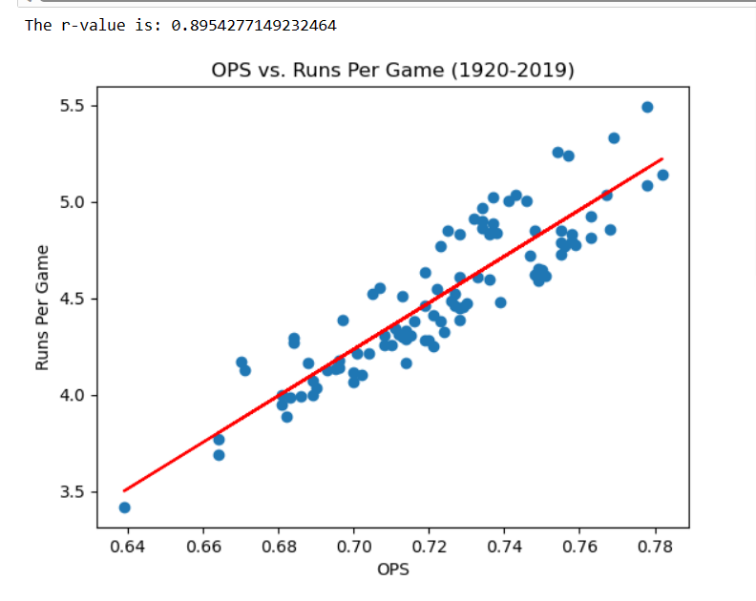
OPS v. Runs Per Game (Ryan)

Slide 9
Analyzing by Decade (Devin)
Binning
Reorganizing data by decade for further analysis and visualization

Slide 10
Runs Per Game by Decade (Devin)

Slide 11
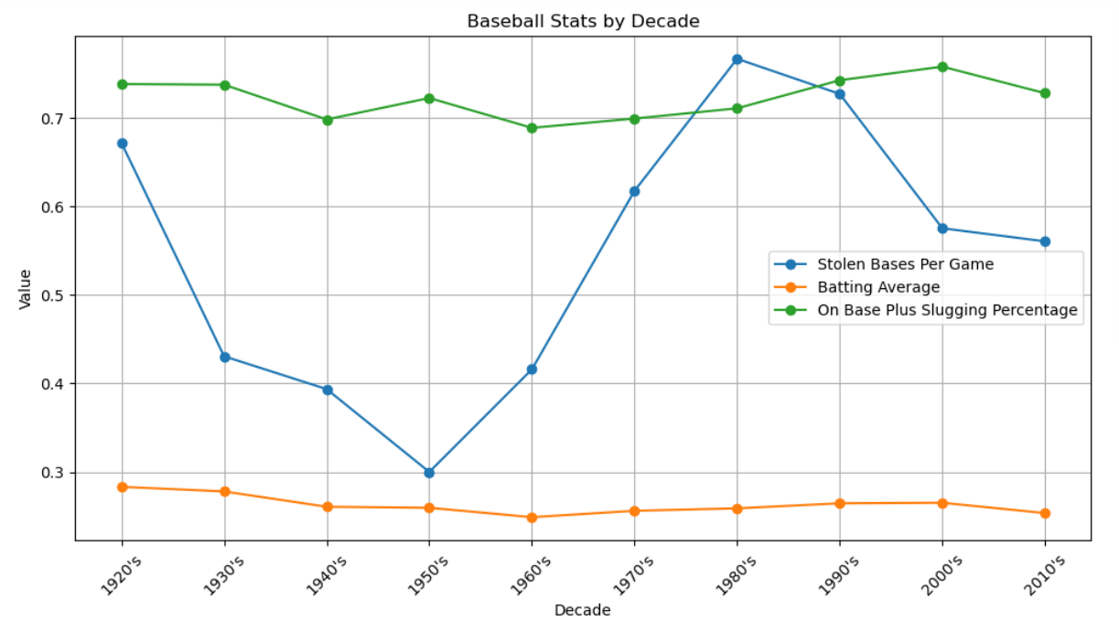
Baseball Stats by Decade (Devin)

Slide 12
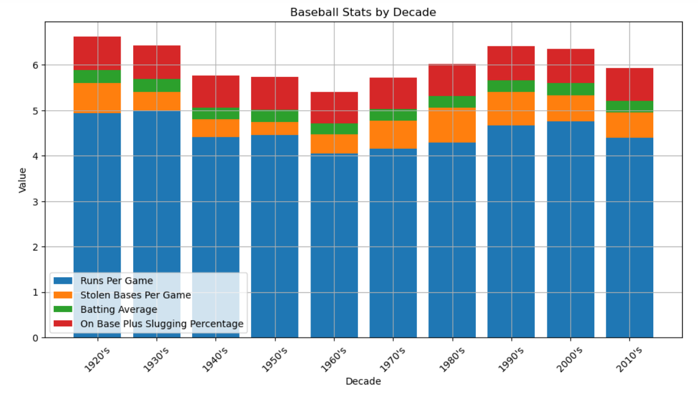
Baseball Stats by Decade (Devin)

Slide 13
Box and Whisker (Grace)

Slide 14
Conclusion (Grace)

