Slide 1

Project 4:
Heart Stroke Risk Prediction
Alec Banerji
Matthew Burch
Kevin Ladisheff
Grace Palmer
Frank Polus
Ryan Vasquez

Slide 2

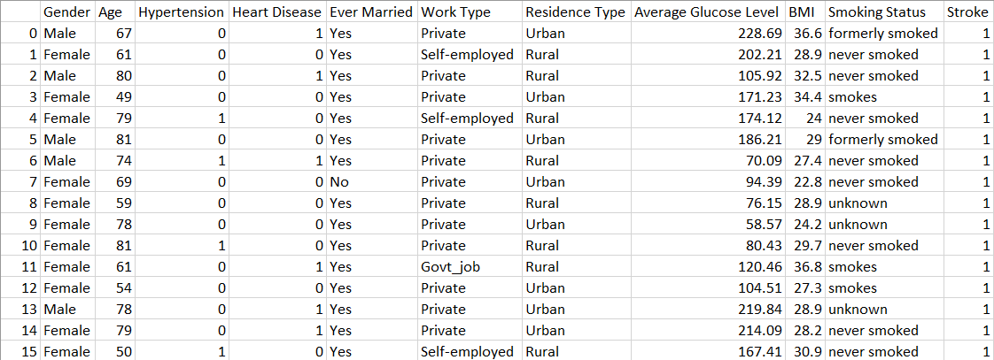
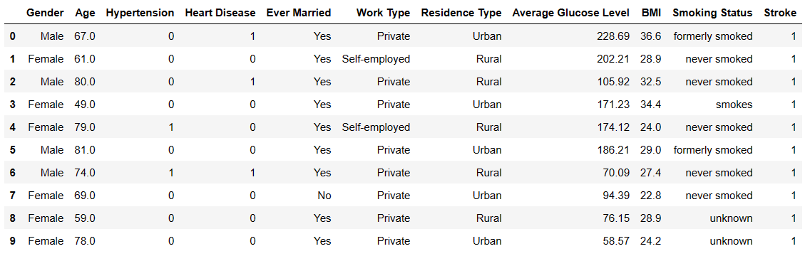

Our Data
Over 5,000 records of clinical data
Non-stroke data overrepresented
Kaggle
ETL pipeline

Slide 3
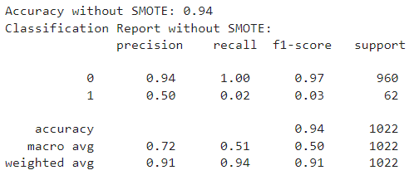
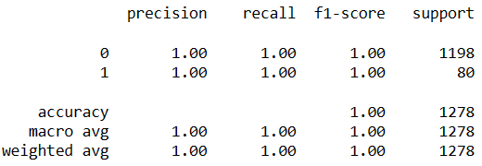
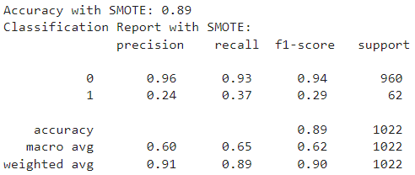

Our Model: Random Forest
Predicting stroke instance and probability
with SMOTE for data diversification
Other models: SVM

Slide 4
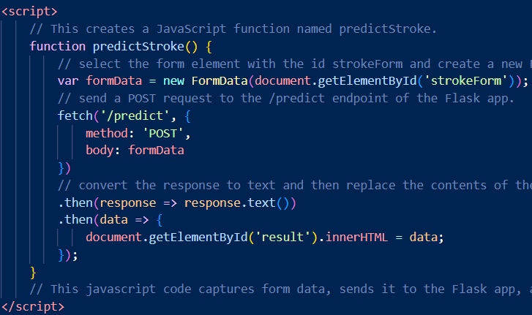
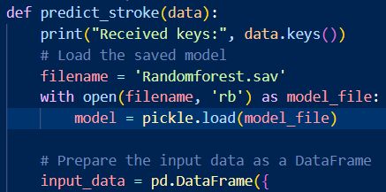
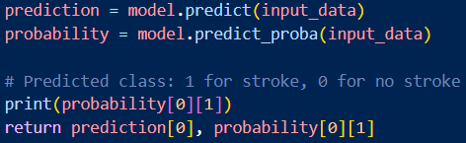
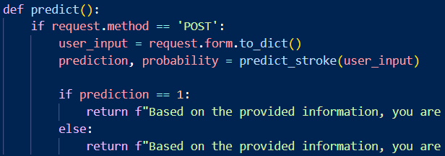
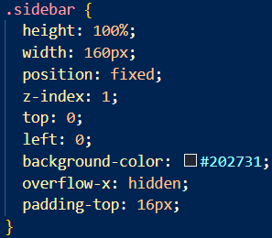
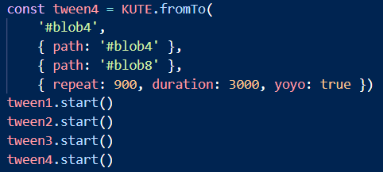
Our Flask App
html/JS
app.py
CSS

Slide 5
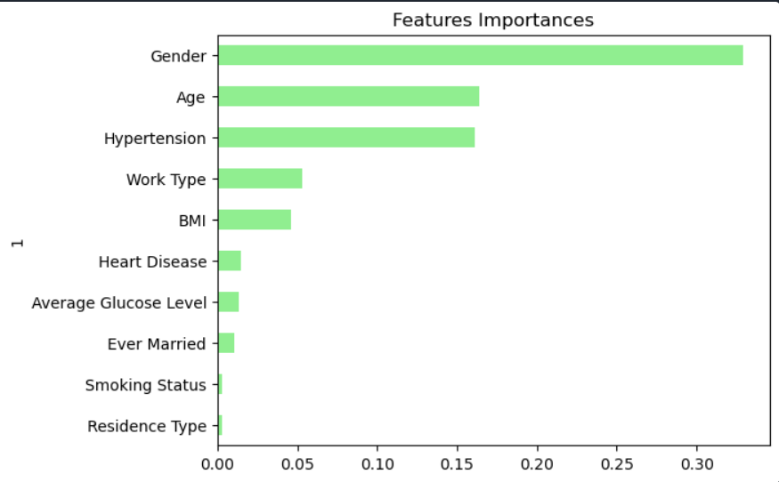
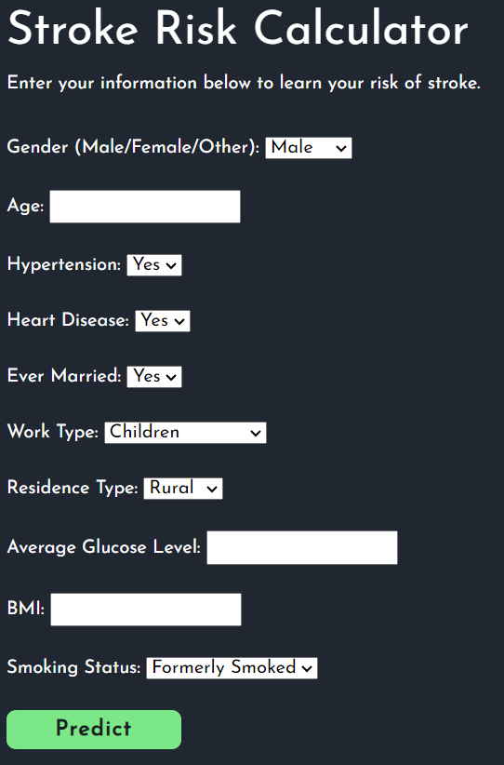
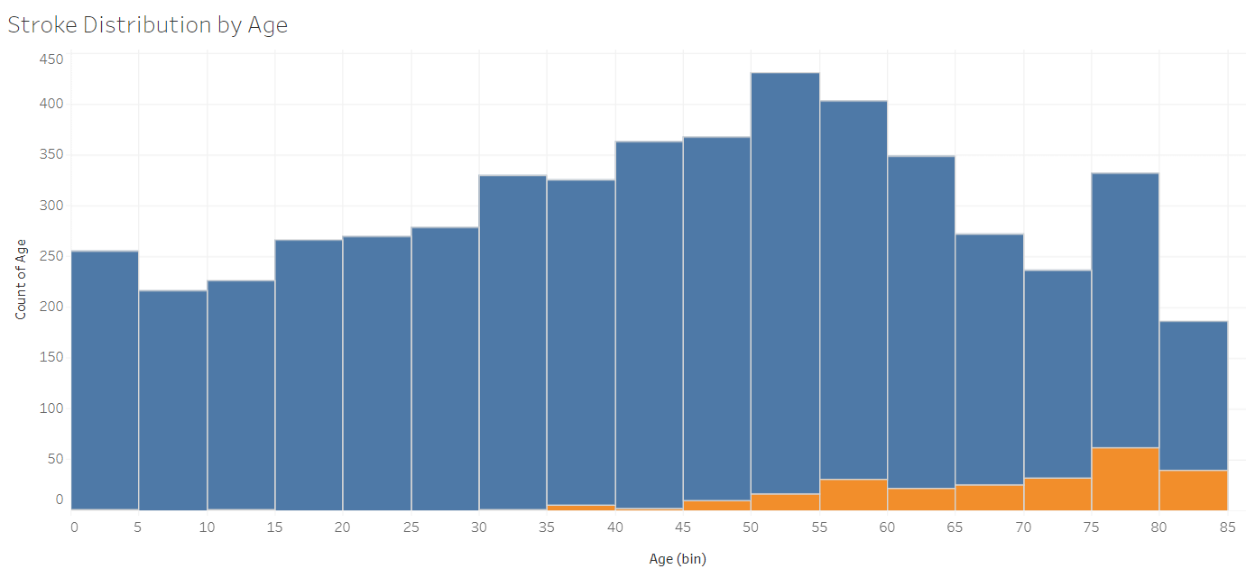
Our Site
Feature Importances
Model Interactivity
Tableau

