Slide 1
Team Joint Report
May 13 (Tue) 2025
Masaki Satoh, Tomoki Ohno, Chihiro Kodama, Shao-Yi Lee, Kohei Yamasak, Chao-An Chen, Kosei Ohara, Masahiro Watanabe, Ray KUO, Shao-Yu Tseng, Yu-Hsuan Fan, Pin-Yu Chao, Hisashi YASHIRO, Shuhei Matsugishi, Chie Yokoyama, Takahashi Kotaro, Aihisa KAMIJO

Slide 2
Sub themes
Climatology
Tropical cyclones
Intraseasonal variabilities & equatorial waves, or convective organization
Extreme precipitation or winds
Mid-latitude disturbances
Land-atmosphere interactions
Variability in mountainous regions and complex terrain
Upscale phenomena: impacts of small-scale features (e.g., convection) on waves and the large-scale circulation (jets, monsoons, ITCZ, blocking, etc.)
Data handling, visualization

Slide 3
Research Interests
Shao-Yu Tseng Diurnal cycle of convection/precipitation over Taiwan
Yu-Hsuan Fan Lee vortex over Taiwan, winter time
Ray KUO MJO
Shao-Yi Lee cloud fractal scheme
Chao-An Chen extreme precipitation, TC -related extreme precipitation, WNP-EA monsoon
Pin-Yu Chao extreme precipitation tracking, tropical cyclone, front, MCS, ...
Ohara energy cycle
Yamasaki cloud and climatology
Takahashi monsoon, seasonal change, precipitation,
Kamijo AI, energy flux in different scale phenomena
Yokoyama MCS tracking, MSC and environment, line-shaped stationary precipitation

Slide 4
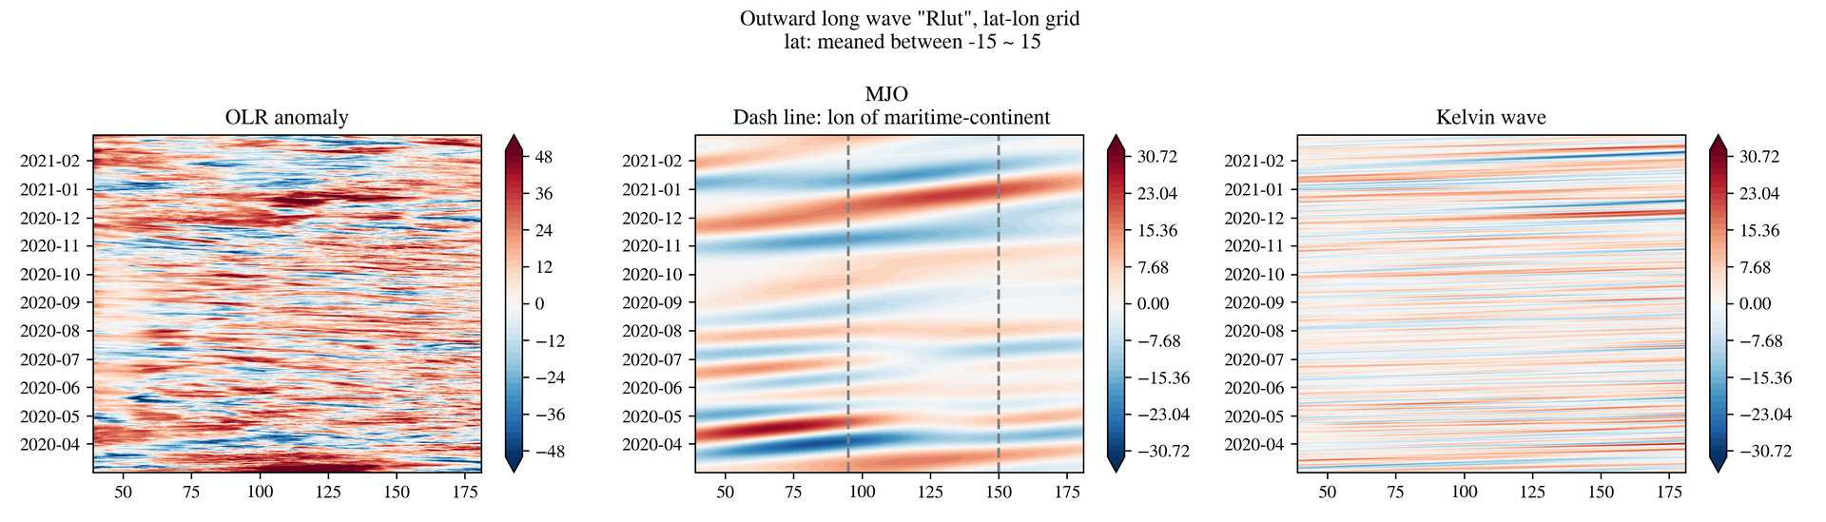
Hacking status
@raykuo
Hey guys, I (finally) plotted the hovmoller diagram of the OLR anomaly (NICAM lat-lon data, 'rlut'). The left panel is the OLR anomaly, and the middle and right panel are for MJO, Kelvin waves. These two signals are band-passed data of the OLR anomaly. We can note that the Barrier effect in the marinetime contenent is not significant in this 1-year simulation.
(5) hk25-Convorg - WCRP Lighthouse MPIM Chat Service (Mattermost)

Slide 5
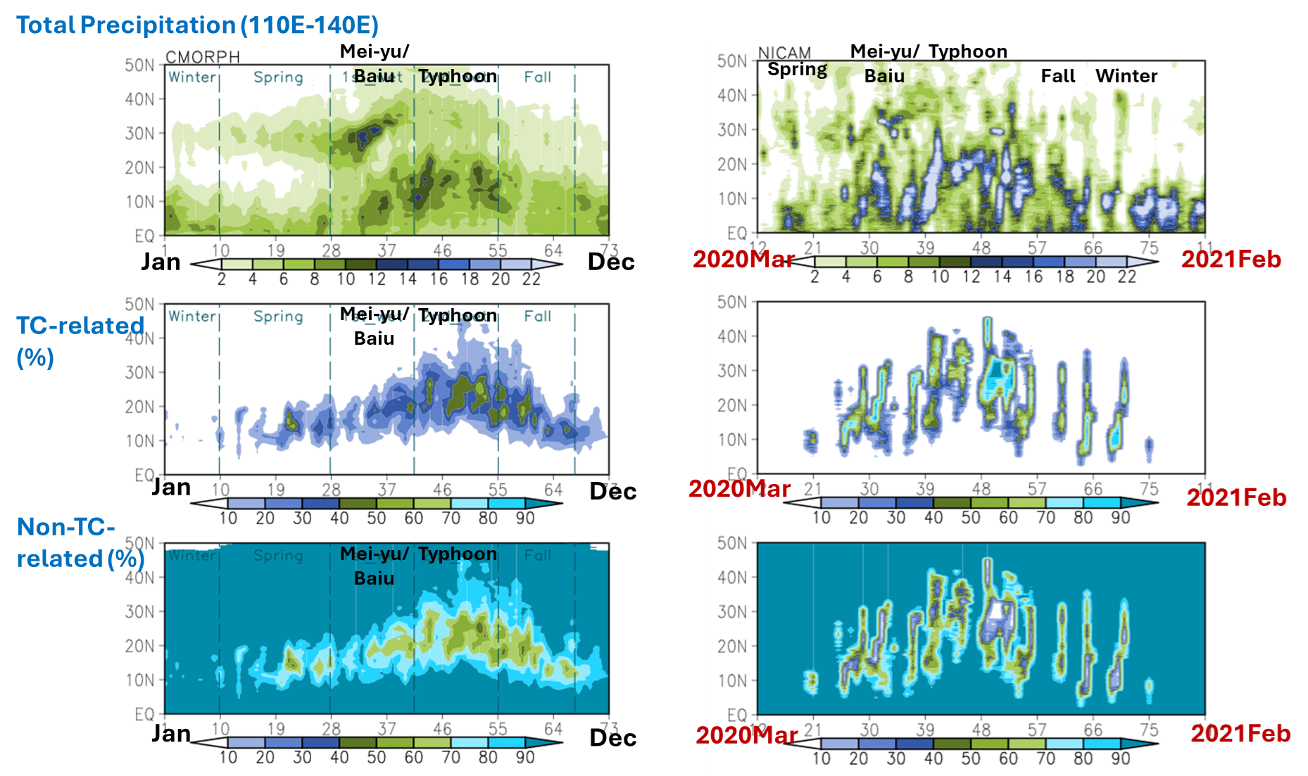
Seasonal Precipitation of the East Asian Monsoon Related to Tropical Cyclones
TC Tracking was provided by Team TC

Slide 6
Hacking issues
Calculation of length of contour lines, for fractal dimension
Some problems in Chunk? Overload of memories.
Do not use .load() and .compute()

