Slide 1
A brief introduction to the NICAM dataset
Daisuke Takasuka (Assist. Prof., Tohoku University)

Slide 2
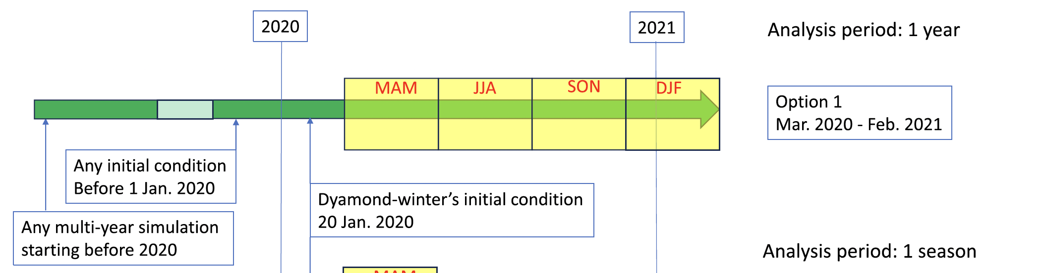
Simulation setup
Following DYAMOND3 (so-called Sendai protocol)
Takasuka et al. (2024, PEPS)
– One year (Mar. 01, 2020 to Feb. 28, 2021) from a 10-year simulation at a 3.5-km resolution
(78 layers with top of ~50km)
Jan. 1. 2011
(initialized with ERA-I)
• w/ slab ocean (MLD of 15m) nudged to daily SST/SIC from the OSTIA product
• Forcing with monthly O3 and daily GHG (following HighResMIP)
Physics | Description
Convective param. | Not used (for both shallow and deep)
Microphysics | NICAM single moment scheme (qv, qc, qi, qr, qs, qg)
Turbulence | MYNN2 (Eddy diffusivity) + Leonard term (Kf = 1.0)
Gravity wave drag | Not used
See Takasuka et al.
(2024, JAMES) for details.

Slide 3
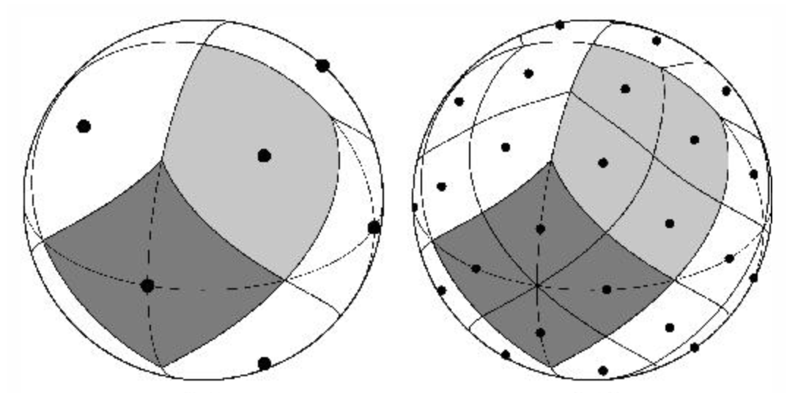
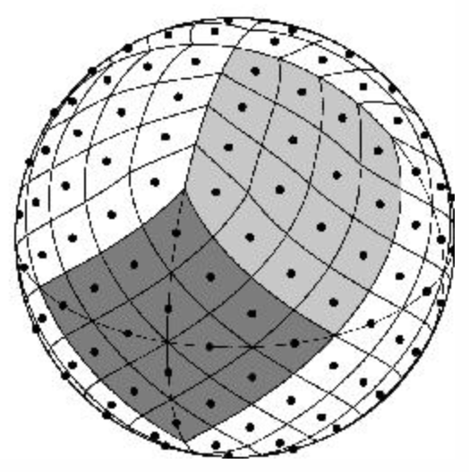
What is available?
Two horizontal structured grid systems are available for analyses of the NICAM data.
(1) HEALPix grid w/ zarr format (highly recommended)
• Making analyses efficient because of
the hierarchical grid structures.
• Easy to handle this on the ”hackathon”
Python environment.
...
Zoom level 0
Zoom level 1
Zoom level 2
(2) Lat-lon grid w/ netCDF format (Option)
• Basically, 0.25-deg grid (Native-grid data for several 2d variables might be added)

Slide 4
What is available?
Two horizontal structured grid systems are available for analyses of the NICAM data.
(1) HEALPix grid w/ zarr format (highly recommended)
– 10 zoom levels (z00 to z09; dx ~10 km).
– Three kinds of time interval (PT1H, PT3H, PT6H)
PT1H: 2d variables (Snapshots for MSLP, OLR, OSR, Us, Vs; Mean for Precip)
PT3H: 2d variables (3-hour mean for all variables)
PT6H: 3d variables (Snapshots for U, V, W, Z, qv, RH, and q_wall) on 25 pressure levels
(2) Lat-lon grid w/ netCDF format (Option)
– In addition to the variables provided on HEALPix, daily land variables are available.
PT1D: Mean for LAI, Runoff (Total and decomposition; see metadata),
soil temperature and moisture, snow-related variables…

Slide 5
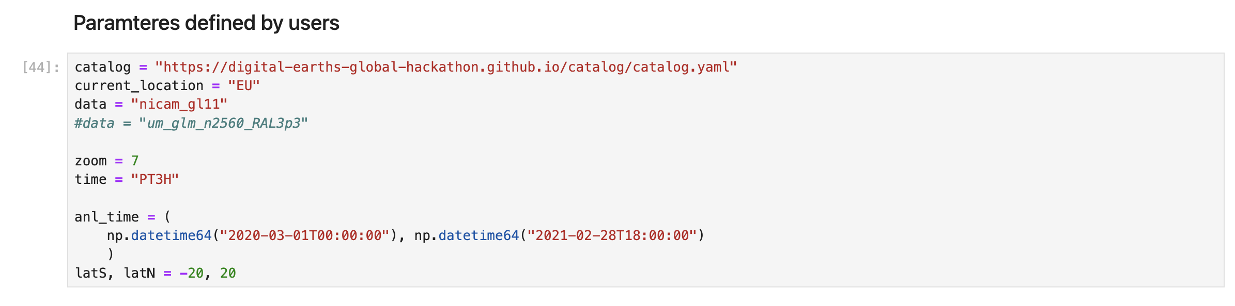
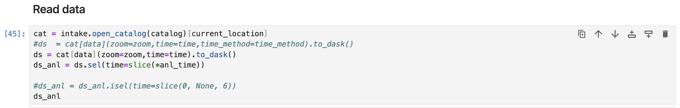
Example: Read the data

Slide 6
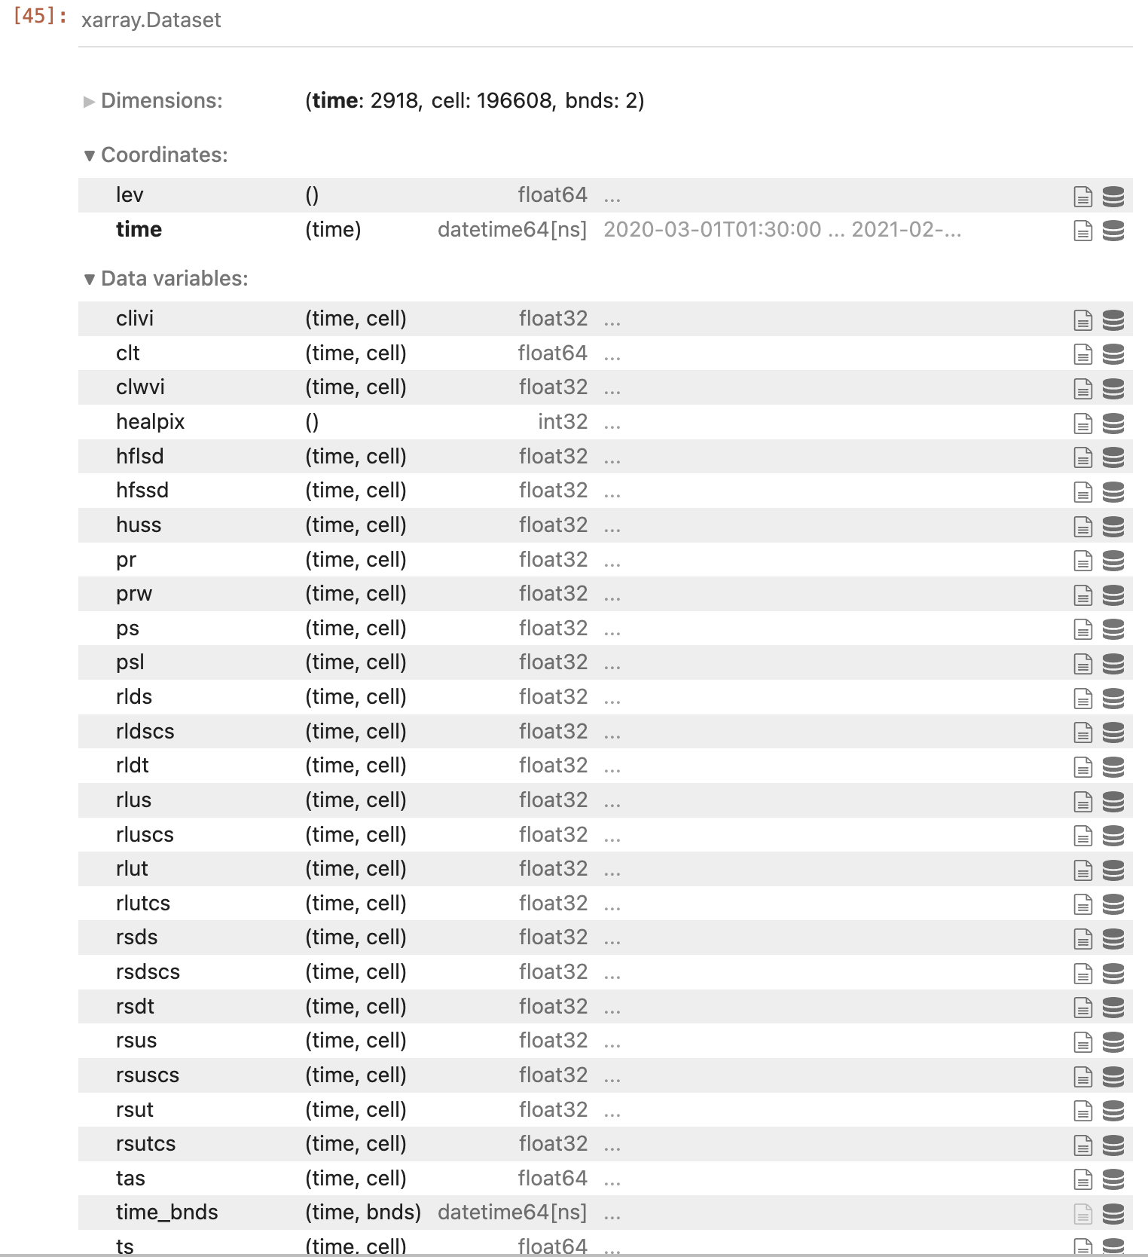
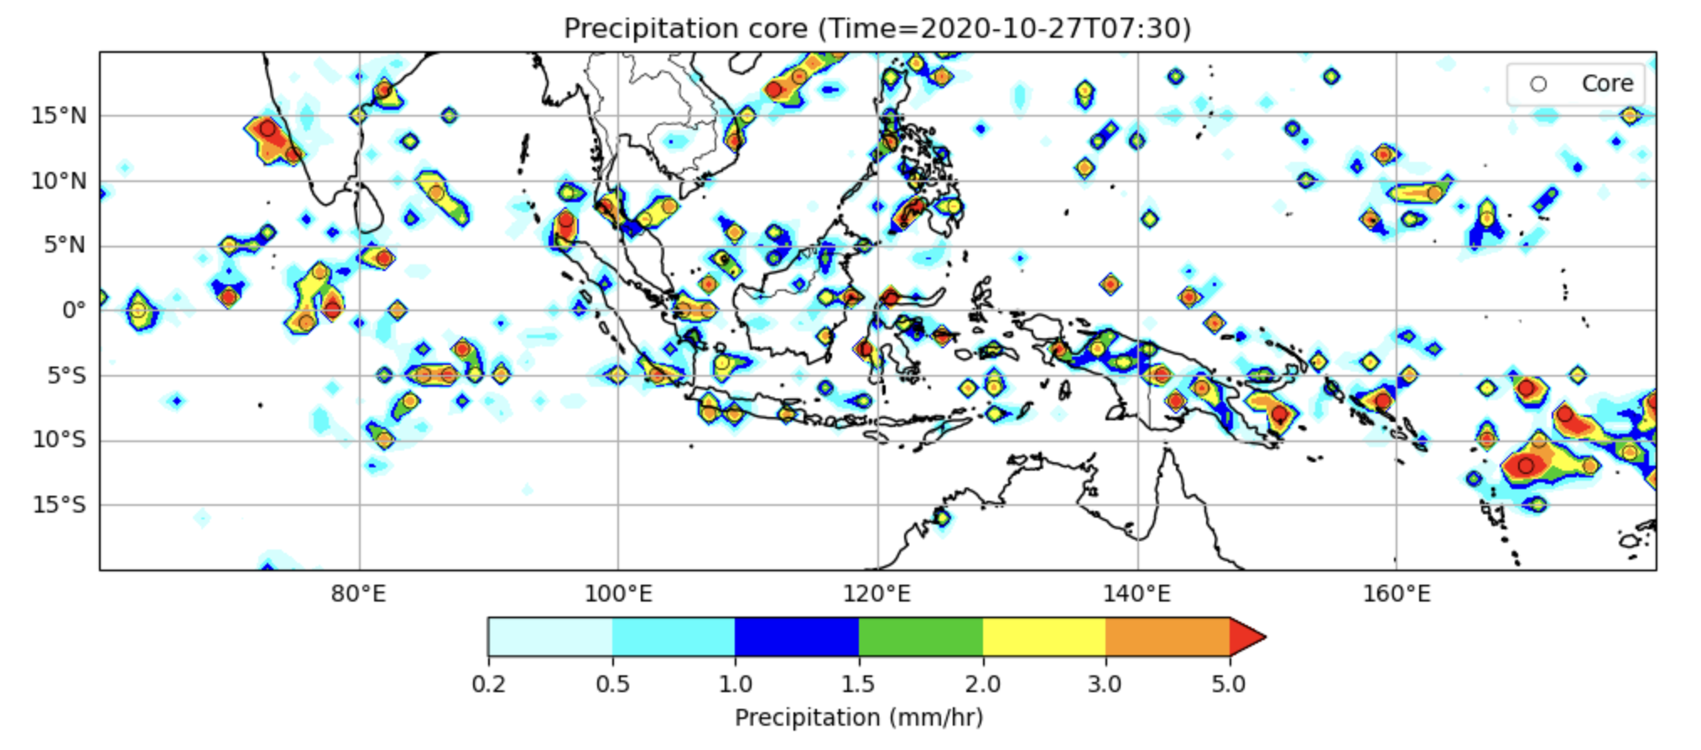
Example: Read the data
After some writing…, for example
Please enjoy hacking the NICAM data &
comparing them with other GSRMs!

