Slide 1


AN OPEN SOURCE WEB-GIS BASED PRECISE SATELLITE TRACKING AND VISUALIZATION TOOL USING TWO LINE ELEMENT DATA
iirs
SAYANTAN | ABHISEK | SHASWAT | SAURABH

Slide 2
INTRODUCTION
Accurate monitoring of satellites plays a pivotal role in analyzing critical mission specific parameters for estimating orbital position uncertainties.
Appropriate DBMS at the software end, could prove its potential as a convenient solution to the existing file based two line element (TLE) [1] data structure.
Web-GIS, being an integral part, links the web-based platform to an interactive visualization of space-borne vehicle and debris tracking.

Slide 3
OBJECTIVES
Building the SQLite3 Database using all available TLE datasets.
Visualizing the satellite tracking in Web GIS platform
Libraries used
OpenLayers3
PHP
Satellite.js
Python

Slide 4
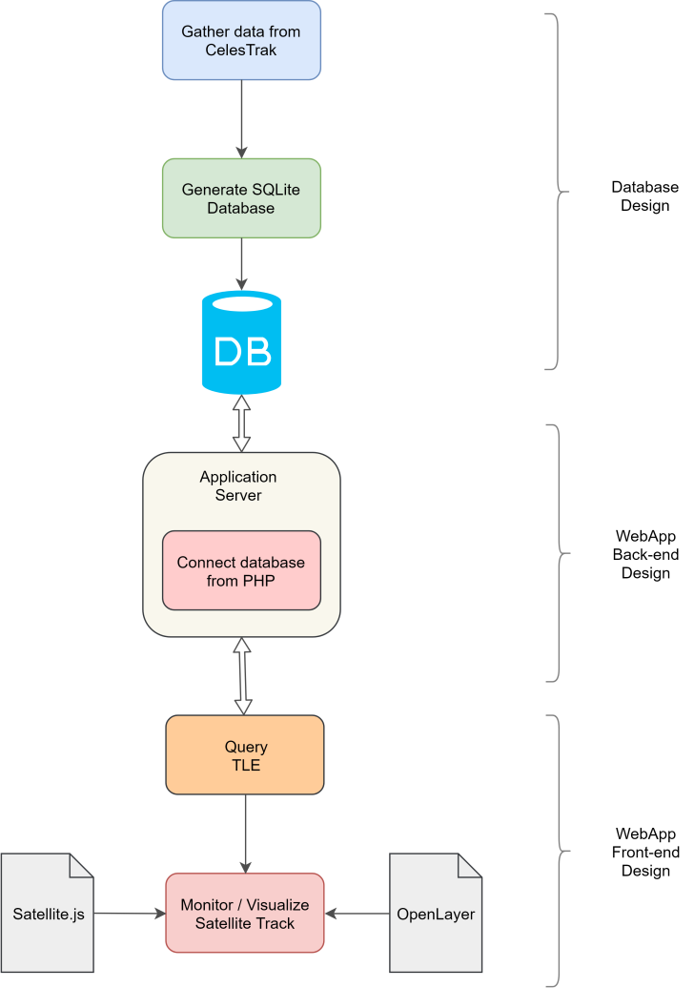
METHODOLOGY

Slide 5
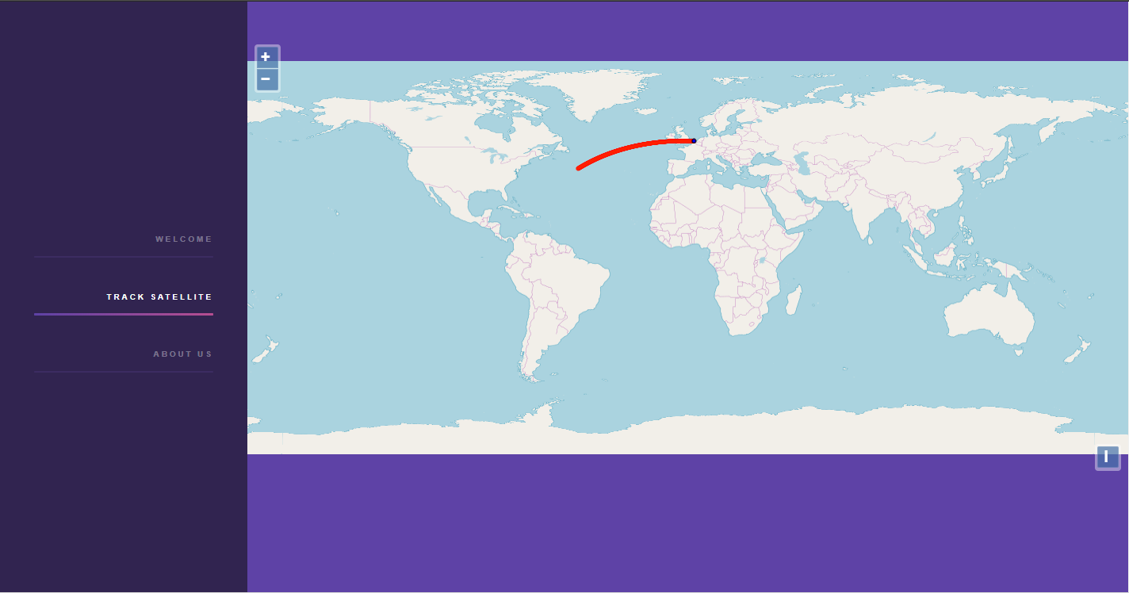
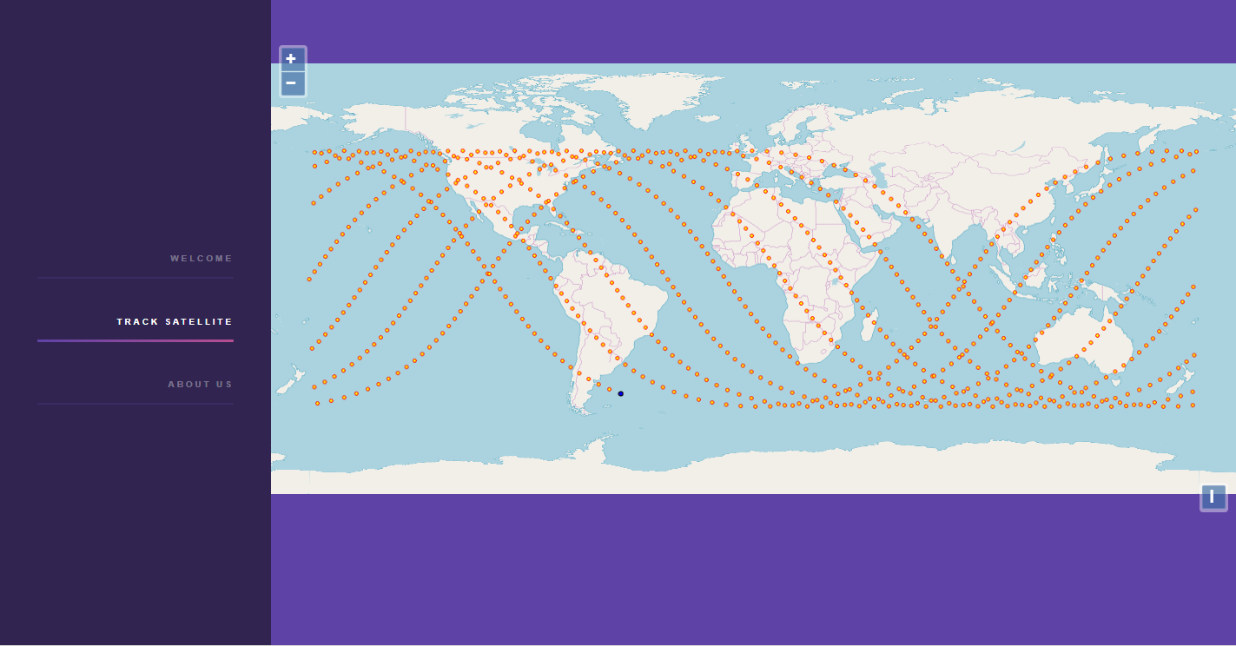
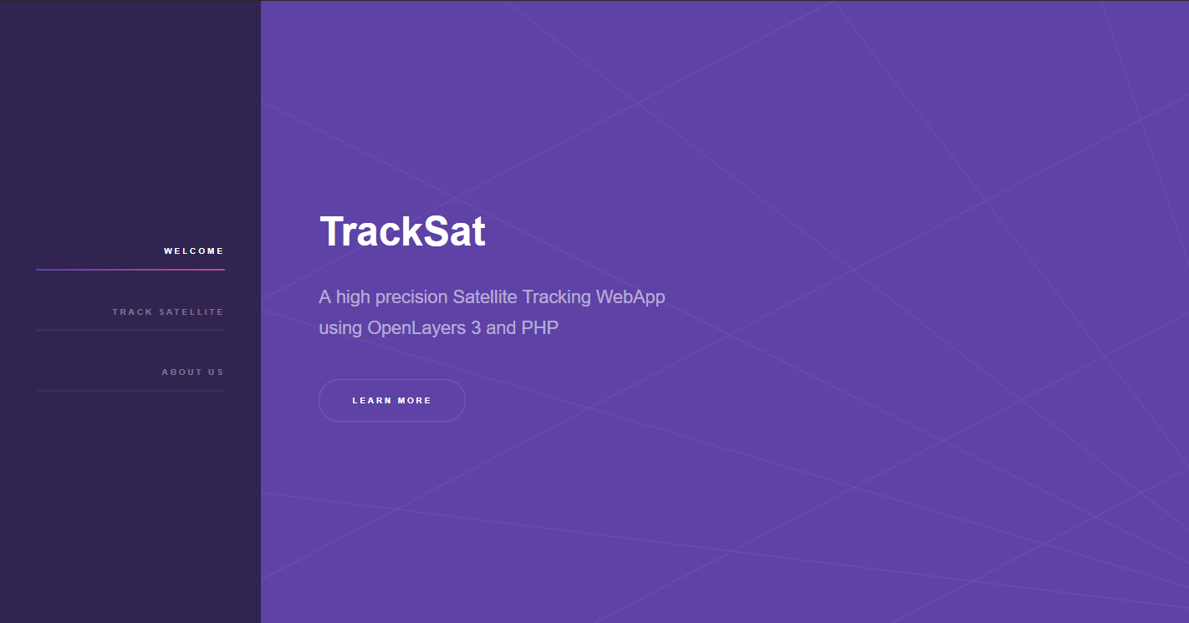
RESULTS

Slide 6
RESULTS
Simulated ground track of ISS (25544)
Notes:
Equatorial track

Slide 7
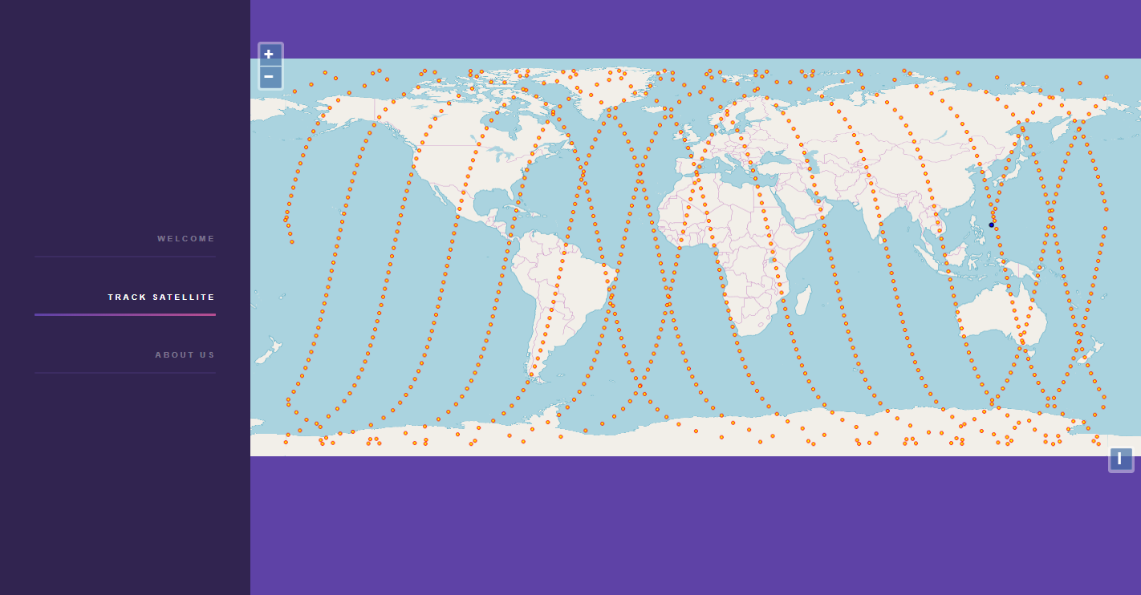
RESULTS
Simulated ground track of ENVISAT (27386)
Notes:
Polar Track

Slide 8
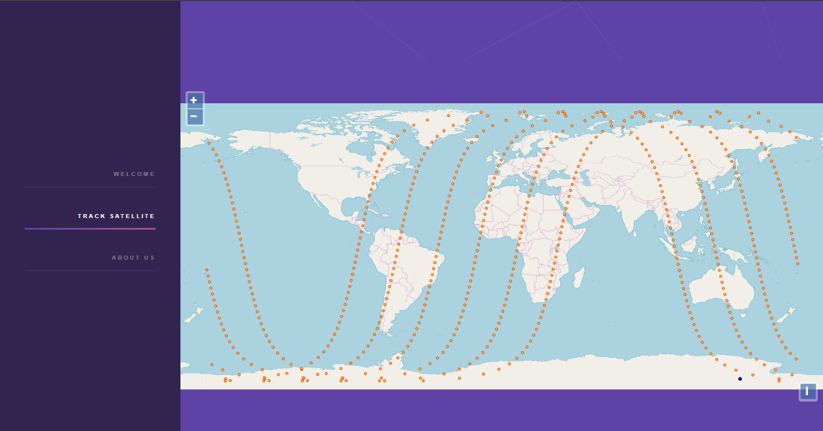
RESULTS
Simulated ground track of Worldview-4 (41848)
Notes:
Polar Track

Slide 9
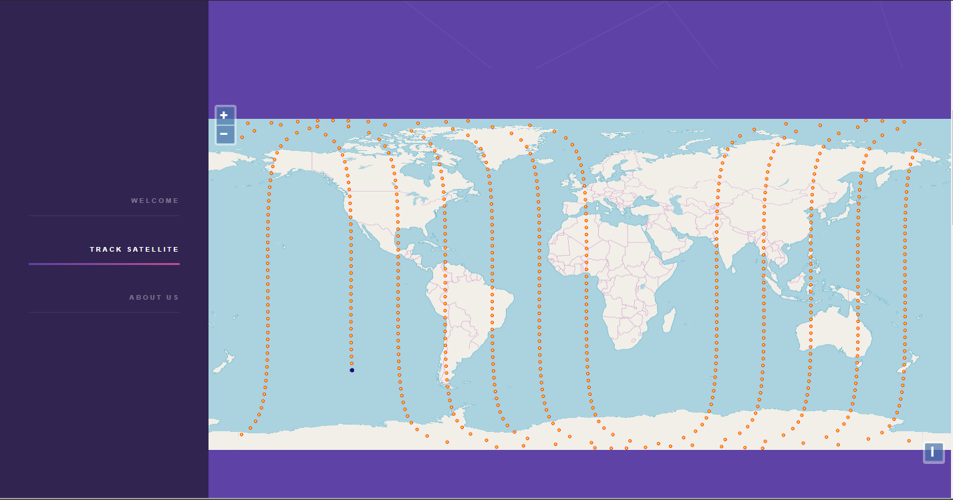
RESULTS
Simulated ground track of IRIDIUM 33DEB (33855)
Notes:
Polar Track

Slide 10
RESULTS
Real time ground track of ISS
Notes:
Real time

Slide 11
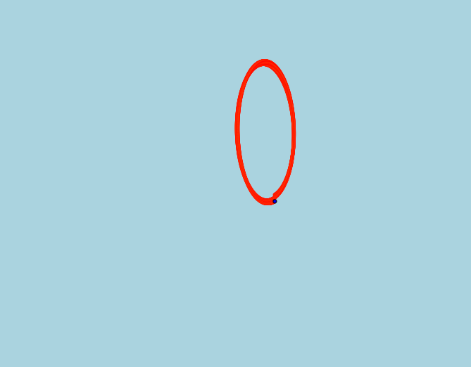
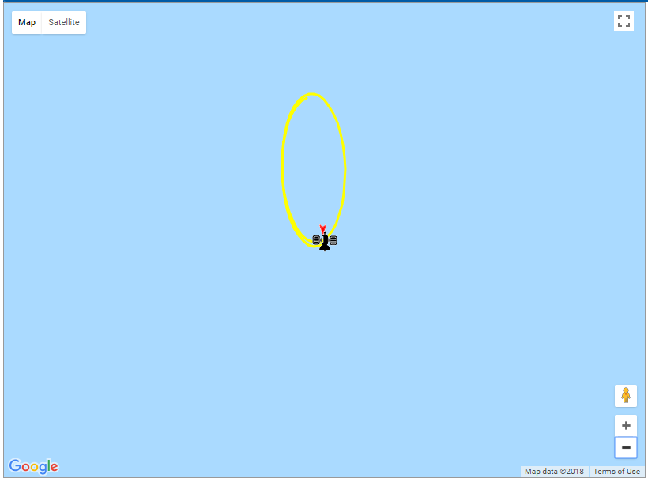
VALIDATION OF INSAT 4CR (32050)
TrackSat
N2YO
Notes:
Real time

Slide 12
CONCLUSION
TrackSat is a lightweight cross-platform webapp that includes popular web libraries.
Prototyping model of SDLC has been adopted for rapid S/W development.
Satellite positional accuracy agrees with that of the United States Naval Observatory and their Astronomical Almanac to be within 0.0005 arc seconds.
Future Scope:
Improving the search feature.
Porting the observable satellite feature of the desktop tool to the web app.
Integrating with Smartphone systems.
Real time ground track of ISS

Slide 13
REFERENCES
Dr. T.S. Kelso, “CelesTrak.” [Online]. Available: http://celestrak.com/. [Accessed: 11-Apr-2018].
N2YO, “N2YO.” [Online]. Available: http://www.n2yo.com/. [Accessed: 18-Apr-2018].
SatView, “SATVIEW -Tracking satellites and Spacejunk in Real time.” [Online]. Available: http://www.satview.org/. [Accessed: 18-Apr-2018].
SATFLARE, “SATFLARE.” [Online]. Available: http://www.satflare.com/. [Accessed: 18-Apr-2018].
Brandon Rhodes, “Skyfield.” [Online]. Available: http://rhodesmill.org/skyfield/. [Accessed: 18-Apr-2018].
Real time ground track of ISS

Slide 14
THANK-YOU
SAYANTAN | ABHISEK | SHASWAT | SAURABH

