Slide 1
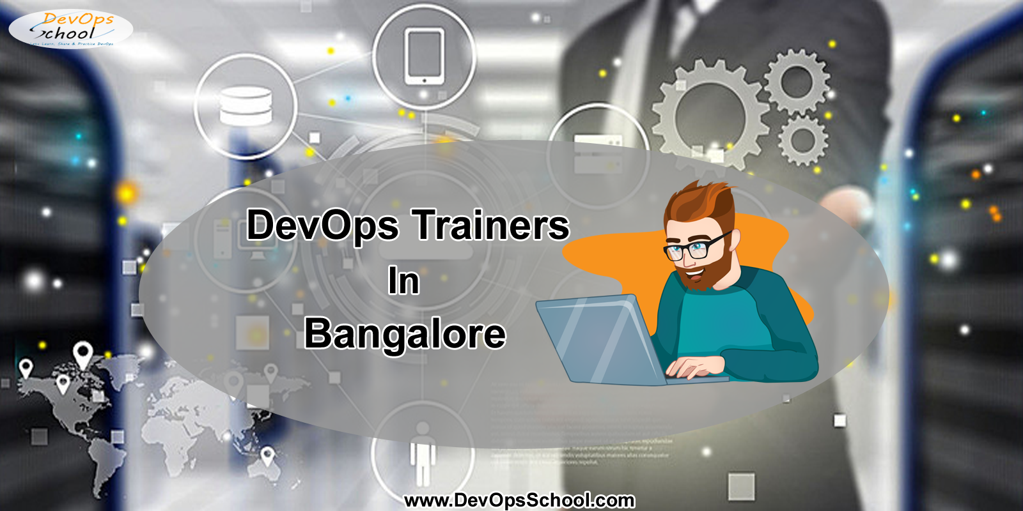

Slide 2

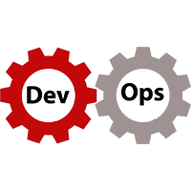
What is DevOps?
DevOps is a culture that you can adopt for continuous improvement. It will help you to bring your Developer and Operations Team to work together with ease. It is more related to communication, collaboration, feedback between different associate such as developers, testers, configuration management team etc. DevOps Plays an important role to increase productivity of organization as a whole.

Slide 3
Why everyone should learn DevOps?
DevOps includes different Phases:
Continuous Integration: It is more of a culture of integrating application code or source code into the source code repositories.
Continuous Testing : Automated Testing or Unit testing to be more precise.
Continuous or Cloud Provisioning : Virtual machines or cloud instance are highly available, flexible and pay per use.
Configuration Management: Configuration Management is useful to make runtime environment ready in consistent manner across all the environments.
Continuous Delivery or Deployment: Continuous Delivery or Continuous Deployment is terms which used loosely in day to day use.

Slide 4
How right DevOps training will help?
In last 4-5 years , I assumes that everyone needs DevOps to increase his productivity and complete their work in fast and automated way. you can check the adoption rate of using DevOps in IT industry which is increasing day by day. Whether you are from IT background or not but you can Learn DevOps.
The demand of DevOps Engineers are increasing, and it will also increase in future because there are few people who understand it and have the skills to implement and work according to it. It provides you multiple tools to increase your ability and work process that will help your organization to increase productivity.

Slide 5
Who is the corporate trainer for DevOps Training by DevOpsSchool.com
DevOpsSchool is the right place to learn and gain training from DevOps experts, where you can find nearly 70 tools at one place. You can easily join their online training and improve your skill-set. You will find their course content industry relevant that is designed by DevOps Experts. They are vastly experienced having experience of more than 15 years.
In their latest course curriculum you will find trending tools like chef, puppet, jenkins, datadog, terraform etc. DevOpsSchool also provides self learning videos, ppts , pdfs and Quizes, these benefits can be accessed by participants from anywhere. It will also provide you assignments and real time scenario based projects. And if you have any query then you can also post your questions on their facebook, linkedin and twitter groups.

Slide 6
How DevOps Training Will help:
If you have DevOps skills then you can join any multinational companies.
It will help you to accelerate your career growth.
It will help you to understand the concept of monitoring and logging, implement virtualization concepts, understand the CI and CD.
Get rid of Silos and bring a sense of shared responsibility within the organization.
What are the Location of DevOps Training by DevOpsSchool.com?
DevOpsSchool provides you the DevOps Training in different cities like Bangalore, Pune, Hyderabad etc.

Slide 7
Qualities DevOps trainers should have:
A good trainer knows the material, lives it, breathes it, and can infuse their own experience into it.
A good trainer makes delivering a class look easy and seamless.
A great trainer is attuned to his or her own energy level and that of the class.
Because trainers are role Models, they should be mature, confident and enthusiastic.
Readiness to allow and encourage participants to learn from themselves and the class in order to create as many organic learning moments as possible.

Slide 8


For DevOps Related Videos, Learning Materials,
DevOps Course Training, Technical Support or many more.
Call us on: +91 700 483 5930
Email: Contact@DevopsSchool.com
Website: www.DevOpsSchool.com

