Slide 1

DevOps Training In Delhi

Slide 2

DevOps training in Delhi
DevOps training in Delhi by expert DevOps trainers offered by DevOps School. We are specialized in DevOps and one of the best DevOps training institute in Delhi region who provides training, consulting, mentoring, certification and complete support to professionals and corporates.
There is a big demand for Skilled DevOps engineers these days in Corporates but there is shortage of qualified DevOps professionals in the industry. This is the right time to learn DevOps and take a lead position in the industry.

Slide 3

What is DevOps?
DevOps is set of processes and tools that emphasize collaboration and helps development and operation team to work together as one team to innovate faster. Its completely changed the way of traditional software development mindset and culture. It facilitates communication, collaboration, integration, and automation amongst Dev and Ops professionals which ultimately ameliorate the speed and quality of delivering software's, features to end users.

Slide 4
Why everyone should learn DevOps?
The Software/IT industry has been rapidly moving towards to automation and DevOps approach is the way to adopt and execute that automation. Year by Year, DevOps adoption rate by organizations is increasing and it will be continue like this.
Many researches from different firms on an average shown that around 78% of the industry adopted DevOps and rest either in the process or they will adopt in near future. Individuals work for Organizations, which means there are organizational benefits and individual benefits. Therefore, let's see in nutshell why one should learn DevOps:-

Slide 5

Organizational benefits:
DevOps provides a better communication platform to work
Shorter time-to-market
Less complex problems to fix
Better product Quality
More reliable releases
Faster delivery of features
Build right product by fast experimentation
Increase productivity and efficiency
Individual benefits
One of the highest paid job according to surveys
Faster Career growth
Improve Skills & Knowledge
Long term Career security
Makes you productive & effective

Slide 6
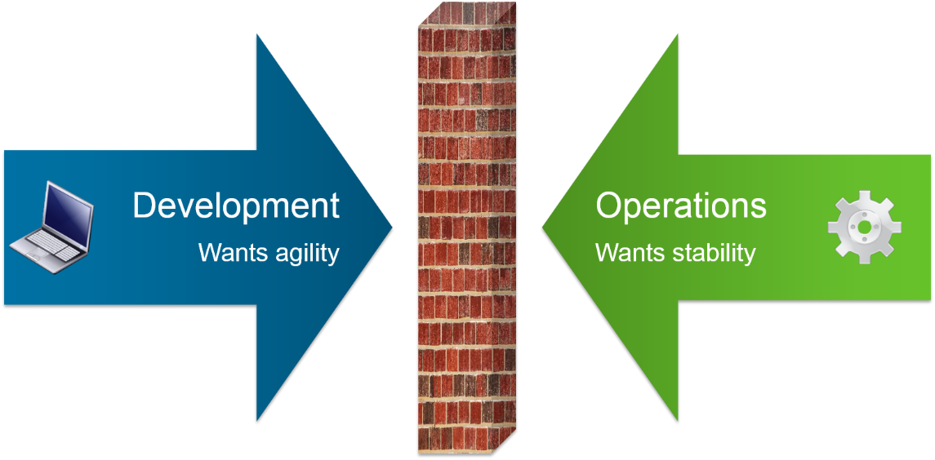
How right DevOps training will help?
Right DevOps implementation is a key of success to achieve DevOps benefits. DevOps is not like one-size-fits-all kind of process that can be applied the same way to every organizations. It depends on how we use different tools to enable automation to work together more efficiently. DevOps demands continuous work and experiments, not something you have done once and that's it. Team throughout the organization should be motivated to do experiment with tools, processes, and structures to achieve the desired results. This is where right DevOps training enables learners to overcome the challenges and build robust solutions and strategies to ensure effective DevOps transition.
Right selection of tools
Helps to build right DevOps skills
Helps to implement best practices
Helps to build right strategies and plan
Makes you ready for real-time work and challenges
Minimize your mistakes

Slide 7
How DevOpsSchool.com will help in your DevOps Training Needs?
DevOps School is the leading training and certification institute for DevOps in Delhi. DevOps School provides classroom training in Delhi on weekends and weekdays and instructed led, live & interactive online batches too by Industry's experienced trainers.
Our DevOps training is designed by experienced industry faculties to make you an expert DevOps practitioner by providing you DevOps best practices of all parts like Continuous Development, Continuous Integration, Continuous Deployment, Continuous Testing, Configuration Management, Continuous Monitoring of the product throughout its lifecycle from start to end.

Slide 8
DevOps School Key focus on Hands-on training, labs, Project and assignments which makes you complete ready to face the DevOps challenges at your work place.
DevOps school provides lifetime access to LMS where a participant can explore, notes, presentations, quizzes, class recordings, step by step guides and various other learning resources which helps them to keep themselves refresh.
DevOps School also provides lifetime technical support to learners which helps them in future while working on real-time projects and its challenges in their workplace
The DevOps skill which we provide makes you ideally suited for top organiza-
tions work culture.

Slide 9

Who is the corporate trainer for DevOps Training by DevOpsSchool.com
Nothing beats the real work experience. "DevOps school" is known by its community of 15+ yrs. experienced professionals who serve their industry expertize through training, consulting and mentoring. Our DevOps trainers, mentors, consultants prepares you for the best career path by providing you the skillsets to successfully build, monitor, run, measure and optimize the pipelines for corporates.

Slide 10
Contact Us:
For DevOps Related Videos, Learning Materials, DevOps
Course Training, Technical Support or many more.
Call on: +91 700 483 5930
Email: contact@devopsschool.com
Website: DevOpsSchool.com
Thank You

