Slide 1

DevOps Training In Pune

Slide 2


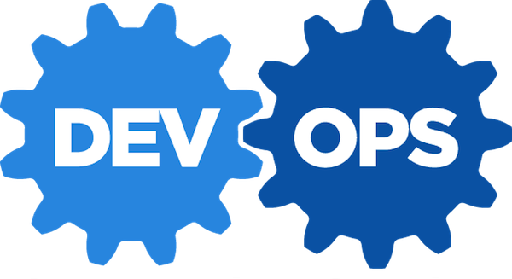
DevOps Training In Pune
DevOpsSchool is the best DevOps training provider in Pune. Our DevOps training will help help you learn DevOps and make you an expert in software development operations, continuous integration, continuous delivery, continuous deployment using DevOps tools - Git, Chef, Docker, Jenkins, Puppet, Ansible and Nagios and more. Get started.

Slide 3

What is DevOps?
DevOps is a change in organizational culture. It’s a process of continuous learning and improvement. DevOps helps in automating many repeatable tasks which increases efficiency and thereby reducing the possibility of manual errors throughout the software development lifecycle.

Slide 4
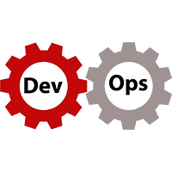
Why everyone should learn DevOps?
In an ever changing technologies and market trends, customer are demanding for faster services and solutions. DevOps enable organizations to become more reliable and agile without nullifying the basic standards and practices that are currently in place. DevOps practice aim to meet the changing market demands by improving business efficiency. Therefore having DevOps skills makes you stand apart and a valuable asset for any IT companies.

Slide 5

How right DevOps training will help?
Better Job Opportunities- A person skilled in DevOps is always welcomed in any top multinational company because there huge gap between certified DevOps professional and their availability.
Increase quality of service- Since DevOps brings quick feedback and higher software release rate, the quality of service improves, as a result there is significant decrease in error-rate.

Slide 6
Adds efficiency to operations- DevOps works on the lean principles which helps in minimizing the wastage of time, and cost by increasing agility of the production and thereby reducing the overhead costs that keep mounting on due to slow processes.
Strengthened, Improved Skill and Knowledge on DevOps- The DevOps ideology represents a new way of thinking and decision-making. As there are many technical and business benefits of DevOps and you can learn how to implement them in your organization.

Slide 7
How DevOpsSchool.com will help in your DevOps Training Needs?
DevOpsSchool Certification Training Course will prepare you for a career in DevOps, the fast-growing field that bridges the gap between software developers and operations. After the training you will become an expert in the principles of continuous development and deployment, automation of configuration management, inter-team collaboration and IT service agility.

Slide 8
You will learn modern DevOps tools like Jenkins, Git, Docker, Ansible, DataDog, New Relic and hands-on experience on many more tools. You can describe DevOps concepts and its principle, explain various types of version control systems, and you can set-up your complete private infrastructure using version control systems and CI/CD tools.
DevOps certification course from DevOpsSchool is enough for you to become an expert in the domain. They have well-structured courses ranging from beginner to advance level. The course is precisely designed keeping in mind the current industrial requirement. Our training philosophy works on the principle of hands-on approach and designed in a way that will help you in becoming a certified practitioner by providing you an intensified training.

Slide 9

What are the Location of DevOps Training by
DevOpsSchool.com?
DevOps training in online & classroom mode in different cities in India like Pune, Hyderabad, Mumbai, Chennai, Bangalore etc. And also having its presence outside India like Malaysia, Thailand, USA, UK, China, UAE, Canada, Amsterdam etc.
Location

Slide 10
Who is the corporate trainer for DevOps Training by DevOpsSchool.com?
DevOpsSchool trainers are certified professionals having experience of more than 15 years. Trainer name is Mr. Rajesh Kumar who is well known in corporates and individual training. He believes in hands-on approach and has great teaching style which is engaging and interesting and even the whole concept is new to someone. DevOpsSchool trainers are passionate teachers and successfully completed 6050Hrs of training with more than 4000 satisfied participants. And also helped many companies to on-board their tools, processes and teams on DevOps culture and practices.

Slide 11
Contact Us:
Contact us For DevOps Related Videos, Learning Materials, DevOps
Course Training, Technical Support or many more.
Call us on: +91 700 483 5930
Email: Contact@DevopsSchool.com
Website: DevOpsSchool.com
Thank You

