Slide 1

QUALITY CONTROL
OF DEEP FOUNDATIONS
Ryszard Rippel MSc. Civil Eng.
Paweł Matejko
MSc. Geotechnical Eng., MSc. Civil Eng

Slide 2

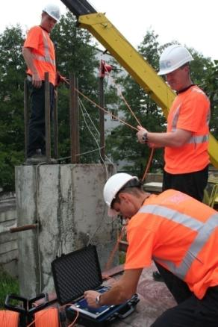
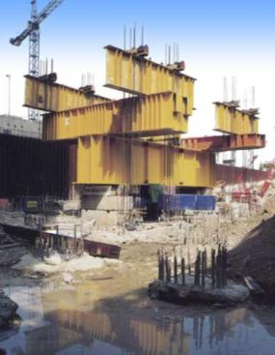
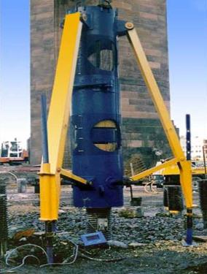
Testing methods:
STATIC LOAD TESTS
DYNAMIC LOAD TESTS
INTEGRITY TESTING
Notes:
Podstawowe badania

Slide 3
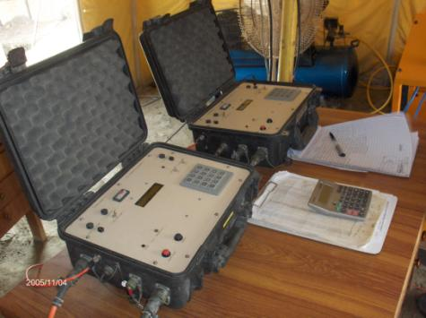
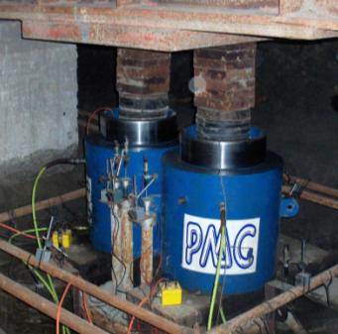
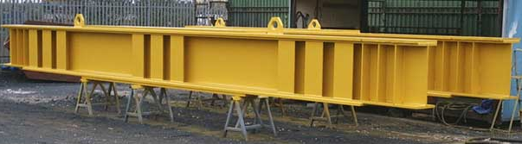
Pile testing equipment:
Beams up to 24 MNm bending capacity
Jacks and load cells up to 15 MN
Data Logging systems with automatic load holding
Dywidag anchoring system

Slide 4
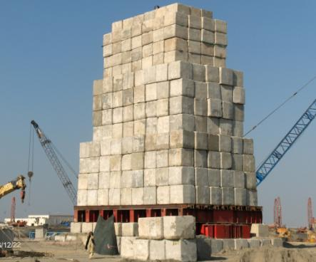
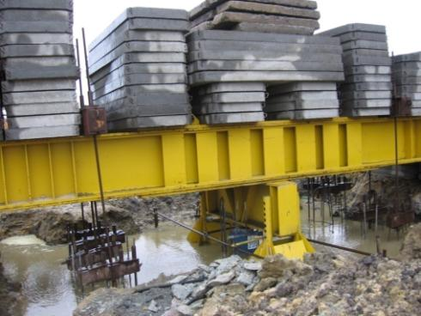
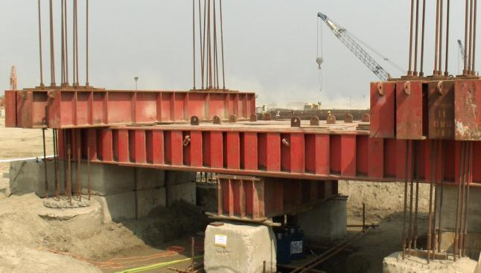
Reaction systems for
Static Load Tests:
anchor piles
kentledge
mixed

Slide 5
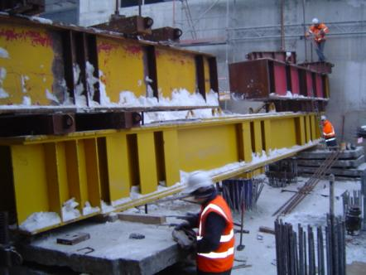
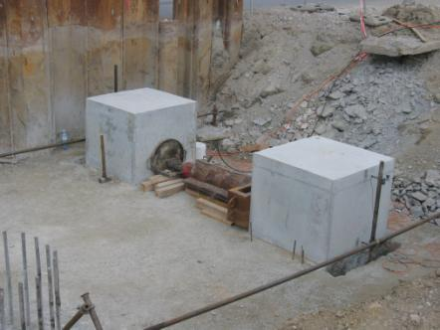
Load Directions of Static Load Tests:
vertical compression or tension
raked
lateral

Slide 6
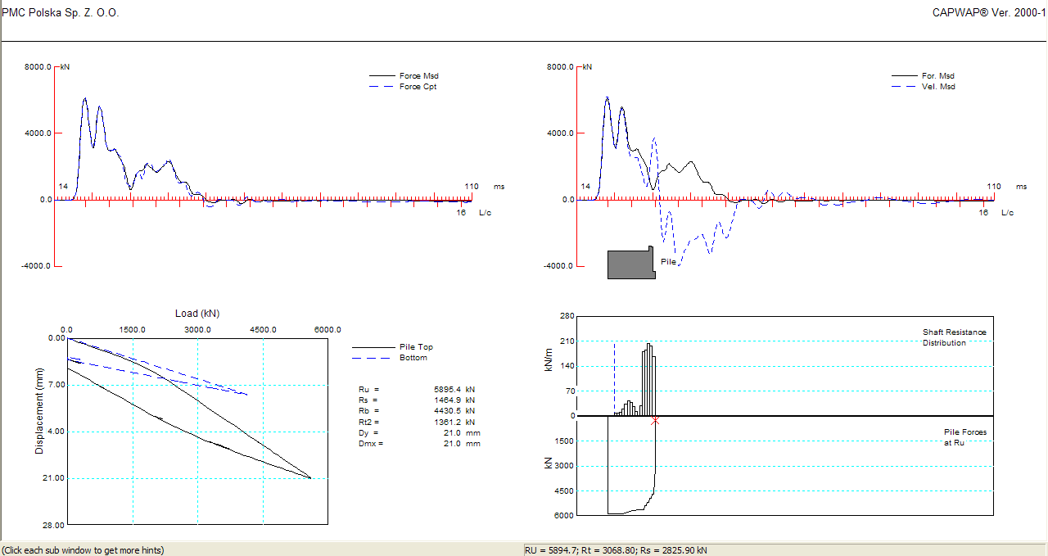


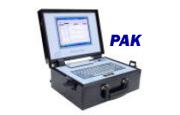
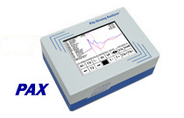
Dynamic Load
Tests Equipment:
PAK computers (Pile Dynamics Inc.)
Up to 8 sensors for test
CAPWAP analyzes
Drop-weights 25 kN i 65 kN

Slide 7
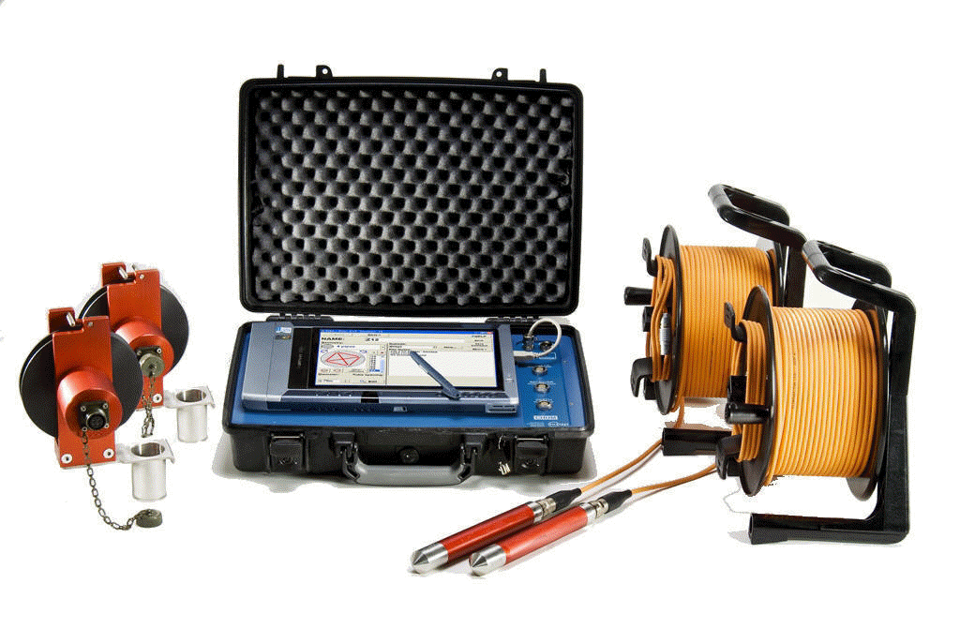
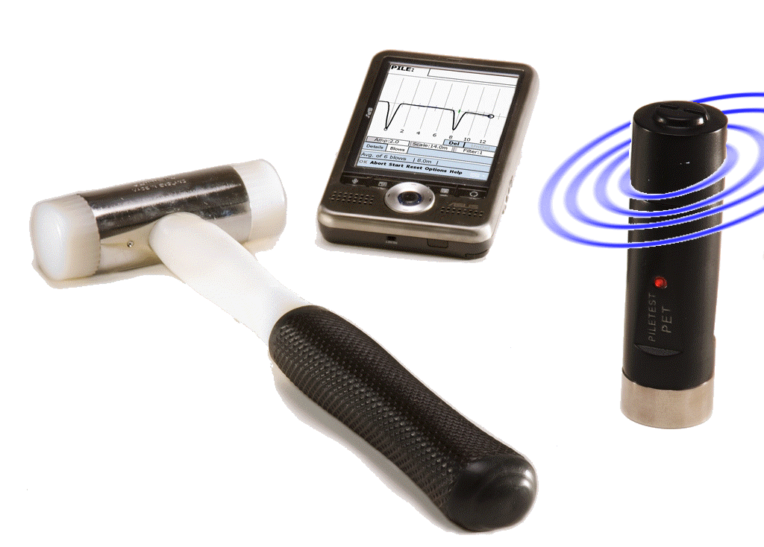
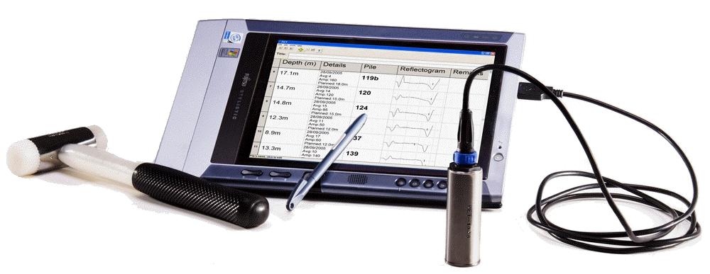
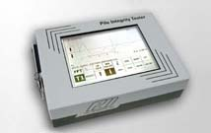
Integrity testing equipment:
Pile Integrity Tester PIT
Pile Echo Tester PET
Cross-Hole Sonic Logging CSL

Slide 8
PILETEST is the Independent Pile Testing Company
Up-to-date pile testing equipment
High quality of measurements
Full range of methods
Immediate reports
Introducing other testing methods:
Instrumented Static Load Tests
Strain Gauges, Extensometers
Constant Rate of Penetration CRP
Inclinometer monitoring
Statnamic

Slide 9
THANK YOU
FOR YOUR attenTion
PMC
PILETEST Sp. z o.o.
ul. Warszawska 153/123
43-300 Bielsko-Biała
Tel. +48 33 822 22 88
Fax. +48 33 822 22 46
info@piletest.eu
www.piletest.eu

