Slide 1
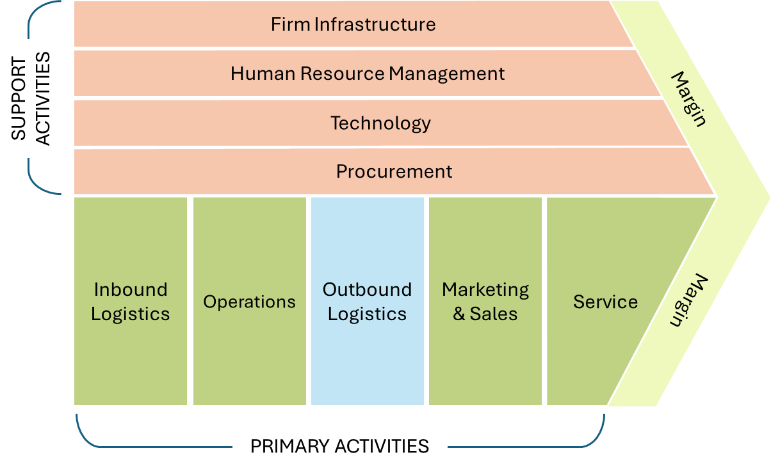
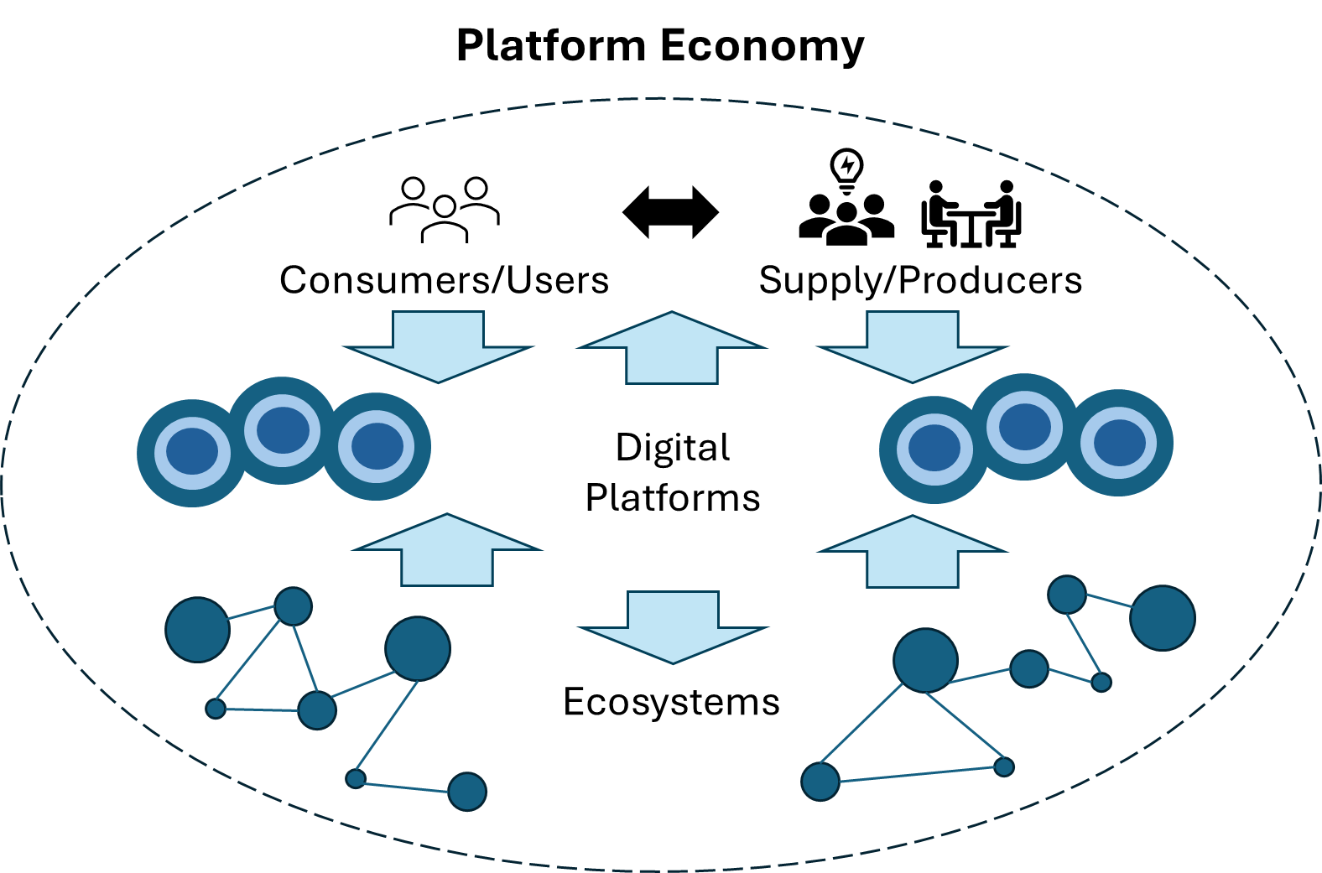
Platform services can be orchestrated to operate a business
Resulting services or products can be sold on digital platforms
Digital entrepreneurs can be consuming users on digital platforms
Digital entrepreneurs can be producing users on digital platforms

