Slide 1
NoSQL Smackdown
Josh Bush
Notes:
Welcome everyone.

Slide 2




Who is this guy?
@digitalBush
digitalbush.com
freshbrewedcode.com
fireflylogic.com

Slide 3
SQL
Notes:
What is NoSQL? - NoSQL isn't a thing. It's just a category of things which it is not. When we talk about not being SQL, we really mean not being relational.
THIS TALK IS NOT to trash relational databases. Relational databases have been around many years for a reason. They do quite a few things very well. However, the industry is reaching a point where we’re recognizing that data storage is not a one size fits all thing.
The goal is to try to help you wade through the myriad number of options.

Slide 4

Right Tool For The Job
http://www.flickr.com/photos/justinbaeder/5317820857/
Notes:
There are a few things to consider when trying to pick out how to store your data:
What does my data model look like?
Is it flat?
Does it have nested structures?
Do you have small or large aggregate roots?
Is it hierarchical?
How do I need to access my data?
Am I read heavy or write heavy? Maybe a mix of both?
Do I have situations where there is contention to write to the same piece of data?
Do I need to do ad-hoc queries?
What kinds of reports do I need to produce?
How much data do you have?
* Three types of lies: lies, damned lies, and benchmarks. Talk about BS metrics where benchmarks compare databases that are durable against in memory stores.

Slide 5
Data Modeling
Notes:
Everyone talks about NoSQL as the solution to managing Big Data. Managing petabytes sounds sexy?
Unfortunately, the nosql focus has been along the lines of “My BIG DATA is BIGGER than your ‘big’ data”
But I’d like to start down a much simpler path. Not all domains are the same, so it really doesn’t make sense that we’d always store our data the same way.

Slide 6
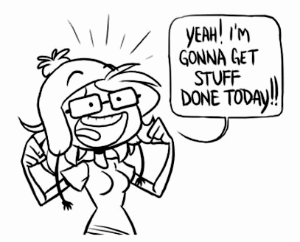
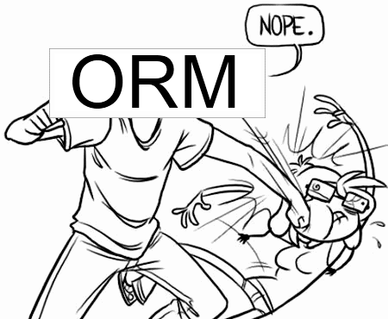
Every. Single. Time.
Notes:
I can’t tell you how many days I’ve spent scratching my head trying to figure out some problem I was having with an ORM.
I suppose it comes with the territory by using an abstraction. You get advantages in certain places, sure. Then there are those days where you just get stuck because it’s hiding something from you.
The more I’ve thought about it though, the less I feel like it’s a problem with ORMs in general and has more to do with trying to stuff certain types of data into a relational model. Hierarchies, dynamic content, versioned data can all be problematic to model.

Slide 7
Friend of a Friend
Relational
Notes:
The first example I want to start with is a social scenario where we want to suggest people who are friends of friends where I might share something in common. Since this is a dev conference, maybe I’d like to find new twitter followers who share the same technology interests that I do.
We need a table to store information about a Person and the a Friend table to relate a Person to a Person. Next we’ll need a table to store technology terms and finally table to link technologies with the people that like them. Simple enough, right?

Slide 8
Friend of a Friend
select Person.Id,Person.Name,Technology.Name
from Person
join PersonTechnology ON (Person.Id = PersonTechnology.PersonId)
join Technology ON (#PersonTechnology.TechnologyId=Technology.Id)
join Friend fof on(fof.FriendWithPersonId=Person.Id)
join Friend friend on(fof.PersonId = friend.FriendWithPersonId)
where friend.PersonId = '@digitalbush'
AND PersonTechnology.TechnologyId in (
select TechnologyId
from PersonTechnology myTech
where myTech.PersonId='@digitalbush'
)
SQL
Notes:
I do SQL every single day and it look me several attempts to get this right.
(Walk through the joins line by line)

Slide 9
Friend of a Friend
START n = node(digitalbush)
MATCH (n)-[:FriendsWith*2]->(fof)-[:Uses]->(t), (n)-[:Uses]->(t)
RETURN fof,t
Cypher (Neo4j)
Notes:
I’ve never touched Neo4j and I stumbled through the query in about half the time of the SQL one.
The syntax is very terse. Notice the arrows showing direction of the relationships.

Slide 10
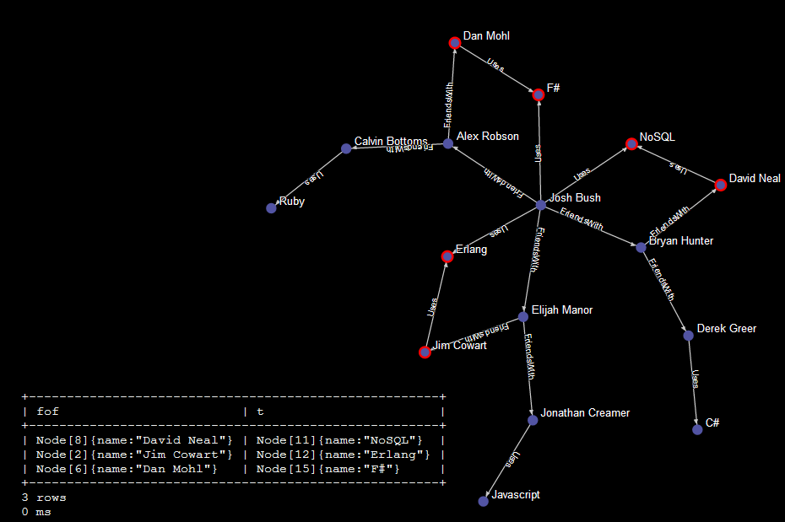
Friend of a Friend
Neo4j
Notes:
And this is the output, yes the OUTPUT when I did the previous query at console.neo4j.org.
It shows you the layout of the graph. Nodes that match your query are highlighted in red.

Slide 11
Dynamic Fields
Relational
Notes:
What you see above is a taste of something I inherited a few years back. The application had to store data that was dynamic.
Think about modeling a web poll where you need to store questions that can take different kinds of answers: numbers,strings,lists,booleans.
My example will be a basic address book where we have the option to have custom data inputs.
Notice that the center of the model should be the contact, but instead it focuses around the input.

Slide 12
Dynamic Fields
DECLARE @contactId uniqueidentifier = newid();
insert into Contact values(@contactId,'Josh Bush','2012-12-31');
--Omitting Phones and Email so the code fits on slide
DECLARE @input1 uniqueidentifier = newid();
insert into Input values(@input1,2);
insert into IntInput values(@input1,1);
insert into Other values(newid(),@contactId,'Number Of Kids',@input1);
DECLARE @input2 uniqueidentifier = newid();
insert into Input values(@input2,3);
insert into ListInput values(@input2);
DECLARE @input2_1 uniqueidentifier = newid();
insert into Input values(@input2_1,1);
insert into StringInput values(@input2_1,'Hudson');
insert into ListItem values(newid(),@input2,@input2_1);
insert into Other values(newid(),@contactId,'Kid Names',@input2);
DECLARE @input3 uniqueidentifier = newid();
insert into Input values(@input3,2);
insert into StringInput values(@input3,'Mountain Dew');
insert into Other values(newid(),@contactId,'Favorite Drink',@input3);
SQL
Notes:
Then here is what we have to do in order to populate a contact with custom information.
Note that I had to prune out the phones and emails to get this to fit the slide.

Slide 13
Dynamic Fields
{
Name:"Josh Bush",
Birthday:"1982-12-31",
Phones:[
{Description:"Work",Phone:"867-5309"},
{Description:"Home",Phone:"555-5555"}
],
Emails:[
{Description:"Work",Address:"josh.bush@fireflylogic.com"}
],
Other:[
{Key:"Number Of Kids",Type:"Number",Value:1},
{Key:"Kid Names",Type:"List",Value:[“Hudson"]},
{Key:"Favorite Drink",Type:"String",Value:"Mountain Dew"}
]
}
Document
Notes:
If we were to store this in a document, it would be much simpler as they lend themselves to content that varies from document to document.
Before you start getting any crafty ideas, serializing the dynamic content as XML or JSON and stuffing it into a CLOB is cheating.
If you do that (I have), you will hate yourself. It’s very hard to report on. With the document example, you’ll have an option to run **map/reduce** against the document and drill down where data exists to surface that to use elsewhere.
There is no dance when it comes time to save this to the database, it’s one call. No need to have an ORM map the types to different tables based on what type of data is being stored.

Slide 14

Did he just say map/reduce?
That sounds confusing.
http://www.flickr.com/photos/philmanker/3654636770/
Notes:
Map/reduce sounds scary, but you are already doing it. If you are a .NET developer and use LINQ, the .Select() is map and .Aggregate() is reduce.
Maps are just a function that take a thing and returns something different.
Reductions are just a function that takes the things that came from the map function and return the answer.
Map/Reduce is a very powerful thing that many nosql databases utilize, so you’ll hear me mention it a few more times in this talk.

Slide 15
SQL to Map/Reduce
SQL
SELECT SalesPersonId,SUM(amount)
FROM sales
GROUP BY SalesPersonId
Becomes
//Map
function(doc, meta) {
emit(doc.SalesPersonId,doc.amount);
}
//Reduce
_sum
CouchDB
Notes:
CouchDB has a built in _sum function to help out here just like SQL

Slide 16
SQL to Map/Reduce
SQL
SELECT COUNT(1)
FROM products
WHERE price < 20.00;
Becomes
//Map
function (doc) {
if (doc.price < 20)
emit(doc.price);
}
//Reduce
_count
CouchDB
Notes:
CouchDB has a built in _count function to help out here just like SQL

Slide 17
Scaling Out
Notes:
The other big NoSQL topic that people talk about is scaling to handle BIG DATA.

Slide 18
CAP Theorem
Consistency
Availability
Partition Tolerance
Pick Two
Notes:
Brewer’s CAP theorem states that you can only have 2 of the following at any given time in a distributed system:
Consistency (all nodes see the same data at the same time)
Availability (a guarantee that every request receives a response about whether it was successful or failed)
Partition tolerance (the system continues to operate despite arbitrary message loss or failure of part of the system)

Slide 19
CAP Theorem
Consistency
Availability
Partition Tolerance
Relational
Notes:
Relational databases are said to be consistent and available. That is, all updates are written to all nodes and each node can answer because it knows it has the right answer. The problem comes in when nodes fall down.

Slide 20
CAP Theorem
Consistency
Availability
Partition Tolerance
To Scale Out
We Need This
Notes:
When we want to scale out though, we automatically have to accept that a node might die. Thus, we have to compromise and give up some availability or consistency.
Note, not all NoSQL is partition tolerant. We’ll talk about that here later.

Slide 21

Partition Tolerance
http://www.flickr.com/photos/exfordy/2700096104/
Now What?
Notes:
Talk about being stranded on an island.
When you are finally found 4 years later, you are asked who is the current president.
If you want to be consistent, you won’t answer because you know your information is out of date.
If you want to be available, you’ll answer with stale information.

Slide 22

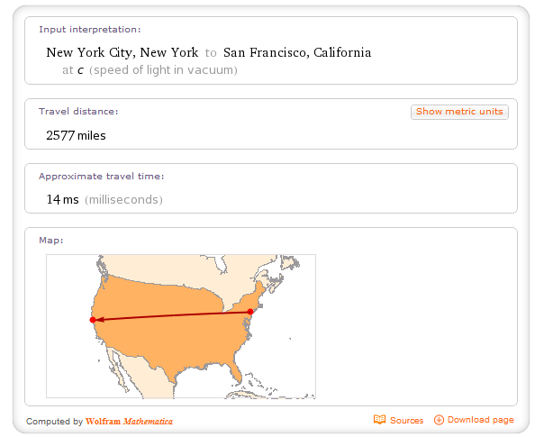
Latency
http://www.flickr.com/photos/ninja999/2132000773/
Light only travels so fast
Notes:
There’s one last thing to think about here. We’re talking about spreading our data out across machines. You think it sucks to load up eclipse or visual studio from your local hard drive? Think about this:
NY to SF is ~70-80ms round trip over the internet right off the bat.
http://serverfault.com/questions/137348/how-much-network-latency-is-typical-for-east-west-coast-usa
Distributing your data to be fast involved you staying in your data center.
Distributing your data for failover to another data center is another topic entirely.

Slide 23
Single Master Replication
Master
Slave
Slave
Slave
Notes:
Single master replication allows us to scale out for reads by duplicating the data to multiple sources. Writes are still limited to a single node.

Slide 24
Single Master Replication
Write
Ack
Write
Write
Write
Master
Slave
Slave
Slave
Consistent
Notes:
In a Master/Save configuration, in order to be consistent we must write our data to all of our slaves. Writes become a bottleneck.
We lose availability because if we can’t reach our slaves we may have to deny a write.
Also, each slave has to be as beefy of a machine as the master. The write can only be as fast as the slowest slave.

Slide 25
Single Master Replication
Write
Ack
Write
Write
Write
Master
Slave
Slave
Slave
Available
Notes:
If we want to be available for writes, then the master can ack a write immediately and then stream the writes to slaves asynchronously. This makes it possible for a process to write to master and immediately read from a slave and not see the data.

Slide 26
Single Master Replication
Read
Master
Slave
Slave
Slave
Read
Read
Read
Notes:
Adding more nodes gives us the ability to read from multiple sources. We also get the advantage of having a spare of the data that could assume master responsibilities.

Slide 27
Sharding
Coordinator /Client
R-Z
K-Q
A-J
Notes:
Sharding involves spreading the data across multiple nodes where no single node has all of the data. This ends up being efficient way to utilize storage across nodes and can achieve good throughput on both writes and reads since the load is spread across multiple nodes.

Slide 28
Sharding
Write
Write
Write
Write
Write
Write
Coordinator /Client
R-Z
K-Q
A-J
Notes:
Writes must be coordinated by a machine to route or each client must know the partitioning scheme. Data is split across a server based on some criteria of the data being saved. Usually a range based partition on the key.

Slide 29
Sharding
Read
Read
Read
Coordinator /Client
R-Z
K-Q
A-J
Read
Read
Read
Notes:
Reads look much the same as writes. We must know which server to go get the data from.

Slide 30
Sharding
Read
Coordinator /Client
R-Z
K-Q
A-J
Read
Read
Read
Notes:
It gets interesting when we end up needing to query a range of data that spreads across multiple shards. Suddenly we have to query multiple servers and then make our coordinating node aggregate them in a meaningful manner.

Slide 31
Multi-Master Replication
Master
Master
Master
Notes:
Like the single master scenario, Multi-master replication allows us to scale out for reads by duplicating the data to multiple sources. But with a multi-master environment we can also write to any node. For this to work, the system has to be prepared to deal with conflicts when the same record is updated on different nodes.
Need to diagram out conflicts

Slide 32
Multi-Master Replication
Read
Master
Read
Read
Master
Master
Notes:
Reads can come from any server just like master/slave.

Slide 33
Multi-Master Replication
Write
Write
Write
Master
Write
Write
Master
Master
Write
Notes:
Now things are getting interesting, we can write to any node and the data is automatically replicated to the other masters. This works as long as there is no conflicts…

Slide 34

Multi-Master Replication
Write
Write
Write
Master
Write
?
Write
Write
Master
Master
Notes:
What happens if we write the same key with different values to different masters. When they replicate a conflict occurs and has to be handled.

Slide 35
Quorum
Node 0
Node 1
Node 2
Node 3
Notes:
Another interesting setup is something you see in Dynamo based systems. You have a ring of nodes and they all know about each other. Any node can service requests for any bit of data. To understand it, we need to talk a little bit about consistent hashing.

Slide 36
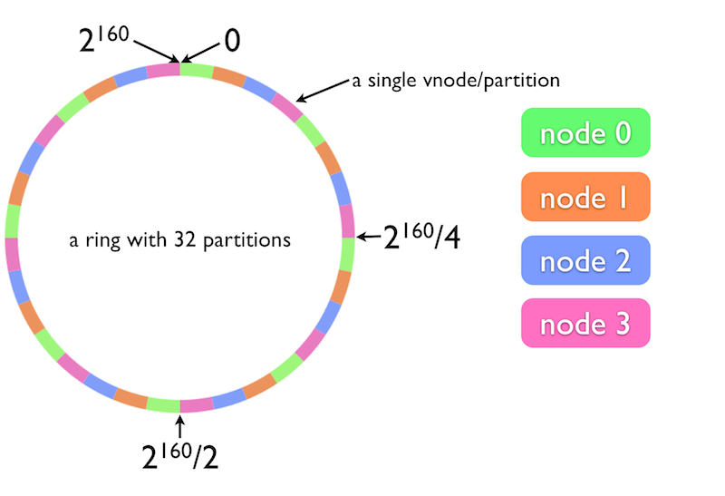
Quorum
http://wiki.basho.com/Concepts.html
Consistent Hashing
Notes:
Take a keyspace and make a ring, then divide that ring into even partitions.
When a node joins or leaves the ring, the partitions are evenly re-distributed to the new nodes.
The benefit here is that when the topology changes, we can adjust without moving all of the data around.
We actually have the capability to scale down!

Slide 37
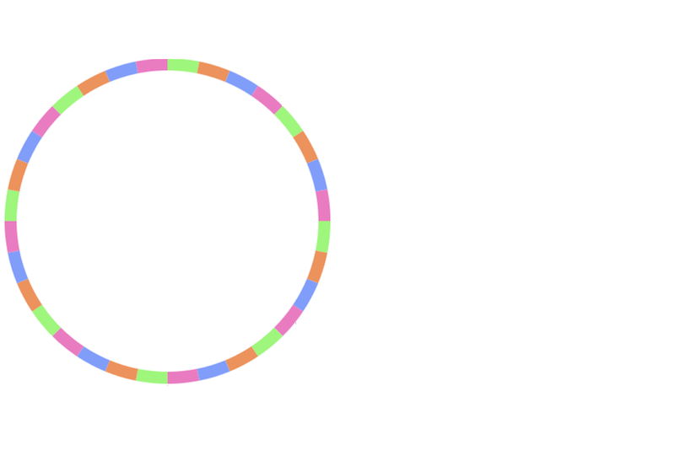
Quorum
put(“car”,”chevelle”)
(N = 3)
http://wiki.basho.com/Concepts.html
Notes:
N = Number of copies of our data.
Kind of like RAID 5.
No mirroring like we see with our master/slave
No striping like we see with out sharding.
N value of 3 means that the data will be replicated to 3 separate partitions on the ring.

Slide 38
Quorum
put(“car”,”chevelle”)
(N = 3) (W = 2)
http://wiki.basho.com/Concepts.html
Notes:
By specifying a W value less than N, we’re able to choose how many nodes we’re okay with ack-ing before we consider the write to be good.

Slide 39
Quorum
get(“car”,”chevelle”)
(N = 3) (R = 1)
http://wiki.basho.com/Concepts.html
Notes:
By specifying a R value less than N, we’re willing to accept less consistency with our data.
We can TUNE our consistency/availability on a request per request basis!

Slide 40





The Players
Notes:
The names you see here are what I’m considering the major players at the moment. There are a few others I would have liked to squeeze into this talk, namely RavenDB and Cassandra.
I’m sorry if your favorite nosql database isn’t on here, the field is changing almost daily. There’s so much flux in this space right now. As such, the focus of this talk will be on concepts with a brief overview of those mentioned here.

Slide 41
“I need data replication that works.”

Slide 42
Written in Erlang
Eventually Consistent
REST API with JSON payload
Map/Reduce in Javascript via View API
MVCC means transaction at document level
Multi-master replication
Cross platform
Notes:
Multiversion concurrency control

Slide 43
When To Use
When to Avoid
Store the state of an aggregate root (DDD).
Master/master replication.
Poor network between nodes.
Flexible schema.
More data than one server can store.
Ad-hoc queries.

Slide 44
“When I start drawing my domain it looks like a tangled mess. ”

Slide 45
Written in Java
Not Partition Tolerant
Java client and a RESTful API
Cypher and Gremlin Query languages
ACID compliance
Master/Slave Replication
Cross-Platform

Slide 46
When To Use
When To Avoid
Highly connected data.
More data than one server can store.

Slide 47
“I need to store values by key. I also could use lightweight pub/sub messaging. It would be handy to have an in memory list. It might also be handy to have …”

Slide 48
Written in ANSI C
Consistent and Available
Master/Save loses Consistency
Custom protocol over TCP
Huge command list to manipulate and query
Multi command transaction support
Master/Slave replication
Cross Platform (Windows not prod quality)

Slide 49
When To Use
When To Avoid
Caching.
Basic pub/sub.
Concurrent writes to shared resources.
Primary data store.
Notes:
Redis is good for storing certain type of data. It has built in structures and a hefty set of commands.
For certain types of data you could use it as a primary store, but typically this is the data store you bring in to augment your primary storage.

Slide 50
“I need my data to always be available no matter what.”

Slide 51
Written in Erlang
Partition Tolerant, Consistency/Availability tunable
HTTP and Protocol Buffers API
Map/Reduce in javascript, full text search, secondary indexes
Dynamo based with read and write quorum
Sorry windows. Linux and OSX.

Slide 52
When to Use
When to Avoid
A lot of data.
Full text search.
High availability of your data.
Single server environment.

Slide 53
“I have massive amounts of data and need to scan over it to gather useful information.”

Slide 54
Written in Java
Consistent and Partition Tolerant
Java and Thrift API
Map/Reduce, Hadoop
Atomic operations at the row level
Sharding + cluster replication
Cross Platform
Built In Versioning and Compression
Notes:
Hbase has some unfortunate terminology which at first glance makes it look like a relational database.
Row keys are stored sorted.
Google BigTable implementation.
Data is stored in maps of maps. Row has column families, column families have columns. Cells are accessed by that tuple (row id, column family, column) and an additional version.

Slide 55
When to Use
When to Avoid
Tons of data.
Schema is fixed.
Versioning.
Single server environment.
Flexible schema.

Slide 56
Summary
 | CouchDB | Neo4j | Redis | Riak | HBase
Consistent
Available
Partition Tolerant

Slide 57

Are you still awake?
http://www.flickr.com/photos/joshunter/2088252449
Notes:
That has been my attempt to cram ALL THE NOSQL THINGS into a talk. Really dumb idea on my part to pick this topic.

Slide 58

There is so much more
http://en.wikipedia.org/wiki/File:Iceberg.jpg
Notes:
It’s impossible to cover all of NoSQL in an hour. Databases are the new cool thing to write and so there is new stuff all the time. While prepping for this talk two interesting projects surfaced. MemSQL and FoundationDB. Meanwhile, the existing players are adding features. MongoDB 2.2 was just released.
What this means for you? First, this is why my talk didn’t focus much on specific products. You need to know the concepts. CAP theorem and latency are real things. Understanding what you need for your specific data requirements are fundamental. Once you know what you need, it becomes easy to find the product which matches.

Slide 59
Resources
http://en.wikipedia.org/wiki/CAP_theorem
Dynamo Whitepaper
Riak Handbook by Mathias Meyer
7 Databases in 7 Weeks by Eric Redmond and Jim R. Wilson

Slide 60
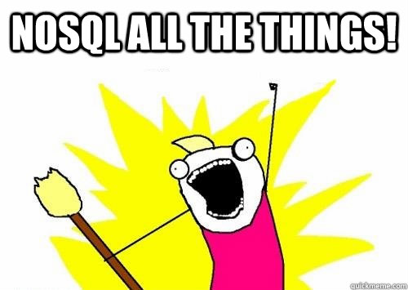
Thank You
@digitalBush

