Slide 1
NoSQL Smackdown
Josh Bush

Slide 2




Who is this guy?
@digitalBush
digitalbush.com
freshbrewedcode.com
fireflylogic.com

Slide 3
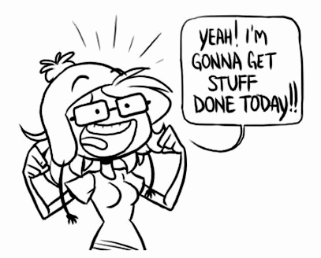
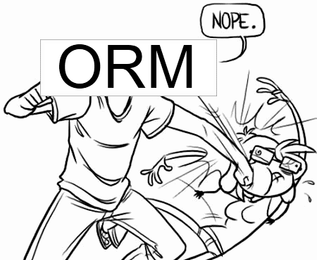
Every. Single. Time.

Slide 4
CAP Theorem
Consistency
Availability
Partition Tolerance
Pick Two
Notes:
Consistency (all nodes see the same data at the same time)
Availability (a guarantee that every request receives a response about whether it was successful or failed)
Partition tolerance (the system continues to operate despite arbitrary message loss or failure of part of the system)

Slide 5
CAP Theorem
Consistency
Availability
Partition Tolerance
Relational

Slide 6

Partition Tolerance
http://www.flickr.com/photos/exfordy/2700096104/
Now What?
Notes:
Talk about being stranded on an island.
When you are finally found 4 years later, you are asked who is the current president.
If you want to be consistent, you won’t answer because you know your information is out of date.
If you want to be available, you’ll answer with stale information.

Slide 7








The Players

Slide 8
Single Master Replication
Master
Slave
Slave
Slave

Slide 9
Single Master Replication
Write
Ack
Write
Write
Write
Master
Slave
Slave
Slave
Consistent

Slide 10
Single Master Replication
Write
Ack
Write
Write
Write
Master
Slave
Slave
Slave
Available

Slide 11
Sharding
Coordinator /Client
R-Z
K-Q
A-J

Slide 12
Sharding
Write
Write
Write
Write
Write
Write
Coordinator /Client
R-Z
K-Q
A-J

Slide 13
Multi-Master Replication
Master
Master
Master

Slide 14
Quorum
Node
Node
Node
Node
Node
Write

Slide 15
Resources
http://en.wikipedia.org/wiki/CAP_theorem
Dynamo Whitepaper
Riak Handbook
7 Databases in 7 Days

