Slide 1
NoSQL Smackdown
Josh Bush

Slide 2




Who is this guy?
@digitalBush
digitalbush.com
freshbrewedcode.com
fireflylogic.com

Slide 3
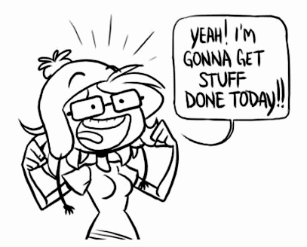
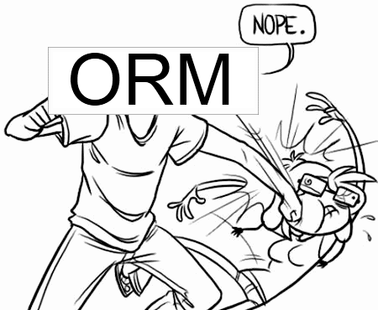
Every. Single. Time.
Notes:
Let’s talk about modeling data here.

Slide 4
Friend of a Friend
select Person.Id,Person.Name,Technology.Name
from Person
join PersonTechnology ON (Person.Id = PersonTechnology.PersonId)
join Technology ON (#PersonTechnology.TechnologyId=Technology.Id)
join Friend fof on(fof.FriendWithPersonId=Person.Id)
join Friend friend on(fof.PersonId = friend.FriendWithPersonId)
where friend.PersonId = '@digitalbush'
AND PersonTechnology.TechnologyId in (
select TechnologyId
from PersonTechnology myTech
where myTech.PersonId='@digitalbush'
)
SQL
Notes:
I do SQL every single day and it look me several attempts to get this right.

Slide 5
Friend of a Friend
start n = node(digitalbush)
MATCH (n)-[:FriendsWith*2]->(fof)-[:Uses]->(t), (n)-[:Uses]->(t)
return fof,t
Cypher (Neo4j)
Notes:
I’ve never touched Neo4j and I stumbled through the query in about half the time. Not only that, but the syntax is much more understandable.

Slide 6
Dynamic Fields
Relational

Slide 7
Dynamic Fields
Document

Slide 8
Versioning
Relational

Slide 9
Versioning
Column Family

Slide 10
CAP Theorem
Consistency
Availability
Partition Tolerance
Pick Two
Notes:
Consistency (all nodes see the same data at the same time)
Availability (a guarantee that every request receives a response about whether it was successful or failed)
Partition tolerance (the system continues to operate despite arbitrary message loss or failure of part of the system)

Slide 11
CAP Theorem
Consistency
Availability
Partition Tolerance
Relational

Slide 12

Partition Tolerance
http://www.flickr.com/photos/exfordy/2700096104/
Now What?
Notes:
Talk about being stranded on an island.
When you are finally found 4 years later, you are asked who is the current president.
If you want to be consistent, you won’t answer because you know your information is out of date.
If you want to be available, you’ll answer with stale information.

Slide 13








The Players

Slide 14
Single Master Replication
Master
Slave
Slave
Slave

Slide 15
Single Master Replication
Write
Ack
Write
Write
Write
Master
Slave
Slave
Slave
Consistent

Slide 16
Single Master Replication
Write
Ack
Write
Write
Write
Master
Slave
Slave
Slave
Available

Slide 17
Sharding
Coordinator /Client
R-Z
K-Q
A-J

Slide 18
Sharding
Write
Write
Write
Write
Write
Write
Coordinator /Client
R-Z
K-Q
A-J

Slide 19
Multi-Master Replication
Master
Master
Master

Slide 20
Quorum
Node
Node
Node
Node
Node
Write

Slide 21
Graph DataBases

Slide 22
Document DataBases

Slide 23
Key/Value DataBases

Slide 24
Columnar DataBases

Slide 25
Resources
http://en.wikipedia.org/wiki/CAP_theorem
Dynamo Whitepaper
Riak Handbook
7 Databases in 7 Days

