Slide 1
NoSQL Smackdown
Josh Bush

Slide 2




Who is this guy?
@digitalBush
digitalbush.com
freshbrewedcode.com
fireflylogic.com

Slide 3








The Players

Slide 4
Data Modeling

Slide 5
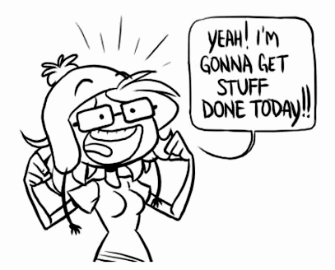
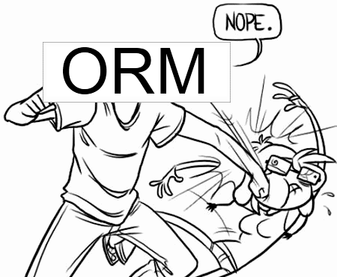
Every. Single. Time.
Notes:
Let’s talk about modeling data here.

Slide 6
Friend of a Friend
Relational

Slide 7
Friend of a Friend
select Person.Id,Person.Name,Technology.Name
from Person
join PersonTechnology ON (Person.Id = PersonTechnology.PersonId)
join Technology ON (#PersonTechnology.TechnologyId=Technology.Id)
join Friend fof on(fof.FriendWithPersonId=Person.Id)
join Friend friend on(fof.PersonId = friend.FriendWithPersonId)
where friend.PersonId = '@digitalbush'
AND PersonTechnology.TechnologyId in (
select TechnologyId
from PersonTechnology myTech
where myTech.PersonId='@digitalbush'
)
SQL
Notes:
I do SQL every single day and it look me several attempts to get this right.

Slide 8
Friend of a Friend
start n = node(digitalbush)
MATCH (n)-[:FriendsWith*2]->(fof)-[:Uses]->(t), (n)-[:Uses]->(t)
return fof,t
Cypher (Neo4j)
Notes:
I’ve never touched Neo4j and I stumbled through the query in about half the time. Not only that, but the syntax is much more understandable.

Slide 9
Dynamic Fields
Relational

Slide 10
Dynamic Fields
DECLARE @contactId uniqueidentifier = newid();
insert into Contact values(@contactId,'Josh Bush','2012-12-31');
--Omitting Phones and Email so the code fits on slide
DECLARE @input1 uniqueidentifier = newid();
insert into Input values(@input1,2);
insert into IntInput values(@input1,1);
insert into Other values(newid(),@contactId,'Number Of Kids',@input1);
DECLARE @input2 uniqueidentifier = newid();
insert into Input values(@input2,3);
insert into ListInput values(@input2);
DECLARE @input2_1 uniqueidentifier = newid();
insert into Input values(@input2_1,1);
insert into StringInput values(@input2_1,'Hudson');
insert into ListItem values(newid(),@input2,@input2_1);
insert into Other values(newid(),@contactId,'Kid Names',@input2);
DECLARE @input3 uniqueidentifier = newid();
insert into Input values(@input3,2);
insert into StringInput values(@input3,'Mountain Dew');
insert into Other values(newid(),@contactId,'Favorite Drink',@input3);
SQL

Slide 11
Dynamic Fields
{
Name:"Josh Bush",
Birthday:"1982-12-31",
Phones:[
{Description:"Work",Phone:"867-5309"},
{Description:"Home",Phone:"555-5555"}
],
Emails:[
{Description:"Work",Address:"josh.bush@fireflylogic.com"}
],
Other:[
{Key:"Number Of Kids",Type:"Number",Value:1},
{Key:"Kid Names",Type:"List",Value:[“Hudson"]},
{Key:"Favorite Drink",Type:"String",Value:"Mountain Dew"}
]
}
Document

Slide 12
Scaling Out

Slide 13
CAP Theorem
Consistency
Availability
Partition Tolerance
Pick Two
Notes:
Consistency (all nodes see the same data at the same time)
Availability (a guarantee that every request receives a response about whether it was successful or failed)
Partition tolerance (the system continues to operate despite arbitrary message loss or failure of part of the system)

Slide 14
CAP Theorem
Consistency
Availability
Partition Tolerance
Relational

Slide 15

Partition Tolerance
http://www.flickr.com/photos/exfordy/2700096104/
Now What?
Notes:
Talk about being stranded on an island.
When you are finally found 4 years later, you are asked who is the current president.
If you want to be consistent, you won’t answer because you know your information is out of date.
If you want to be available, you’ll answer with stale information.

Slide 16
Single Master Replication
Master
Slave
Slave
Slave

Slide 17
Single Master Replication
Write
Ack
Write
Write
Write
Master
Slave
Slave
Slave
Consistent

Slide 18
Single Master Replication
Write
Ack
Write
Write
Write
Master
Slave
Slave
Slave
Available

Slide 19
Sharding
Coordinator /Client
R-Z
K-Q
A-J

Slide 20
Sharding
Write
Write
Write
Write
Write
Write
Coordinator /Client
R-Z
K-Q
A-J

Slide 21
Multi-Master Replication
Master
Master
Master

Slide 22
Quorum
Node
Node
Node
Node
Node
Write

Slide 23
Graph DataBases

Slide 24
Document DataBases

Slide 25
Key/Value DataBases

Slide 26
Columnar DataBases

Slide 27
Resources
http://en.wikipedia.org/wiki/CAP_theorem
Dynamo Whitepaper
Riak Handbook
7 Databases in 7 Days

