Slide 1
Computer labs
Goal:
Consolidate the concepts learned during the lecture
Hands-on experience with collecting and evaluating DTD
Prepare for the group assignments
You can only miss one lab to have the right to the resit. You cannot miss the peer feedback sessions.
The solutions are online
Work in groups is encouraged!

Slide 2
Group project
Goal: Practice the entire workflow of answering a research question using DTD, including assessing errors in the data and the potential harms for society.
Two deliverables: a written report (week 5) and a presentation (week 8)
Example research questions:
How politically polarized is Dutch society?
Is hate speech more likely to be shared on social media feeds of specific subpopulations?
Have individuals become more emotional after 7th October 2023?
Take into consideration:
In the second assignment, you will use a text classification model to label the data. These models can detect the presence of hate speech, political leanings, personality traits, or different emotions. Make sure that your RQ is about one of these topics and that your data contains text.
Potential datasets (where you are likely to be able to extract data):
User-centric approaches: TikTok, X, Instagram, LinkedIn, 9GAG, Imgur, Gab, Truth Social, Douyin
Platform-centric approaches: The Guardian (comments), Facebook Social Connectedness Index, Reddit comments
Don’t try anything too complicated! The focus is not on answering a complex RQ, but on assessing the errors in the data and the potential consequences for the analysis.
Notes:
Based heavily on the labs
W3: We will discuss if the RQ matches the data and the data collection
(i.e. meet already next week!)

Slide 3
Group project
Timeframe (see group guidelines):
Before the feedback moment in week 3:
Decide on a research question that you would like to investigate using DTD. Feel free to come up with a couple options.
Take a quick look at the ethical review form.
Start collecting data (you will learn how to next week)
Week 3: Feedback moment (15 min/group). Come prepared!
Prepare a few (<5) slides with your progress (RQ, dataset, proposed next steps) which indicates on what topics each group member worked (each slide should contain the contributors).
Before feedback moment in week 4:
Finish collecting data
Discuss the errors you anticipate in the data (you will need to read BbB chapter 3.1-3.4 for that)
Week 4: Feedback moment (15 min/group). Come prepared! (bring slides)
Week 5: Submission of first report (< 1000 words)
Notes:
Based heavily on the labs
W3: We will discuss if the RQ matches the data and the data collection
(i.e. meet already next week!)

Slide 4
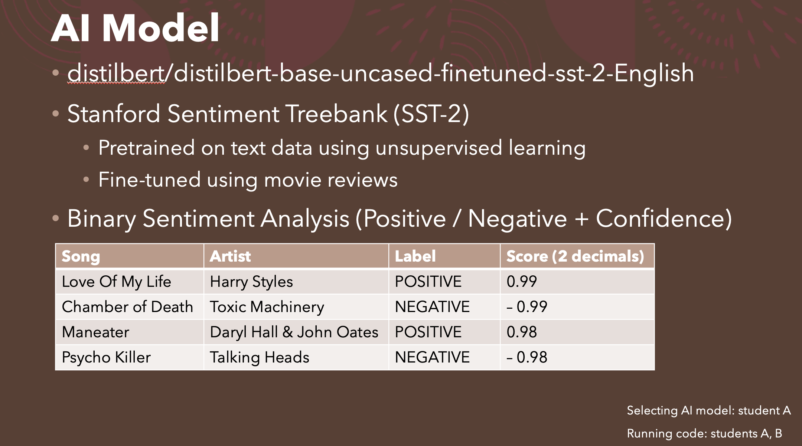
Example slide

Slide 5
Password to upload your assignments
Written in the classroom’s whiteboard. Please ask a classmate

Slide 6
Group project
Timeframe: (cont)
Before feedback moment on week 6:
Run a text classification model of your choice (you’ll learn in week 5)
Discuss the biases you expect to arise from this.
Reflect on the ethical and power imbalances of the data used.
Week 6: feedback moment (15 min/group). Come prepared! (bring slides)
Before feedback moment on week 7:
  Fill the ethical questionnaire (PRIDE).
  Elaborate how you would expand the study to tackle the issues you encounter
  Draft a presentation
Week 7: Feedback moment (15 min/group). Come prepared! (bring slides)
Week 8: Group presentation
Week 9:: Q&A and Exam

Slide 7
Group project grading (see rubrics online)
30% process: Course-wide individual grade
  The same process grade is used for both assignments
  Attendance and active participation in all four feedback moments are mandatory
  Assignment 1 group result first. Final grades after week 7. See the next slide for points and evidence
70% group work
  Assignment 1: Report (<1,000 words, excluding references and potential figures).
  Assignment 2: Presentation (12 minutes + 5 minutes Q&A)

Slide 8
Individual process grade
Four feedback sessions: 20 points each (weeks 3, 4, 6 and 7)
  20 points for attendance and participation at the expected level
  0 points if absent, not participating, or participating very little
  No intermediate scores. Four sessions = 80 points = 8.0
20 extra points (all or nothing) for consistently doing more than expected; 100 points = 10.0
  Evidence: answers to practical instructors and task distribution and contributors in the progress slides

Slide 9
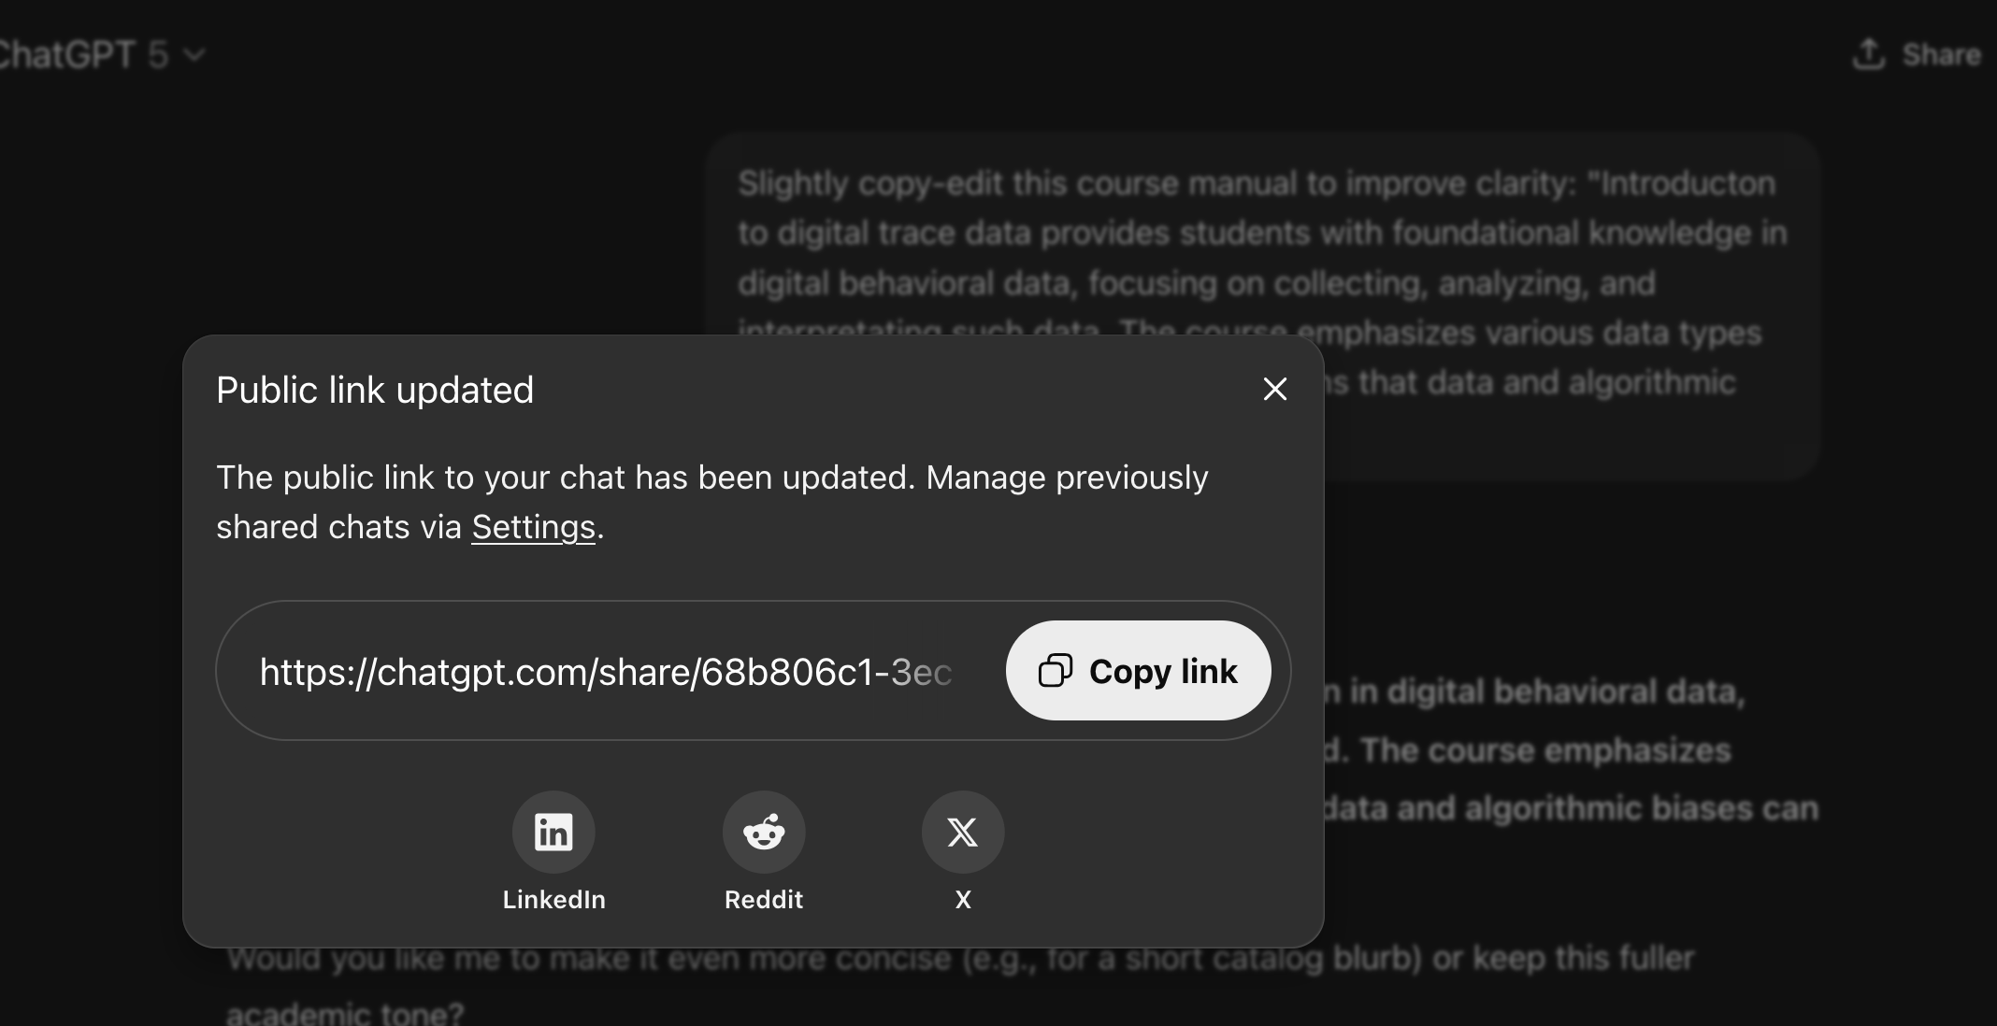
Use of Generative AI
The use of generative AI must be clearly indicated in the assignment, including a link to the full conversation with the tool (either using the Share button in the top-right corner, or exporting the conversation to an online document).

Slide 10
Assignment 1 GenAI reflection
Required section in Assignment 1
  Link the relevant GenAI conversation or conversations
  Identify where GenAI resulted in cognitive offloading
  Identify where GenAI supported learning
Not graded or otherwise taken into consideration
  Does not count towards the 1,000-word limit

Slide 11

Group contract
Group work is often great (deeper learning, teamwork skills, community)
But it can be challenging when working styles or expectations clash.
A group contract sets ground rules and expectations and mitigate these problems.
Please spend 2 minutes individually to think about and write down:
* Four ground rules that will benefit you and your group (e.g., having regular meetings every week)
* 1 – 4 things you have experienced in the past and you DO NOT want to happen, alongside with how you think it can be prevented
(activity based on Gloria Totten’s group contract template)

Slide 12
Final 20 minutes: draft group contract
Discuss as a group how you envision working together. Discuss each person’s responsibilities and make agreements on how to collaborate
You can use the template posted on the website (project guidelines), or here: https://docs.google.com/document/d/1VdUVTzQaxsFTXqVFKyJlNi9FZ_WlRKkHP-da_1MlPxI
(click on File -> Make a copy)
Although completing and signing it is not required, we encourage you to do so. This will allow us to intervene in the rare case conflict arises.
First step for the group project (start already this week):
Read project guidelines
Start thinking about possible research questions and datasets that could help answering it. Keep it simple!

