Slide 1

It takes nerves

Slide 2
A very brief introduction to Elixir
It takes nerves
Runs on the Erlang VM
Similar syntax to Ruby
Concurrent
Scalable
Fault Tolerant (more about this later)
Functional
Pipes
Matching

Slide 3

What is Nerves?
It takes nerves
Platform and tools that enable quick embedded software development using Elixir and the Erlang VM
Write once, push to multiple single board computers by changing TARGET env variable

Slide 4
Project pitch
It takes nerves
As a…
…really snoopy (or as my daughters would say “creepy”) dad…
I want to…
…track when family members enter and leave the house without having to change anything in their behavior or have them carry around anything they don’t already carry with them…
…so that…
…I know who is home when I get home without having to look at my phone or “take roll call.”

Slide 5
How?
It takes nerves
Raspberry PIs
One as the light indicator
One as a Bluetooth Beacon
Personal Phones (what teen goes anywhere without it?)

Slide 6
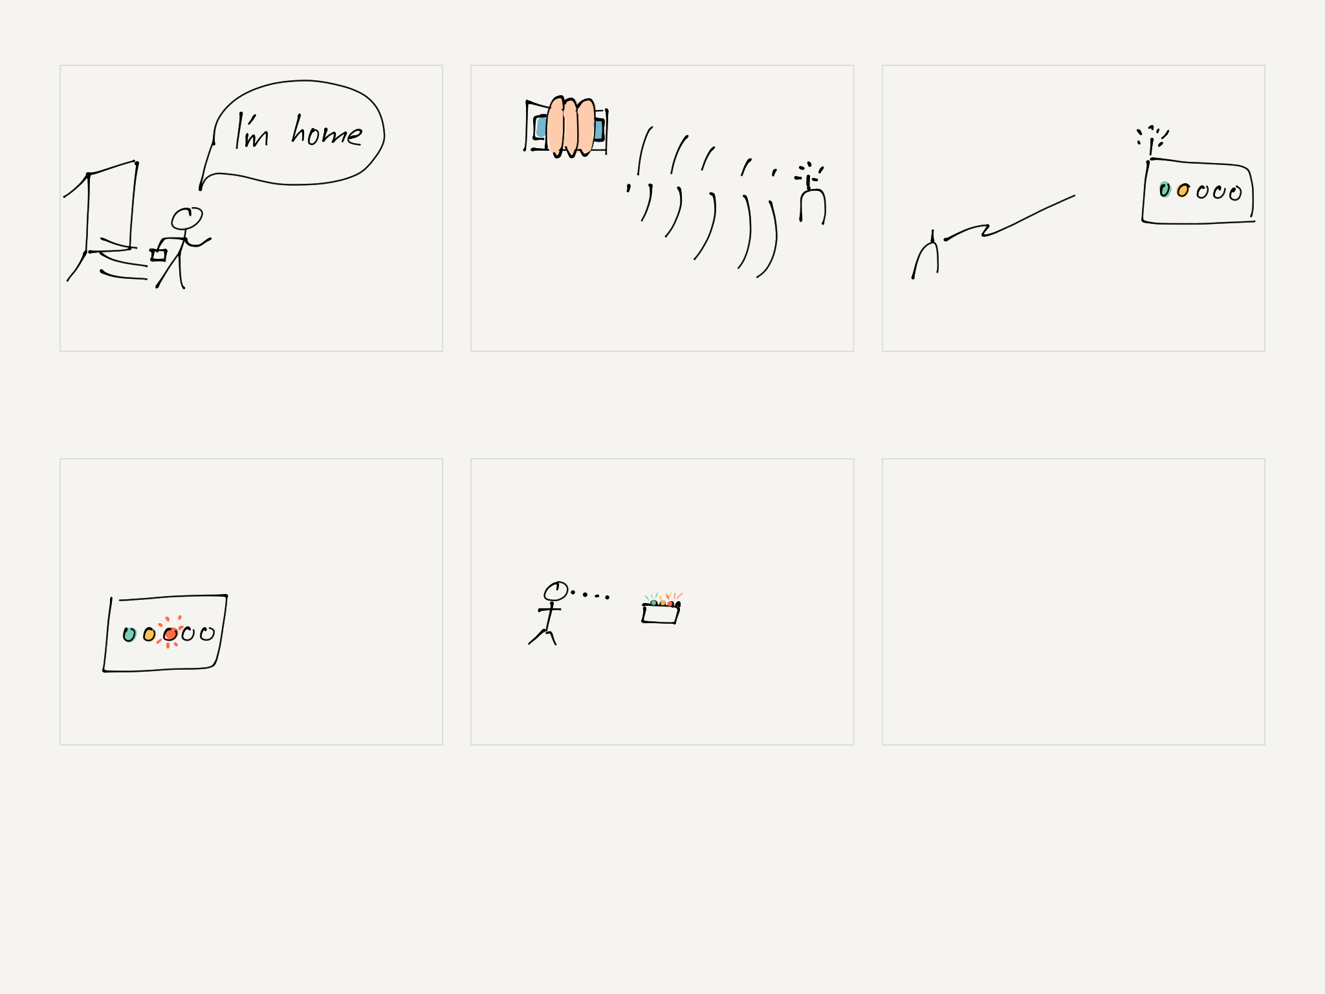
Story Board

Slide 7
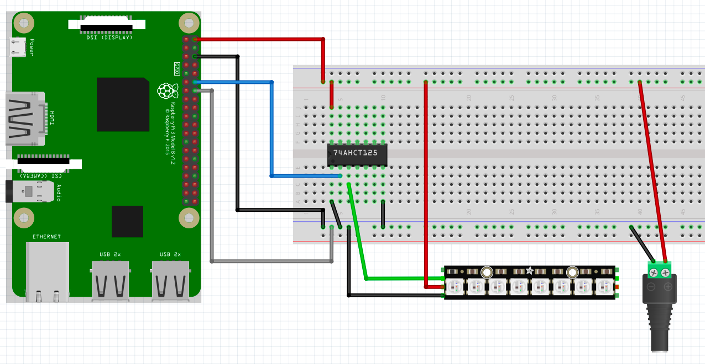
The wiring
It takes nerves

Slide 8
Parts
It takes nerves
Raspberry PI 3 and PI Zero W
NeoPixel stick (https://www.amazon.com/gp/product/B00IEDH26K)
Wires to connect them in (https://www.amazon.com/gp/product/B00NBSF724/)
Level Shifter (https://www.amazon.com/gp/product/B00XW2L39K)
Heat Shrink (https://www.amazon.com/170pcs-100mm-Polyolefin-Shrink-selling/dp/B01N4EPMYM)
5v DC Jacks and Adapters
Power Cord (https://www.amazon.com/gp/product/B01303TWZ2)
Terminal (https://www.amazon.com/gp/product/B00W058HHQ)
(Nice to have) USB UART (https://www.amazon.com/dp/B078W5L8W1) 2 for $10

Slide 9
Step o: Create the project
It takes nerves
Install elixir & nerves
Create directory…why? Poncho
Create firmware project
Make FTW

Slide 10
Poncho
It takes nerves
Project grouping
Control what is loaded when within the firmware project
You control what projects and processes see explicitly

Slide 11
The Final Project
Firmware
UI
Memory
Lights

Slide 12
Why the different processes?
It takes nerves
Firmware controls
Start up order
Restarts in the event of a crash
Rogue process cannot kill another process (just tie up computing resources)

Slide 13
Step 1: Making Lights Blink
It takes nerves
Create lights project
Add dependencies (to both mixes)
config changes
networking
ssh
RingLogger and the magic of ~.

Slide 14
Step 2: Putting a Web Interface on It
It takes nerves
Phoenix (the web framework for Elixir)
A very quick overview
Adding into the firmware

Slide 15
Step 3: The Day of REST
It takes nerves
Add to the routes
GET (list, one)
POST (creating)

Slide 16
Step 4: remembering
It takes nerves
Process communication
Adding to the WebUI

Slide 17
Step 5: I spy with my little beacon
It takes nerves
Python? Why?
KISS

Slide 18
Step 6: color code all the things
It takes nerves
Read from Storage
Set colors based on status
Set color for specific pixel based on person

Slide 19
Step 7: Home improvements
It takes nerves
Improve the web interface so it shows status as well
Maybe even a LiveView (update pages via websockets)
Make the beacon in Elixir as well
More fault tolerant when no/poor connection
MQTT persistent messages for both beacons and memory process
Multiple beacons in the house and add “room location” to the data being sent
Direct connection to the lights instead of current LED subsystem
Environment sensors
Other project idea: Smart Garage Door (not a dumb light sensor}

Slide 20
Code
It takes nerves
Ya…about that
Git repo needs to be cleaned because I messed up
Not so secret secrets
Will be published to https://github.com/digitalbias/light_commander

Slide 21
Nerves in production
It takes nerves
FarmBot (CNC Farming)
Smart Rent (Property management)
Rose Point (Navigation)
LeTote (Kiosks)
Open Pantry (Soup Kitchen)

