Slide 1

Plan Your Next Move Like a Chess Game

Slide 2
> whoami
david.c.mitchell
Professionally
Professional Developer since 1996
Taught programming to NASA, WCF, Autosoft, IHC and others
Worked in startups, mid-sized, large companies and as a business owner
Product Manager @ O.C. Tanner while getting MBA from BYU
Personally
Taught leadership principles to people from the following companies:
Bain Capital, Inside Sales, Novell, RealSalt, ZCMI, Vivint, doTerra
Shodan in Aikido
Certified Advanced PADI diver

Slide 3

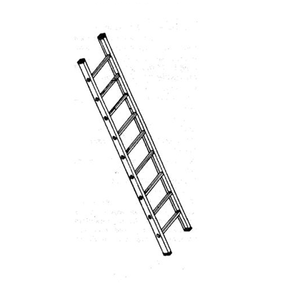

Mental Model

Slide 4
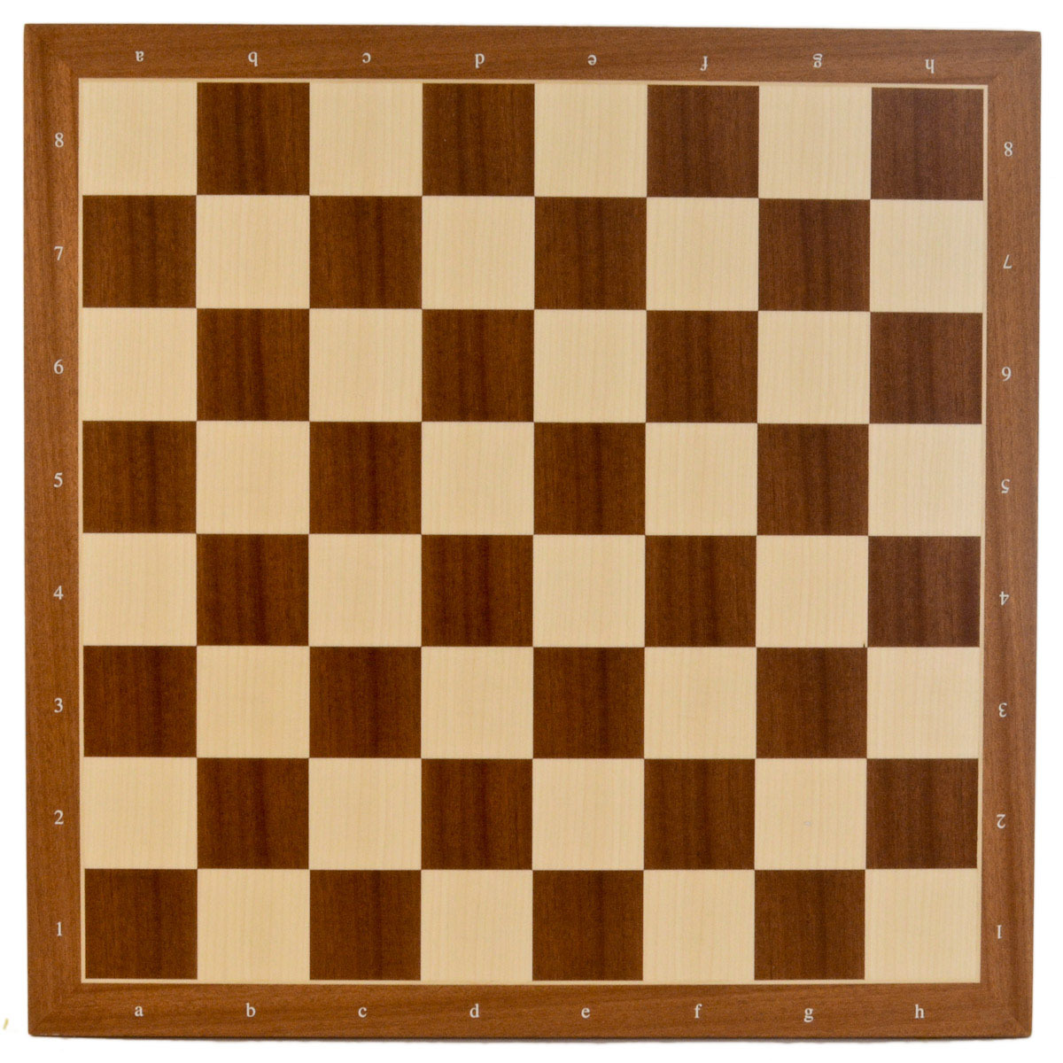
Horizontal Axis
Industries or Specialities
Health Care
Manufacturing
Finance
Retail
Consulting
Machine Learning
QA
Product
Software Development
Vertical Axis
Job Title, Responsibility or Experience
Jr. Developer
System Engineer
Product Manager
Scrum Master
Leading a Project or Initiative
Rearchitecting a System
Migrate to New ERP System

Slide 5

The 70-20-10 Rule
Professional Growth Ratio
70% Work Experience
20% Personal Network
10% Education

Slide 6
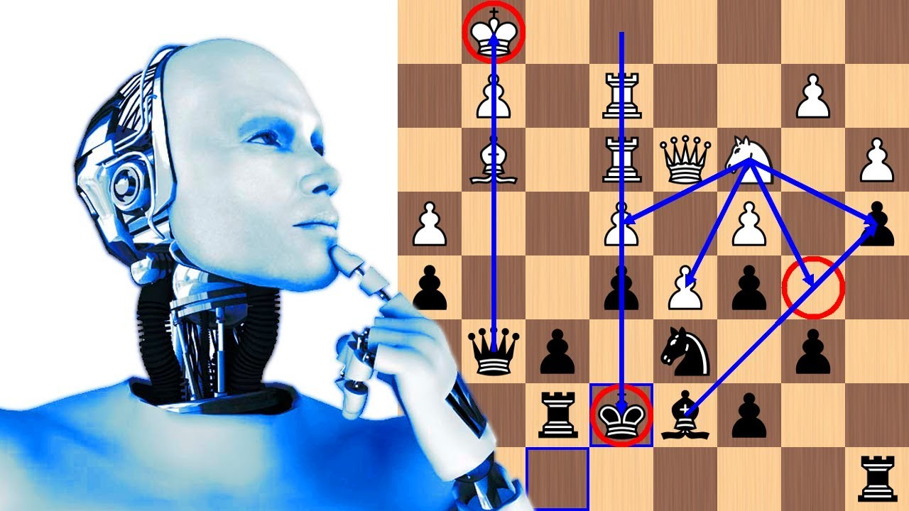
Tools to Help Navigate Your Next Move

Slide 7
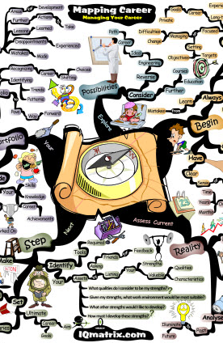
Personal Experience Map

Slide 8


Experiences
Two types of experience
Functional: Show competency in skills
Management: Show how you perform in situations
How do you find out what experiences to go after? You ask someone

Slide 9
Interview Experts
Interview best and brightest in the field, ask them what helped them get to where they are
Find leaders on the “best” lists (articles in trade mags, books you like, speakers at conferences, referrals from people you work with)
Request an interview asking them to help someone (you) in their field
Ask for insights on what experiences helped them grow the most
Resume and LinkedIn stalk: Look at what they say helped them or what value they provided

Slide 10

Build the Map
4-7 Functional Experiences (horizontal)
3-4 Management Experiences (vertical)
Focus on experiences that will accelerate career
Experiences should show meaningful business outcome

Slide 11

Review and Plan
Focus on experiences which will help you move the direction you want (70-20-10 rule)
Focus on what can help in the next 2-5 years
Review it every 6 months and every time you change companies or jobs/positions. Update if necessary.

Slide 12
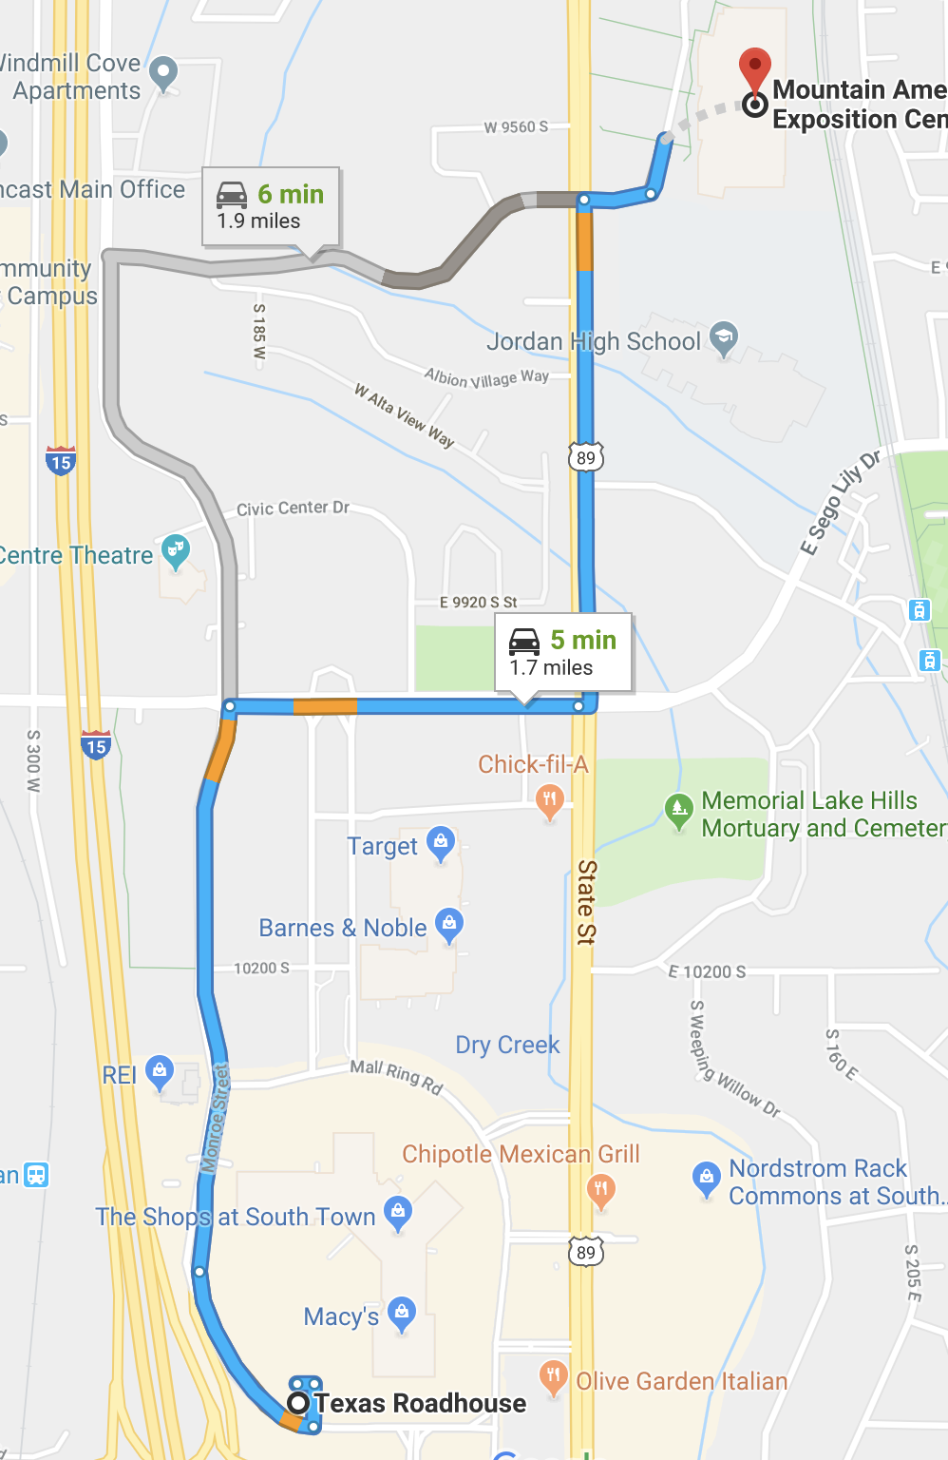
From/To & Interviewing

Slide 13
From/To
Start with:
What is your next move?
What experience do you want next?
What technology do you want to learn?
What industry looks interesting or could help you grow?

Slide 14
The Statement
“From a _____ to a _______”
From a pure backend developer to a full stack expert with a focus on rails and react.
From an individual contributor who adds value through technical expertise to a leader who provides vision and direction through clear collaboration on technical architecture decisions.

Slide 15
Interviewing
Check your ego at the door
Ask trusted superiors and colleagues for feedback on From/To
Ask for brutal honesty because transparency will help you grow

Slide 16

Matrix Ranking

Slide 17
Matrix Ranking
Designed to take the guess work out of choosing a position or job opportunity
You decide what criteria you feel is most important

Slide 18
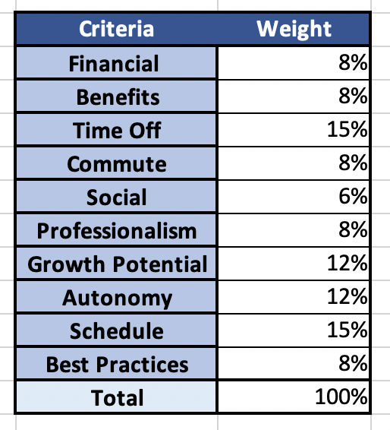
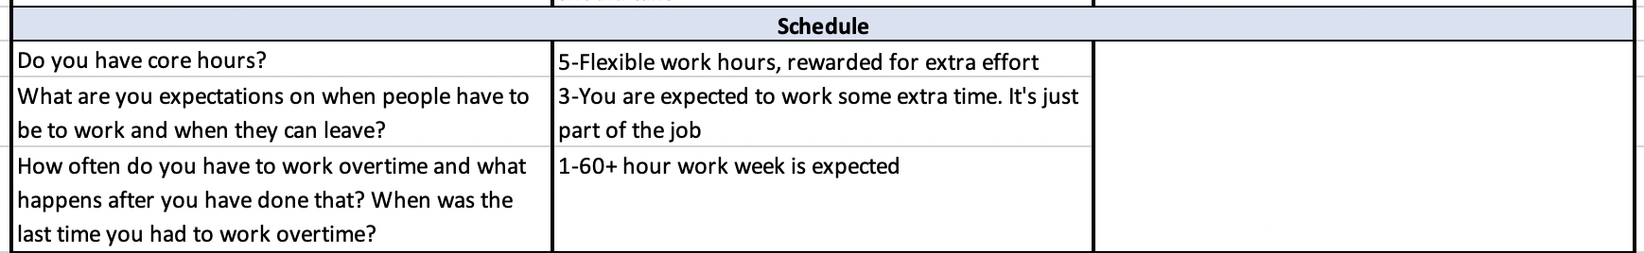
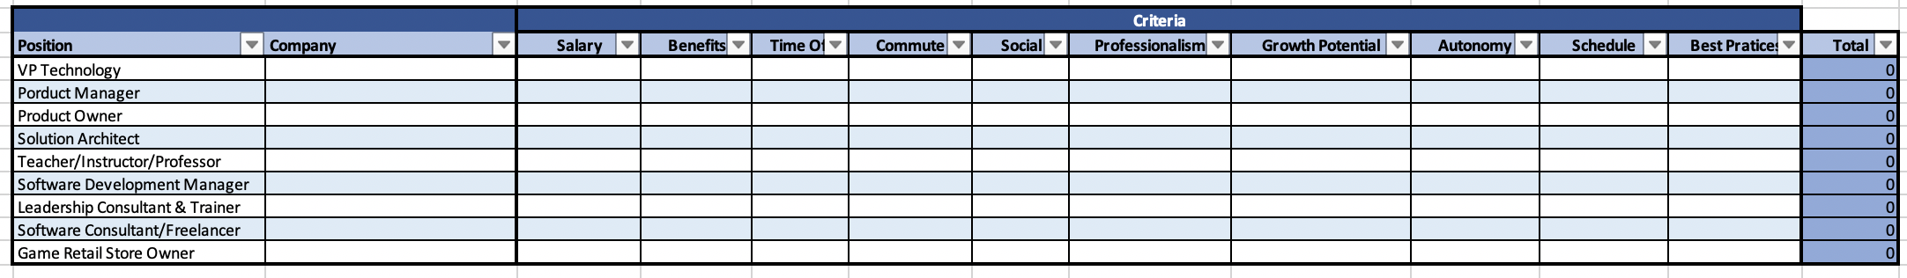
Criteria and Weights
Criteria with Sample Questions
Overall Rankings

Slide 19
Criteria and Weights
List all the things which are important to you
Divide evenly
Then adjust what is more and least important

Slide 20
Determine Sample Questions and Ranks

Slide 21
List Options and Evaluate

Slide 22
Summary of Tools
Experience Map
From/To & Interviewing
Matrix Ranking

Slide 23
Why Move At All?
Or
The Three “B”s

Slide 24
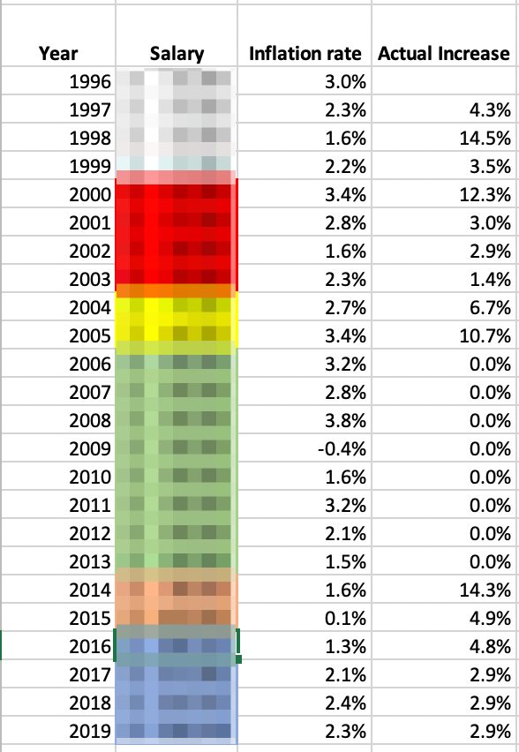
Bump (in salary)
Company Change
Working for Self
Position Change

Slide 25

Burnout

Slide 26
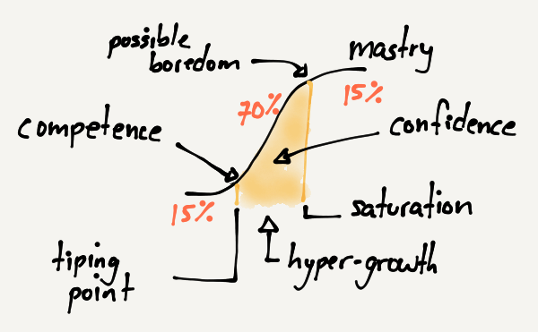
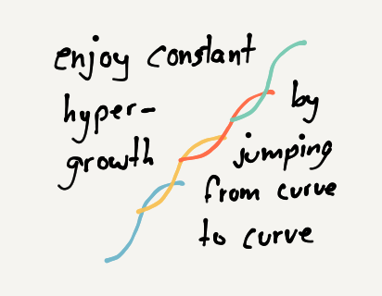
Boredom
“Disrupt yourself”, by Whitney Johnson

Slide 27
“If you don’t disrupt yourself, somebody else will”
–Peter Diamandis
Co-founder and Executive Chairman of Singularity University

Slide 28
So disrupt yourself
on your terms
and plan it like a chess move

Slide 29
Thank You

Slide 30
References
Make A Career Plan (https://capd.mit.edu/explore-careers/career-first-steps/make-career-plan)
Suggestions for a Good Development Plan (https://www.ninds.nih.gov/Funding/Training-Career-Awards/Mentored-Career-Awards/Suggestions-Good-Career-Development-Plan)
3 Steps to Create Your Own Career Development Plan (https://www.workitdaily.com/steps-career-development-plan)
A Simple Way To Map Out Your Career Ambitions (https://hbr.org/2018/11/a-simple-way-to-map-out-your-career-ambitions)
The 70-20-10 Model for Learning and Development (https://trainingindustry.com/wiki/content-development/the-702010-model-for-learning-and-development/)
The Secret to Finding Lasting Career Satisfaction (https://www.gsb.stanford.edu/insights/secret-finding-lasting-career-satisfaction)
Why You Should Journey Map Your Life (https://theuxblog.com/blog/customer-journey-mapping
How Will You Measure Your Life (https://hbr.org/2010/07/how-will-you-measure-your-life)
Managing Oneself (https://hbr.org/2005/01/managing-oneself)

