Slide 1
Micro-mania
Jacob Crain
Daniel Hamilton
Matt Dolan

Slide 2
Micro-mania
Gaming console with 4 minigames
Flappy Bird
Goomball
Slither
Tiles

Slide 3
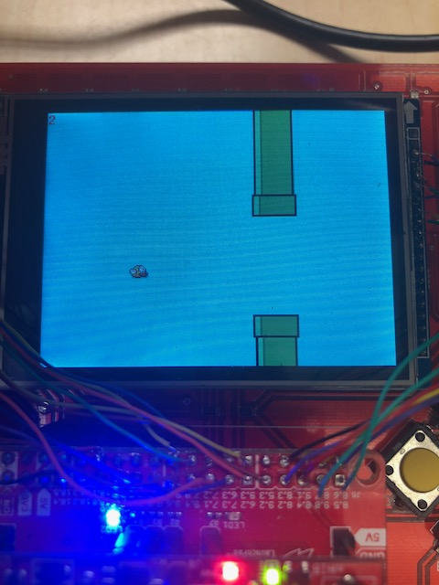
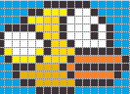
Flappy Bird
Very similar to the traditional Flappy Bird on phones
Added two player capability, players compete for higher score and see each others point of view on their screen

Slide 4
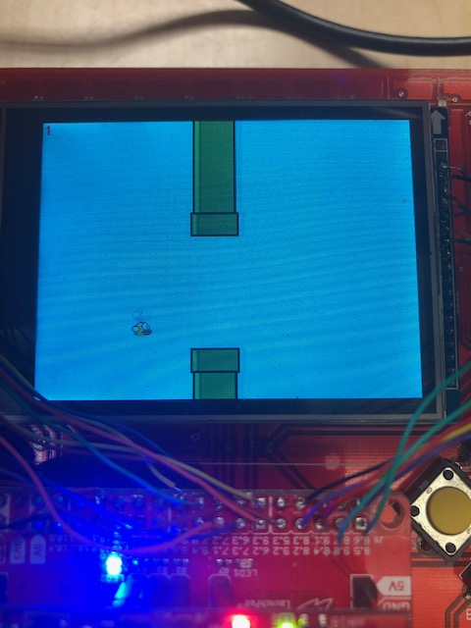
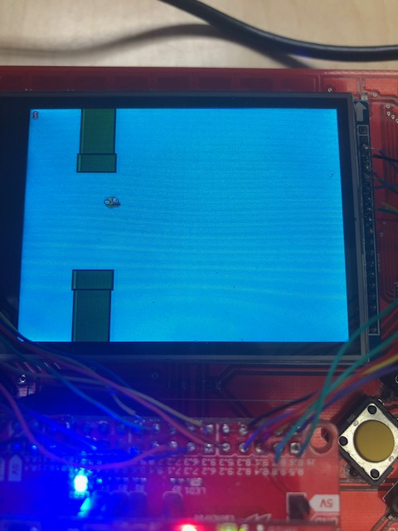
Flappy bird
Sprite implementation for the bird
Dynamic creation and deletion for the pipes

Slide 5
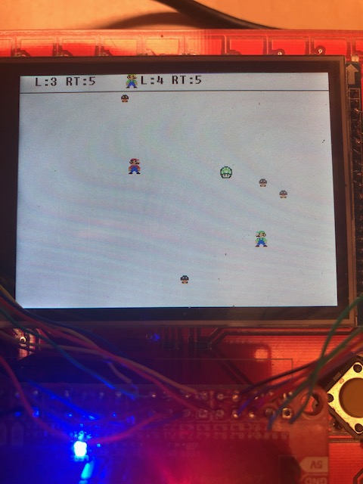
Goomball
Player 1 is Mario, Player 2 is Luigi
Survive the longest by dodging the Goombas
Each players life count and run time are displayed above the arena
Predefined macros allow for easy changes to the number of Goombas, lives, and max and min speeds

Slide 6
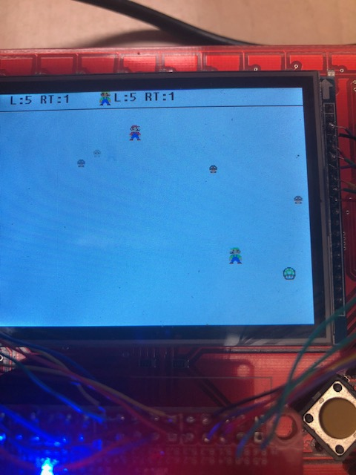
Goomball
Sprite implementation for Mario, Luigi, Goomba, and Mushroom
If you collide with a Goomba you lose a life.
If you collide with the life you increase your life total by 1.

Slide 7
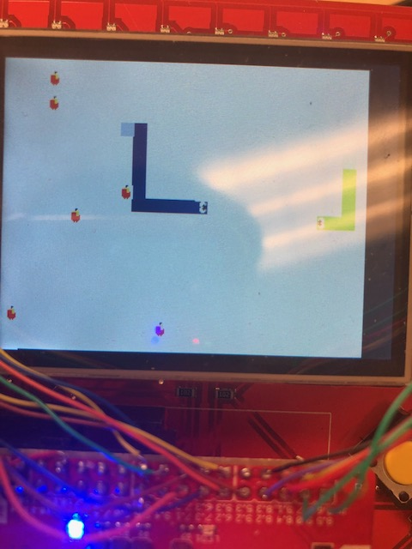
Slither
2 player snake game
Grow your snake by eating the apples
Hide from other snakes and attack them by making them run into your snake

Slide 8
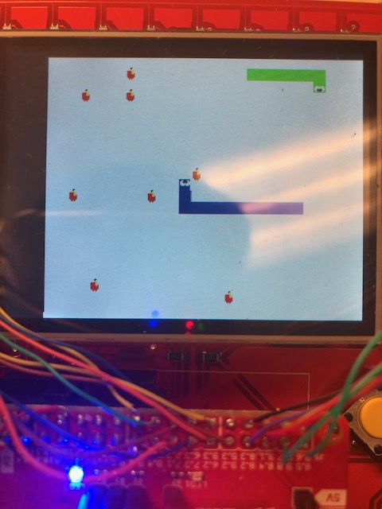
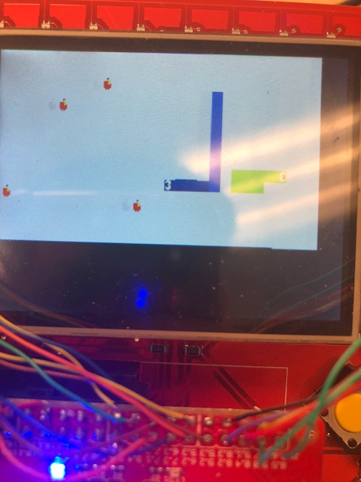
SLITHER
Virtual map with player screens showing only their point of view
Predefined game macros allows for quick manipulation of map size, max food count, player colors, and animation timings

Slide 9
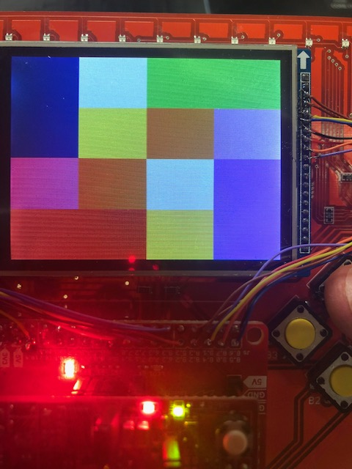
TILES
Single player game using memorization
Remember the picture shown at the beginning consisting of 8 colors
Match each pair of colors together with out mistakes to get the best score

Slide 10
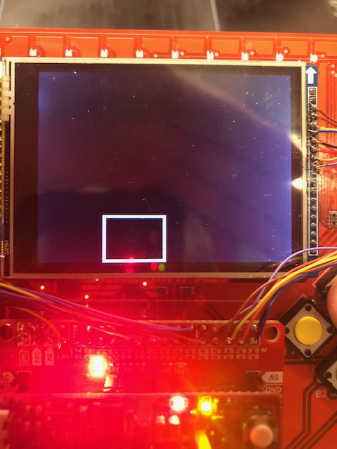
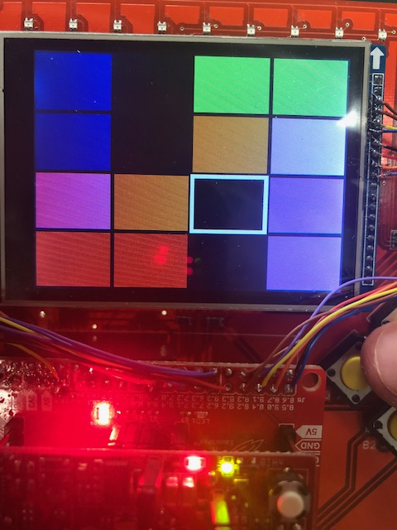
TILES
Keeps score of total moves for overall score
Randomly generates the tile map for repeated games

Slide 11
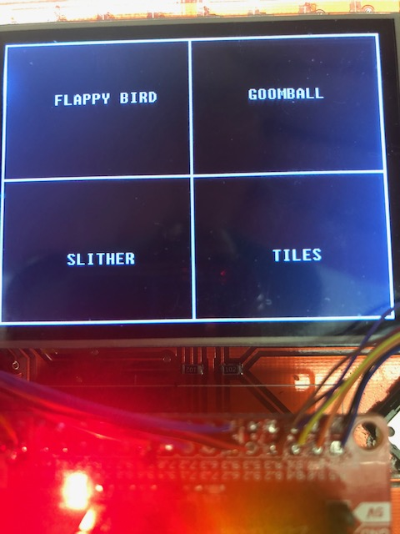
Console integration
After each game is finished, the Macro-Mania returns to a menu screen where the host player can choose from 3 other games to play, or replay the same game

Slide 12
Parallel writing to LCD
16x faster writing speeds on average
Spi requires 48 bits to write 16 bits of data to 1 register on the lcd
Parallel requires 2 transfers to write to 1 register

Slide 13
Problems Encountered
Manipulating the boards to work in parallel
Syncing host to client for minimal lag
Transferring data for large arrays over wifi

