Slide 1
Humanist Priorities
Crystal Hall
chall@bowdoin.edu

Slide 2
What I am going to ask you:
What are the humanistic questions that you would like your students to ask during your DH unit or course?
What are the humanistic skills that you would like your students to demonstrate successfully at the end of the DH unit or course?
How do those questions and skills align with your course goals?

Slide 3
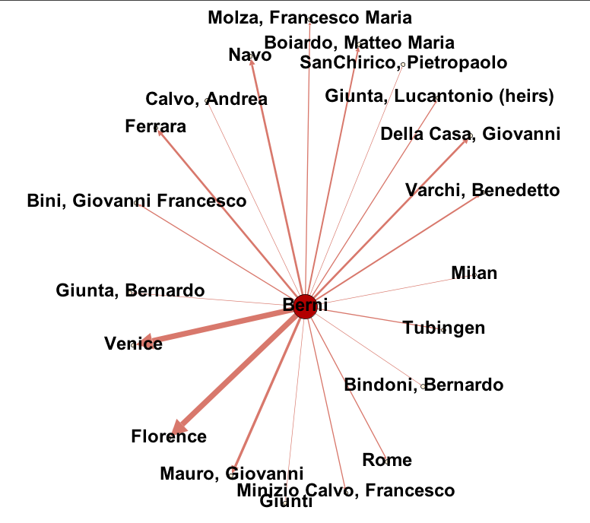
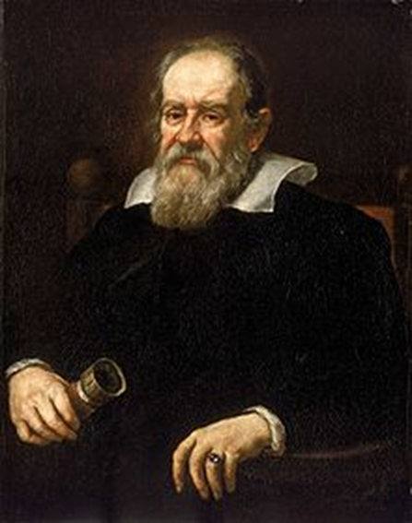
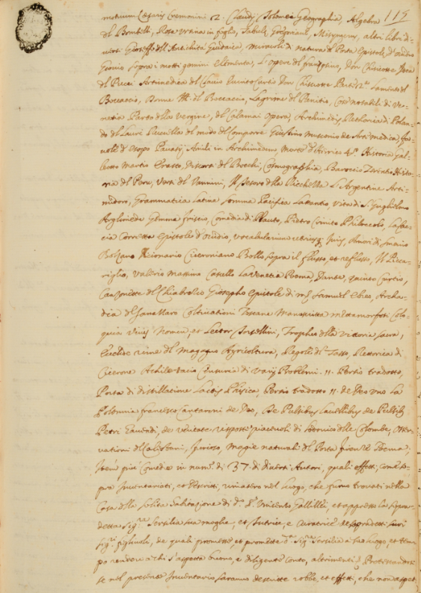

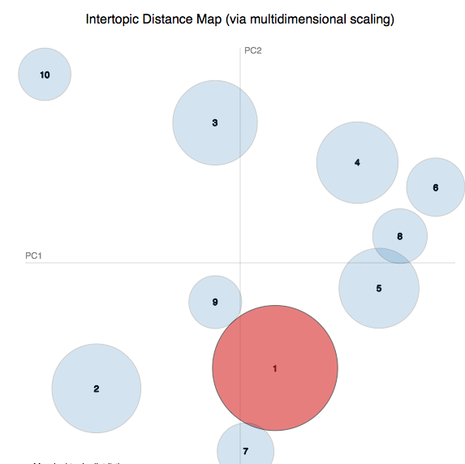
GaLiLeO:
Galileo’s Library and Letters Online
700 early modern books
4000 letters
Concerns:
Historical use of materials
DH training for our fields

Slide 4
Instead of building “telescopes”:
Applying the technology (artistic, social, humanistic, physical applications)
Investigating the technology (strengths, weaknesses, assumptions, consequences for theory related to its construction, historical parallels)
Testing of the technology (limitations of the model it presumes, exceptions to the ontologies upon which it is based, consequences of its application, improvements and refinements of its functionality)
Creating and communicating expressions of its need, use, and impact

Slide 5
GaLiLeO as a Site for Humanistic Intervention in Computation
During the process of digitization
During the process of database construction
During the design of the interface
Based on the use of the project

Slide 6
What I am going to ask you:
What are the humanistic questions that you would like your students to ask during your DH unit or course?
What are the humanistic skills that you would like your students to demonstrate successfully at the end of the DH unit or course?
How do those questions and skills align with your course goals?

Slide 7
A Literary Scholar at Work

Slide 8
A Literary Scholar at Work
Relationship 1
Relationship 2
Relationship 3
Relationship 4
Object of Study
Context 2
Context 3
Context 1
Context 4
New Knowledge about the Object

Slide 9
Potential:
“If and when new evidence is discovered, prior conclusions may need to be revised or abandoned – such was the case with the Ptolemaic model of a geocentric universe.” Jockers, Macroanalysis, 6
More discovery, documentation, interpretation, contextualization, evaluation, differentiation, explanation
More humanists!

Slide 10
Your Turn: Discuss with a Partner
What are the humanistic questions that you would like your students to ask during your DH unit or course?
What are the humanistic skills that you would like your students to demonstrate successfully at the end of the DH unit or course?
How do those questions and skills align with your course goals?

Slide 11
For your consideration:
Our Americas Archive Partnership http://oaap.rice.edu/
Recovering the US Hispanic Literary Heritage Project https://artepublicopress.com/recovery-project/
“As scholars of Latinx Studies – as well as those in related fields such as hemispheric studies, Black Atlantic studies, and indigenous studies – work to question the assumptions and omissions of our print-dominated past, digitization projects have become sites for recuperating lost voices, for breaking out of the disciplinary formations that have made sense of cultural history to find new patterns, and for increasing participation in the production of knowledge itself.”
Kelly Kreitz, “Toward a LatinX Digital Humanities Pedagogy” (2017)

