Slide 1
Continuous Delivery & Deployment with vFabric by Emil Siemes, September 2012

Slide 2
Continuous ...
Continuous integration: Your application always builds and passes its tests, including all the pieces from different sub-teams.
Continuous delivery: Your application always builds and deploys to a test environment and passes its tests.
Continuous deployment: Your application is always ready to deploy to production through a largely automated process.

Slide 3
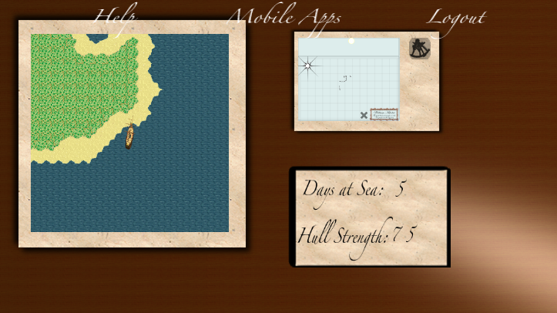
The App: iiCaptain
HTML5/JavaScript Client
Apps for iOS, Android, BlackBerry & Windows Phone
Spring based Server App
Server generates unique maps
Demo does not really depend on the App
Pick your own
https://github.com/digitalemil/iiCaptain

Slide 4




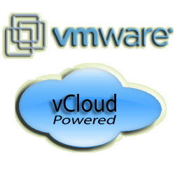

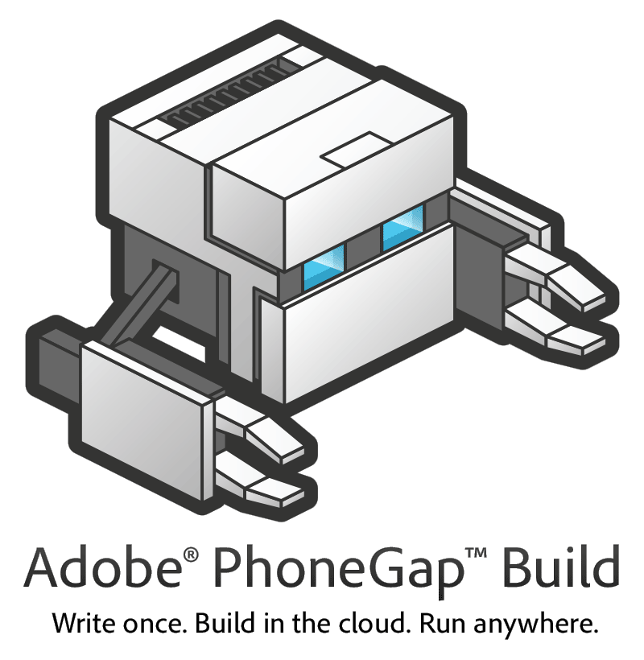




Continuous Delivery
STS
Jenkins
6. Optional deployment
2. poll, svn co,
mvn
3. REST deploy
vFabric Application Director 5.0 Beta
1. svn commit
Blueprint & Profile
5. selenium
4. provision
7. build client App
Makes native App from HTML5/JS
Server App

Slide 5
Remarks
Fully automated build, junit, provision, deploy, integration test
To make it a Continuous Delivery you would update your production war file after you successfully passed the integration tests
You can extend the demo with APM
MongoDB not used yet -> replace with GFE
You can make it even more Cloud-like by putting the sources in git and point c9.io (browser based ide) to it. Use buildhive (from cloudbees) and you can develop and provision the whole app (client & server) from without leaving your browser!
It‘s a better together demo (CF & vFabric)
Uploading the client apps to Apple‘s AppStore, Google Play etc. still a manual step

Slide 6
Questions?
Get it here:
https://github.com/digitalemil/iiCaptain

