Slide 1
Enabling DevOps with vFabric Continuous Delivery & Deployment Demo by Emil Siemes, September 2012

Slide 2





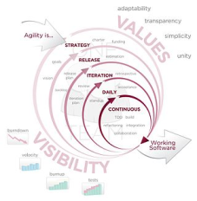










Applications Today
Deployed on virtual and cloud infrastructure Span across Private, Public and Hybrid Clouds
Public/Private/Hybrid Cloud
Private Clouds
Public Clouds
Developed with ‘agile’ or ‘iterative’ methodologies Apps released early and often
Written in diverse frameworks Traditional (Java, .Net) and Modern Frameworks
Expanding into new application types Mobile, SaaS, social
Cloud Operating Model
Driven by the Cloud Journey
Leads to distinction of ownership and collaboration
DevOps
Apps released early and often
Businesses need frequent changes and expect higher service level.
Source: http://en.wikipedia.org/wiki/Agile_software_development
Notes:
Diverse nature in which applications live in today’s environment. It’s challenged along different dimensions
From physical to virtual and now to Cloud infrastructure spanning from Private, Public and Hybrid Cloud.
Developers follow different development methodologies from Waterfall to Agile. That leads to frequent application releases.
Then there are diverse frameworks – Java, .Net and some other new frameworks that makes this entire space interesting or challenging.
Also, from single type of application to new application types like App as a Service, Smart phone app or Social application
All these are driven primarily by two models or a hybrid of both models
Cloud Operating Model
Customer who want to ride this cloud journey either using Private or Public Cloud offering
In that there is a distinct owner Cloud Provider and Cloud consumer model.
DevOps
Agile methodologies, entire process starts with developers releasing code more frequently.
This is driven mostly by Business, as they need agility and better response time.

Slide 3


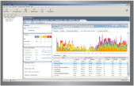






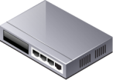
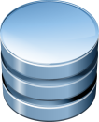
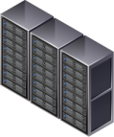
The Paradigm Shift – Separate the Layers
Cloud Consumers
Optimize
Application
Developers
Performance
Availability
Usage
Cost
Build
Deploy
Monitor
Application
Operations
Performance
Availability
Usage
Cost
Utilization
Application Visibility
Cloud Providers
Infrastructure Service
Health
Cost
Cloud Ops
(Infra-NOC)
Performance
Capacity
Config
Security
Private
Public
Notes:
As applications get virtualized and pushed into a cloud (Private or public) there is a very clear separation between the infrastructure management paradigm and the application management one – they are no more intertwined.
The infrastructure managers are provider of compute platform for the VMs running on them and should not care what is in that VM.
The Application owners do not care where physically or on which HW their applications are running
There is however the need to provide visibility to both sides of the wall as to what is happening on the other side: Application owners need to know the platform is indeed providing adequately to the demand of the application (Compute power, I/O, disk latency etc..) in a clear aggregated matter.
The Infrastructure owner will need to know the Application is running well if they conduct change to the platform

Slide 4
Continuous What?
Continuous Integration: Your application always builds and passes its tests, including all the pieces from different sub-teams.
Continuous Delivery: Your application always builds and deploys to a test environment and passes its tests.
Continuous Deployment: Your application is always ready to deploy to production through a largely automated process.
vFabric Application Director addresses both Continuous Delivery and Deployment and enables the DevOps model

Slide 5
Continuous Delivery Demo
Demo Time!
But first a short explanation

Slide 6
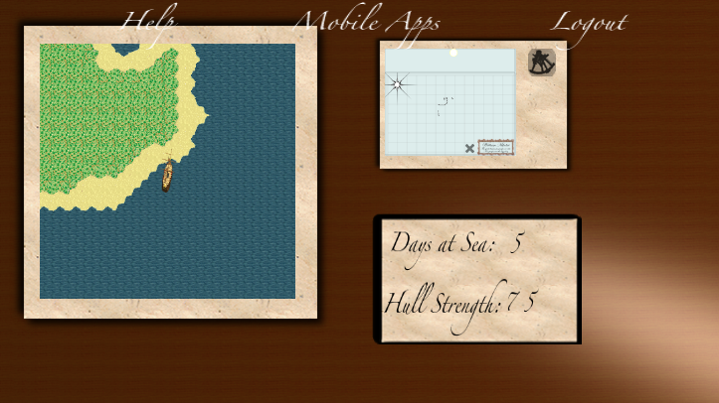
The App: iiCaptain
HTML5/JavaScript Client
Apps for iOS, Android, BlackBerry & Windows Phone
Spring based Server App
Server generates unique maps consumed by the client
Demo does not really depend on the App
Pick your own
https://github.com/digitalemil/iiCaptain

Slide 7




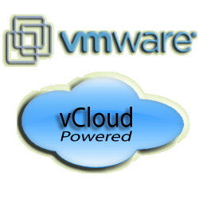

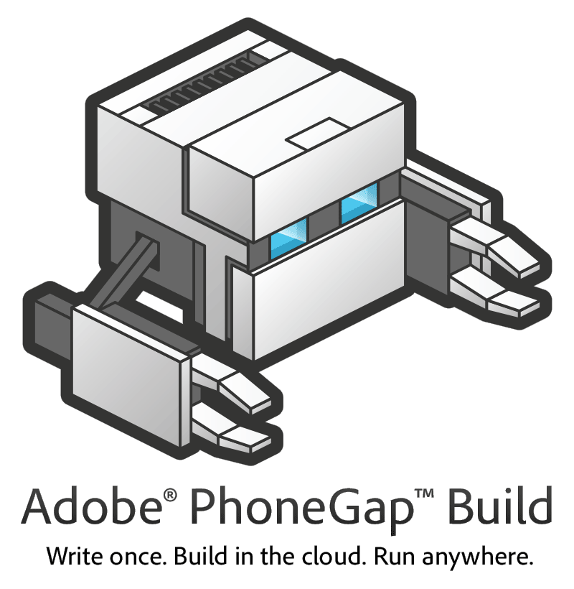




Continuous Delivery with vFabric
STS
Jenkins
8. Optional deployment
2. poll, svn co,
mvn
3. REST deploy
vFabric Application Director 5.0
1. svn commit
Blueprint & Profile
5. selenium
4. provision
6. jmeter
9. build client App
Makes native App from HTML5/JS
Server App
7. performance
data
vFabric APM

Slide 8
Questions?
Get it here:
https://www.vmware.com/products/application-platform/vfabric-application-director/overview.html
https://github.com/digitalemil/iiCaptain

