Slide 1

Twitter ABM
Opinion Formation in Online Social Networks

Slide 2
Purpose
Simulate the opinion formation on twitter by using Agent Based Modelling
Visualize opinion distribution over time
Detect network effects (cascades, clustering, isolation)
Play with parameters
Develop simulation environment package for Opinion Formation in Twitter Networks

Slide 3
Status Quo: Network
Create Network:
Creates a Bárabasi-Albert network based on preferential attachment
Update Network:
Add agents to the network over time
New agents connect based on preferential attachment list randomly to n initial agents

Slide 4
Status Quo: Agents
opinion
inclination to interact
perceived public opinion
check regularity
active (boolean)
inactive ticks
feed
liked Tweets
retweeted Tweets

Slide 5
Status Quo: Tweet
opinion
weight
source agent
published at (tick)
like count
retweet count

Slide 6
Status Quo: Simulation Step
Active agents are shuffled, each agent performs following steps:

Slide 7
Logging
Current logs contain:
Dataframe with agent data:
opinion, indegree, active status, perceived public opinion, inactive ticks, and inclination to interact for each step
Agent_list with all agents (also inactives) at final state
Graph representing the final network structure
Tweet List with all published tweets in simulation, every tweet in final state

Slide 8
Parameters to think about
Agents create tweets that have a similar opinion to their current own + rand(-0.1:0.0000001:0.1)
Self-initiated opinion change?
At each step, an agent connects to 4 new inputs out of neighbors of neighbors
Connect more new neighbors to keep preferred network size if he runs out of inputs?
At each step, an agent looks at his inputs and disconnects all out of an opinion_thresh of 0.5
Disconnect only a part of those agents/the worst, mind the standard deviation of all current friends for opinion threshold?
Update check_regularity: Agent feels comfortable if perceived public opinion is in threshold of 0.3. Otherwise check_regularity gets reduced
Agent gets inactive if he misses more than two ticks

Slide 9
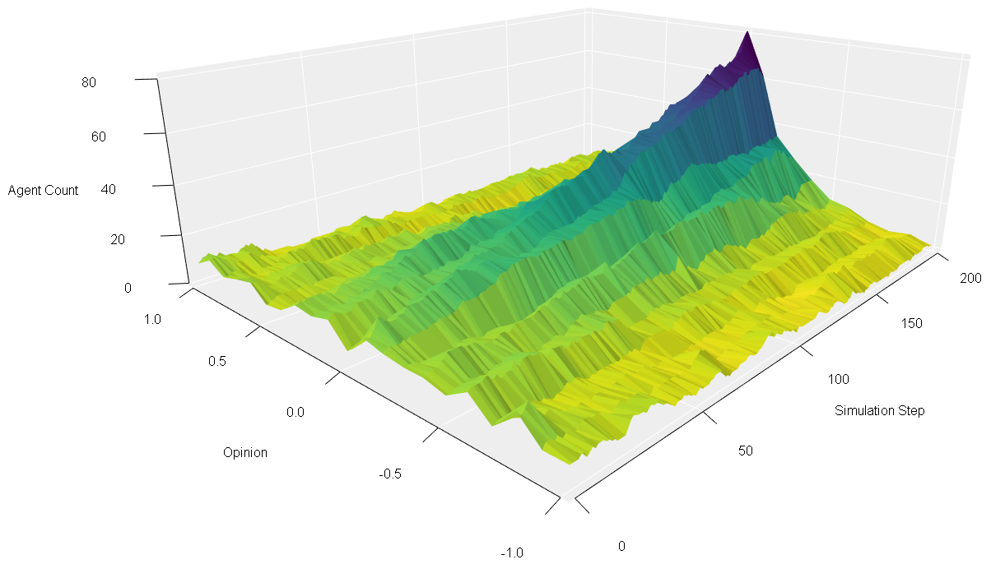
Visualization
200 Agents, 200 Steps
10 initial connections
Thresholds:
Update_opinion = 0.3
Baseweight = 0.99
Like tweet = 0.2
Retweet = 0.1
4 agents joining at each step
Agents form consensus

Slide 10
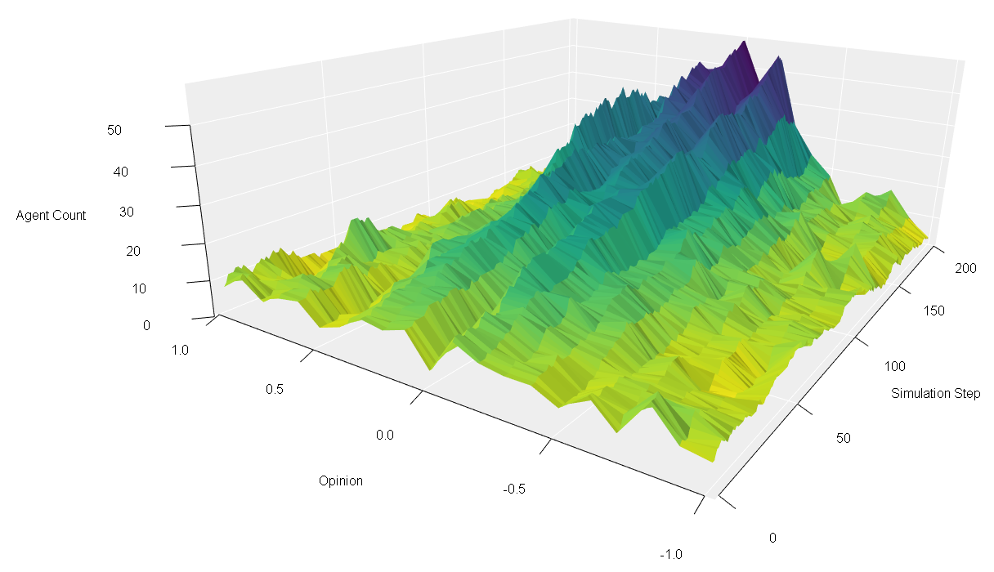
Visualization
200 Agents, 200 Steps
10 initial connections
Thresholds:
Update_opinion = 0.3
Baseweight = 0.99
Like tweet = 0.2
Retweet = 0.1
Check_regularity = 0.4
4 agents joining at each step
Agents form consensus

Slide 11
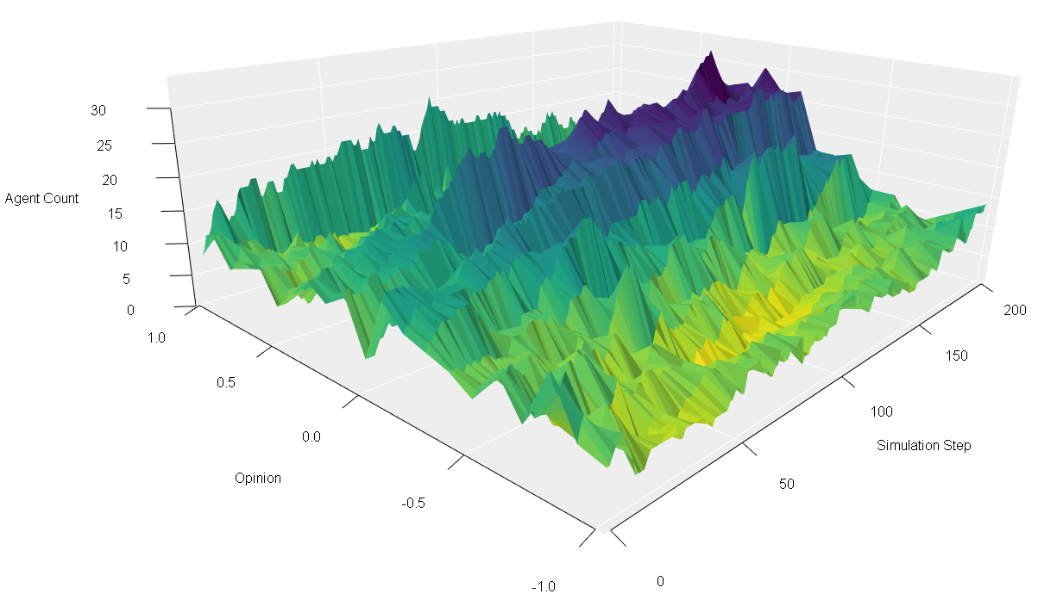
Visualization
200 Agents, 200 Steps
10 initial connections
Very narrow thresholds:
Update_opinion = 0.1
Baseweight = 0.99
Like tweet = 0.2
Retweet = 0.1
4 agents joining at each step
Now, the opinion distribution stays broader and less consensual

Slide 12
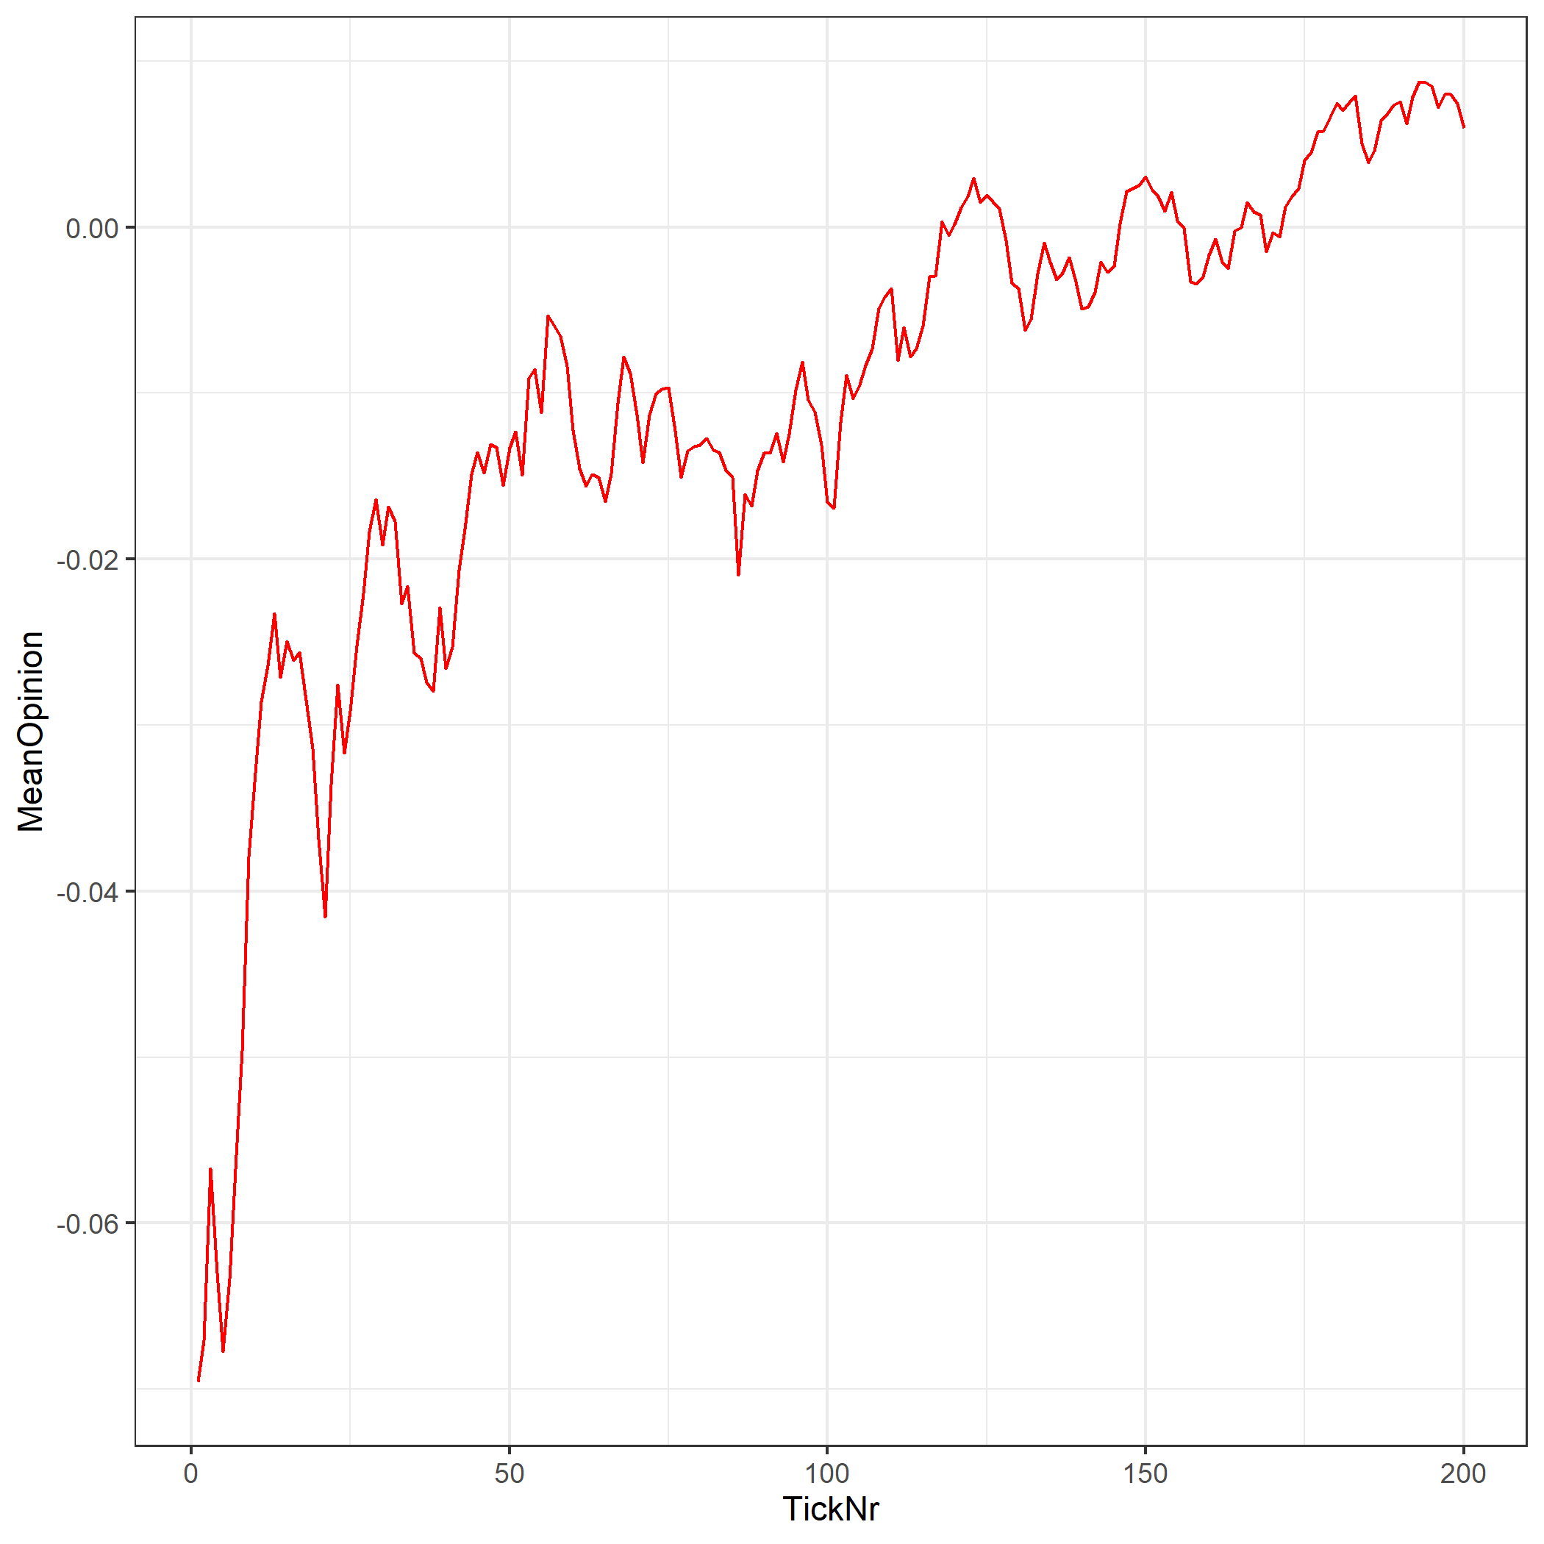
Visualization
development of mean opinion

Slide 13
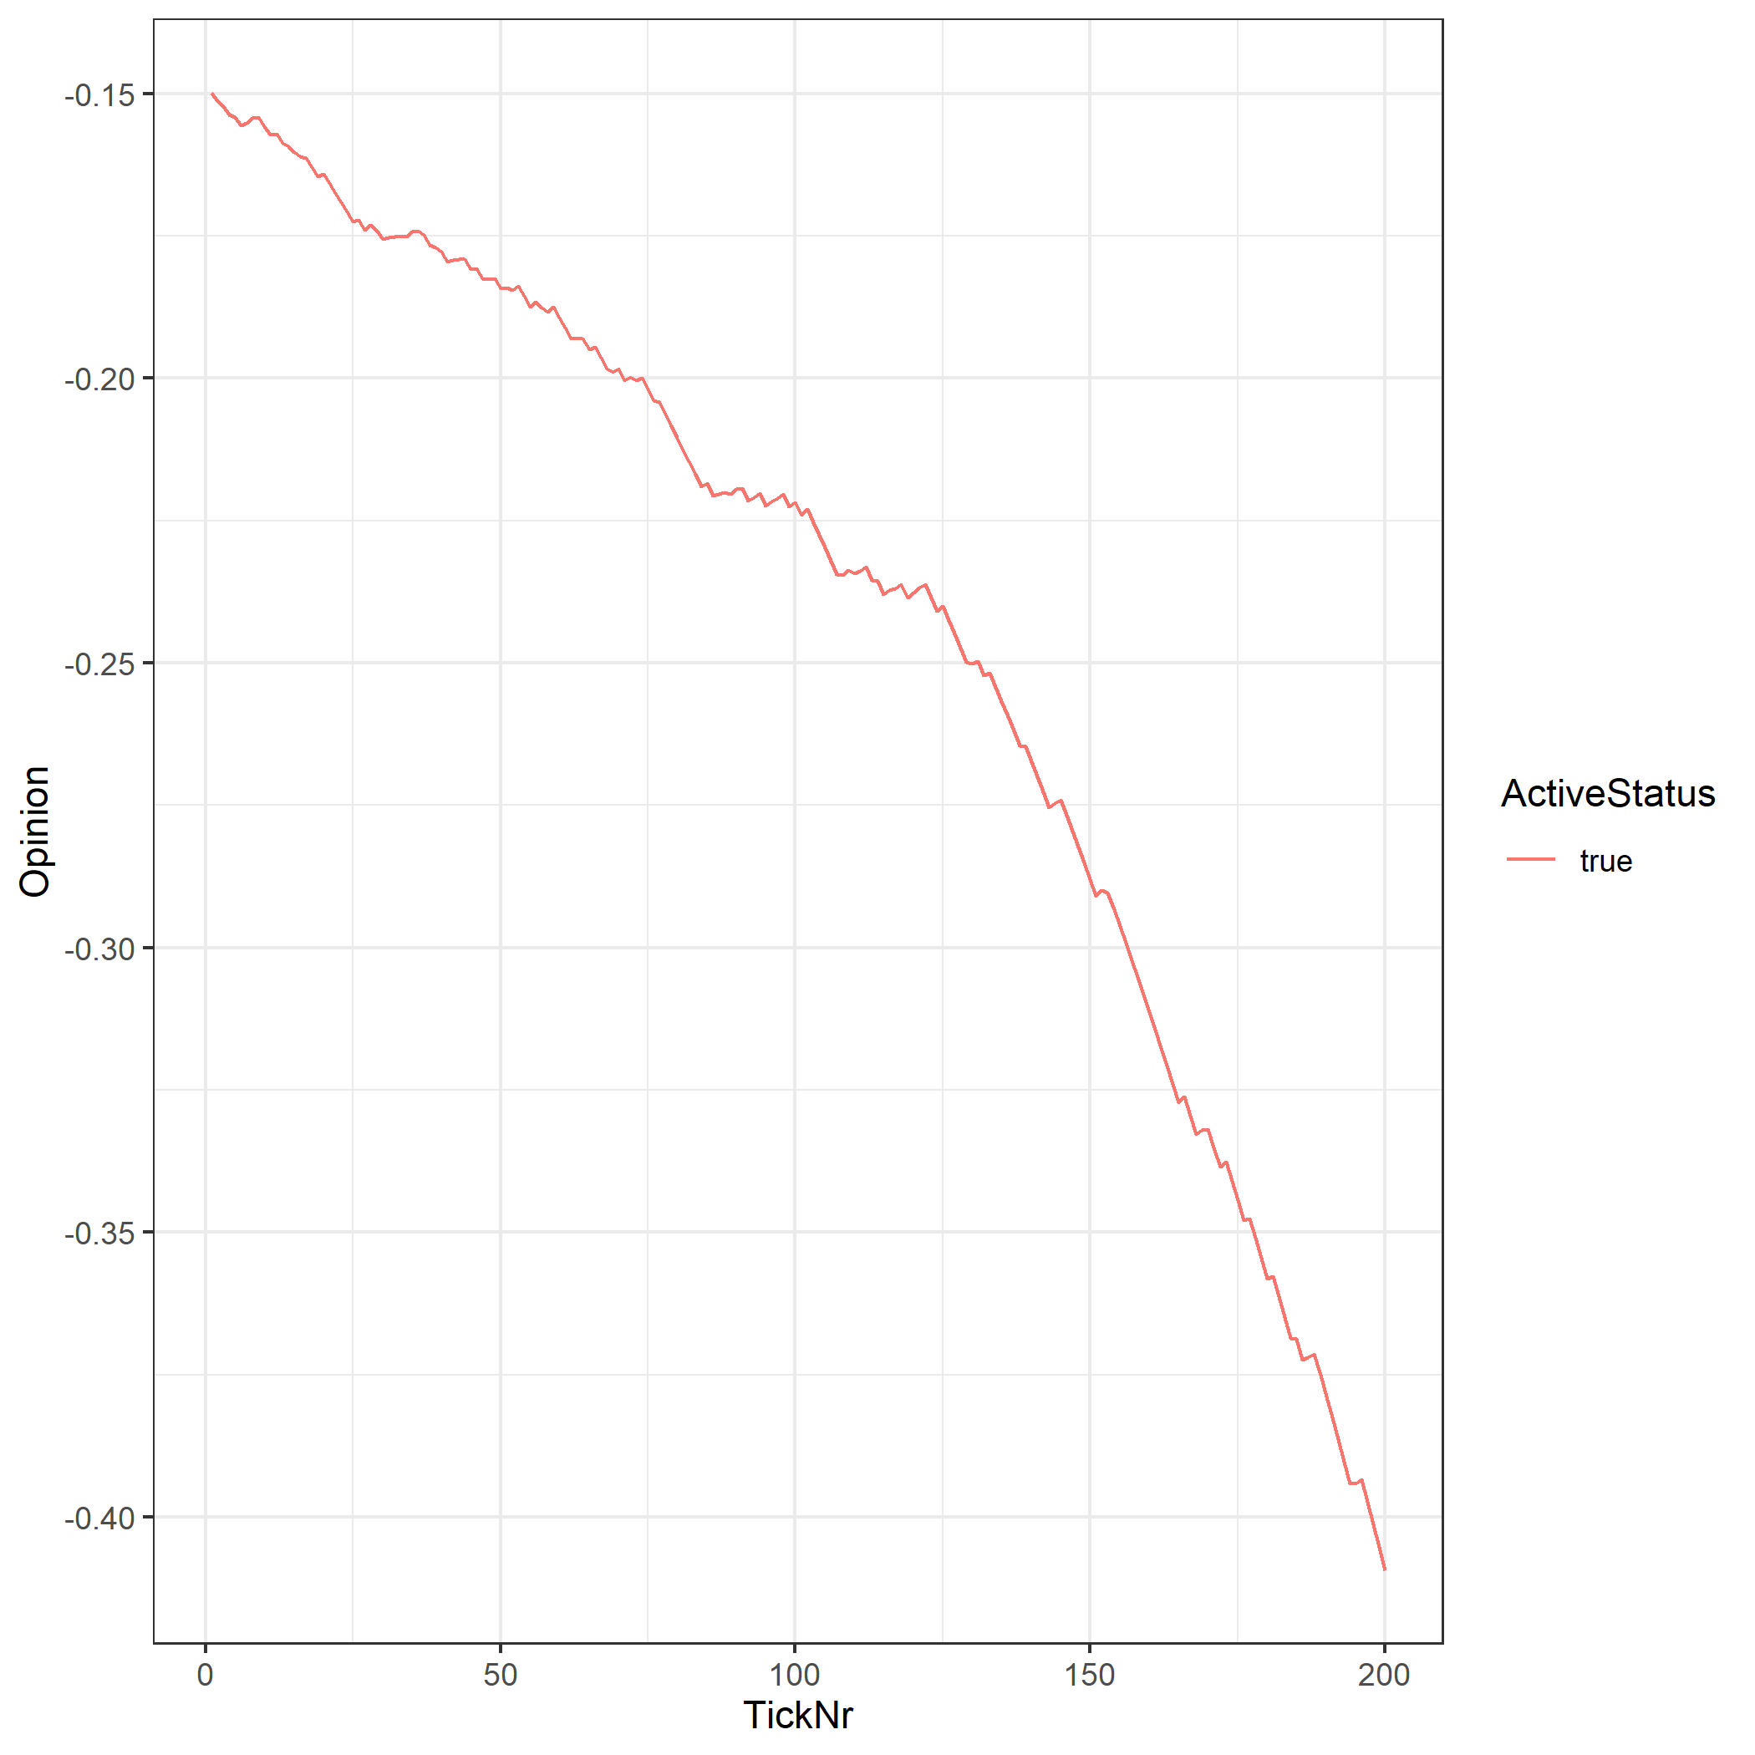
Visualization
looking at specific agents

Slide 14
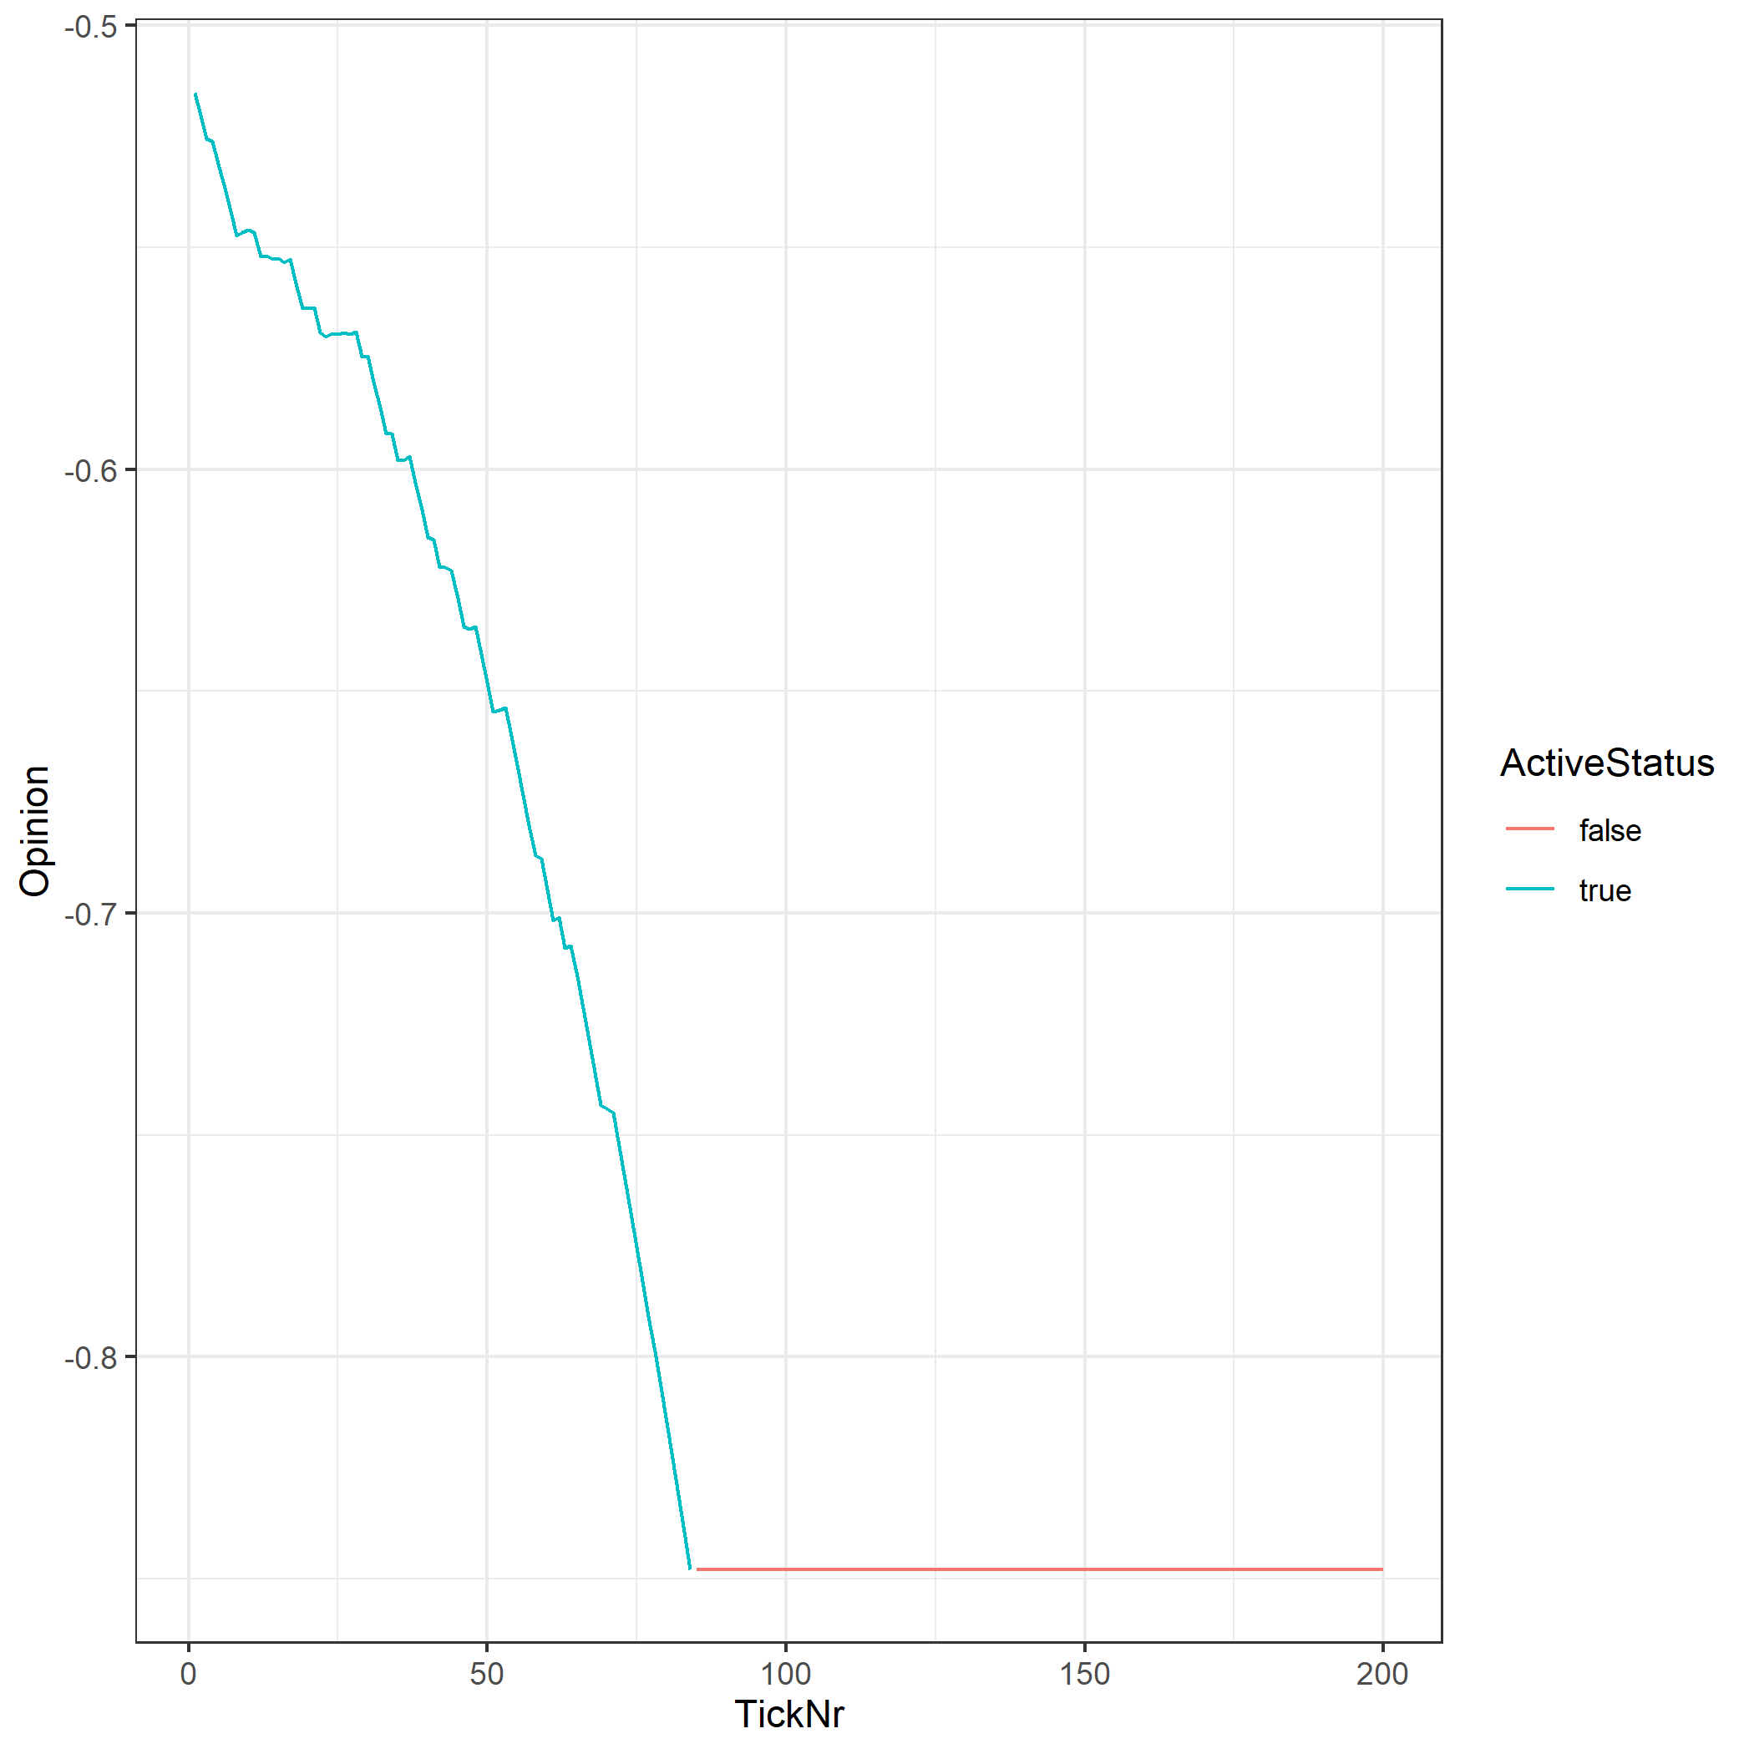
Visualization
looking at specific agents

Slide 15
Functionalities to think about
Agent personality
Social Bots
…?

