Slide 1
Before replacing a component,
First check whether it is available in the KiCad library.
If the component is not available, search for it online and add it to your KiCad library.
Component Search Engine:
www.componentsearchengine.com
For instructions on adding downloaded libraries to KiCad, refer to the following YouTube tutorial:
https://www.youtube.com/watch?v=7qVhKbithF0&t=1237s
Component Search Engine provides free schematic symbols, PCB footprints, and 3D models for KiCad, making it a convenient resource when a required component is missing from the standard KiCad libraries.

Slide 2
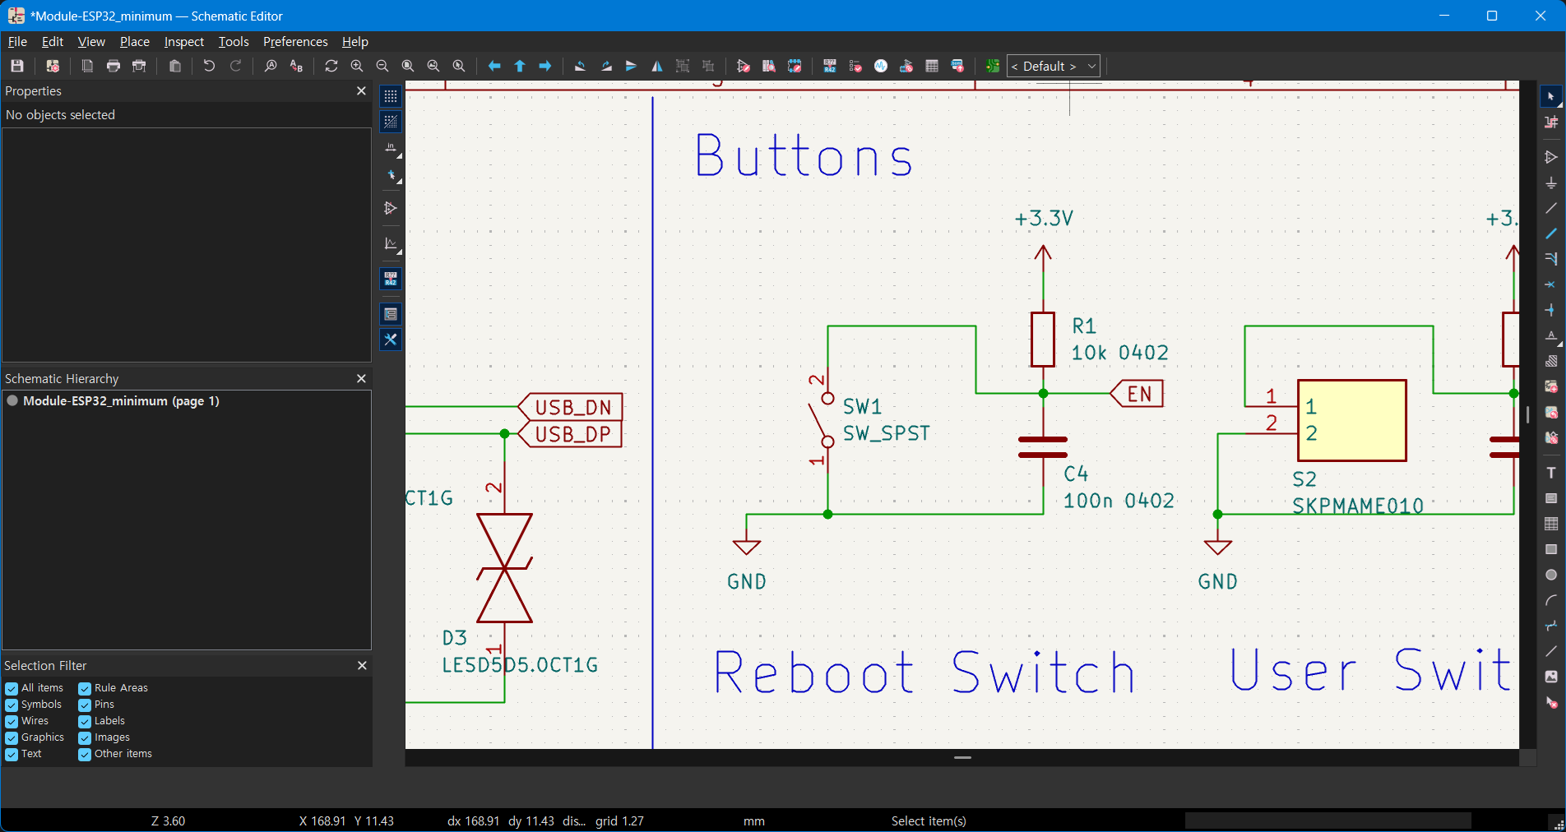
1. Add a part
Click the Add Symbol icon on the right toolbar, or simply press the A key to add a new component to the schematic.
대체할 부품 심볼

Slide 3
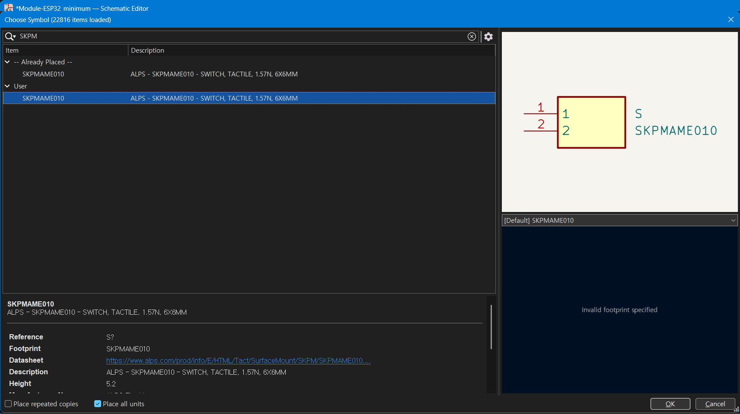
2. Find a part in the symbol library
Enter the component name in the Library Filter field (for example, SKPMAME010), then click OK.

Slide 4
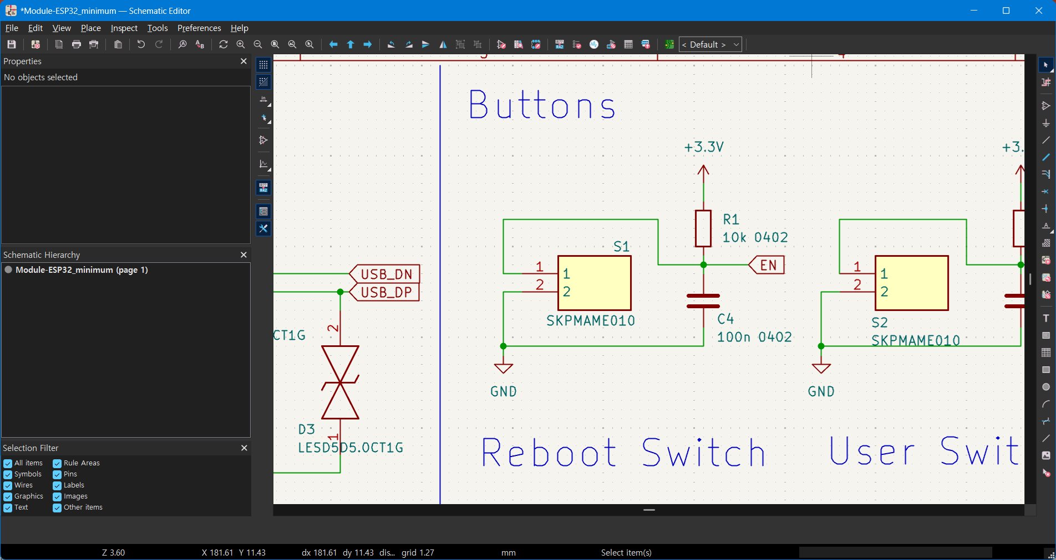
3. Replace the symbol
Delete the existing symbol, then place the newly added symbol in the same location and reconnect the wires.
the new symbol

Slide 5


4. Go to PCB editor
Move to PCB editor by clicking “Switch to PCB editor” icon.

Slide 6
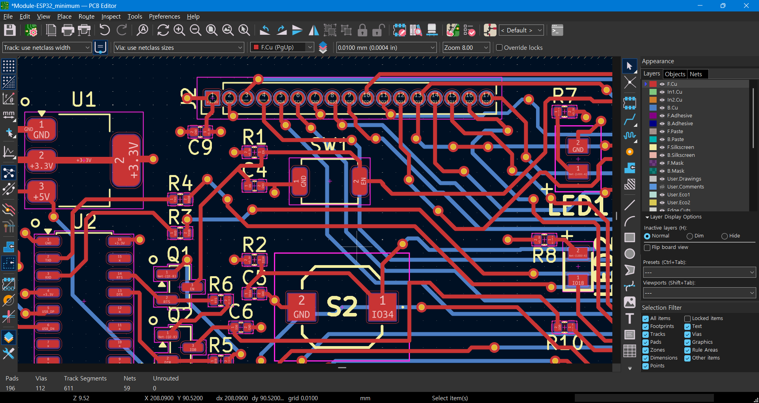

5. Update PCB
Click icon, “Update pcb from the schematic”
대체할 부품 심볼

Slide 7
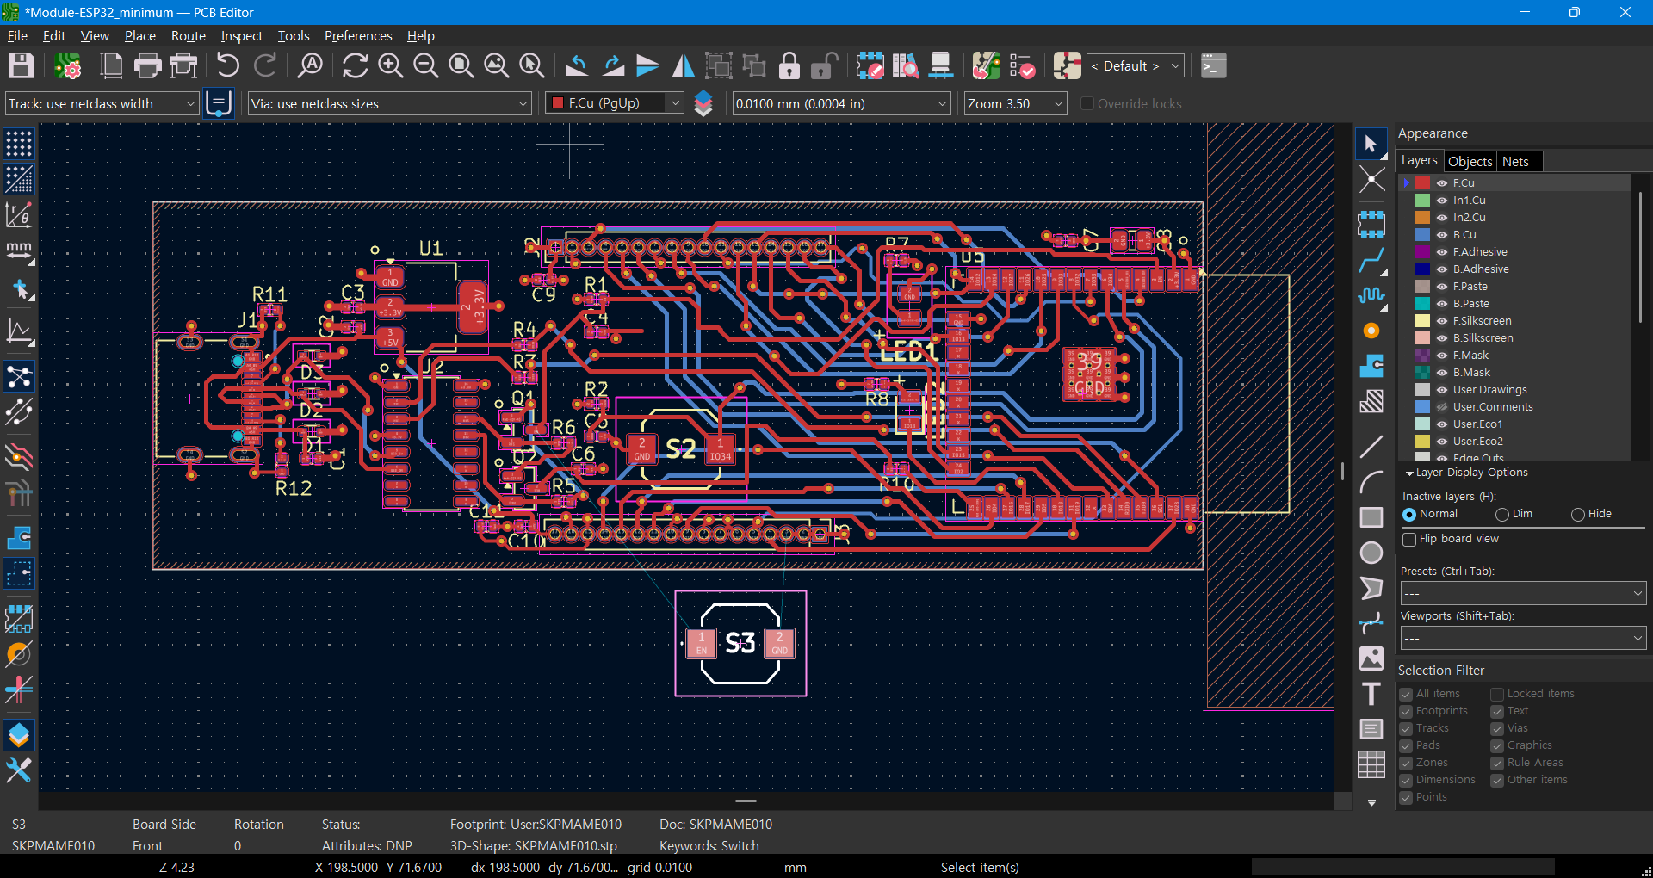
6. Place the new footprint
Place the new footprint by clicking the mouse button

Slide 8
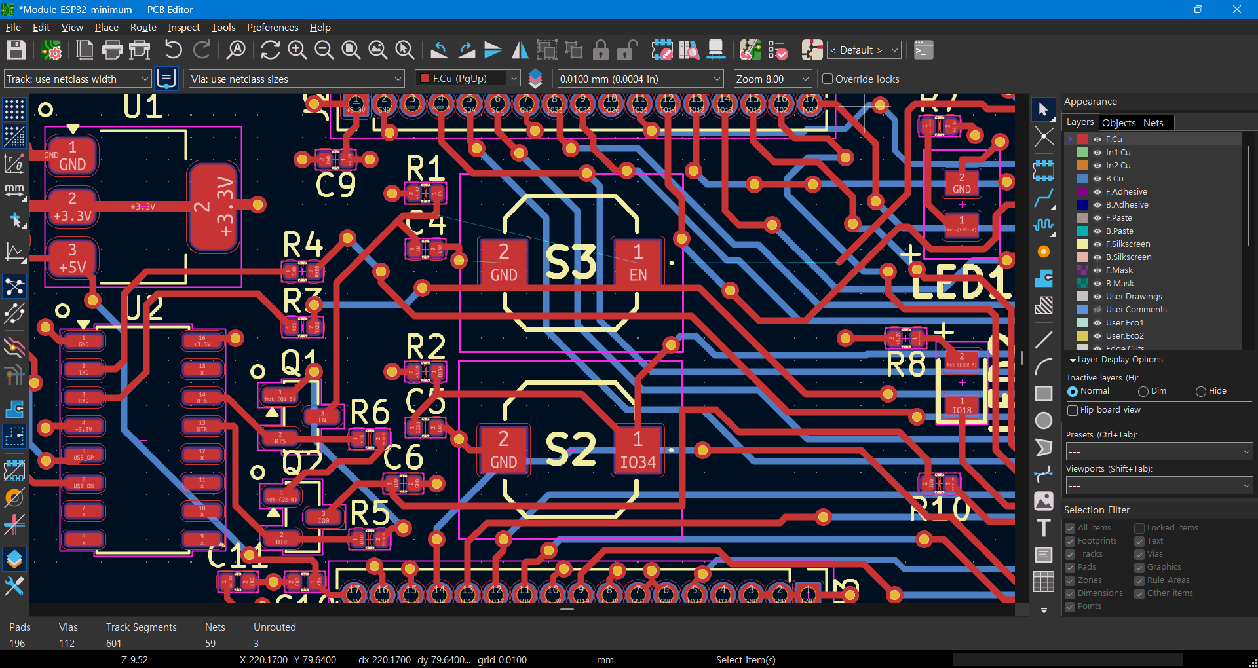
7. Rewire
Reconnect the wires to the new footprint

Slide 9
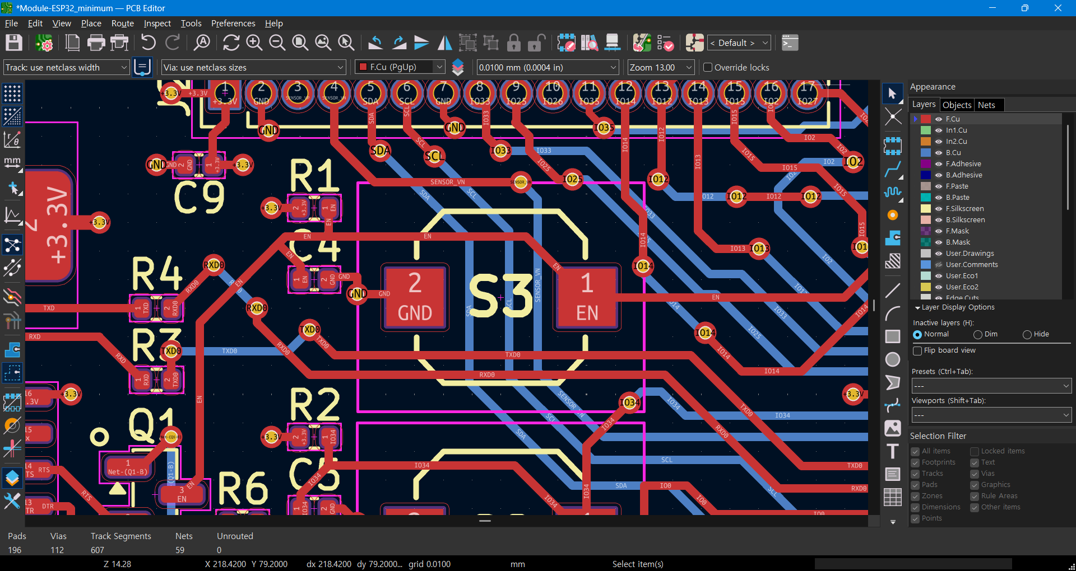
8. Arrange nearby paths
Avoid conflict of existing wires with the new footprint.

