Slide 1
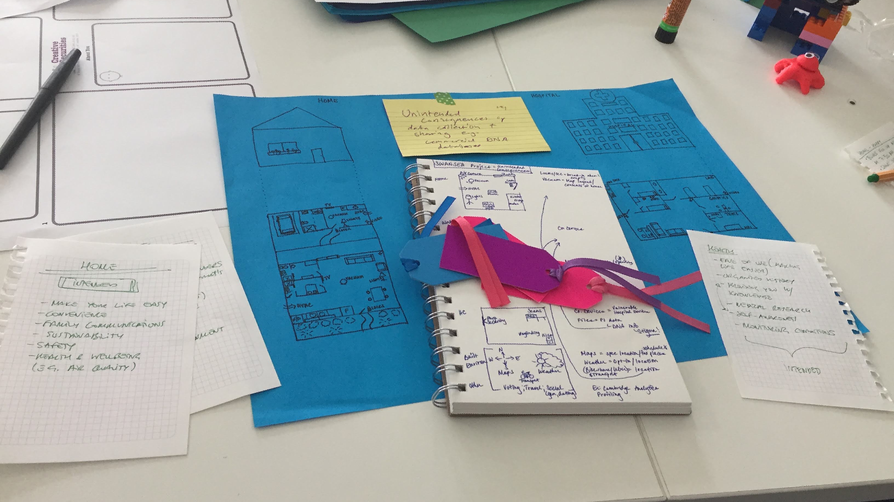

Notes:
PJ: Empty slide here
1

Slide 2
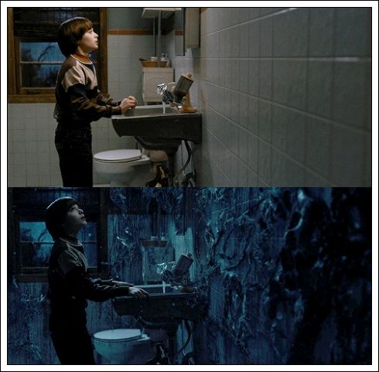


Notes:
PJ: Empty slide here
2

Slide 3
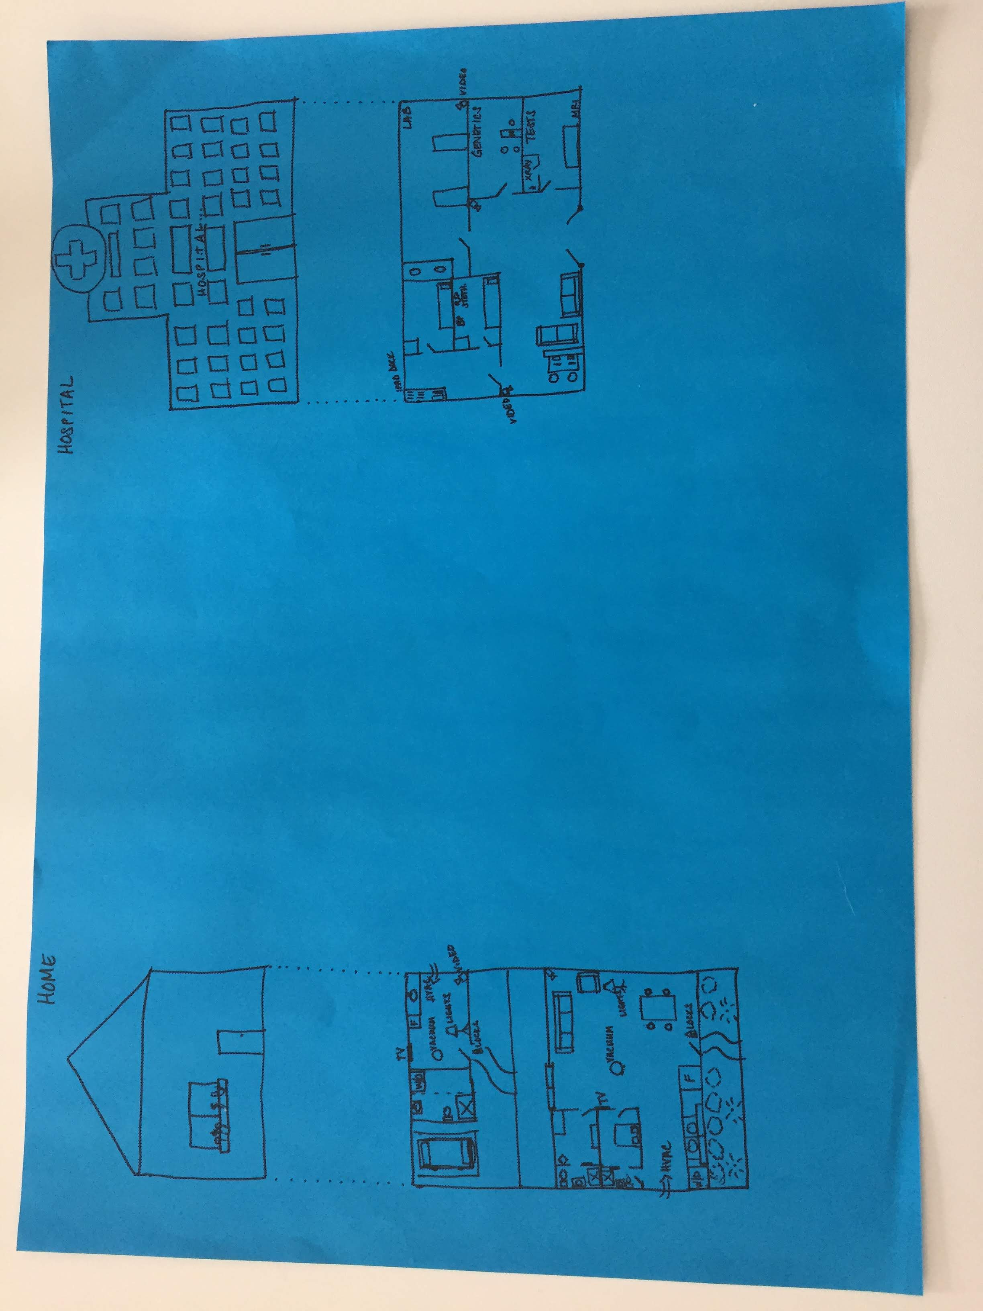
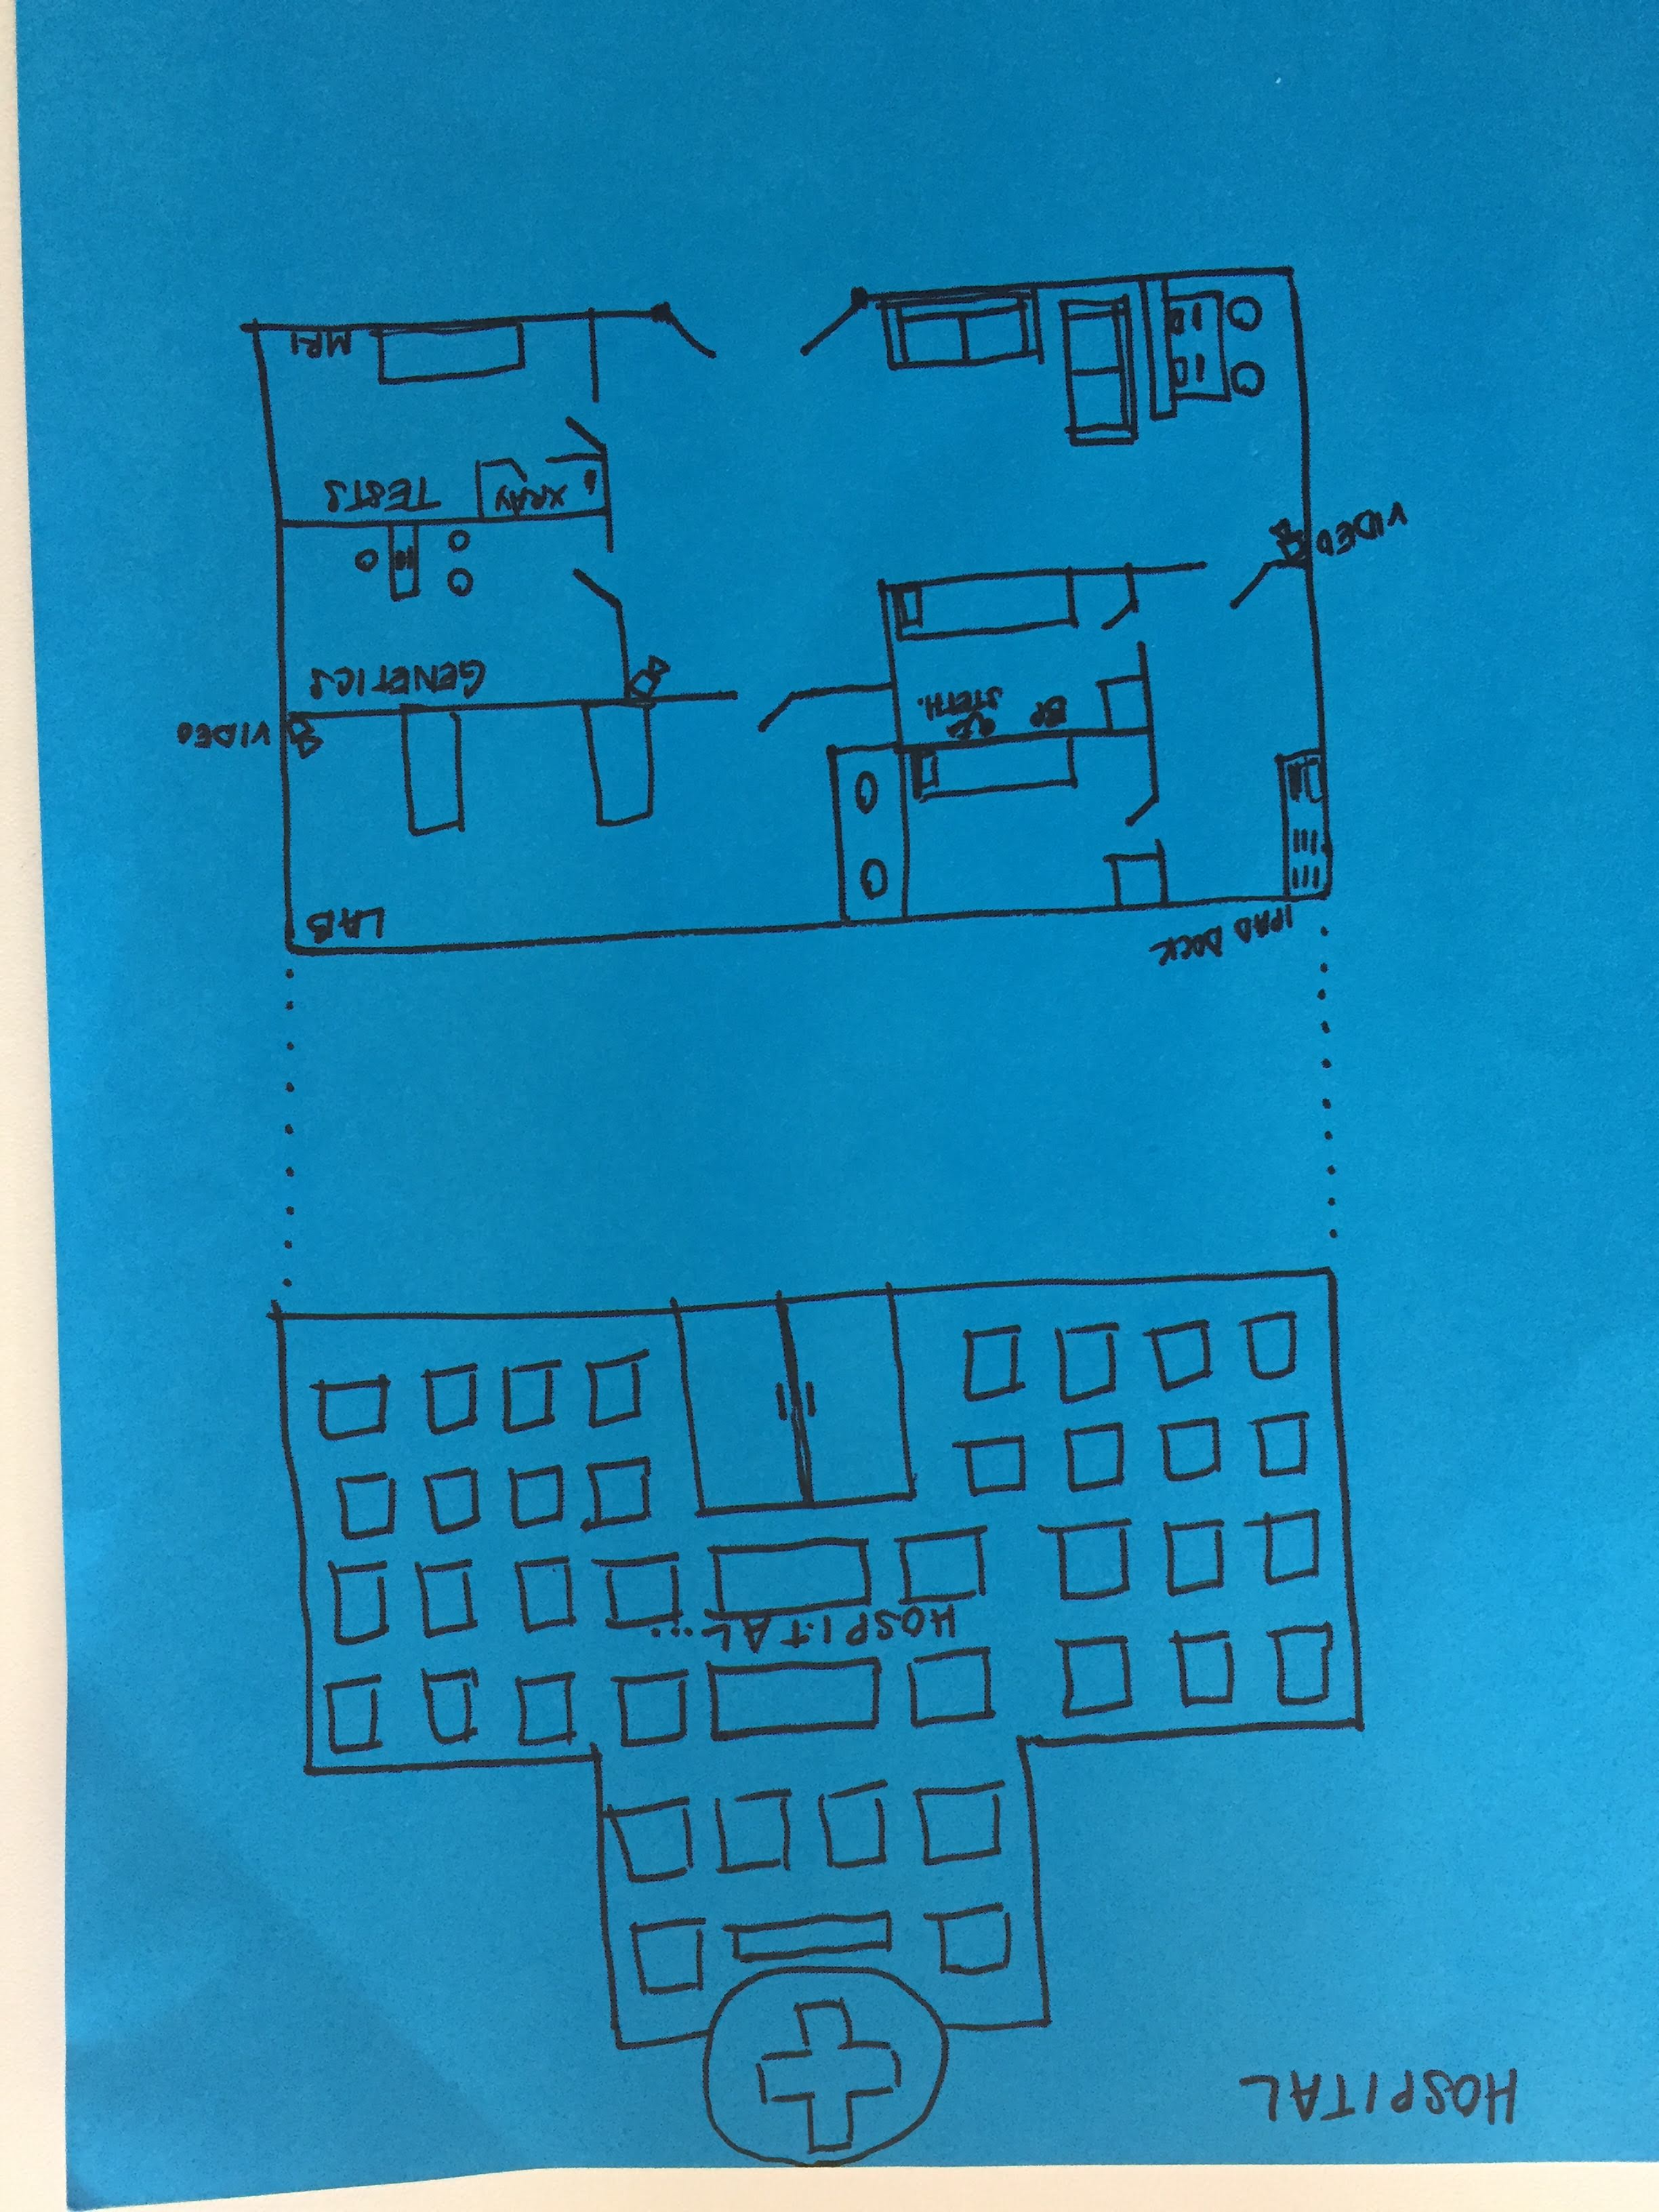
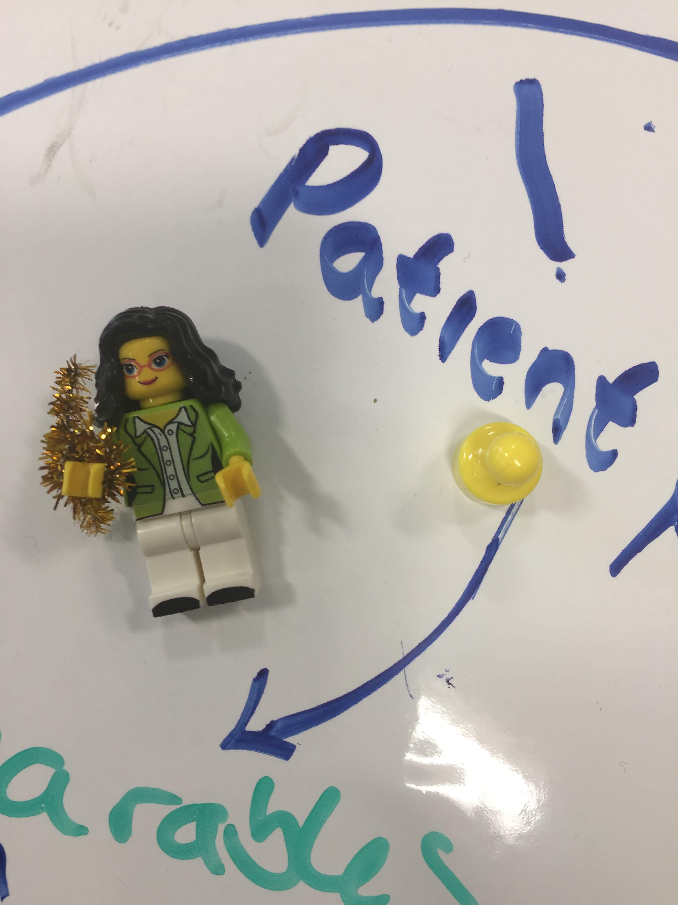
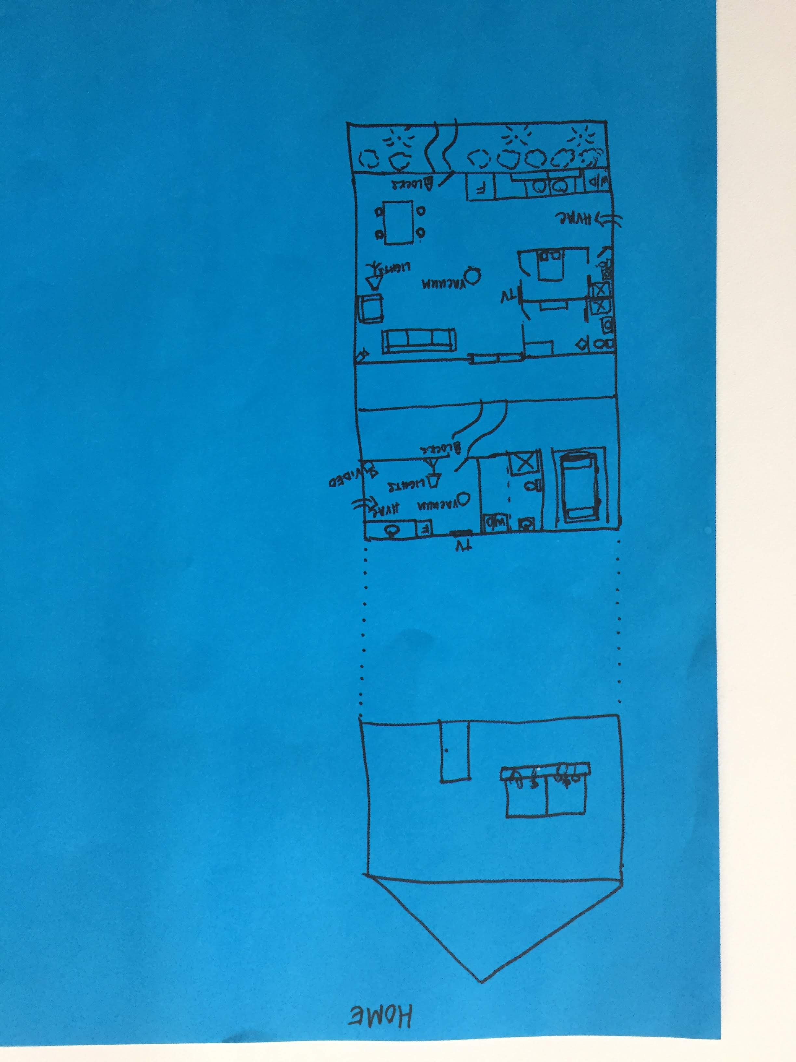
Notes:
PJ: Empty slide here
3

Slide 4
SCENARIO: HOME
INTENDED USES:
Ease of Use / Convenience
Family communication
Sustainable practice
Safety
Health & Well-being
Notes:
PJ: Empty slide here
4

Slide 5
SCENARIO: HOME
INTENDED USES:
Ease of Use / Convenience
Family communication
Sustainable practice
Safety
Health & Well-being
UNINTENDED USES:
Break-in/Burglary
Third parties knowing contents
Surveillance
Hacking
Domestic abuse
Notes:
PJ: Empty slide here
5

Slide 6
SCENARIO: HOSPITAL
INTENDED USES:
Ease of Use / Convenience
Organize history
Provide users with knowledge (e.g., data, context, suggested action)
Medical research
Self-awareness
Monitoring Conditions
Notes:
PJ: Empty slide here
6

Slide 7
SCENARIO: HOSPITAL
INTENDED USES:
Ease of Use / Convenience
Organize history
Provide users with knowledge (e.g., data, context, suggested action)
Medical research
Self-awareness
Monitoring Conditions
UNINTENDED USES:
Risk profiling (e.g., Insurance, Employers, Family Members, Government)
Profiling -> Discrimination
Personal Privacy Loss
Stigma
Anxiety/Stress -> Hypochrondria
Notes:
PJ: Empty slide here
7

Slide 8
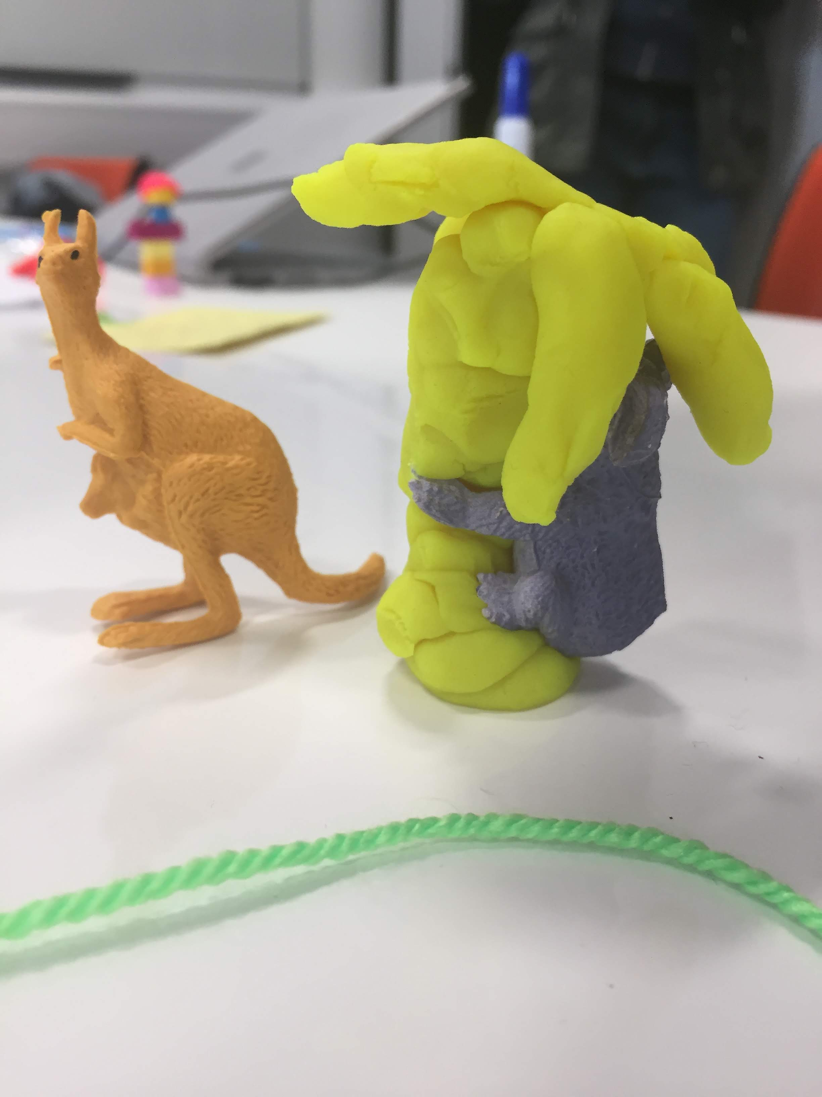
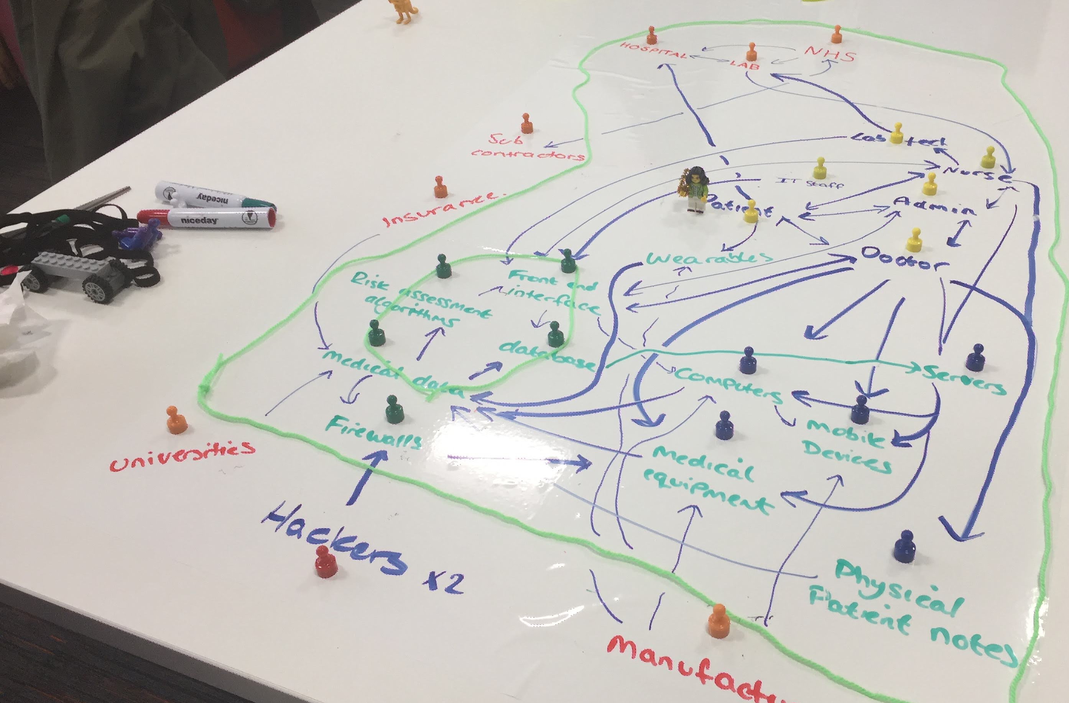
Notes:
PJ: Empty slide here
8

Slide 9
Notes:
PJ: Empty slide here
9

Slide 10
Notes:
PJ: Empty slide here
10

