Slide 1


Leveraging Tech for Healthcare Maintaining Access to medical data Enhance health and wellbeing
Ali Shahaab,
Dr Aikaterini Stamou,
Ayan Chatterjee,
Ben Morrison

Slide 2
Problem Statement
Health data is not portable.
It takes weeks for the data to be ported from one GP to another.
Cross border portability is nearly impossible.
Relying on individual carrying their medical records, mostly hard copies.
Can we have global healthcare data portability system?
Would access to complete medical history aid in developing more fairer AI/DSS systems?
Notes:
Decision support system. We need a system that is neutral, no owner and can be trusted.

Slide 3
What we did…
We constructed stories of human agents and examined the need of such system.
Did a data mapping exercise to understand how different datapoints and agents interact with each other.
Discussed the socio-political, ethical and technical challenges around having such a system.

Slide 4
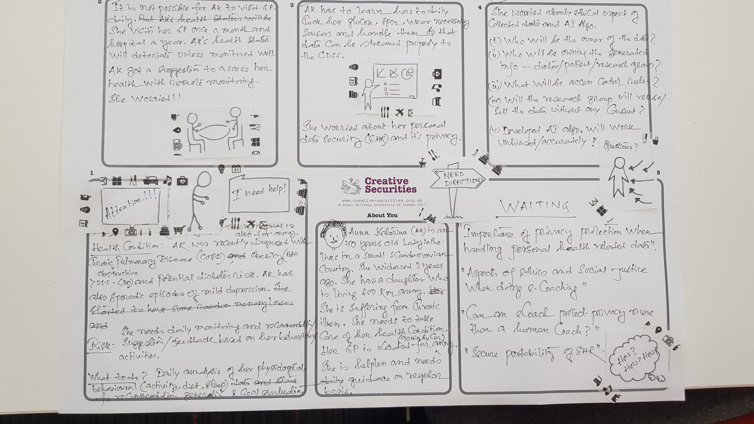
Meet Anna…

Slide 5
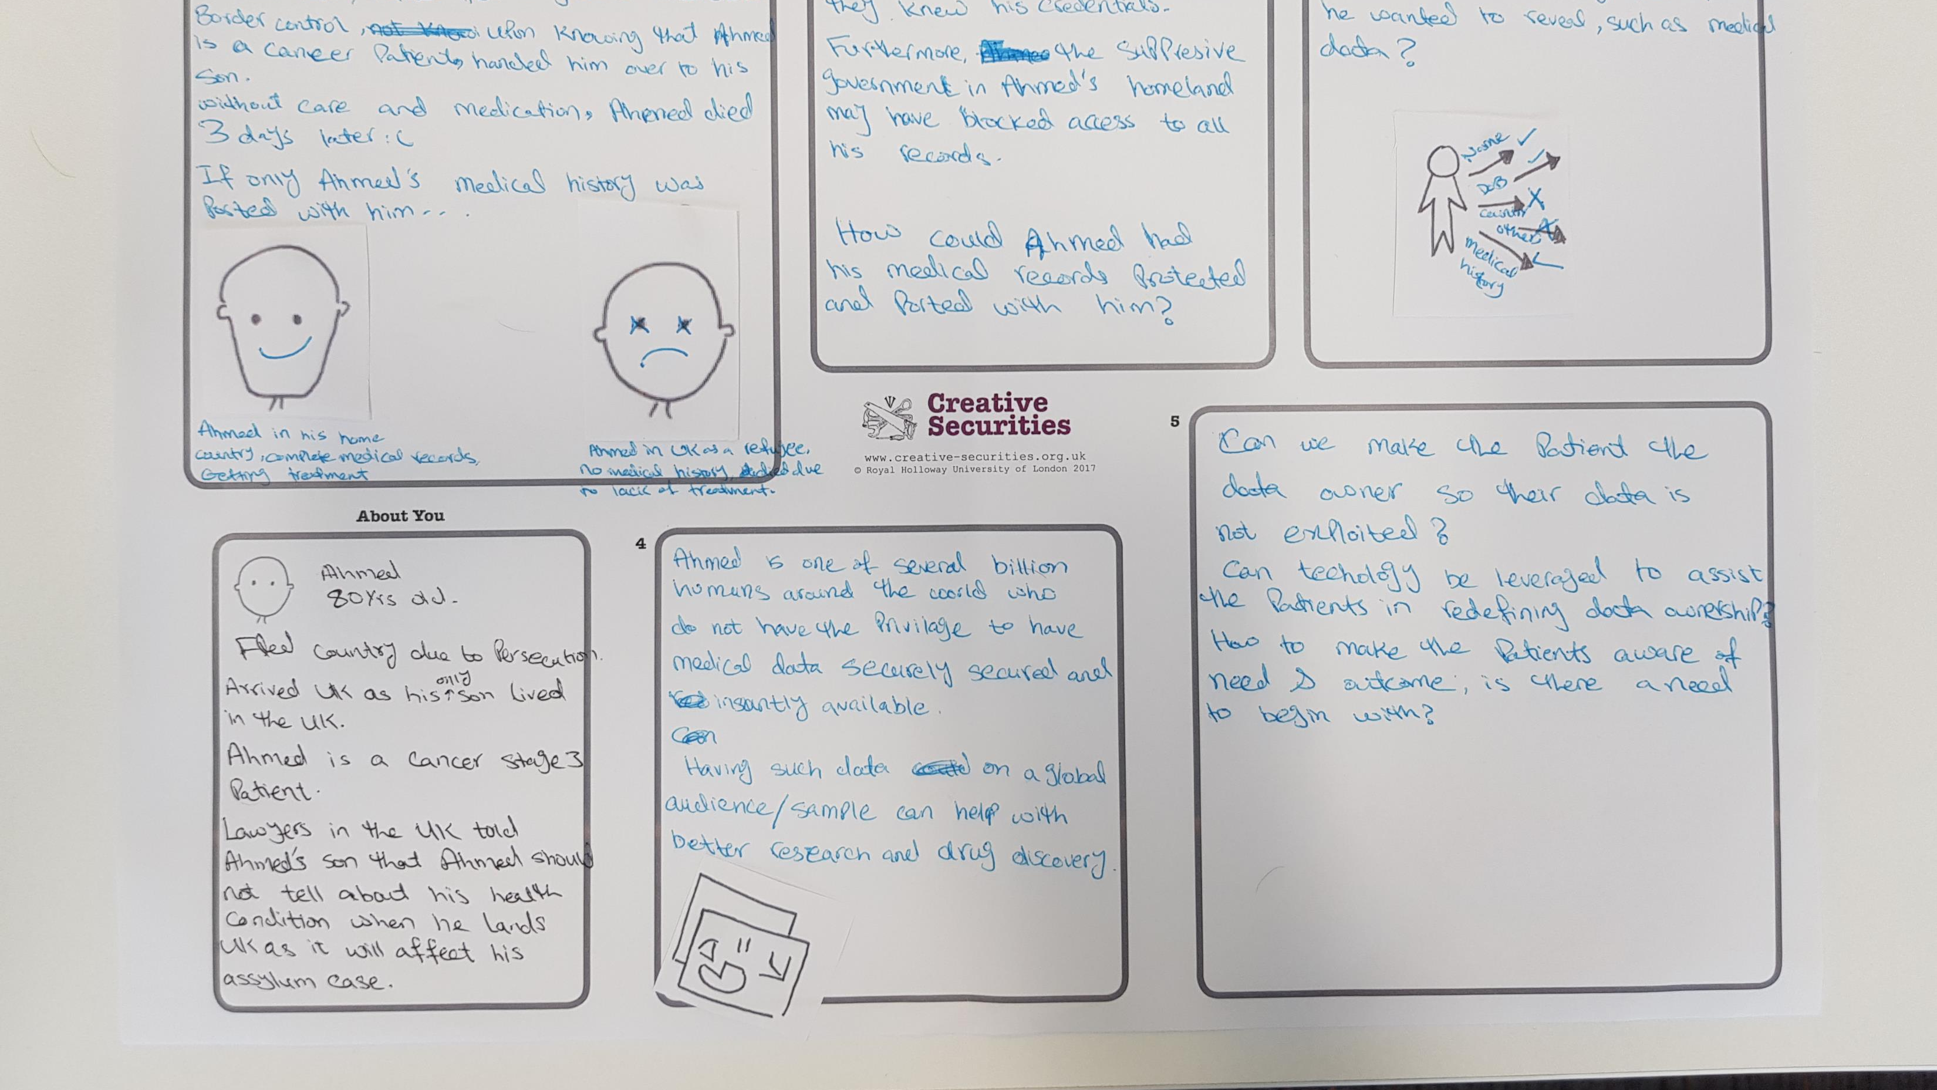
Meet Ahmed…

Slide 6
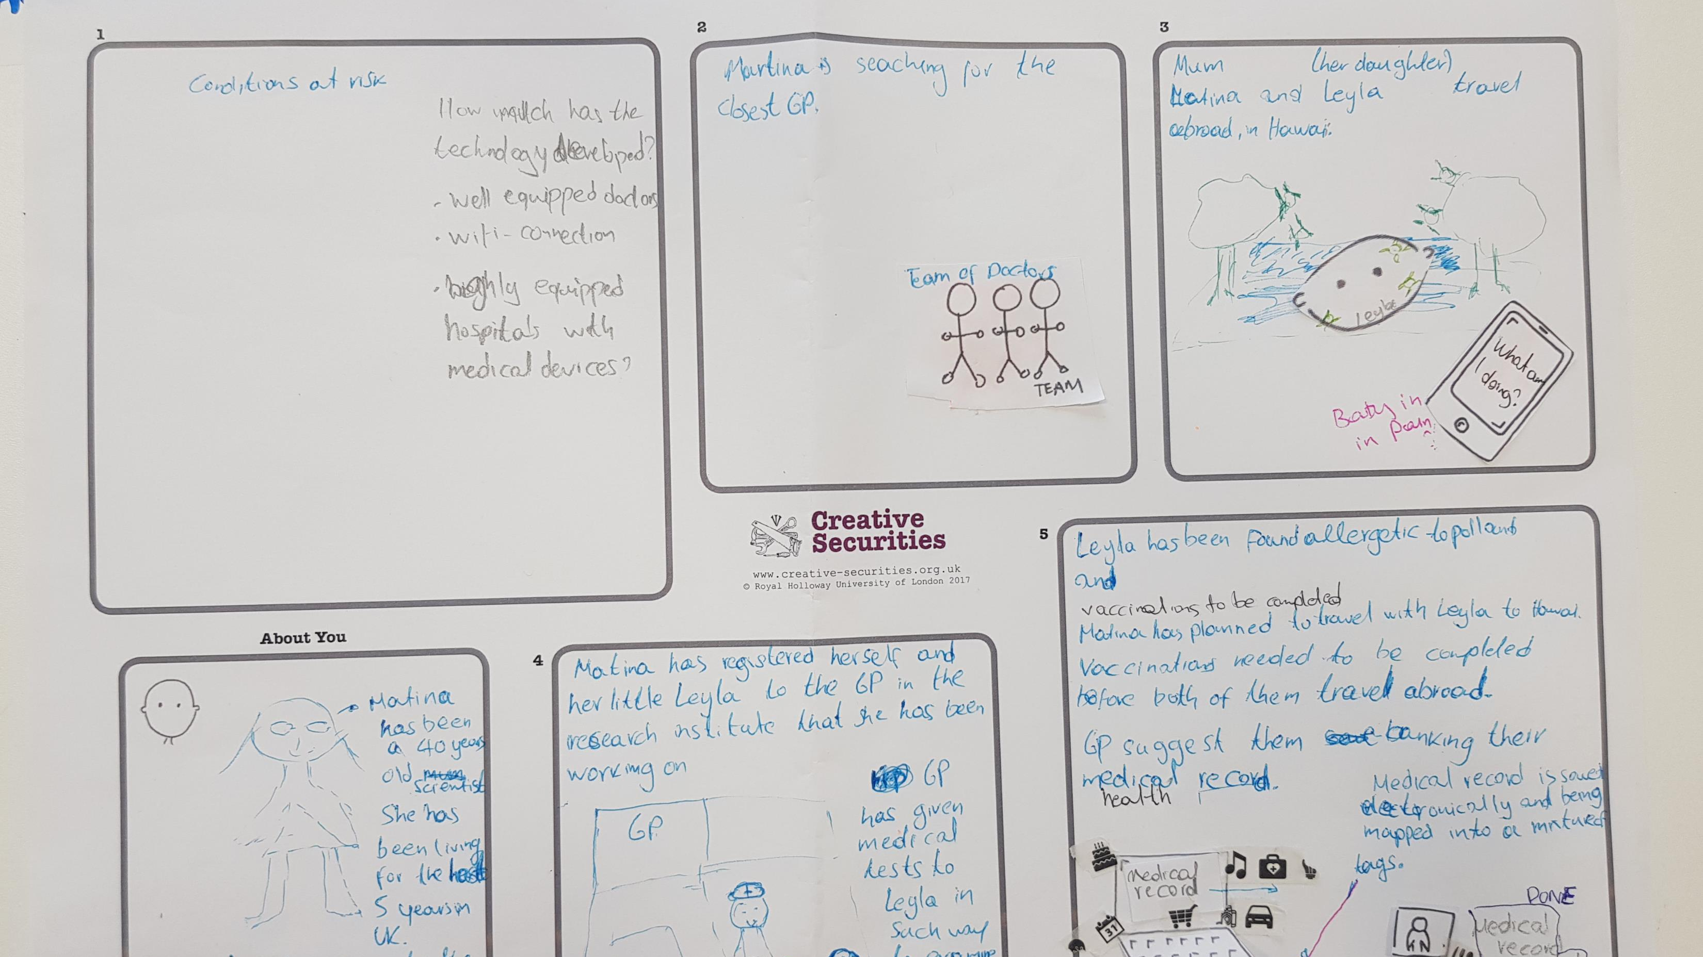
Matina & Leyla…

Slide 7
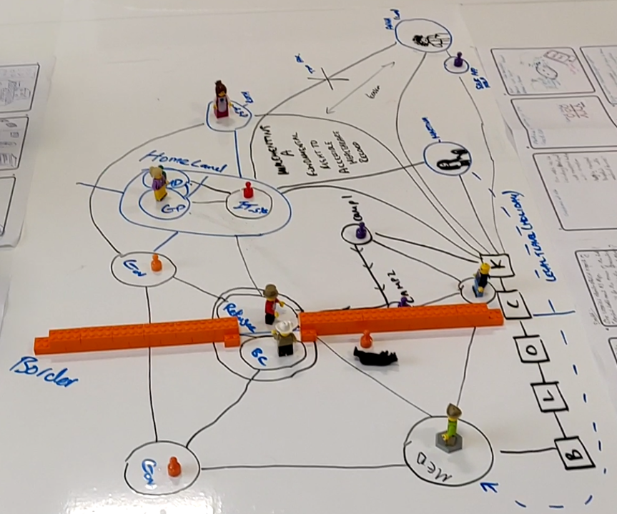
Collaborative engagement exercise
How different agents interact with each other.
Each subject has its own requirements & constraints.

Slide 8
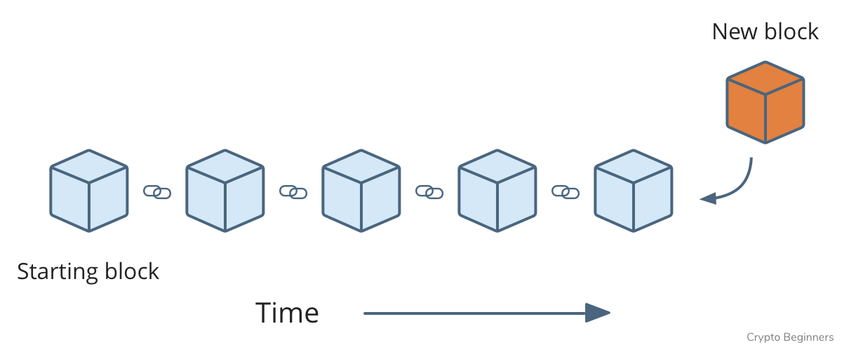
What is Block chain?
Immutable way of storing Information.
Highly resilient to breaches and hacks.
Very temper evident.
Distributed
Smart contracts

Slide 9
Distributed
Replicated
No single point of failure
Very difficult to hack

Slide 10
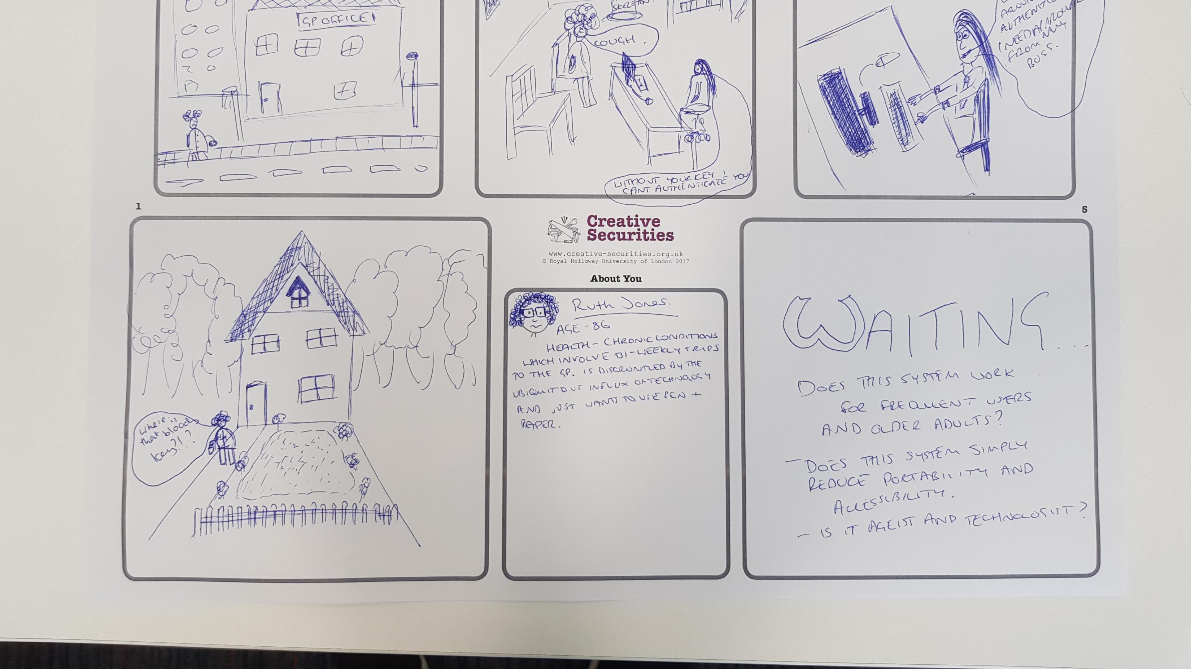
Ruth Jones

Slide 11
Challenges
Accessibility
Control/ownership of data and results
Who to trust?
How to involve end users?

Slide 12
