Slide 1
AWS and Docker

Slide 2
AWS Setup
Refer to Setup Guide

Slide 3
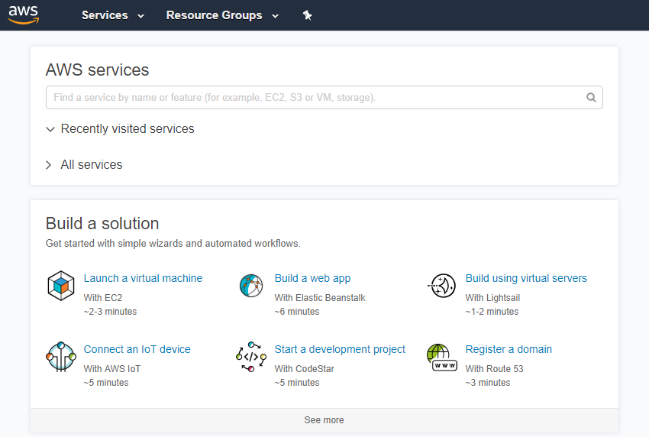
Login to AWS & Navigate to Home Page

Slide 4
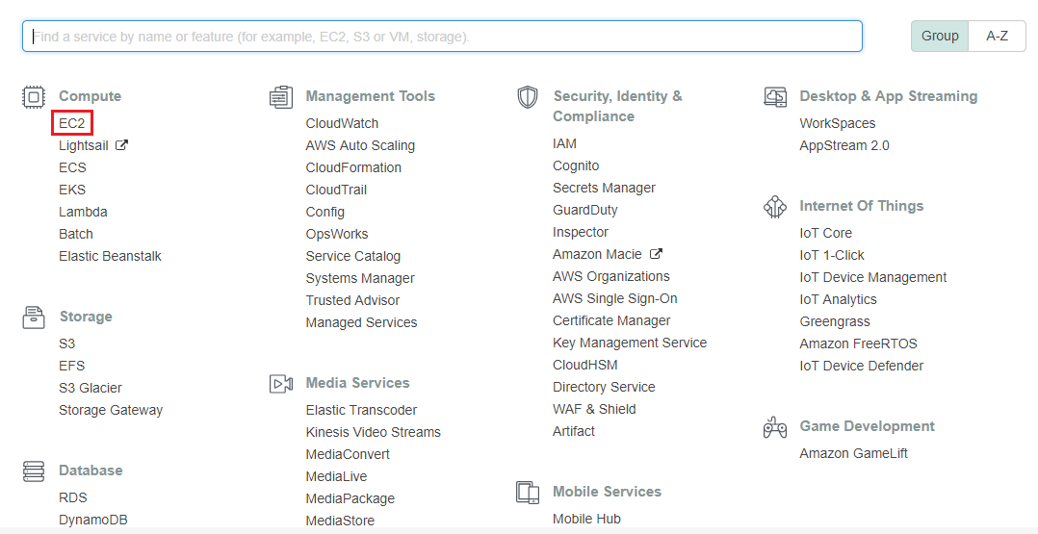
Invoking EC2

Slide 5
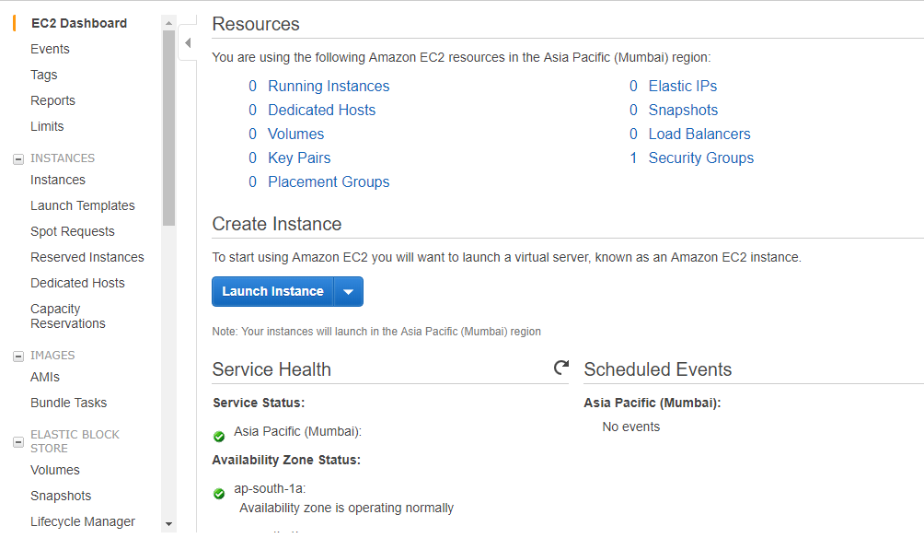
EC2 Dashboard
Click Launch Instance

Slide 6
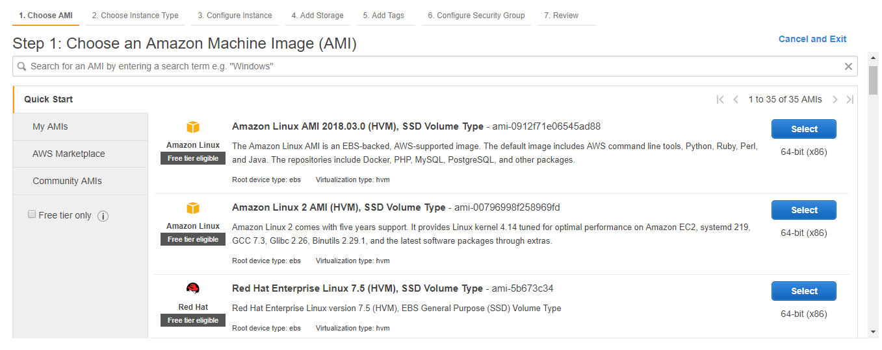
Choosing an AMI

Slide 7
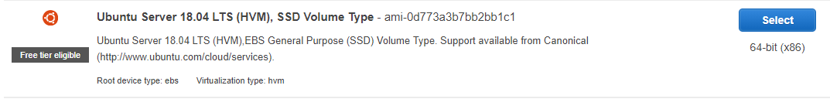
Choosing Ubuntu Image Do not use any other image
Click Select

Slide 8
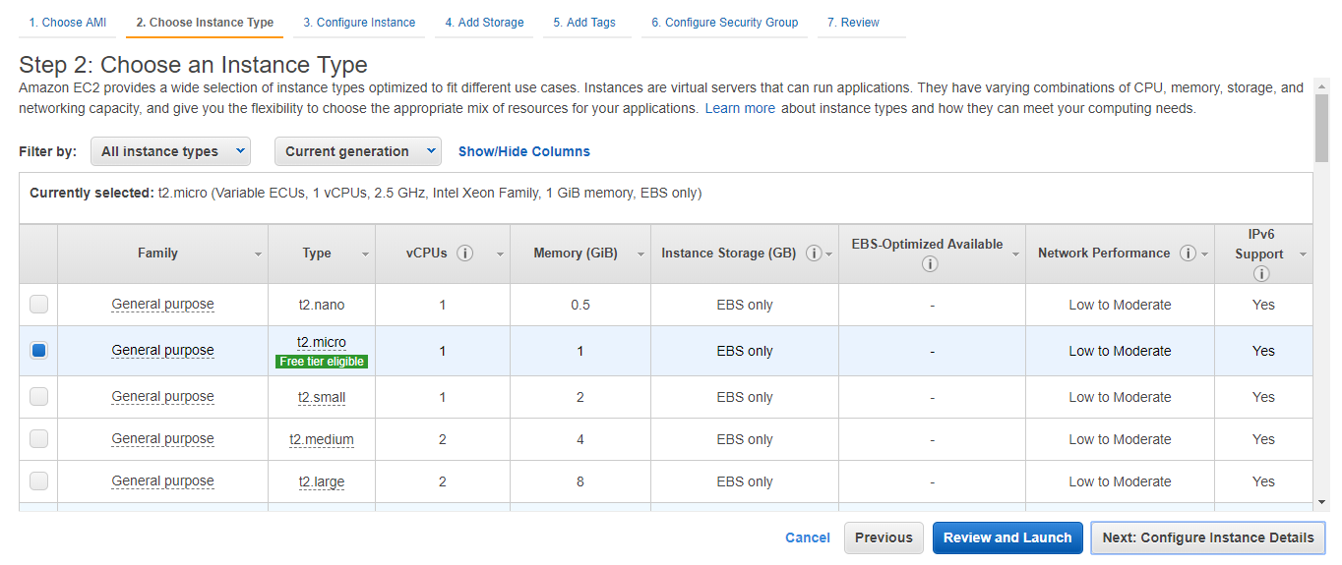
Choosing Instance Type(Free Tier)
Click Next: Configure Instance Details

Slide 9
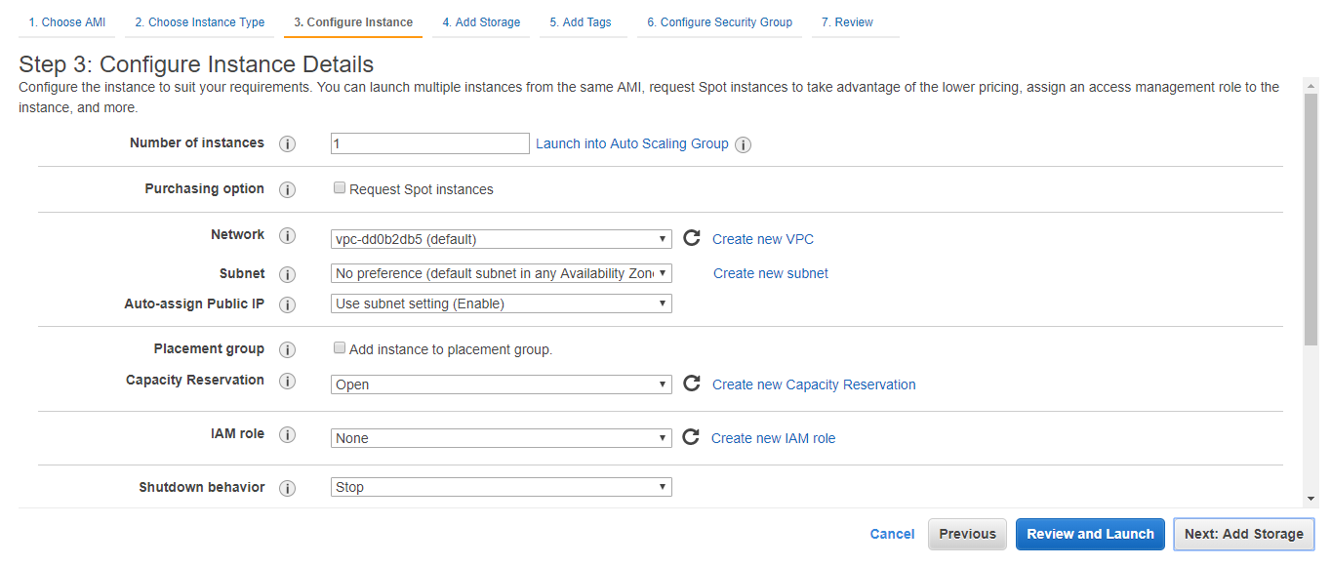
Configuring Instance Details(Keep as default)
Click Next: Add Storage

Slide 10
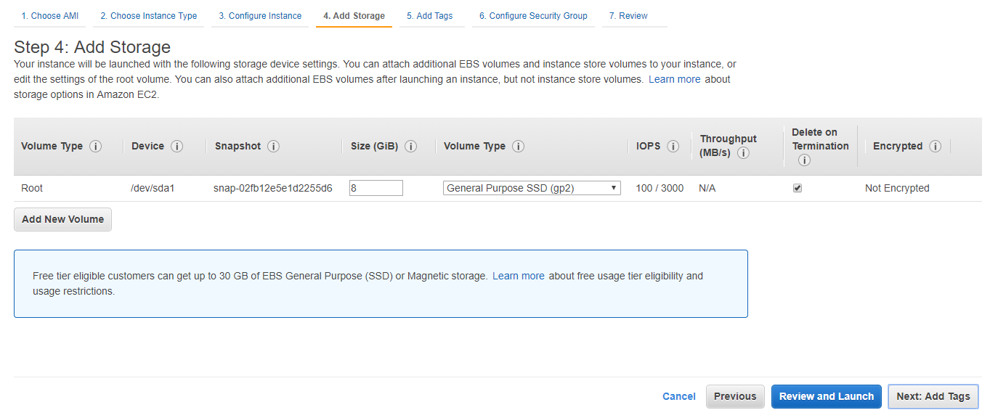
Adding Storage(Keep as default)
Click Next: Add Tags

Slide 11
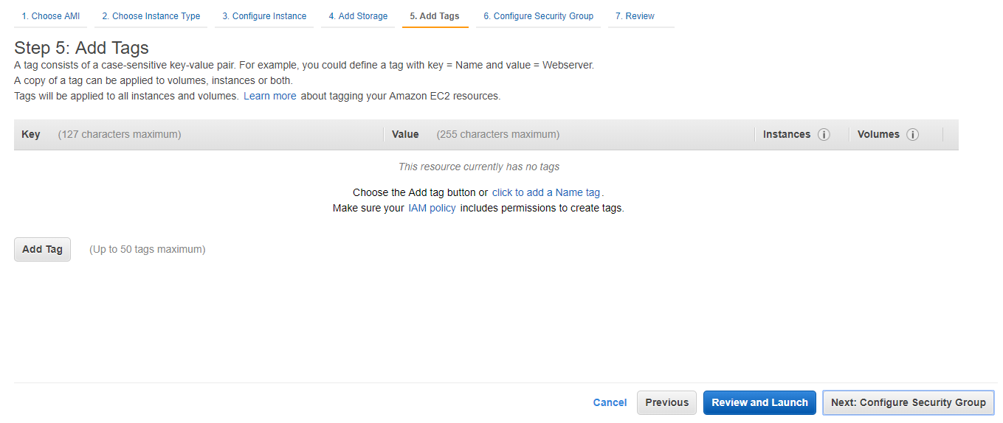
Adding Tags(Keep as default)
Click Next: Configure Security Group

Slide 12
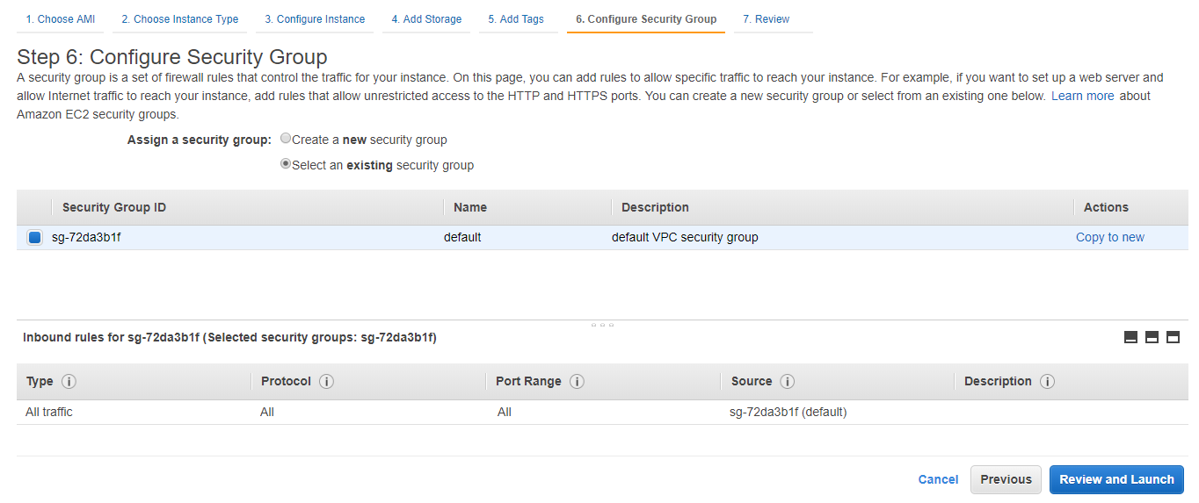
Configuring Security Group(Keep as default)
Click Review and Launch

Slide 13
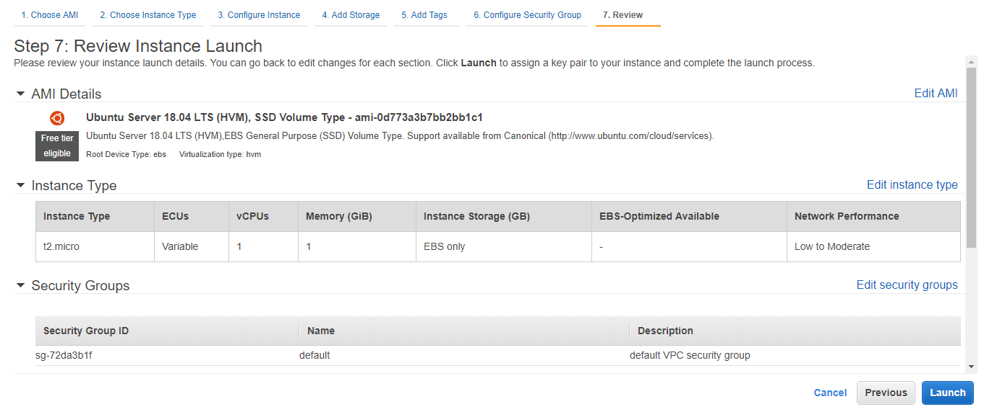
Reviewing
Click Launch

Slide 14
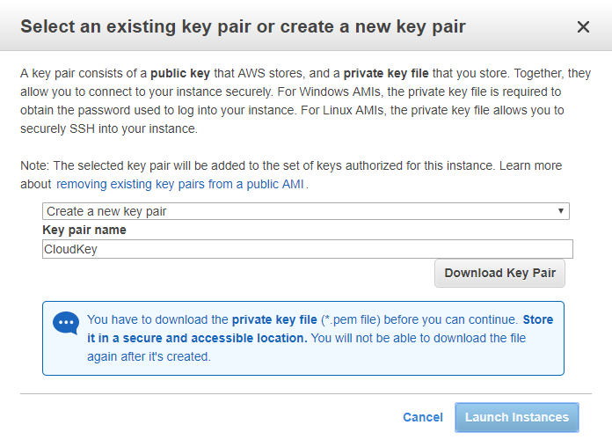
Key-Pair Creation
Select Create a new key pair
Enter key pair name(e.g. CloudKey)
Click Download Key Pair
Key (.pem) will be downloaded

Slide 15
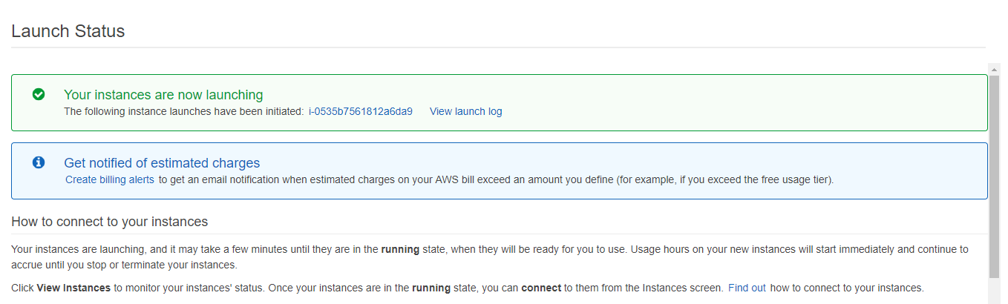
Launch Status
Click instance id(e.g. i-0535b7…)

Slide 16
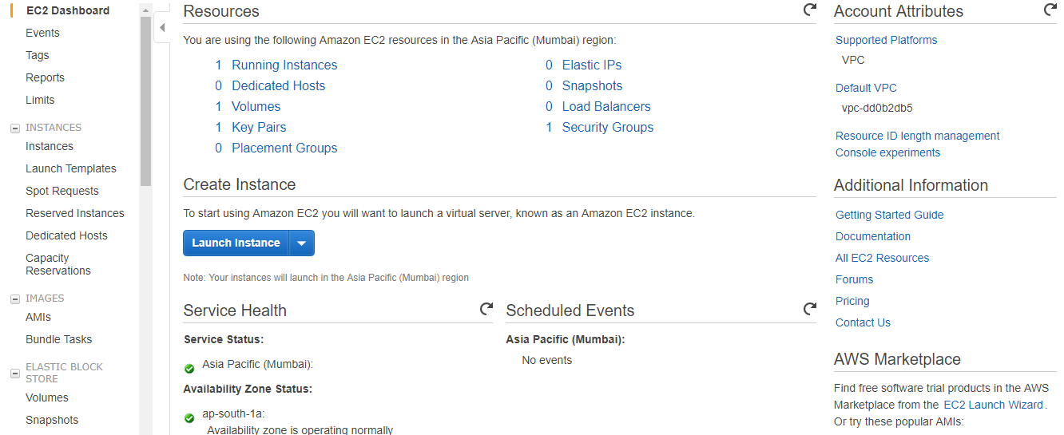
EC2 Dashboard
Click Running Instances link

Slide 17
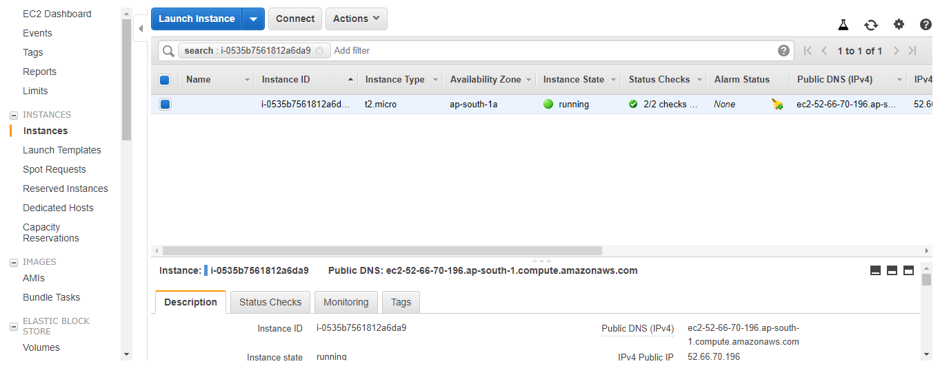
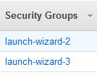
Running Instance
Drag the page from left to right, you will find Security Groups section
Click Security Groups link(e.g. launch-wizard-2)
You will navigate to Inbound section(next slide)

Slide 18
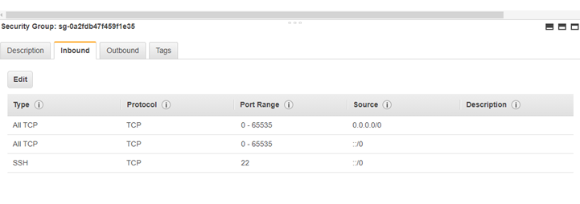
Create an In-bound rule on AWS
Click Edit
Add 2 rules(All TCP)
Note: SSH rule will be shown in the list default
Save

Slide 19
Running Instance
Come back to running instance page
Click Connect

Slide 20
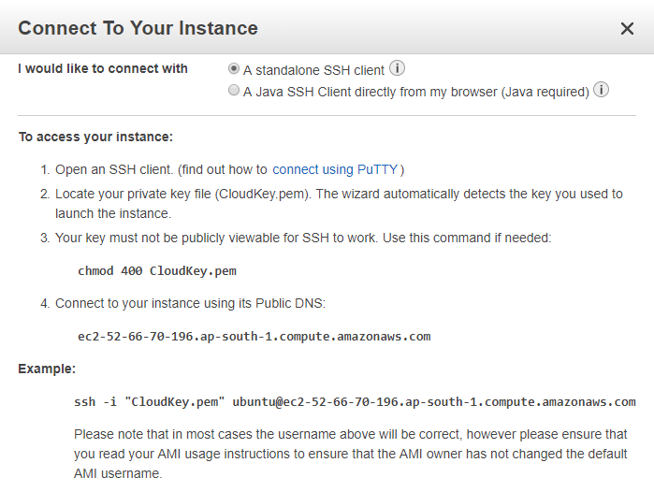
Connecting To Instance
We will use PuTTy to access AWS instance

Slide 21
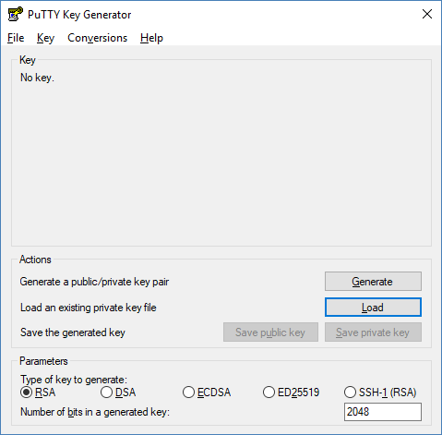
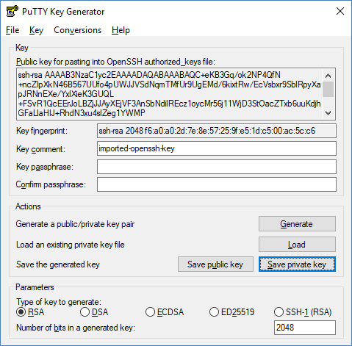
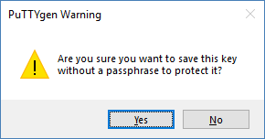
Using Puttygen to Import Key
Launch puttygen.exe
Click Load
Browse key(.pem) from machine
Click Save private key
Click Yes on pop-up
Browse the location
(e.g. C:\DO-United\Tools\) where you want to save new key(.ppk) & Save it
Close Putty Key Generator window

Slide 22
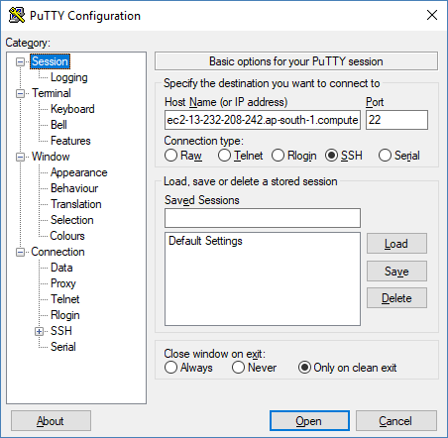
Using Putty to Connect
Launch putty.exe
Go to Session
Enter AWS Host Name or IP address(e.g. Ec2-13-233…)
Note: AWS Host name / IP address will be available on your AWS web account

Slide 23
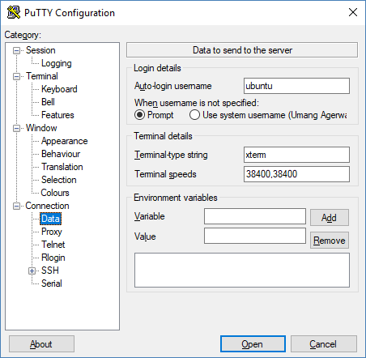
User → ubuntu/ec2-user
Go to Connection
Go to Data
Enter username(e.g. ubuntu/ec2-user) in Auto-login username section

Slide 24
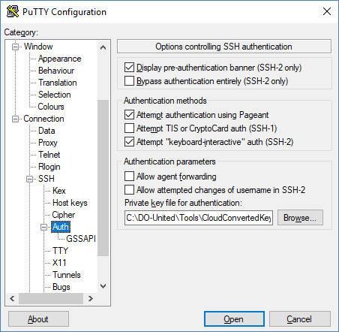
Selecting the Private Key
Go to SSH
Go to Auth
Browse key(.ppk) from machine
Click Open

Slide 25
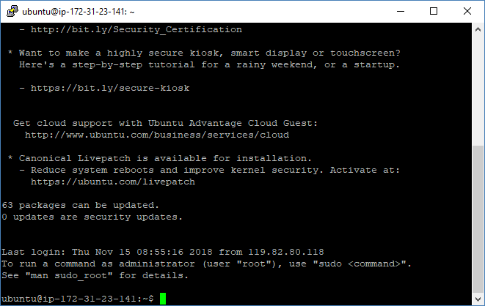
Connected to Putty

Slide 26
Install Docker on AWS server
If you create an Ubuntu instance on AWS, run following commands in terminal
sudo apt-get update
sudo apt-get install docker.io
docker --version

Slide 27
Jenkins on AWS

Slide 28
Run the container on AWS server Manually
Run following commands:
sudo docker images
sudo docker container ls -a
sudo docker pull <<image name>>
sudo docker run -it -p 8080:8080 <image id> /bin/bash
OR
docker run --rm -u root -p 8080:8080 -v jenkins-data:/var/jenkins_home -v /var/run/docker.sock:/var/run/docker.sock -v $HOME:/home <<image name>>

Slide 29
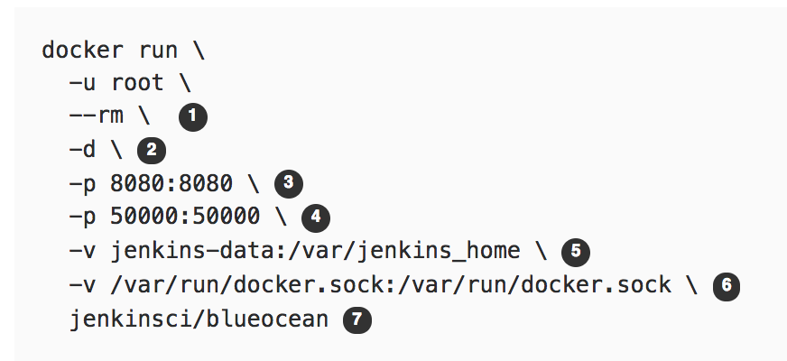

Understanding the Command
(O) Automatically removes the Docker container when it is shut down
(O) Runs the jenkinsci/blueocean container in the background (i.e. "detached" mode) and outputs the container ID
Maps port 8080 on the host machine to port 8080 of the jenkinsci/blueocean container
Let’s not worry about it right now
( O but highly recommended) Maps the /var/jenkins_home directory in the container to the Docker volume with the name jenkins-data (automatically created if non-existen). Makes Jenkins state to persist each time you restart Jenkins
Allows blueocean container to communicate with the Docker daemon when we use “agent” command in pipeline code
Maps the $HOME directory on the host machine to the /home directory in the container. Windows has slightly different syntax

Slide 30
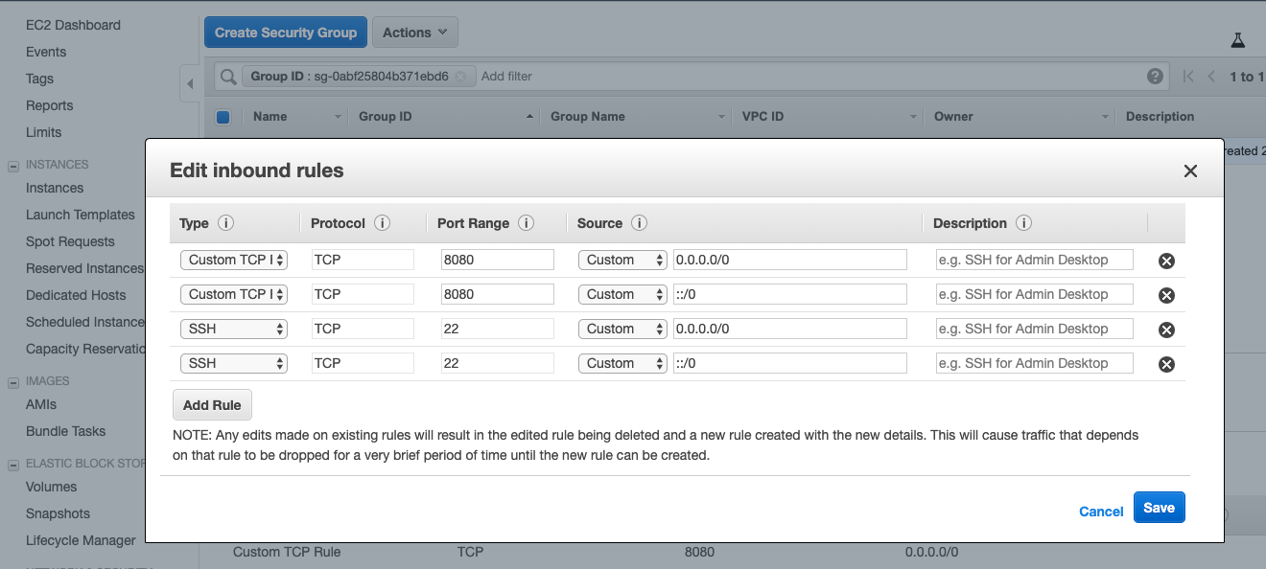
Create an In-bound rule on AWS

Slide 31
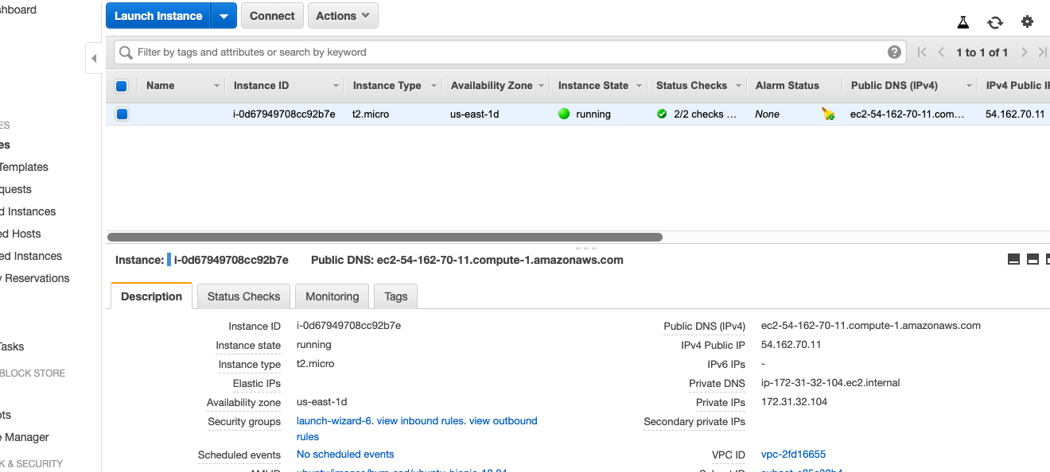
Capture the IP Address of the AWS Instance

Slide 32
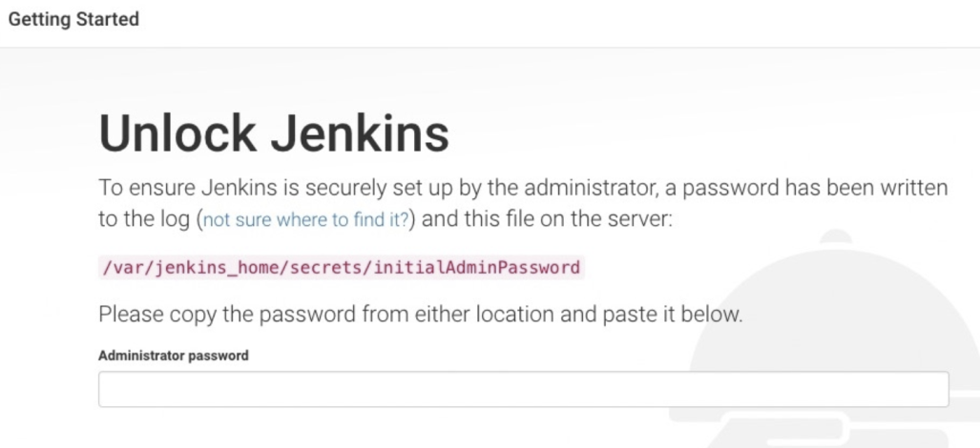
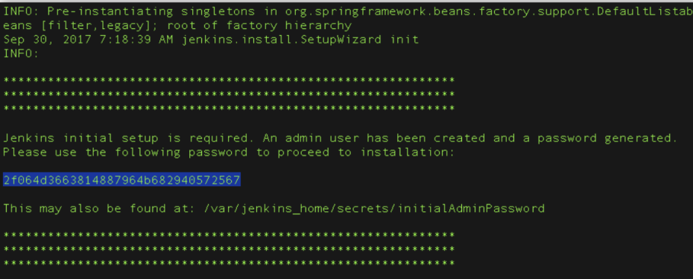
Unlocking Jenkis
After the 2 sets of asterisks appear in the terminal/command prompt window, browse to http://<<IP Address>>:8080 and wait until the Unlock Jenkins page appears
This is the same IP which we captured in the previous slide
From the terminal/command prompt window again, copy the automatically-generated alphanumeric password (between the 2 sets of asterisks)
On Customize Jenkins page click Install suggested plugins
IF YOU ARE RUNNING ALL THIS SECOND TIME then password will not be available on the screen. See next slide for recovering the password

Slide 33
Getting Jenkins Password
docker container ls
docker exec -it <container id from prv cmd> /bin/bash
cat /var/jenkins_home/secrets/initialAdminPassword
Note – Use sudo

Slide 34
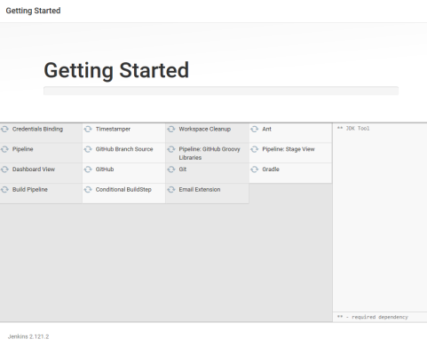
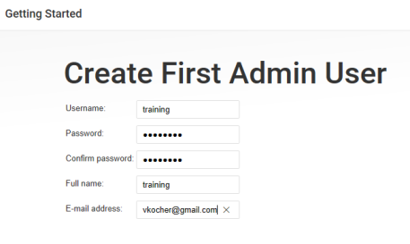
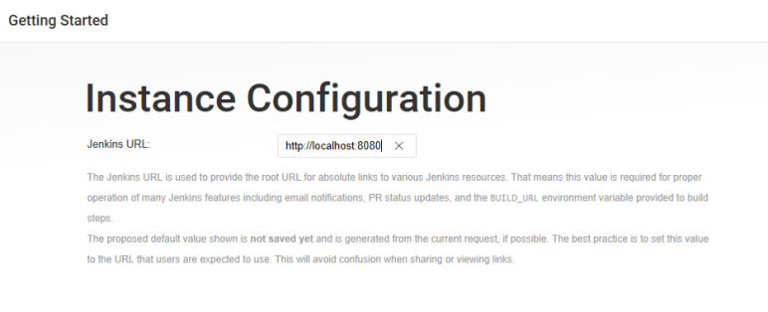
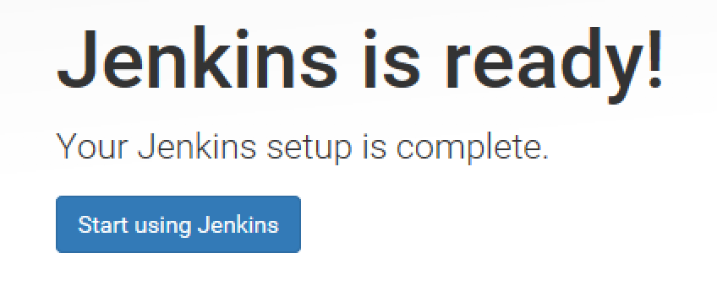
Getting Started
When the Create First Admin User page appears, specify your details in the respective fields and click Save and Finish.
When the Jenkins is ready page appears, click Start using Jenkins.
Please note
This page may indicate Jenkins is almost ready! instead and if so, click Restart.
If the page doesn’t automatically refresh after a minute, use your web browser to refresh the page manually.
If required, log in to Jenkins with the credentials of the user you just created and you’re ready to start using Jenkins!
you can stop the Jenkins/Blue Ocean Docker container by typing Ctrl-C

Slide 35
Getting Sample Code
Open the browser and go to https://github.com/login
Login to your account
Launch URL https://github.com/umangsaltuniv/simple-java-maven-selenium-app
Click Fork at right top section
“Simple Java Maven app” repository will be added on your GitHub account
Note: Simple Java Maven project has sample app & some unit and selenium tests that will run automatically once we create a pipeline project

Slide 36
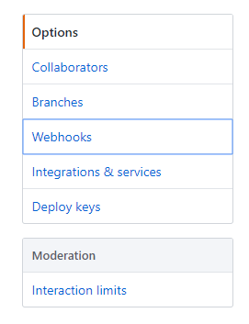
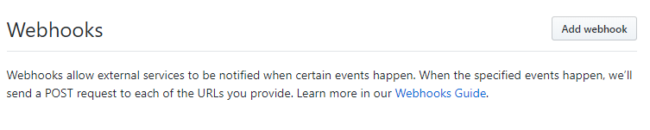
Setup Webhook on GitHub
Go to GitHub Web
Go to “simple-java-maven-app” repository
Navigate to the "Settings" tab
Select the "Webhooks" option on the left menu
Click "Add webhook"

Slide 37
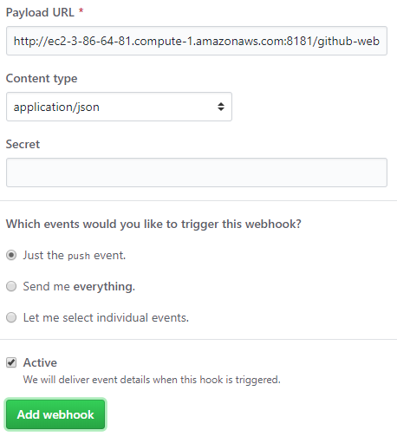
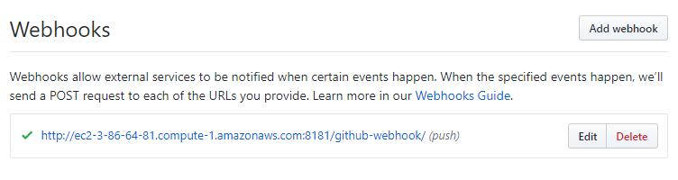
GitHub Settings
For "Payload URL":
Use the address for the aws server instance (e.g. http://ec2-3-86-64-81.compute-1.amazonaws.com:8080/)
Add /github-webhook/ to the end of it
example: http://ec2-3-86-64-81.compute-1.amazonaws.com:8080/github-webhook/
Select "application/json" as the encoding type
Leave "Secret" blank (unless a secret has been created and configured in the Jenkins "Configure System -> GitHub plugin" section)
Select “Just the push event"
Make sure "Active" is checked
Click "Add Webhook"

Slide 38
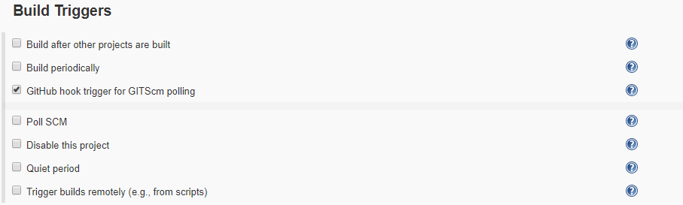
Create Pipeline Project
Go to Jenkins Dashboard
Click “New Item” at top left section
Enter any meaningful item name(e.g. simple-java-maven-app) > Select Pipeline > Click OK
Select ”GitHub hook trigger for GITScm polling” checkbox under Build Triggers section
Go to Pipeline section
Choose the ”Pipeline script from SCM” option from the ”Definition” field
Choose the ”Git” option from the ”SCM” field
Enter your Repository URL(e.g. https://github.com/<Your username>/simple-java-maven-app )
Enter “Jenkinsfile.txt” under “Script Path” section
Click Apply
Click Save

Slide 39
Run Pipeline Project
Make some change in code on GitHub
Pipeline project will be triggered automatically on Jenkins, once you make any changes on GitHub

Slide 40
Multiple Docker Containers

Slide 41
Automation:
In the example above, you deployed just a single Docker container to a single EC2 Instance. What happens if you have many different Docker containers (e.g., one container for a front-end web app, another for a back-end, another for a database, and so on) and you have to deploy multiple copies of each of those containers across many EC2 Instances. You wouldn’t want to repeat all of these manual steps over and over again, so you need a way to automate deployment
Integration:
Running a Docker container is only one piece of the puzzle. You also need to integrate it with all the other parts of your infrastructure, such as routing traffic to your containers (load balancing) and ensuring the your containers continue running (monitoring, alerting, crash recovery).
One way to solve both of these problems is to use the EC2 Container Service(ECS).

Slide 42
Deploying Docker containers on ECS
The idea behind ECS is that you create an ECS Cluster—which is a group of EC2 Instances managed by ECS—define what Docker containers you want to run, and ECS will take care of deploying those containers across the Cluster, rolling out new versions, and integrating with other AWS infrastructure. ECS can make it easier to manage multiple Docker containers running on multiple EC2 Instances—if you can figure out all the steps required to use it. These steps are:
Create an ECS Cluster
Create an ELB
Create IAM Roles
Create an Auto Scaling Group
Run Docker containers in your ECS Cluster
Update Docker containers in your ECS Cluster

Slide 43
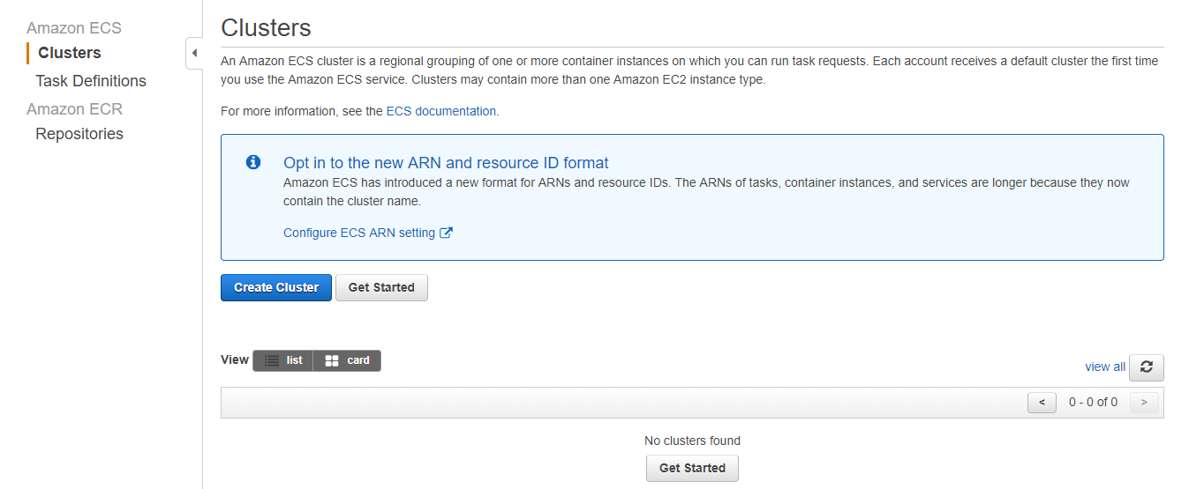
Creating a ECS Cluster
Notes:
Open up your AWS Console and click on the EC2 Container Service link > Click Clusters > This takes you to the Clusters page in the normal ECS UI. To create a Cluster, click the blue “Create Cluster” button

Slide 44
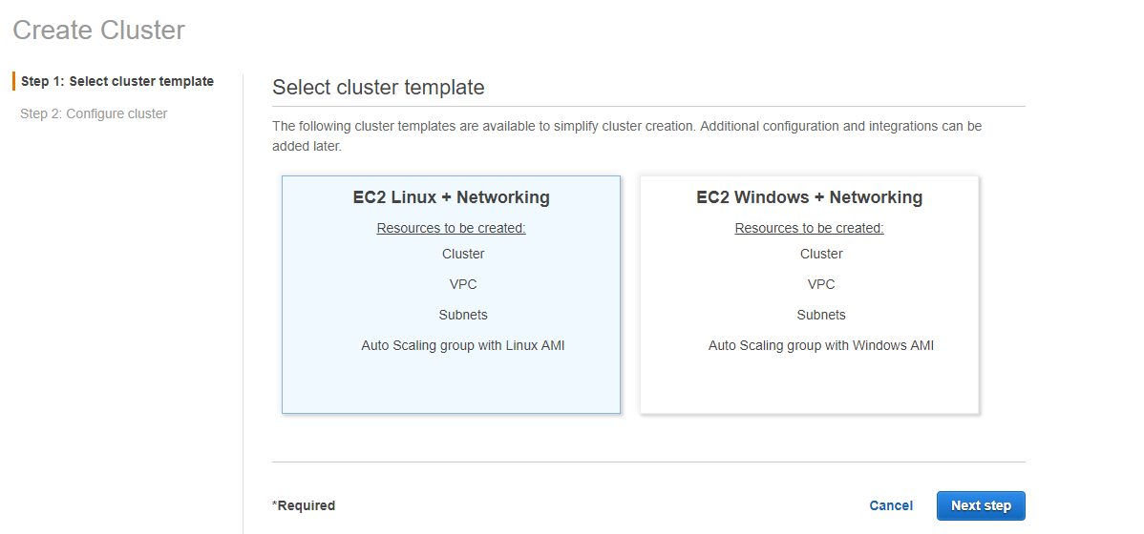
Notes:
Keep default selected option(EC2 Linux + Networking) > Next steps

Slide 45
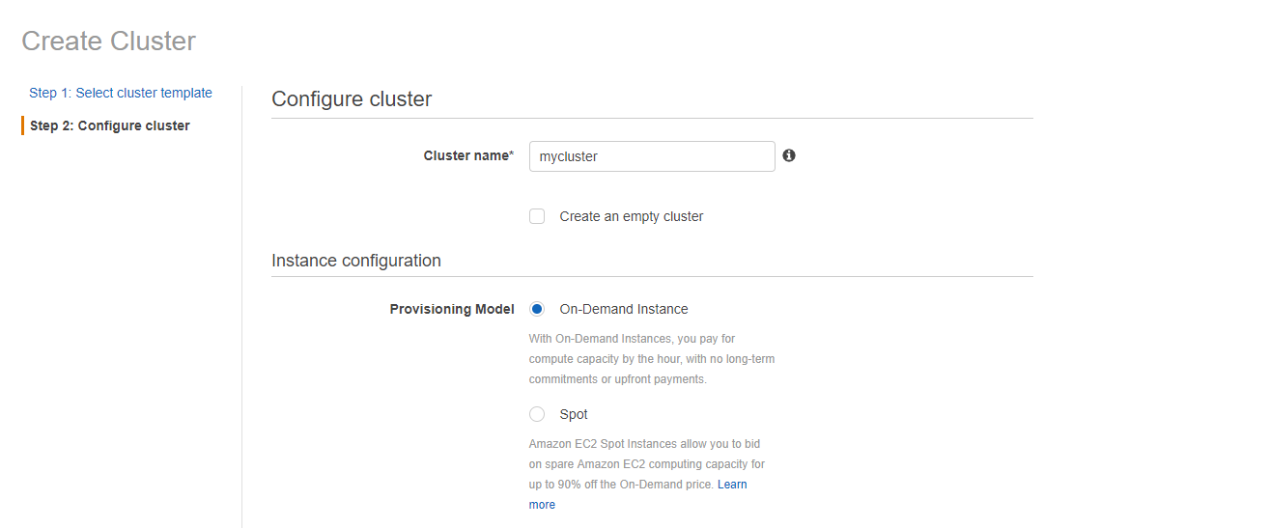
Notes:
Give the cluster a name, such as mycluster > Fill the form > Create > view Cluster
Form details:
Cluster name – mycluster/docker image name
On Demand Instance(pay by hour)
EC2 Instance Type – t2.small
No. of instances – 1 or 2
EBS Storage – 22
Key pair – select your keypair or generate by EC2 console(Create key pair/import key pair)
Networking - select/create vpc, subnets, security groups, security group inbound rule
Key details will be available under Key Pairs at EC2 dashboard
Key Name – CloudKey
Key Value - aa:1d:fe:b7:0d:1e:5e:f4:97:e6:29:c0:99:c4:f8:ad:f6:d0:46:06
Container instance IAM role - default
You need to create a bunch of new EC2 Instances and register them in the Cluster. Deploying, monitoring, and updating many EC2 Instances manually is tedious and error prone. A better solution is to use an Auto Scaling Group and an Elastic Load Balancer.

Slide 46
Elastic Load Balancer
You can use an Elastic Load Balancer (ELB) when you are running multiple EC2 Instances and you want to distribute load between them. The ELB monitors the health of your EC2 Instances, so if one goes down (due to a crash or an Auto Scaling Group reducing the number of instances) it can take it out of rotation or if a new one comes up (due to a new deployment or an Auto Scaling Group increasing the number of instances) it can add it to the rotation. Your users always send their requests to the ELB, so they are shielded from any changes within your data center.
Create the ELB first and then move on to the Auto Scaling Group.

Slide 47
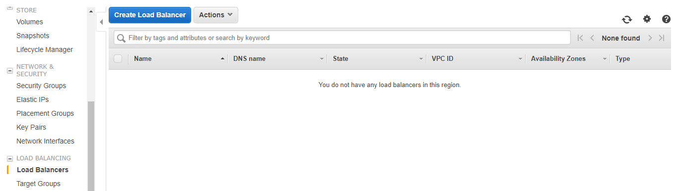
Create Load Balancer
Notes:
Click Load Balancers > Click Create Load Balancer

Slide 48
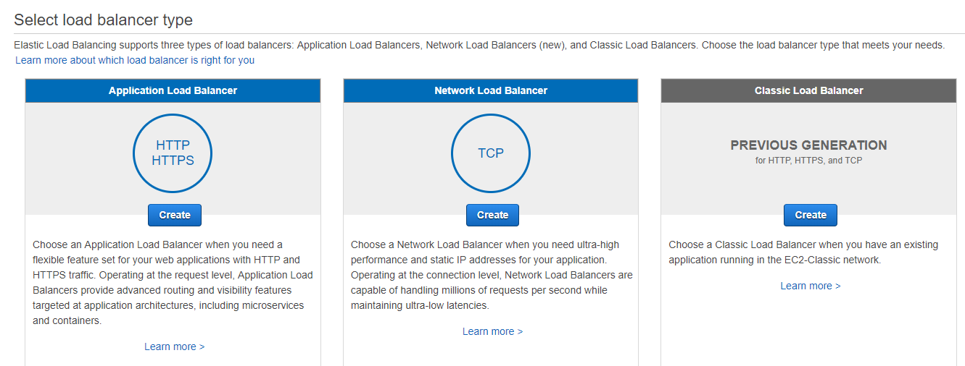
Select a Load Balancer Type
Notes:
For Application Load Balancer, choose Create

Slide 49
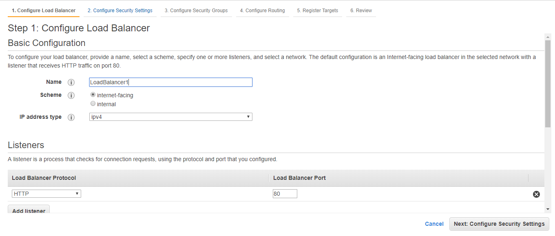
Configure Your Load Balancer and Listener
Notes:
Enter Name
Keep other default values as it is

Slide 50
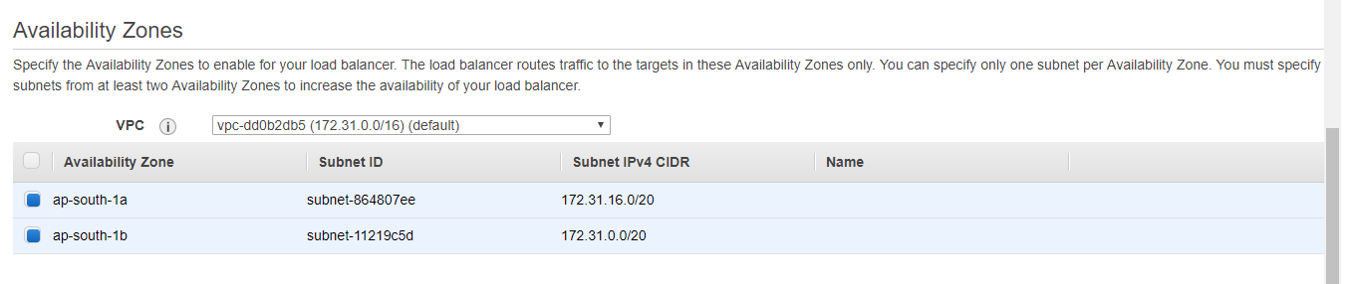
Notes:
Select 2 subnets(instances)
Click Next: Configure Security Settings

Slide 51
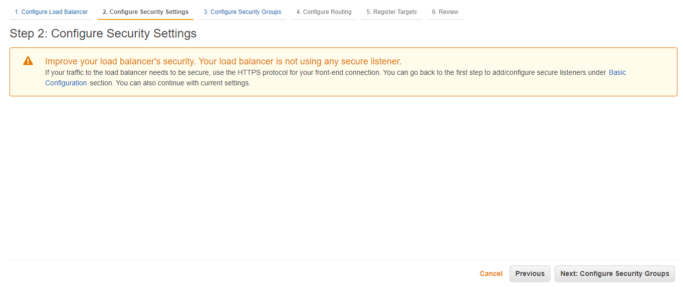
Notes:
Click Next: Configure Security Groups

Slide 52
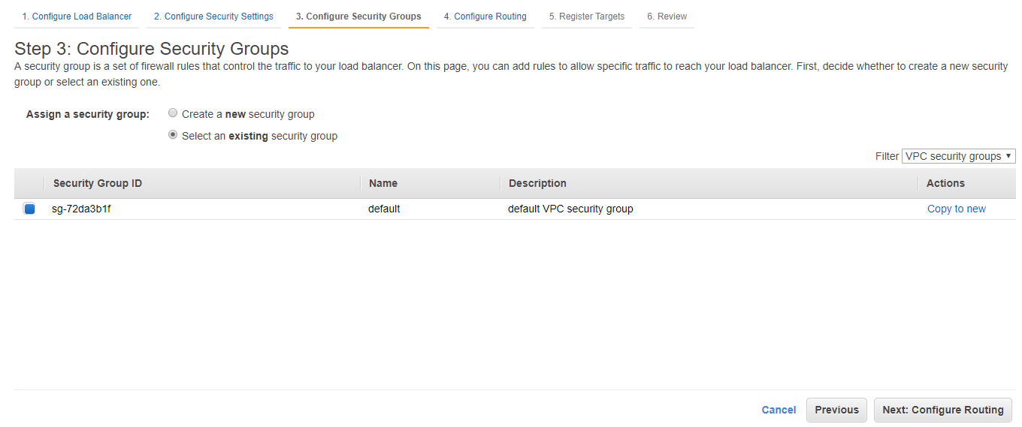
Configure a Security Group for Your Load Balancer
Notes:
Click Next: Configure Routing

Slide 53
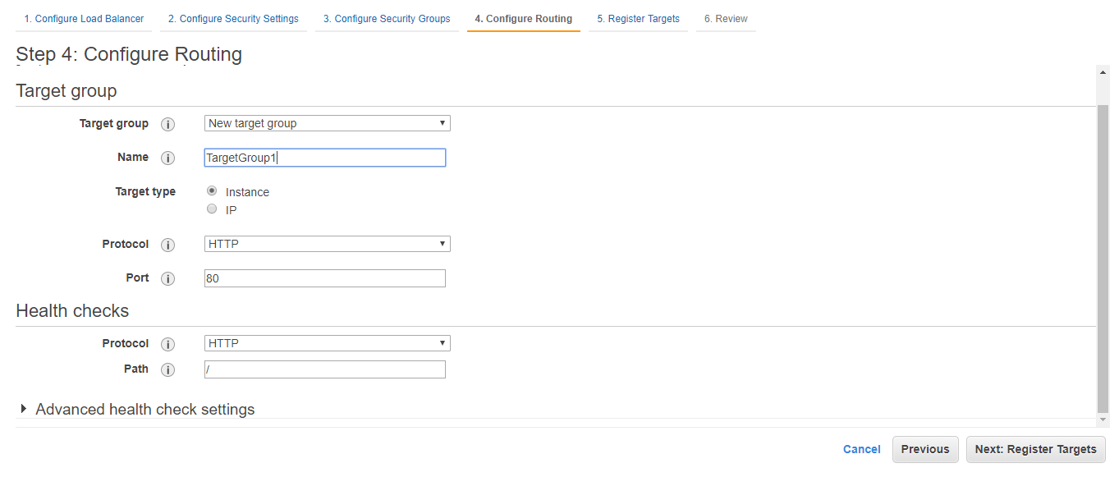
Target Group
Notes:
Enter Target Name
Click Next: Register Targets

Slide 54
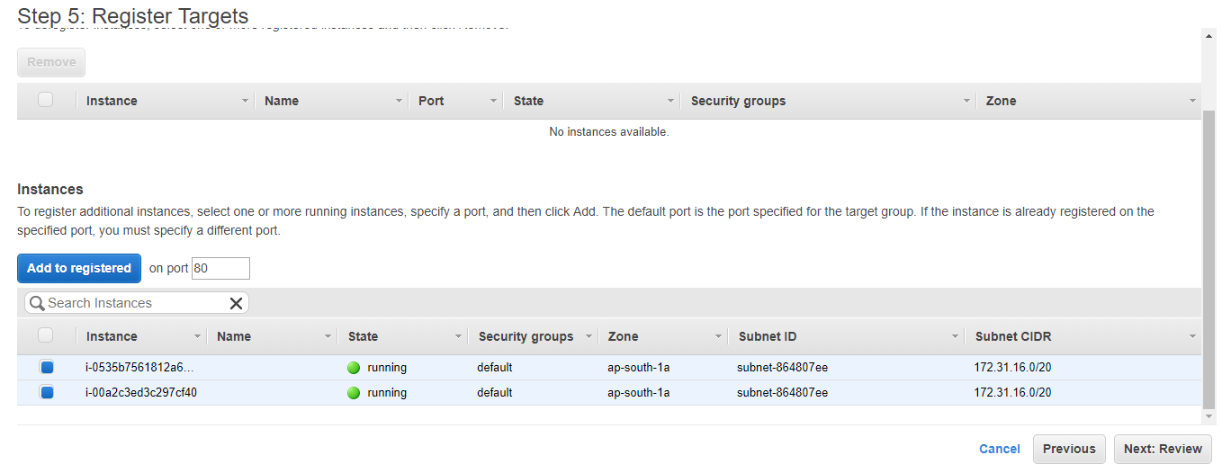
Notes:
Click Add to registered

Slide 55

Register Targets with Your Target Group
Notes:
Select both instances
Click Next: Review

Slide 56

Create and Test Your Load Balancer
Notes:
Click Create

Slide 57

Notes:
Click Close

Slide 58


Slide 59

Notes:
On the navigation pane, under LOAD BALANCING, choose Load Balancers.
Select the newly created load balancer.
On the Description tab, copy the DNS name of the load balancer (for example, my-load-balancer-1234567890.us-west-2.elb.amazonaws.com). Paste the DNS name into the address field of an Internet-connected web browser. If everything is working, the browser displays the default page of your server.

Slide 60

IAM Roles

Slide 61

Notes:
Click Roles

Slide 62


Slide 63


Slide 64


Slide 65


Slide 66


Slide 67


Slide 68

Create another IAM Role

Slide 69


Slide 70

Notes:
Why we created 2 roles - To allow the ECS Cluster to talk to your ELB so it can notify the ELB when it is deploying or undeploying Docker containers

Slide 71


Starting/Stopping Instance(if required)

