Slide 1
European Computer Driving Licence
Module 7 – Information and Communication
Chapter 7.1 – Browsing

Slide 2

The Internet
The Internet:
Consists of an INTERnational NETwork of connected computers
The World Wide Web
Consists of hundreds of millions of web pages stored on computers around the world which can be accessed via the Internet

Slide 3
Web Browser software
A browser program such as Microsoft Internet Explorer is needed to view web pages
Connection is made via the computer of an Internet Service Provider or ISP Examples are: Freeserve, BT, AOL, Tiscali. Permanent (broadband) or dial-up connections are available
To start Internet Explorer, double-click internet Explorer icon next to the Start button
Or click Start then All Programs then Internet Explorer
A web page will appear on screen. This will probably be a page that was set as a default by your ISP or computer manufacturer
A dialog box may prompt you to connect: enter your username and password in the dial-up box and click Connect

Slide 4
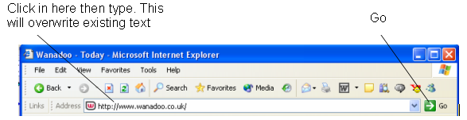
Entering an address
Go to a different web page by clicking into the Address Bar at the top of the screen. The text will highlight and can be overwritten
Type in the address eg. www.bbc.co.uk and click Go or press Enter
The web site’s home page will open

Slide 5
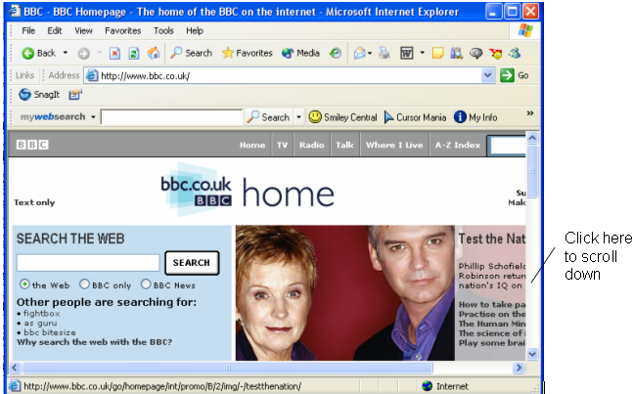
Entering an address
Pages may continually change as sites are updated regularly
Web pages may be longer than the screen – like this one. To see the whole page, either click in the scroll bar or press the Page Down key. Ctrl-End takes you to the bottom of the page, Ctrl-Home back to the top

Slide 6

Navigating the Web
Most pages have hot links – also called hyperlinks which are shortcuts to jump to another page or section
The mouse pointer will change to a hand when it is over a hyperlink
These are usually text underlined in blue but may also be pictures
Clicking a hot area will jump the browser to that page or area of information

Slide 7


Returning to a previous page
Clicking the Back button on the toolbar will return you to the previous web page
Clicking repeatedly will eventually take you back to the home page
Clicking the Forward button takes you forward again through the pages
Hyperlinks you have already clicked will have changed colour to remind you that you’ve been there
Both Back and Forward buttons have a down-arrow which you can click on and choose a page from the list

Slide 8
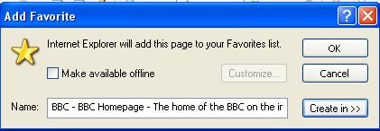
Bookmarking a page
Bookmarking a page saves it to a list of favourite sites. You don’t have to type in the address to access it.
Access a web site to bookmark
Click Favorites from the menu bar, then Add to Favorites
Click OK

Slide 9
The web page address
A web page address is called a Uniform Resource Locator – URL. It has distinct parts separated by dots, each part having a special significance http://www.bbc.co.uk
http:// - (Hypertext Transfer Protocol) - the browser adds this automatically. This is the protocol (set of rules) used for sending/receiving data between computers. ftp:// (File Transfer Protocol) is another used for transferring files
www – World Wide Web
bbc.co.uk - the domain name (owner) of the site and has several parts
co – type of site i.e. a commercial organisation. International companies generally end in .com

Slide 10
The web page address
Other types of sites are gov (government), org (non-profit organisation), ac or edu (educational organisations)
co – commercial if site not .com or US-based e.g. co.
uk (UK), de (Germany), es (Spain), fr (France)
There may be the name of a file on the end of the address (after a slash) such as /index.htm
Web pages are written in the computer language Hypertext Markup Language (HTML)

Slide 11
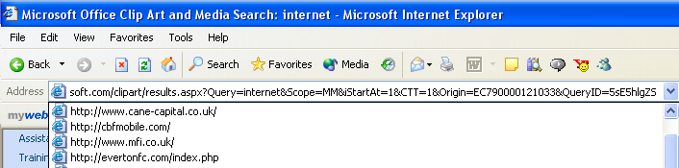

Entering an address from the Address Bar
Click the down-arrow to the right of the address bar. A list of the URLs of recently visited web sites will appear
Click a URL. The browser will jump to that page
Click into the address bar and type just part of an address eg www.b
Internet Explorer will display a list of URLs beginning with the first letter of the domain name. Select the address in the list

Slide 12

Returning to a bookmarked page
For a quick way to return to a page (eg. the BBC home page), you could either use the Back button again or find it in Favorites if you have saved it there
Click the Favorites icon
The Favorites pane will appear at the left of the screen. Click the required page
Click the Favorites icon to hide the pane

Slide 13
Refreshing a web page
The browser stores viewed web pages in a cache folder on the hard drive. This speeds up access to the page when viewed at a later date
If you are not sure whether you are looking at the latest version of the page, or you get an error message when trying to access a page, click the Refresh icon
This will reload and update the page from the Internet instead of the cache

Slide 14
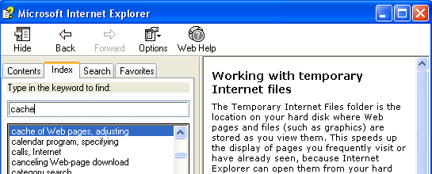
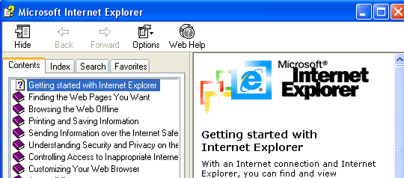
Using Help Function
Use the Help Function in Internet Explorer to find information
Click Help then Contents and Index (or press the F1 key)
Click a Contents item to see the associated help information
Or click the Index tab and type in a keyword of information to be found
There is also Microsoft online Help from the Web Help button
Close the Help window when you have your information

Slide 15
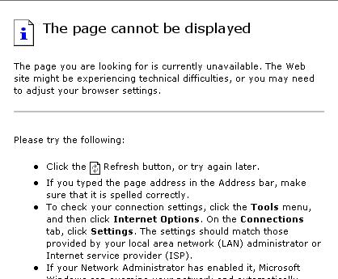
Stopping a page downloading and Missing pages
If a web page is taking too long to open, click the Stop icon
The browser may occasionally display a message similar to this:
This may happen because:
You have typed in the address incorrectly
There may be a problem with the site server
You may have clicked a hyperlink that is no longer available
The page may have been removed or changed its address

Slide 16

Ending an Internet session
Close Internet Explorer by either clicking the Close icon
Or selecting File then Close
If you have a dial-up connection you should disconnect as soon as you have finished since being on the Internet uses your phone line
Closing Internet Explorer does not automatically disconnect you
At the bottom right of the screen is the Dial-up icon
Right-click the Dial-up icon and select Disconnect

