Slide 1

Turnstile
Second Generation Instant Messaging and File Sharing Client
J.D. Henderson

Slide 2

What is Peer-to-Peer?
Finds Data and Services
Distributes Load
Taps Previously Unused Storage and Bandwidth
Usually Decentralized
Exciting New Research Field
Client
Client
Client
Internet
Client
Client
Decentralized Network
Notes:
P2P IS
-Scraps Client/Server Model
-Finds Data and Services without DNS
-Users control all hardware and software
-Shares computing, bandwidth, and storage
P2P is NOT
-New
-Napster

Slide 3
Uses of Peer-to-Peer
Distribute Large Files
Instant Messaging
SPAM Detection
Distributed Computing
Distributed File Systems
Web Indexing
Distributed Backup
Databases
Replacement for VPN
Notes:
Intel is developing server peer-to-peer technology
Microsoft has it integrated in its .NET platform and XP Service Pack 1

Slide 4
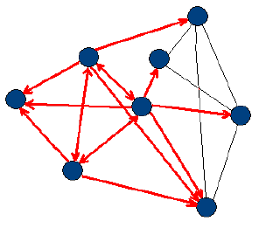
Peer-to-Peer Approaches
Flood Queries
Super Nodes
Centralized Searches
Distributed Hash Tables
Swarm Intelligence
Projects
  Gnutella
  MUTE
  CAN
  Tapestry
  Pastry (Microsoft)
  Chord (MIT)
Flood Query

Slide 5
Project Objective & Challenges
Design an Open Peer-to-Peer Protocol: YAWP
  Handle Failure
  Secure Communication
  Support Millions of Nodes
  Handle Nodes Leaving and Joining
  Robustness with Untrusted Nodes
  Abstracted Programming API
Implement a Client: Turnstile
  Example use of the Protocol
  Instant Messaging and File Transfer

Slide 6
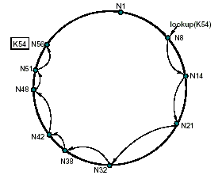
Distributed Hash Tables
Works with Millions of Nodes
Balanced Distribution of Data
Quick Searches
Shared Bandwidth
Semi Network Aware
Robust and Fault Tolerant
Self Organizing
High Recall
Chord Distributed Hash Table
Notes:
Recursive or Iterative
Search 1 Million Nodes in 20 Hops

Slide 7
Project Summary
YAWP (Yet Another Wonderful Protocol)
  Full Specification Documented
  Distributed Hash Table (SHA-1 Hash Algorithm)
  RSA Public/Private Keys
  Twofish Symmetric Cipher
  Workgroup Keys (social network)
  Failure Recovery and Redundancy
Turnstile Client
  Over 15,000 Lines of Code
  Linux and Windows Versions

Slide 8
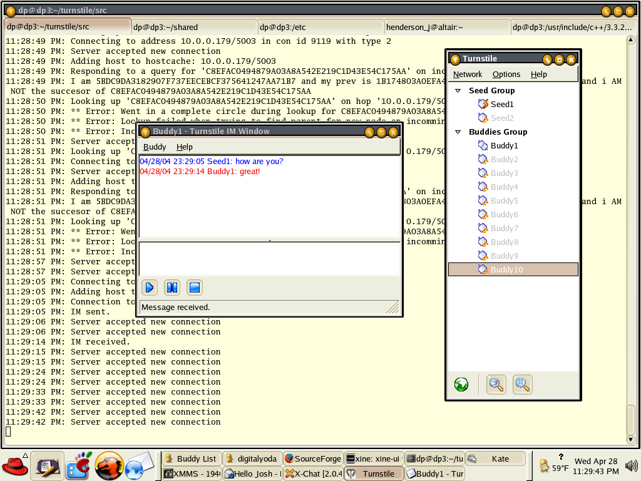
Turnstile Screenshots
Instant Message Window
Buddy Window (Main Window)

Slide 9
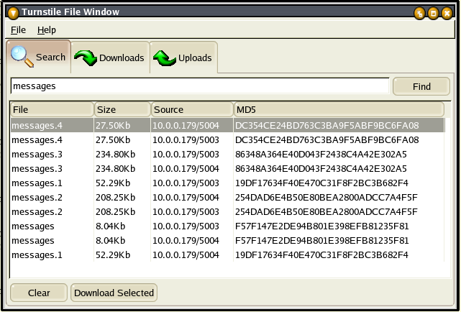
Turnstile Screenshots
File Search Window

Slide 10
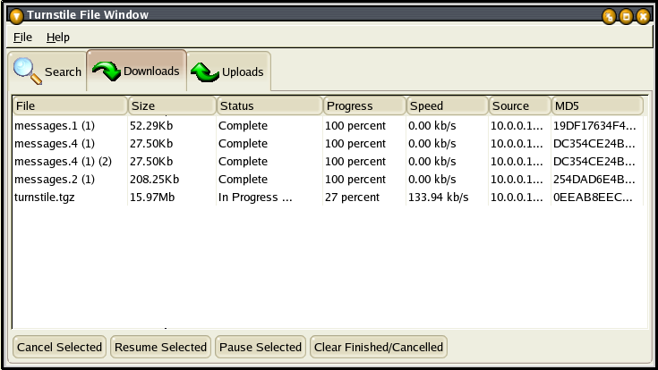
Turnstile Screenshots
File Download Window

Slide 11
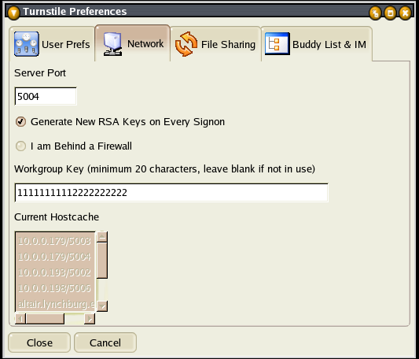
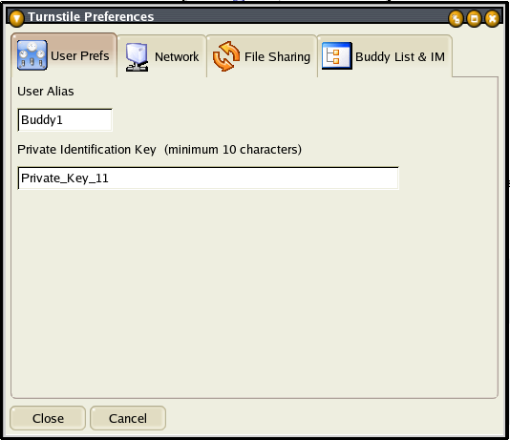
Turnstile Screenshots
User Preferences
Network Preferences

Slide 12
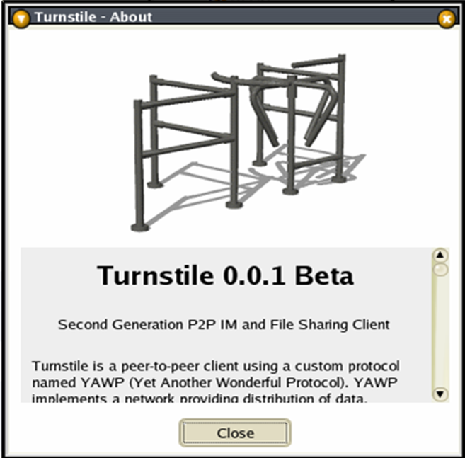
Future Work
Higher Fault Tolerance
Social Network Integration
Enhanced File Transfer
Group Chat
Selective Routing
Protocol specification, source code, and more can be found at http://www.digitalpeer.com/projects/turnstile/

