Slide 1


Slide 2
is a cloud application management service that makes it easy to deploy and operate applications of all shapes and sizes.
You can define the application’s architecture and the specification of each component including package installation,
software configuration and resources such as storage.
Start from templates for common technologies like application servers and databases
or build your own to perform any task that can be scripted.
AWS OpsWorks includes automation to scale your application based on time or load and dynamic configuration
to orchestrate changes as your environment scales.

Slide 3
App Deployment
You can pull your code from a repository and install it on one or all of your instances.
You can have multiple applications in a stack that are configured to work together as a system.

Slide 4
Auto Healing
If an instance fails, AWS OpsWorks can replace it with a new one.

Slide 5
Automatic Instance Scaling
You can adapt the number of running instances to match your load, with time- or load-based auto scaling.
The instances in your pool can vary in size, letting you scale gradually or quickly.
This allows you to handle load spikes and save money by only using exactly what is needed.

Slide 6
Monitoring
AWS OpsWorks sends all of your resource metrics to Amazon CloudWatch,
making it easy to view graphs and set alarms to help you troubleshoot and take automated action based on the state of your resources.

Slide 7
AWS OpsWorks Pricing
There is no additional charge for AWS OpsWorks.
You pay for AWS resources (e.g. EC2 instances, EBS volumes, Elastic IP addresses) created using OpsWorks in the same manner
as if you created them manually. With all AWS services, you only pay for what you use, as you use it;
there are no minimum fees and no upfront commitments.

Slide 8
The AWS Free Tier enables hands-on experience with Amazon Web Services at no charge for 12 months after you sign up.
After creating your AWS account you can use any of the 18 products and services, listed below, for free within certain usage limits.

Slide 9
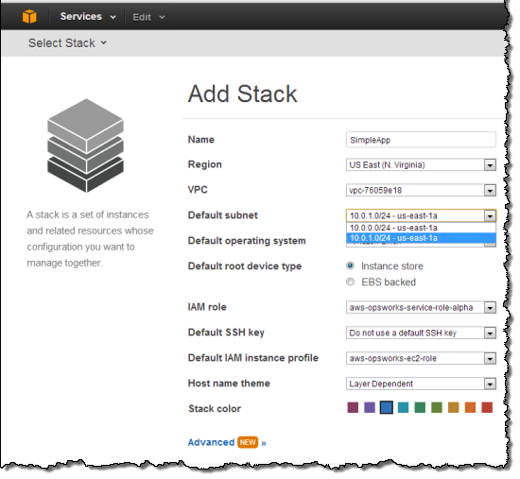

Slide 10
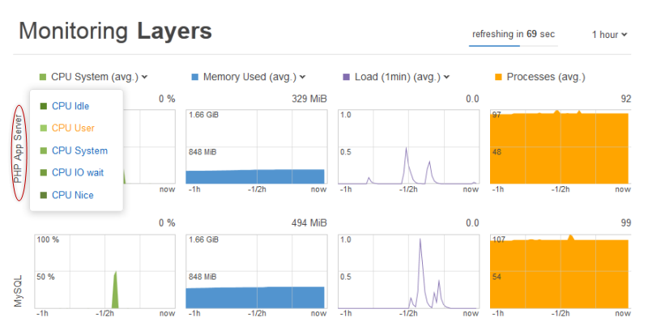

Slide 11
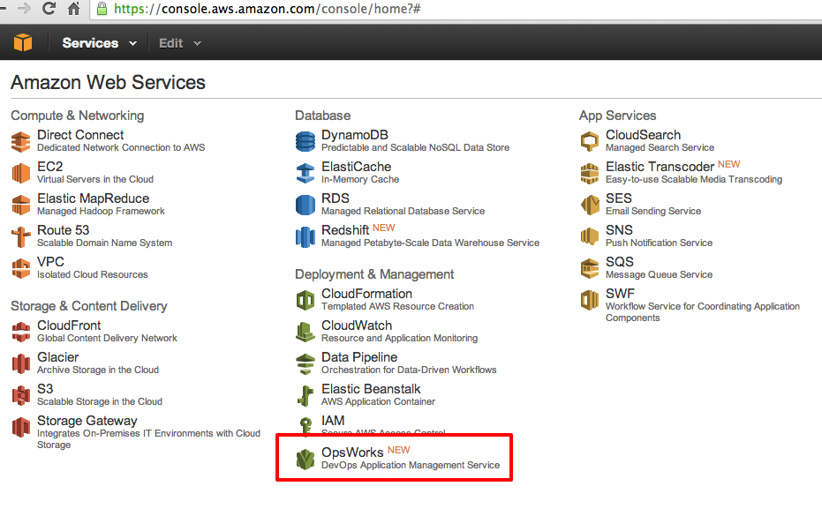

Slide 12
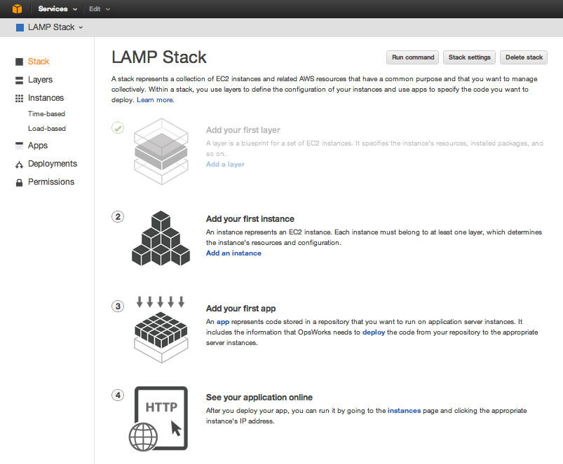

Slide 13
