Slide 1
OpsWorks
Is it worth it

Slide 2
AWS OpsWorks
AWS OpsWorks is a cloud application management service that makes it easy to deploy and operate applications of all shapes and sizes.

Slide 3
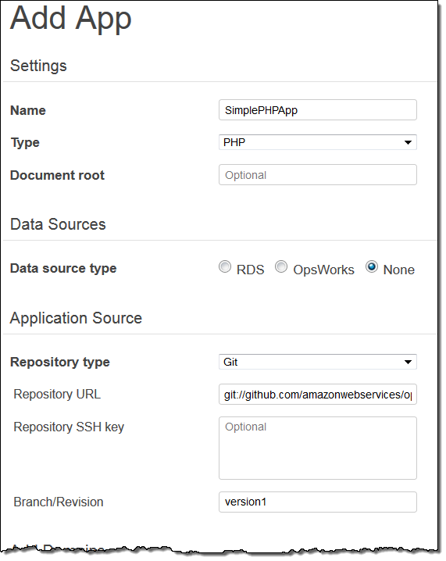
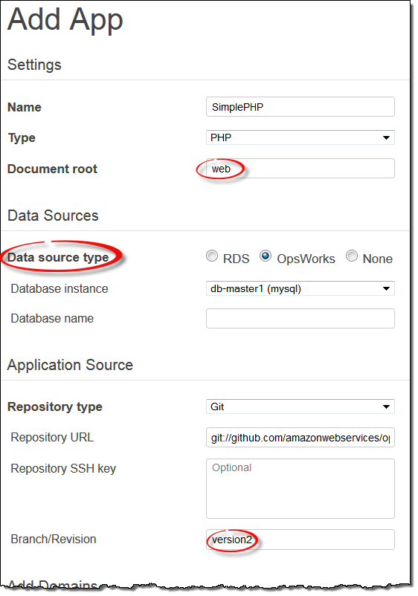
Better control over deployment
updates
bug fix

Slide 4
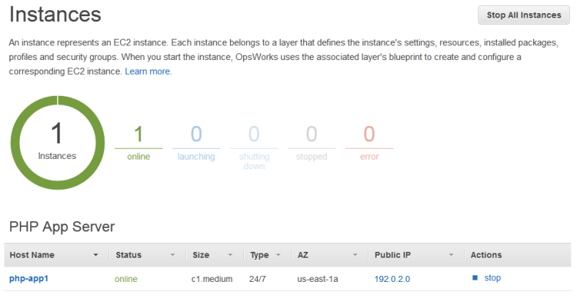
Scaling

Slide 5
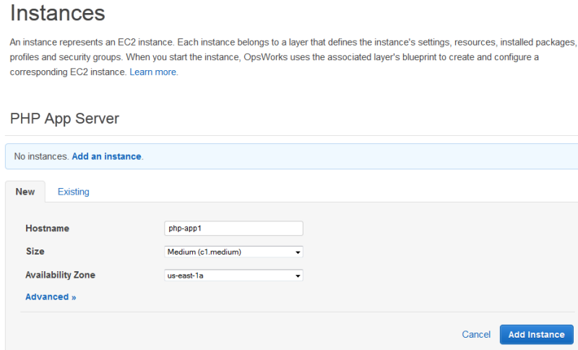
Scaling
redundancy

Slide 6
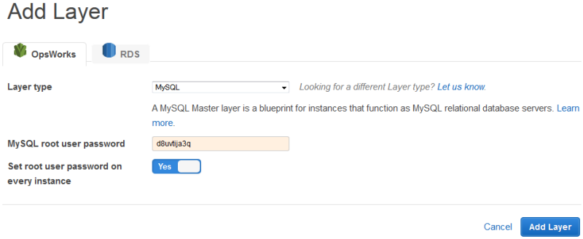
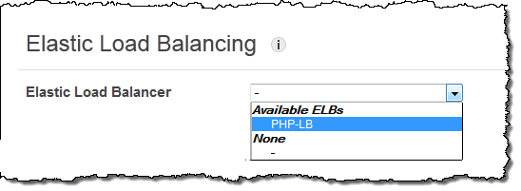
Scaling

Slide 7
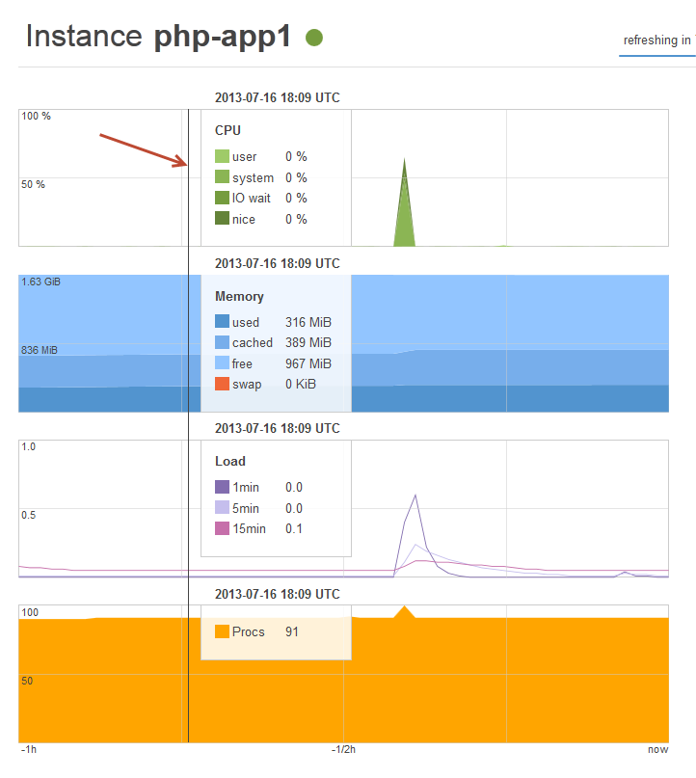
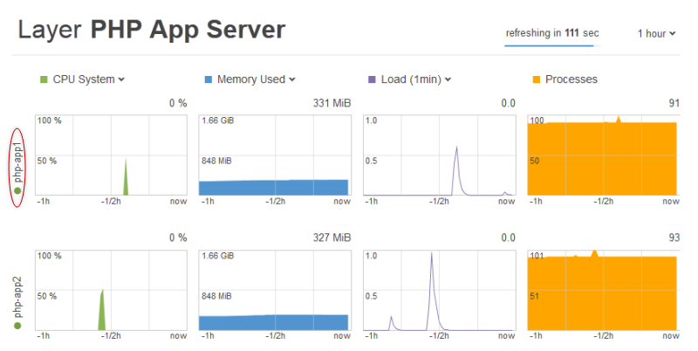
Monitoring and automation
AWS OpsWorks sends all of your resource metrics to Amazon CloudWatch,
making it easy to view graphs and set alarms

Slide 8
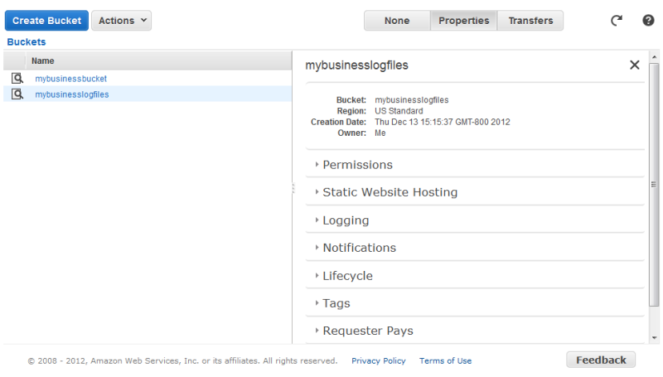
Backups
better access to backups

Slide 9
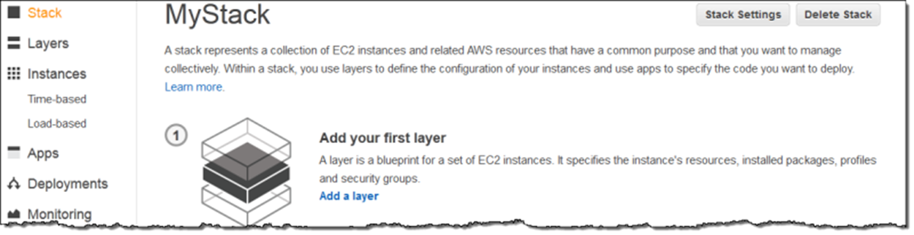
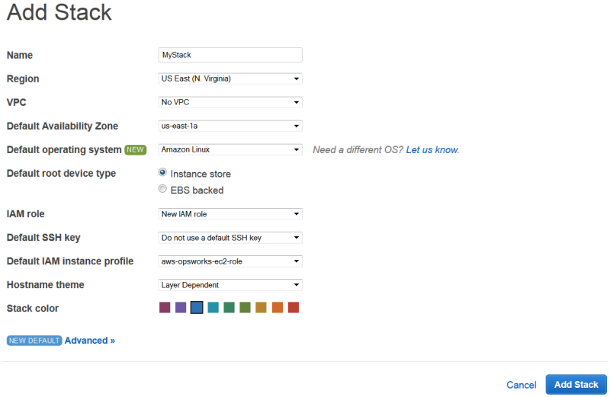
better replication of dev and test environments

Slide 10
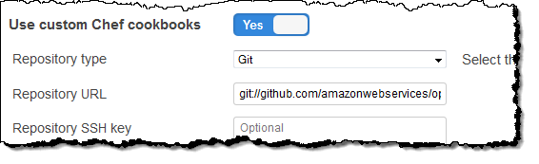
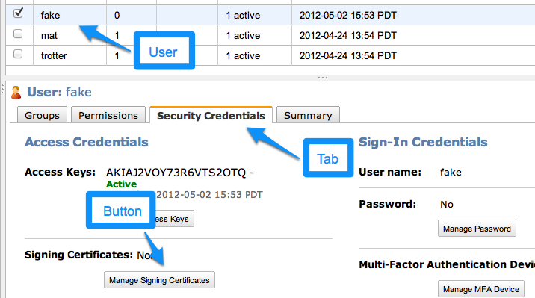
Accountability
AWS Identity and Access Management (IAM) to provide robust ways of controlling how users access AWS OpsWorks

Slide 11
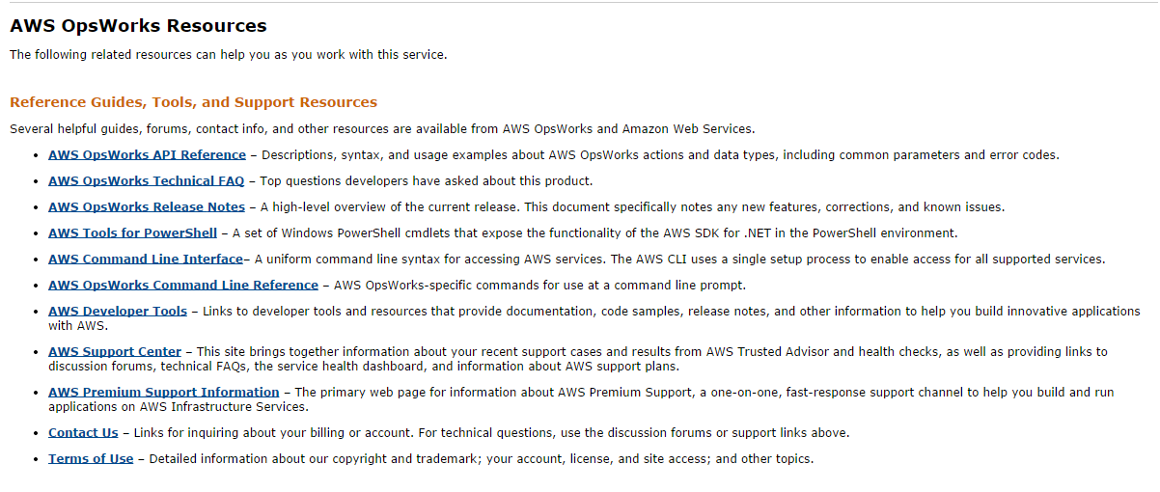
In house?
OpsWorks is a high-level service
Our in house team can ‘build on it’ rather than re-inventing it

Slide 12
Things that ULCC does
Deploy Moodle with a set of plugins that they maintain

Slide 13
Universities using OpsWorks
Anhanguera
http://www.anhanguera.com/
Founded in 1973, Anhanguera is one of the largest universities in Brazil and one of the largest in the world, offering over 500,000 undergraduate and postgraduate courses. The university has over 70 campuses throughout Brazil, and hundreds of offices supporting distance learning. Anhanguera University has more than 10,000 teachers and over 6,000 administrative staff.

Slide 14
The Challenge
Anhanguera is one of the world’s largest users of Moodle, an e-learning platform that that allows students and teachers to work collaboratively online. Moodle is available to all students and has millions of hits per week as students, teachers, and administrators use the platform. The IT department at the university developed an extensive data center to manage the volume of users and content. However, as the university continued to grow at a rapid pace, it became increasingly difficult for IT to deliver Moodle and other applications reliably. Anhanguera looked for a more reliable and flexible alternative with the ability to grow.

Slide 15
Why Amazon Web Services
Anhanguera decided to build a cloud environment using Amazon Web Services for increased reliability and scalability.

Slide 16
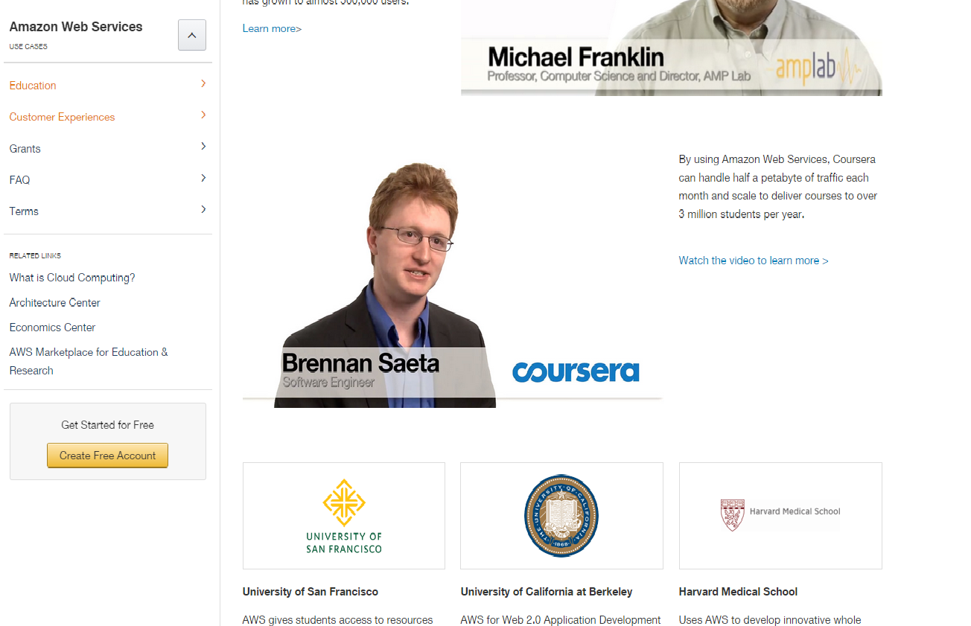
Education

Slide 17
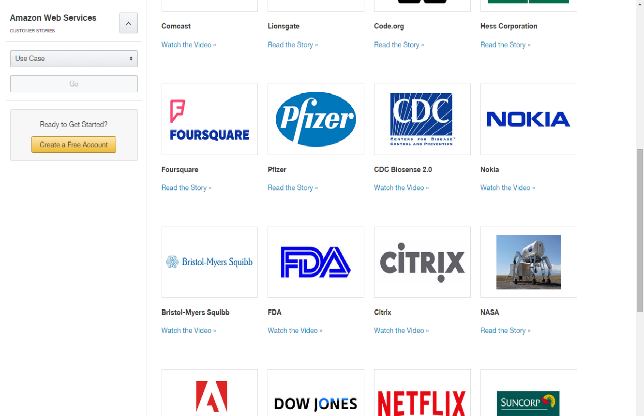
Businesses using OpsWorks

Slide 18
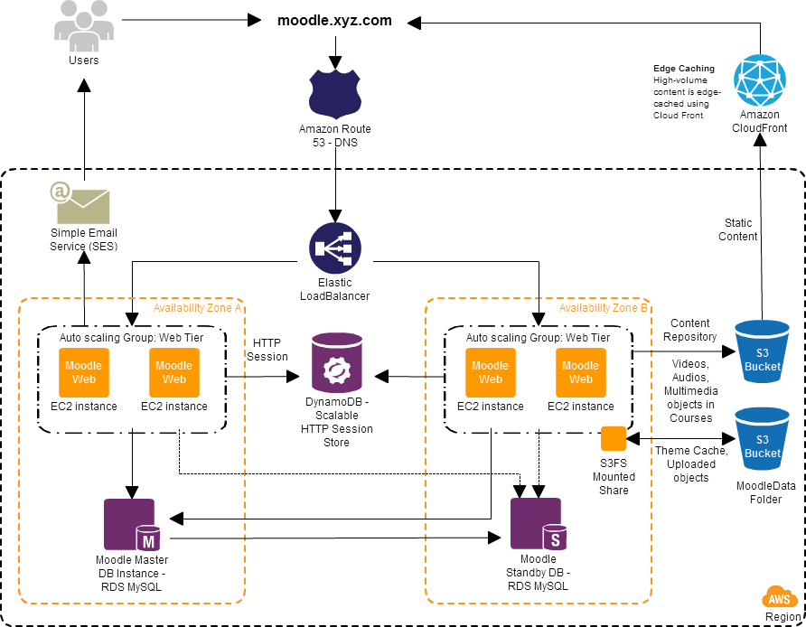
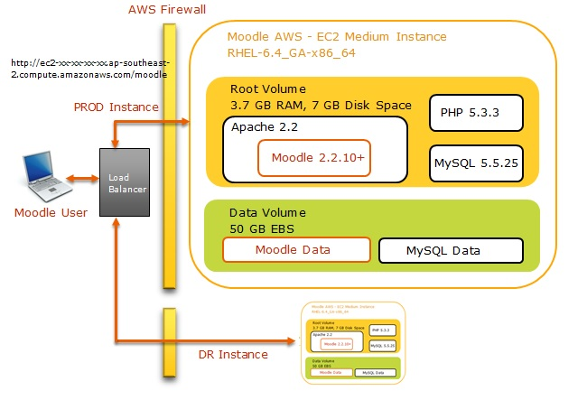
Possible architecture

Slide 19
AWS Free Tier
Could Quickly try a ‘dev’ environment
The AWS Free Tier enables hands-on experience with Amazon Web Services at no charge for 12 months after you sign up.

