Slide 1

Today's presentation
Address some of the issues we have with Moodle being hosted externally

Slide 2

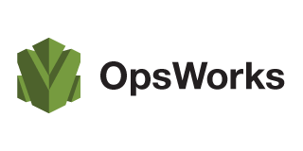
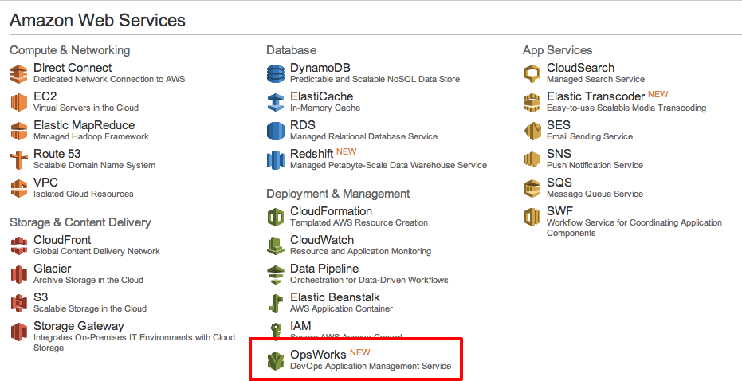
AWS OpsWorks
One possible answer

Slide 3
Will try to cover
What is it
Issues it can address
Quick Demo
“raised eyebrows”
Pros (advantages)

Slide 4
An application management service that makes it easy to deploy and operate applications of all shapes and sizes.
Starting from templates for common technologies or building your own.
You have full control of deployments, scaling, monitoring, and automation of each component.

Slide 5
Your app = resources + software config + deploy
Everything is code

Slide 6
is a cloud application management service that makes it easy to deploy and operate applications of all shapes and sizes.
You can define the application’s architecture and the specification of each component including package installation, software configuration and resources such as storage.
Start from templates for common technologies like application servers and databases or build your own to perform any task that can be scripted.
AWS OpsWorks includes automation to scale your application based on time or load and dynamic configuration to orchestrate changes as your environment scales.
Notes:
What is it

Slide 7
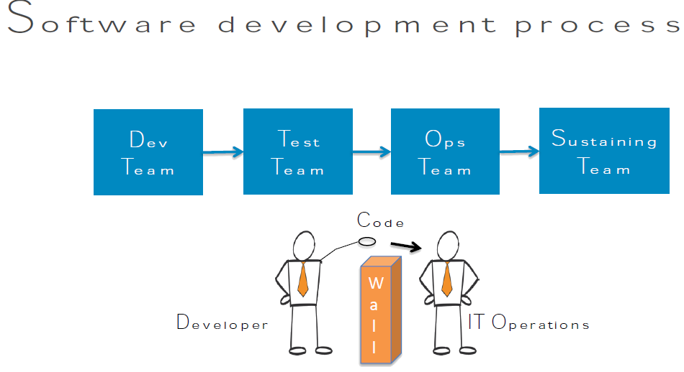

Slide 8
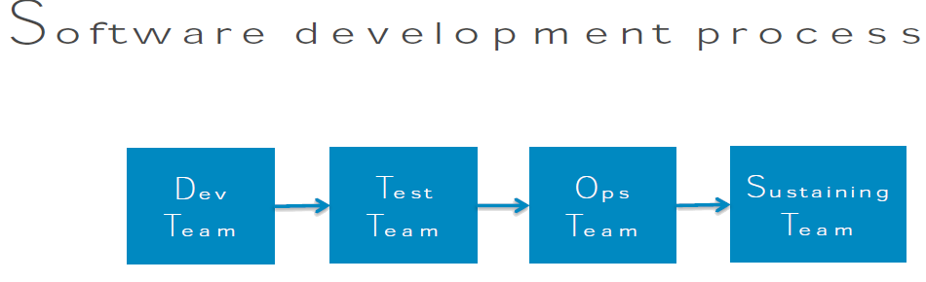
Handsoffs can cause trouble
Who is responsible for scaling
How to troubleshoot issues than span teams
Coordination can cause delays

Slide 9
What is “DevOps”?
"development" and "operations"
a buzzword
a concept
A philosophy? Cultural change? Paradigm shift?
Alignment of development and IT operations with better communication and collaboration?
Improvement in software deployment?

Slide 10
What’s hard about deploying changes?
• For any change, such as database credentials, source code, package updates, security fixes
– Authorize requestor
– Get change onto each server
– Perform update
– Verify
– Make logs available
• OpsWorks handles these tasks for you
Automation

Slide 11
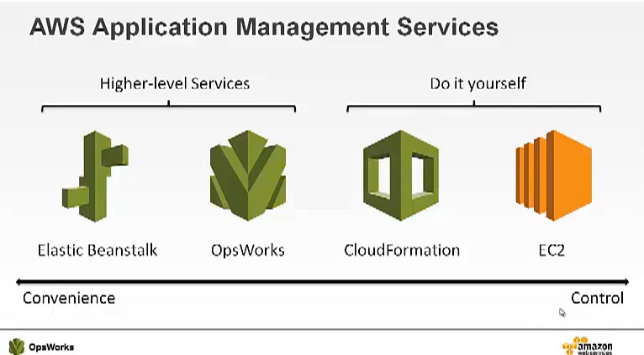
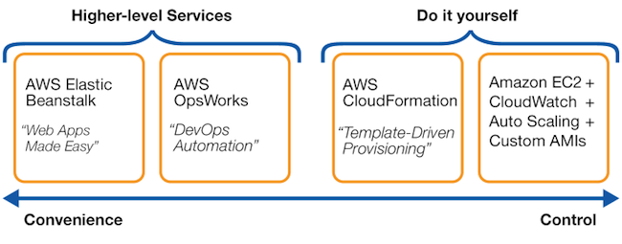

Slide 12
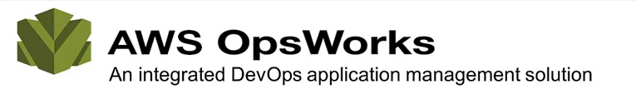
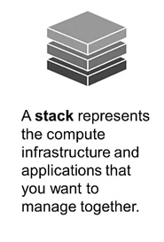
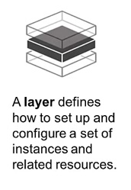
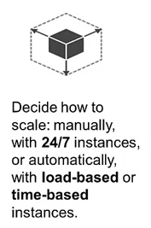
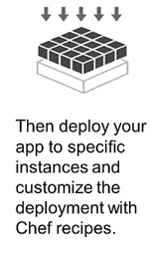

Slide 13
Each layer has
at least one instance.
An instance represents an Amazon EC2 instance and defines its basic configuration, such as operating system and size.
associated set of Chef recipes that AWS OpsWorks runs on the layer's instances at key points in an instance's life cycle.
A layer's Setup recipes perform tasks such as installing and configuring the layer's packages and starting daemons;
the Deploy recipes handle downloading applications; and so on. You can also run recipes manually, at any time.

Slide 14
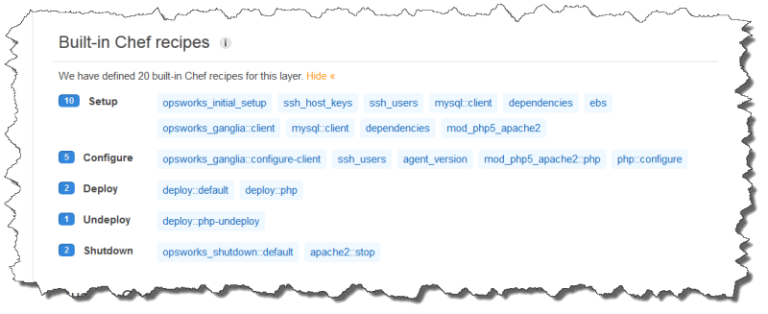
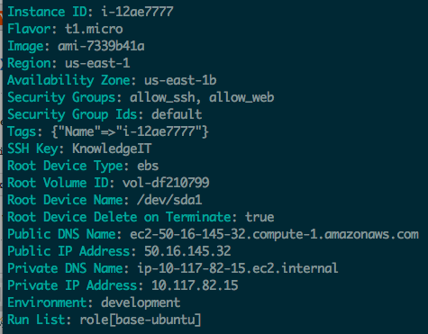
Chef recipes

Slide 15
App Deployment
You can pull your code from a repository and install it on one or all of your instances.
You can have multiple applications in a stack that are configured to work together as a system.

Slide 16
Auto Healing
If an instance fails, AWS OpsWorks can replace it with a new one.

Slide 17
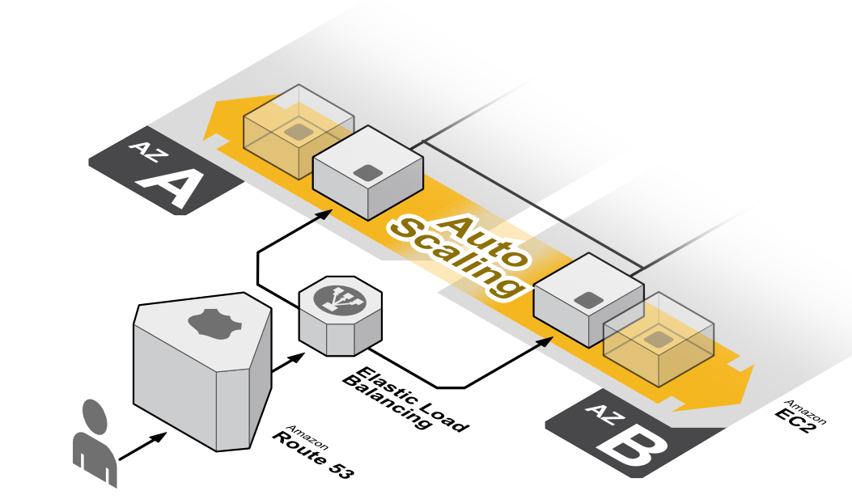
Automatic Instance Scaling
You can adapt the number of running instances to match your load, with time- or load-based auto scaling.
The instances in your pool can vary in size, letting you scale gradually or quickly.
This allows you to handle load spikes and save money by only using exactly what is needed.

Slide 18
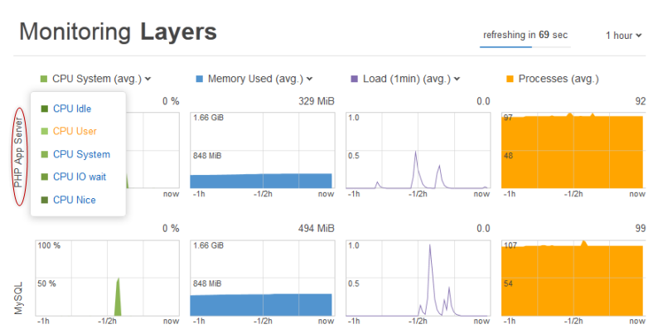
Monitoring
AWS OpsWorks sends all of your resource metrics to Amazon CloudWatch,
making it easy to view graphs and set alarms to help you troubleshoot and take automated action based on the state of your resources.

Slide 19
AWS OpsWorks Pricing
There is no additional charge for AWS OpsWorks.
You pay for AWS resources (e.g. EC2 instances, EBS volumes, Elastic IP addresses) created using OpsWorks in the same manner
as if you created them manually. With all AWS services, you only pay for what you use, as you use it;
there are no minimum fees and no upfront commitments.

Slide 20
AWS Free Tier
The AWS Free Tier enables hands-on experience with Amazon Web Services at no charge for 12 months after you sign up.
After creating your AWS account you can use any of the 18 products and services, “listed below”, for free within certain usage limits.

Slide 21

Demo

Slide 22

Alternatives
Run Chef in house
getchef.com

Slide 23
Additional questions
Possible implementations

Slide 24
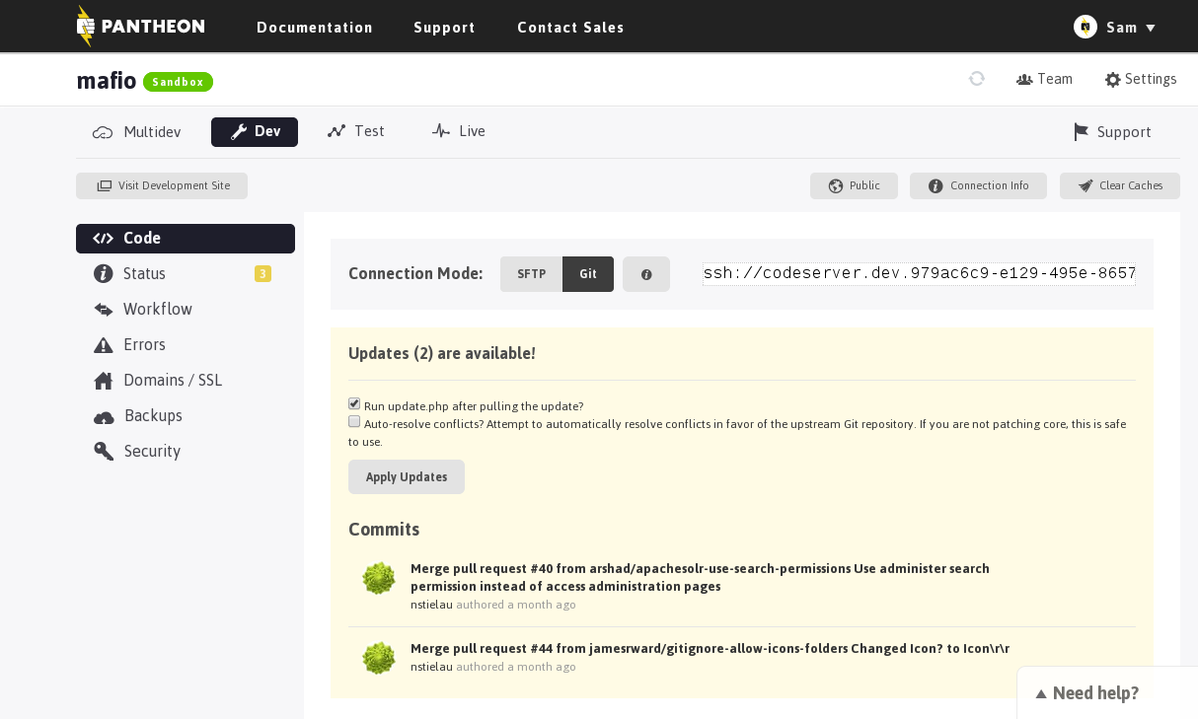
https://www.getpantheon.com/how-it-works

Slide 25
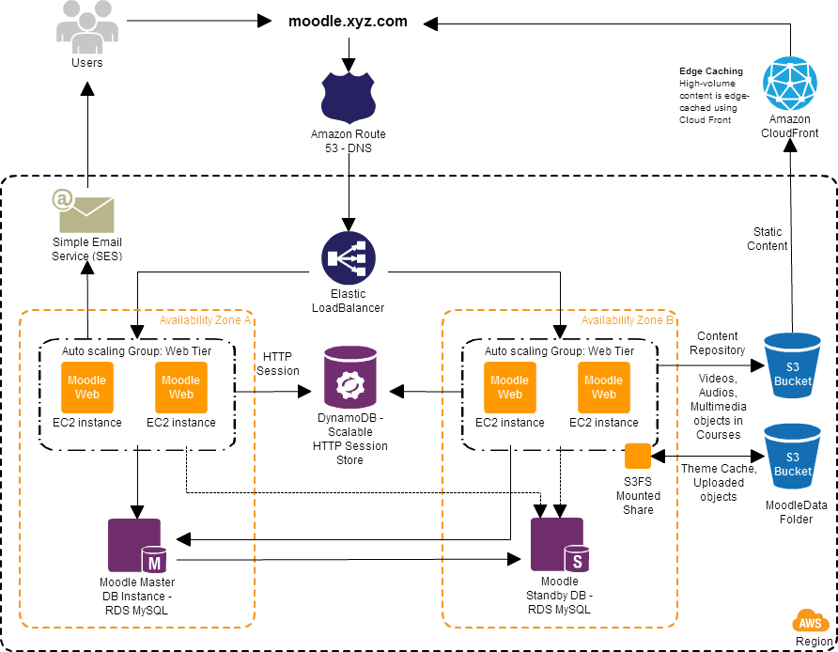

Slide 26
