Slide 1

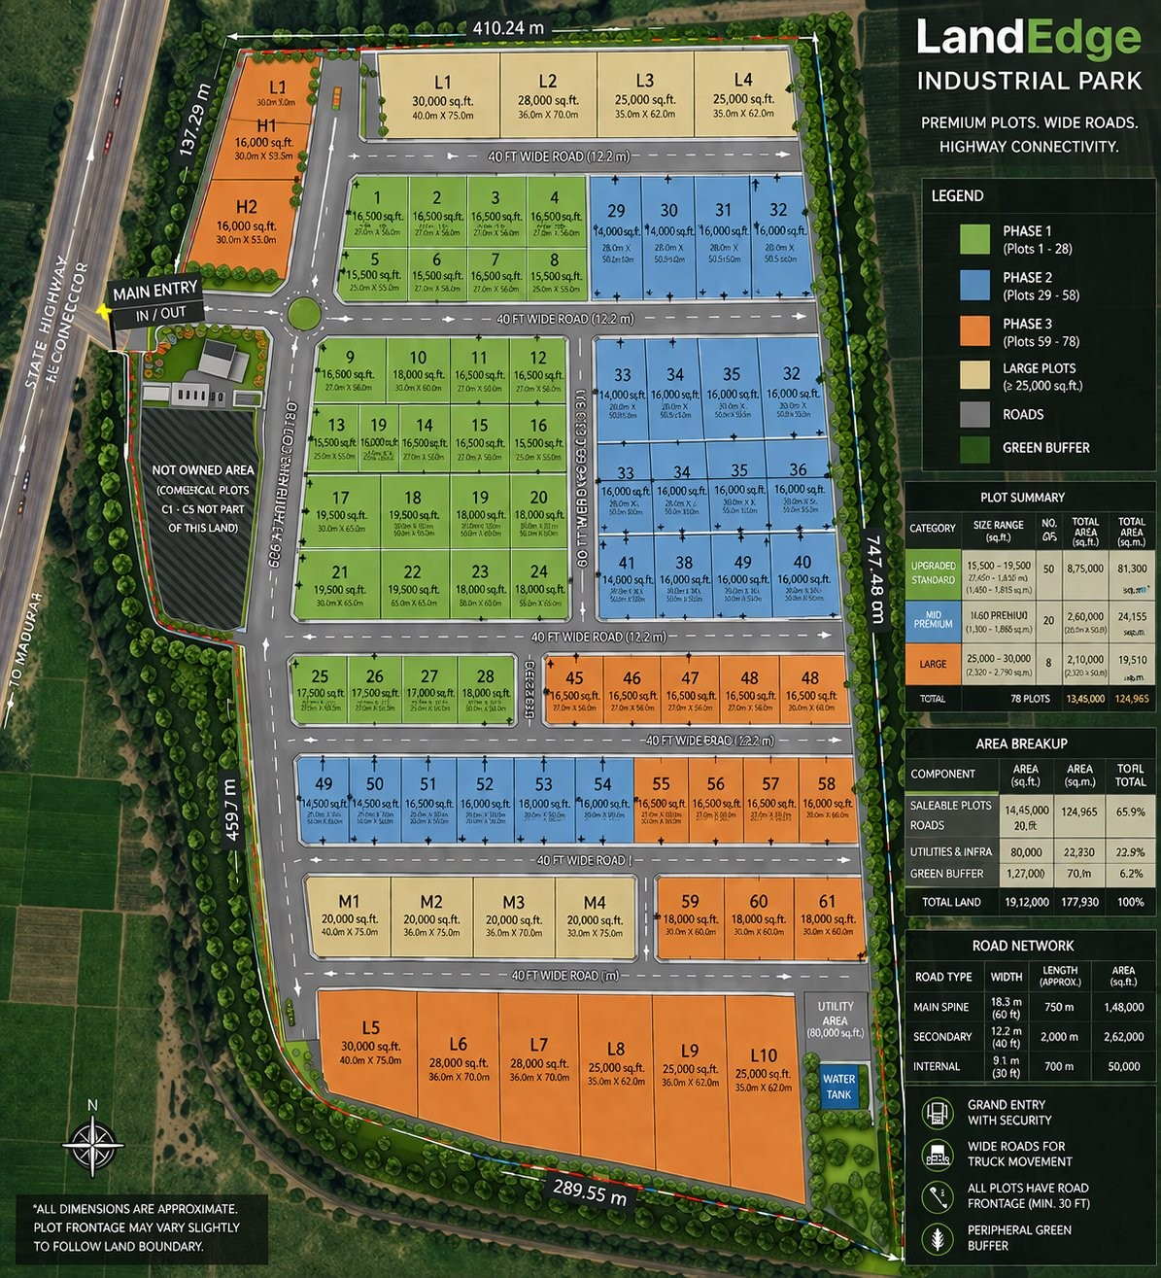

LandEdge
MIYAGAM · KARJAN · VADODARA
INDUSTRIAL PARK
Your Factory.
Your Land.
Own a premium industrial plot in Gujarat's fastest-growing
corridor — and build your business on solid ground.
78
NH-48
RERA
Plots
Available
Highway
Frontage
Compliant
Title
Bharthana, NH-48, Karjan Taluka
Vadodara District, Gujarat — 391 240

Slide 2





WHY THIS LOCATION?
Bharthana · NH-48 · Karjan Taluka, Vadodara — One of Gujarat's most connected industrial addresses
Karjan Town
NH-48 (Delhi–Mumbai Hwy)
3 km
0 km
Local market, banks, services
Direct highway frontage at site
Miyagam Karjan Junction
Vadodara City
2 km
~30 km
Railway freight & passenger access
Skilled workforce & business hub
Vadodara Airport
TBEA Energy (Neighbour)
~45 km
2 km
3rd busiest airport in Gujarat
World-class transformer manufacturer
Gujarat is India's #1 state for Ease of Doing Business for 4 consecutive years · ₹28,500 Cr DMIC investment committed to this corridor
LandEdge Industrial Park · Miyagam, Karjan, Vadodara
landedge.projects@gmail.com · +91 92122 44201

Slide 3
MASTER PLAN
47 acres · 78 plots · 3 phases · Miyagam, Karjan
COLOUR LEGEND
Phase 1 — Plots 1–28
Phase 2 — Plots 29–58
Phase 3 — Plots 59–78
Large Plots (L1–L10, M1–M4)
Roads Network
Green Buffer
19.12L
65.9%
40 ft
sq ft total
saleable area
wide roads
LandEdge Industrial Park · Miyagam, Karjan, Vadodara
landedge.projects@gmail.com · +91 92122 44201

Slide 4
CHOOSE YOUR PLOT
Three categories — from first factory to large-scale manufacturing
★ MOST POPULAR
MID PREMIUM
LARGE FORMAT
STANDARD
Precision. Scale. Control.
Think Bigger. Build Bigger.
Start Small. Grow Big.
20 plots
8 plots
50 plots
available
available
available
11,600 – 13,000
25,000 – 30,000
15,500 – 19,500
sq ft
sq ft
sq ft
Dimensions:
Dimensions:
Dimensions:
20m × 50m (typical)
40m × 75m (typical)
27.45m × 50m (typical)
Ideal for:
Ideal for:
Ideal for:
Precision engineering · Pharma ancillary
Packing & processing · Storage
Warehousing · Logistics hubs
Bulk manufacturing · Auto ancillary
Light manufacturing · Fabrication
Assembly units · MSME entrepreneurs
Starting from ₹900/sq ft · RERA-registered · Title clear · All plots have 30 ft minimum road frontage
LandEdge Industrial Park · Miyagam, Karjan, Vadodara
landedge.projects@gmail.com · +91 92122 44201

Slide 5







WHAT'S INCLUDED WITH YOUR PLOT
Everything done. You just build your factory.
Wide Motorable Roads
Power Infrastructure
Water Supply
Security & Boundary Wall
18.3m main spine, 12.2m secondary, 9.1m internal — designed for heavy trucks
Underground electrical lay-in up to plot boundary. Dedicated transformer per zone
Piped water supply with 80,000 sq ft utility area + independent water tank
Grand entry gate with security cabin. Peripheral compound wall around entire park
Green Buffer & Landscaping
Direct Highway Access
Clear Title + RERA
Plot-Ready Handover
6.2% of total area landscaped. Peripheral tree line. Clean, organised park aesthetics
In/out gate directly onto State Highway. NH-48 access within minutes. No bottlenecks
Fully surveyed, RERA-registered plots. All legal documentation handled before handover
Level plot with road frontage. Utility connections at boundary. Start construction on Day 1
LandEdge Industrial Park · Miyagam, Karjan, Vadodara
landedge.projects@gmail.com · +91 92122 44201

Slide 6

IS THIS PLOT RIGHT FOR YOU?
LandEdge Industrial Park is ideal for entrepreneurs and businesses looking to own their manufacturing space
✓ THIS PLOT IS FOR YOU IF...
INDUSTRIES AT HOME HERE
You want to own your factory space instead of paying rent
⚙ Engineering & Fabrication
You're an MSME owner in manufacturing, engineering, pharma, chemicals, food processing, or auto ancillary
💊 Pharmaceuticals
🏗 Construction Materials
You need highway connectivity for raw material delivery or finished goods dispatch
🚗 Auto Ancillary Parts
You want a RERA-clear title in a professionally developed park
📦 Logistics & 3PL
You're looking for a sound real-estate asset that also serves your business
🌿 Agro Processing
You want to expand from a rented unit into your own permanent facility
🔌 Electrical Components
🧴 FMCG / Consumer Goods
You're planning a greenfield unit and want to start construction quickly
♻ Plastics & Packaging
LandEdge Industrial Park · Miyagam, Karjan, Vadodara
landedge.projects@gmail.com · +91 92122 44201

Slide 7

PRICING & HOW TO BOOK
Transparent pricing · No hidden charges · Flexible payment options
INDICATIVE PRICING
HOW TO BOOK
Standard (15,500–19,500 sq ft)
₹900 / sq ft
~₹1.4 – 1.75 Cr
1
Site Visit
Call or WhatsApp to schedule. Our team will show you available plots.
Mid Premium (11,600–13,000 sq ft)
₹950 / sq ft
~₹1.1 – 1.24 Cr
2
Choose Your Plot
Select plot number, size and location within the park.
Large Format (25,000–30,000 sq ft)
₹900 / sq ft
~₹2.25 – 2.7 Cr
3
Booking Amount
Pay 20% booking token. Plot held exclusively for you.
All prices inclusive of infrastructure, legal documentation & RERA registration
4
Agreement & Title
Sale agreement executed. Full legal documentation provided.
Stamp duty & registration charges: as per Gujarat govt rates
Construction is buyer's responsibility after possession
5
Possession
Payment plan: 20% booking · 30% on agreement · 50% on possession
Receive plot-ready handover. Start construction immediately.
LandEdge Industrial Park · Miyagam, Karjan, Vadodara
landedge.projects@gmail.com · +91 92122 44201

Slide 8
OWN VS RENT — WHY OWNERSHIP WINS
Stop paying rent forever — build equity on the land your business stands on
RENTING
OWNING AT LANDEDGE
✗ Rent increases every 3–5 years
✓ One-time purchase — no recurring rent
✗ No asset creation for your business
✓ Industrial land appreciating 18–22% p.a.
✗ Landlord can ask you to vacate
✓ Full ownership — your asset, your legacy
✗ Cannot mortgage to raise capital
✓ Mortgage the plot to raise working capital
✗ No control over structure or layout
✓ Build exactly what your process needs
✗ Deposit locked, no returns
✓ Loan against property available from banks
✗ Business uncertainty at renewal
✓ Business continuity — never evicted
Industrial land in Vadodara district has appreciated 18–22% year-on-year since 2021. Your plot pays you back.
LandEdge Industrial Park · Miyagam, Karjan, Vadodara
landedge.projects@gmail.com · +91 92122 44201

Slide 9




LandEdge Industrial Park
3 REASONS TO DECIDE NOW
Miyagam · Karjan · Vadodara
Limited Inventory
Book Your Site Visit
Today
Only 78 plots total across all phases. Early buyers choose the best locations.
We'll show you available plots, walk you through the infrastructure,
and answer every question — with no pressure.
Price Appreciation
Industrial land in this corridor is appreciating 18–22% p.a. Delay costs money.
+91 92122 44201
landedge.projects@gmail.com
Call or WhatsApp
Email us anytime
Bharthana, NH-48, Karjan Taluka, Vadodara District,
Gujarat — 391 240
Start Building Fast
RERA-clear, plot-ready handover. Your construction can begin Day 1 of possession.
Limited plots · Early launch pricing · Book now

