Slide 1


CORPORATE PITCH DECK
LandEdge
Industrial Plot Development
PROJECTS
Logistics & Warehousing Zones
Developing Gujarat's
Commercial & MSME Clusters
Industrial Future
Highway-Linked Connectivity
Premium industrial plots, logistics hubs &
commercial zones across Gujarat's DMIC corridor
19.12
78+
₹100 Cr+
Lakh sq ft
Plots
Revenue
Total Land
Phase 1: LandEdge IP
Projected (Phase 1)
Gujarat · DMIC Corridor · NH-48 Adjacent

Slide 2




ABOUT LANDEDGE PROJECTS
Vision · Mission · What We Build
Who We Are
Industrial Plots
Sub-divided, RERA-compliant industrial plots with full infra: roads, power, water, boundary
LandEdge Projects is a Gujarat-based industrial land developer specialising in premium plotted developments for manufacturing, logistics, and commercial enterprises.
We identify high-growth micro-markets along Gujarat's DMIC corridor and transform raw land parcels into fully-serviced, RERA-compliant industrial estates — ready for immediate factory construction.
Logistics Zones
Large-format plots (25,000–30,000 sq ft) suited for warehousing & 3PL operators
Commercial Clusters
Our Mission
MSME-facing commercial zones with retail frontage and office space
"Democratise industrial land ownership — give every MSME access to world-class infrastructure at accessible price points."
Land Aggregation
Sourcing 50–100 bigha parcels near major cities for future developments
LandEdge Projects
CONFIDENTIAL | 2026

Slide 3



THE MARKET OPPORTUNITY
Gujarat's industrial land market is structurally undersupplied — and demand is accelerating
#1
₹28,500Cr
3,000+
18–22%
Ease of Business
DMIC Investment
MSMEs Seeking
Land Appreciation
Gujarat — 4 years running
Committed to Gujarat
Industrial land in corridor
p.a. since 2021
KEY DEMAND DRIVERS
Post-GST logistics restructuring driving warehouse & industrial demand across Gujarat belt
EV, pharma, chemicals & FMCG ancillary units expanding into Vadodara–Anand corridor
Power surplus + Dedicated Freight Corridor access makes Gujarat lowest-cost manufacturing state
NH-48, Western Railway freight corridor & upcoming Delhi–Mumbai Expressway converge here
LandEdge Projects
CONFIDENTIAL | 2026

Slide 4
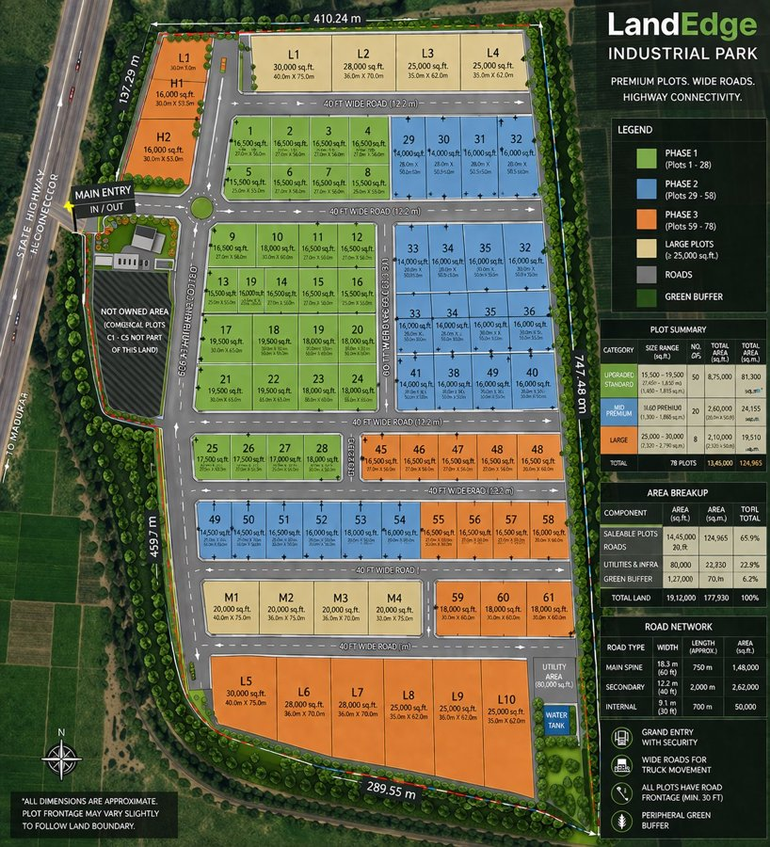
LANDEDGE INDUSTRIAL PARK
Miyagam, Vadodara District, Gujarat · Flagship Project · Phase 1 Under Development
Total Land:
19.12 lakh sq ft (47 acres)
Saleable Area:
12.49 lakh sq ft (65.9%)
Total Plots:
78 industrial plots
Plot Sizes:
15,500 – 30,000 sq ft
Road Network:
18.3m spine + 12.2m secondary + 9.1m internal
Location:
15 km from Vadodara · NH-48 access
Green Buffer:
1.27 lakh sq ft (6.2%)
RERA:
Filing in Phase 0
LandEdge Projects
CONFIDENTIAL | 2026

Slide 5



WORLD-CLASS INFRASTRUCTURE
Every plot delivered plot-ready — with all utilities in place before the first sale
Wide Road Network
Power & Utilities
Water & Drainage
18.3m main spine · 12.2m secondary · 9.1m internal roads — built for heavy truck movement
Underground utility lay-in: power, water, telecom. Dedicated transformer capacity per zone
Independent water tank (80,000 sq ft utility area) + storm drainage infrastructure
Security & Entry
Green Buffer
Highway Connectivity
Grand entry gate with security cabin. Peripheral boundary wall. CCTV-ready backbone
6.2% of total land as landscaped green buffer + 22.9% utilities & infra set-aside
Direct access to State Highway & NH-48. 15 km from Vadodara. Western Railway freight access
LandEdge Projects
CONFIDENTIAL | 2026

Slide 6
PLOT CATEGORIES & PRICING
Three tiers to match every industrial need — from MSME units to large-scale manufacturing
UPGRADED STANDARD
Plot Size:
Dimensions:
Total Area:
₹900
/sq ft
15,500 – 19,500 sq ft
27.45m × 1,850 m (typ.)
8,75,000 sq ft total
50 plots
available
Ideal for MSMEs, light manufacturing, fabrication and assembly units
MID PREMIUM
Plot Size:
Dimensions:
Total Area:
₹900
/sq ft
11,600 – 13,000 sq ft
20.0m × 50.0m (typ.)
2,60,000 sq ft total
20 plots
available
Suited for precision manufacturing, storage facilities and pharma ancillaries
LARGE FORMAT
Plot Size:
Dimensions:
Total Area:
₹900
/sq ft
25,000 – 30,000 sq ft
40.0m × 75.0m (typ.)
2,10,000 sq ft total
8 plots
available
For logistics operators, bulk warehousing, and large-scale manufacturing facilities
TOTAL: 78 Plots · 13,45,000 sq ft saleable area · ₹900 – 1,000 / sq ft · Projected Revenue: ₹100 Cr+
LandEdge Projects
CONFIDENTIAL | 2026

Slide 7

DEVELOPMENT ROADMAP
36-month phased execution — infrastructure first, sales second
PHASE 0
PHASE 1
PHASE 2
PHASE 3
Months 1–6
Months 7–12
Months 13–24
Months 25–36
Development
Soft Launch
Active Sales
Premium Exit
Land levelling & earthworks
Broker network activation
Mass-market outreach campaign
Final 25% premium inventory
Road construction (18m + 12m + 9m)
Investor site visit programme
Bulk buyer & institutional targeting
Price: ₹970–1,000/sq ft
Boundary wall + grand entry gate
40% plots targeted for sale
35% additional plots (target)
Project wind-down & audit
Underground utilities lay-in
Launch price: ₹900/sq ft
Price step-up: ₹935/sq ft
Investor distributions begin
Landscaping + green buffer zones
First revenue inflows begin
Digital + physical channel activation
Full exit by Month 36
RERA registration filing
Marketing collateral rollout
Cash breakeven expected Q5–Q6
₹53 Cr net profit (base case)
LandEdge Projects
CONFIDENTIAL | 2026

Slide 8
FINANCIAL SUMMARY
Strong returns across all scenarios — breakeven below market clearing price
PROJECT COST STRUCTURE
↘ Conservative
~₹25 Cr
Land Acquisition
₹30.00 Cr
75% sold · ₹850/sqft
ROI ~52%
Roads, Utilities & Infra
₹11.60 Cr
Approvals, Legal & RERA
₹0.90 Cr
→ BASE CASE
~₹53 Cr
Contingency (5%)
₹2.10 Cr
100% · ₹900/sqft
ROI ~111%
Marketing & Sales (3%)
₹3.00 Cr
TOTAL COST
₹47.60 Cr
↗ Optimistic
~₹63 Cr
Gross Revenue (78 plots @ ₹900/sqft)
₹100.20 Cr
100% · ₹1,000/sqft
ROI ~132%
NET PROFIT
₹52.60 Cr
Breakeven: ₹800/sq ft · Well below current market of ₹900–1,100/sq ft
LandEdge Projects
CONFIDENTIAL | 2026

Slide 9
LOCATION & CONNECTIVITY
Miyagam, Karjan Taluka, Vadodara District — at the heart of Gujarat's industrial corridor
State Highway Access
NH-48 (Delhi–Mumbai)
Direct entry from State Highway — main approach road to project
15 km from Vadodara · national freight highway for truck logistics
DMIC Corridor
Vadodara City
Within DMIC influence zone · ₹28,500 Cr committed investment
15 km to city centre · 400+ active MSMEs in Vadodara–Anand belt
Freight Rail
Madupar Village
Western Railway dedicated freight corridor for bulk cargo
Adjacent village ensures local workforce & ancillary services
LandEdge Projects
CONFIDENTIAL | 2026

Slide 10
RISK MANAGEMENT
Industrial land development is proven in Gujarat. Key risks are identified and managed.
Risk Factor
Likelihood
Impact Level
Mitigation Strategy
Slow sales absorption
Medium
High
Phased pricing + broker network. 75% sold still returns ₹25 Cr profit.
Construction cost overrun
Low
Medium
5% contingency built in. Fixed-price contracts for all civil works.
Regulatory / approvals delay
Medium
Medium
RERA filing in Month 1. Gujarat has fastest approval turnaround in India.
Land title / litigation
Low
High
Full legal due diligence pre-acquisition. Title insurance recommended.
Market price correction
Low
Medium
Breakeven at ₹800/sqft. No dependency on appreciation to be profitable.
Liquidity / investor exit
Low
Low
Land as collateral. Plot sales generate liquidity from Month 7 onwards.
LandEdge Projects
CONFIDENTIAL | 2026

Slide 11
FUNDING & PARTNERSHIP
₹48 Cr total capital requirement · Three structures available · Flexible terms
★ RECOMMENDED
A
B
C
Self-Funded
Bank + Equity
JV / Investor
₹48 Cr
₹28 + ₹20 Cr
₹24 Cr each
Promoter equity only
LAP loan + promoter equity
50:50 or profit share
Full profit retention
Leverage amplifies returns
Lower promoter outlay
Zero interest cost
Interest ~₹4–5 Cr (3yr)
Investor: ~₹26 Cr return
Maximum upside
Loan secured on land asset
IRR-linked structure
Clean cap table
Recommended for efficiency
Flexible governance
LandEdge Projects
CONFIDENTIAL | 2026

Slide 12
LandEdge Projects
NEXT STEPS
INDUSTRIAL · LOGISTICS · COMMERCIAL
01
Sign NDA → receive full data room access
Join a High-Conviction
Industrial Opportunity
02
Site visit + introduction to project team
We are seeking capital partners, JV investors, and co-developers
for LandEdge Industrial Park, Miyagam — Phase 1.
03
Term sheet: structure, returns, governance
Full transparency — financial model, land records, layout on NDA
Site visit arranged on request at 24 hrs notice
04
Legal due diligence + financial close
Flexible structures: equity, debt, or hybrid
Experienced promoter team with land development track record
⏱ Investor window open — next 60 days
landedge.projects@gmail.com | +91 92122 44201

