Slide 1
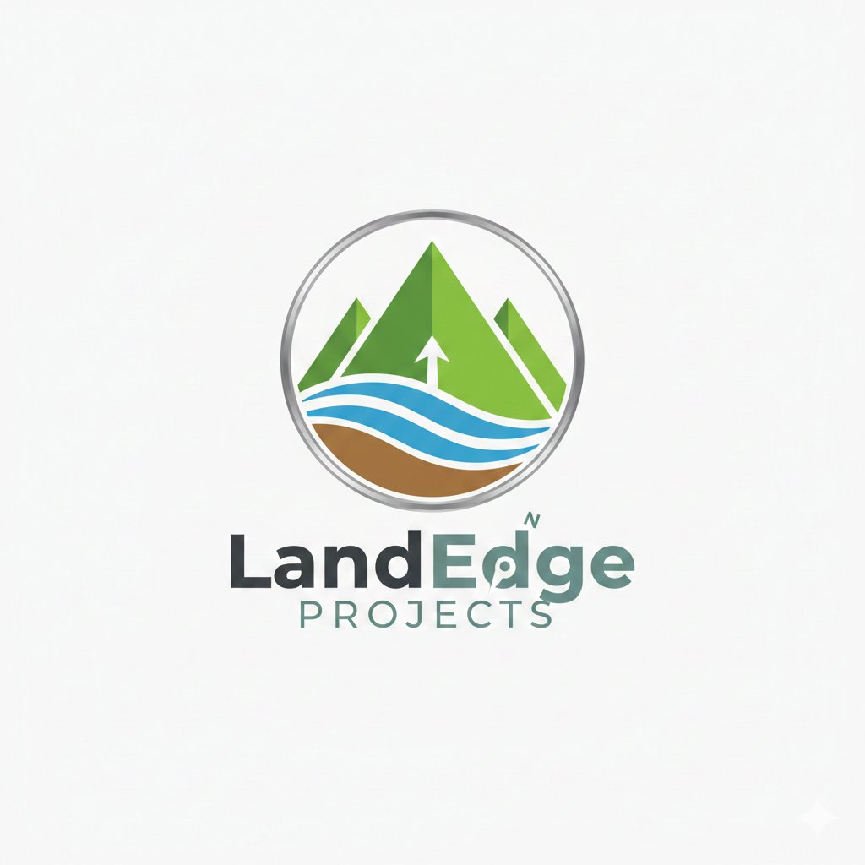
LandEdge
PROJECTS
PART A — COMPANY OVERVIEW
Gujarat's Leading
Industrial Land
Developer
PART B — PROJECT VADODARA
Premium industrial plots. Wide roads. Highway connectivity.
RERA-compliant estates across Gujarat's DMIC corridor.
DMIC
RERA
₹250 Cr+
3 Yr
Corridor Focus
All Projects
Revenue Pipeline
Full Exit
INVESTOR PRESENTATION · 2026

Slide 2

PROMOTER · MAIN FOUNDER
STRATEGIC FOCUS
VG
Redefining wholesale distribution through category-driven models;
Building next-generation Industrial, Commercial Parks in High-Growth regions
CORE STRENGTHS
Project conceptualisation & end-to-end execution
Scaling distribution-led businesses
Vikas Gupta
Building D2C brands in FMCG & personal care
CS | MBA — IIM Ahmedabad
TRACK RECORD
Built & scaled multiple ventures across sectors
22+
10+
Successfully scaled D2C brands in competitive markets
Years
Entrepreneurial
Experience
Years
Active
Investing
Strong execution capability from idea to scale
EDGE
Combines operator mindset with investor perspective — enabling disciplined growth, capital-efficient scaling and systems that last.
LandEdge Projects · Investor Presentation 2026
CONFIDENTIAL
2 / 17

Slide 3




PART A · COMPANY OVERVIEW
About LandEdge Projects
Who We Are
Industrial Plot Development
LandEdge Projects is a Gujarat-based specialist industrial land developer. We identify, acquire and develop premium industrial estates along Gujarat's DMIC corridor — delivering RERA-compliant plots to manufacturers, MSMEs and logistics operators.
Sub-divided, RERA plots with all utilities — start construction Day 1
Logistics & Warehousing Zones
Our Difference
25,000–30,000 sq ft large-format plots for 3PL and bulk storage
Infrastructure before sales. We complete all roads, utilities, boundary walls and landscaping before a single plot is offered — ensuring buyers receive a genuinely construction-ready asset, not a promise.
Commercial & MSME Clusters
Retail frontage plots supporting the park's business ecosystem
"Democratise industrial land ownership — every MSME deserves world-class infrastructure at accessible price points."
Land Aggregation Pipeline
Sourcing 50–100 bigha NH-adjacent parcels across Gujarat
LandEdge Projects · Investor Presentation 2026
CONFIDENTIAL
3 / 17

Slide 4





PART A · OUR PROCESS
How We Work — End to End
Core Principle: All infrastructure is 100% complete before the first plot is offered for sale — no half-built handovers, ever.
01
02
03
04
05
Site
Identification
Due Diligence
& Approvals
Infrastructure
Construction
Plot Sales
Launch
Possession
& Exit
NH-adjacent parcels, title clear, zone compatible, 50–100 bigha
Legal, RERA, NA conversion, town planning, env clearance
Roads, utilities, boundary wall, drainage, landscaping — all done before sale
Broker network, direct outreach, registered sale agreements
Plot-ready handover, utility transfer, investor distributions
LandEdge Projects · Investor Presentation 2026
CONFIDENTIAL
4 / 17

Slide 5


PART A · COMPETITIVE EDGE
Our USPs — What Sets LandEdge Apart
Infrastructure-First Delivery
RERA-Compliant, Bankable Title
All roads, utilities, boundary wall and drainage completed before marketing. Buyers get a genuinely ready plot — not a layout plan.
Every project is RERA-registered. Buyers can use their plot as collateral for bank loans from Day 1 of possession.
Premium Highway-Frontage Locations
Wide-Road Industrial Standard
Our site selection criteria require NH or State Highway entry. No landlocked sites, no indirect access — trucks in and out without congestion.
18.3m main spine, 12.2m secondary, 9.1m internal — all engineered for heavy truck, container and bulk transport movement.
MSME-Optimised Plot Configurations
Managed Estate Environment
Plot sizes from 11,600 to 30,000 sq ft — designed so an MSME entrepreneur can afford a complete, functional factory floor.
Landscaped green buffer, staffed security gate, compound wall and post-possession estate management create a premium park environment.
LandEdge Projects · Investor Presentation 2026
CONFIDENTIAL
5 / 17

Slide 6





PART A · PRODUCT STANDARD
The LandEdge Infrastructure Standard
Wide Road Network
Power Infrastructure
Water & Drainage
Security & Entry Gate
18.3m spine · 12.2m secondary · 9.1m internal · all-weather truck-grade
Underground electrical duct to plot boundary · dedicated transformer capacity
Piped water supply · independent reservoir · storm drainage network
Grand entry with security cabin · perimeter compound wall · CCTV backbone
Green Buffer
RERA Title & Docs
30 ft Min. Road Frontage
Plot-Ready Handover
Minimum 6% of total estate area landscaped · peripheral tree line
Registered sale deed · RERA certificate · utility connection papers on possession
Every plot has at minimum 30 ft individual road frontage — no shared entrances
Level, surveyed plot · boundary pegs · utility stub at boundary · build Day 1
LandEdge Projects · Investor Presentation 2026
CONFIDENTIAL
6 / 17

Slide 7

PART A · MARKET CONTEXT
Why Gujarat — Why Now
#1
₹28,500Cr
3,000+
18–22%
Ease of Business
DMIC Investment
MSMEs Seeking Land
Land Appreciation p.a.
India — 4 consecutive years
Committed to Gujarat
Active industrial corridors
Vadodara corridor since 2021
KEY DEMAND DRIVERS
OUR SITE SELECTION CRITERIA
Post-GST logistics restructuring driving warehousing demand across Gujarat belt
Within 3 km of NH or State Highway — direct plot entry, no diversion roads
EV, pharma, chemicals & FMCG ancillary units expanding in Vadodara–Anand corridor
Within 5 km of railway freight station or DFC node
Delhi–Mumbai Expressway + Dedicated Freight Corridor convergence in this zone
Adjacent to existing GIDC or established industrial cluster
Acute shortage of sub-20,000 sq ft plots with full utility infrastructure
Within 50 km of major city (Vadodara, Surat, Ahmedabad, Rajkot)
Rising MSME formalisation creates demand for RERA-clear, bankable land assets
Minimum 50 bigha contiguous parcel with clean NA conversion pathway
LandEdge Projects · Investor Presentation 2026
CONFIDENTIAL
7 / 17

Slide 8
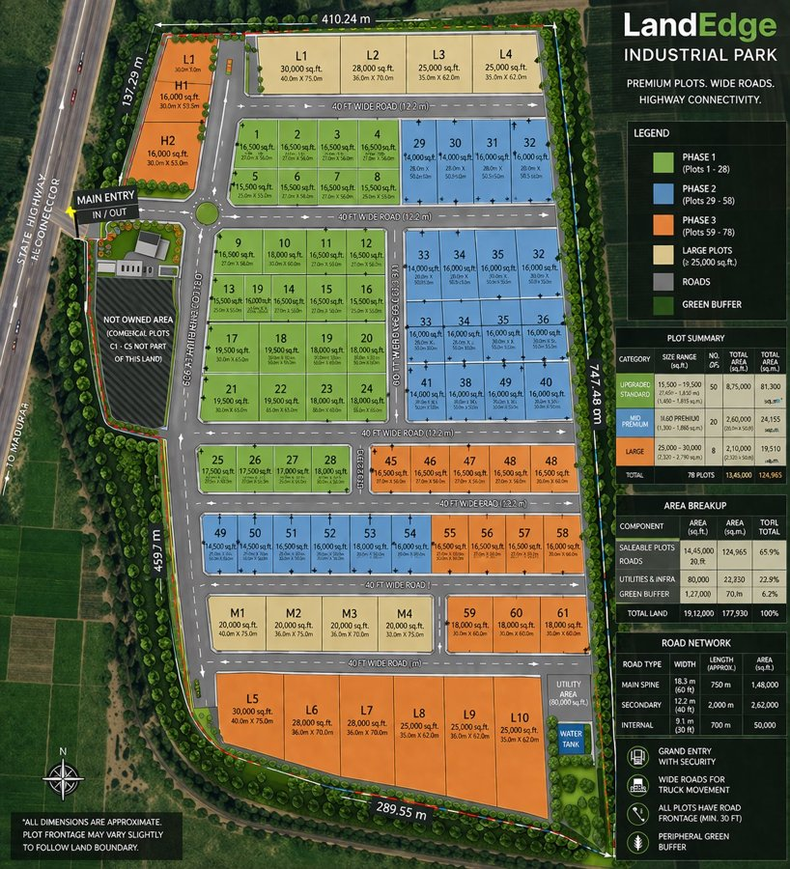
PART A · TRACK RECORD
What We Have Built — What's Coming
LAUNCHED · PHASE 1 ACTIVE
DEVELOPMENT PIPELINE
LandEdge Industrial Park
Project Vadodara
Miyagam, Karjan · NH-48 · Vadodara District, Gujarat
Under NDA · Detailed in Part B
47 Acres
78 Plots
Project Surat
Site identified · Due diligence
Total Land
3 Phases
Project Anand
19.12L sqft
₹100 Cr+
Pipeline · Land aggregation
Gross Area
Target Revenue
Project Rajkot
Pipeline · Market study
Pipeline subject to due diligence completion
LandEdge Projects · Investor Presentation 2026
CONFIDENTIAL
8 / 17

Slide 9
₹85 Cr
PART B
Land Cost
Project
Vadodara
₹145 Cr
Development + Costs
₹250 Cr+
Total Revenue (3 Yr)
Industrial Park Development Opportunity
Vicinity of Vadodara, Gujarat
~₹95 Cr
Net Profit (Base)
Investor-Only · Confidential · Under NDA

Slide 10


PART B · PROJECT VADODARA
The Opportunity — Vadodara Industrial Corridor
WHY VADODARA DISTRICT
PROJECT VADODARA
Strategic Location:
Vadodara sits at the intersection of NH-48 (Delhi–Mumbai), Western Railway freight corridor and the DMIC industrial spine
An industrial park development in the vicinity of Vadodara city — on an NH-adjacent site within the established industrial growth corridor.
DMIC Corridor Benefit:
₹28,500 Cr DMIC investment committed; Vadodara–Anand belt a designated industrial growth node under the national plan
Site Type:
NH-adjacent, DMIC zone
Power & Infrastructure:
Gujarat's power surplus, dedicated freight rail, and lowest-cost manufacturing environment in India converge here
Plot Count:
~100 industrial plots
Existing MSME Density:
400+ active MSMEs in Vadodara–Anand belt across auto, pharma, engineering and chemicals — proven, repeat-buyer market
Target Sector:
Manufacturing, Logistics, MSME
Project Status:
Land under NDA · Parcel details on data room access
Land Value Trajectory:
Industrial land in Vadodara district has appreciated 18–22% p.a. since 2021, driven by post-DMIC announcement demand
Timeline:
6-month infra build · 30-month sales · Full exit Yr 3
Exact parcel details provided on NDA execution
LandEdge Projects · Investor Presentation 2026
CONFIDENTIAL
10 / 17

Slide 11
PART B · PROJECT PARAMETERS
Project Vadodara — Scale & Specifications
~100 Acres
~100+ Plots
~33 Lakh sq ft
Total Land Area
Industrial Plots
Gross Area
NH-adjacent site in Vadodara district industrial zone
Plot sizes 15,000–30,000 sq ft across 3 categories
~65% saleable; remainder roads, utilities, green buffer
3-Phase Layout
Full Infra
RERA Registered
Phased Development
All Utilities Included
Clean Title
Phase 1 launched first; Phase 2 & 3 on momentum
18m spine roads, underground utilities, security gate
RERA filing in Phase 0; possession after full approval
LandEdge Projects · Investor Presentation 2026
CONFIDENTIAL
11 / 17

Slide 12
PART B · FINANCIAL MODEL
Project Vadodara — Cost Structure
TOTAL PROJECT COST BREAKDOWN
COST COMPOSITION
Land Acquisition
58.3%
₹85.00 Cr
₹85Cr
Land Acquisition
Roads, Utilities & Civil Works
19.6%
₹28.50 Cr
Boundary Wall & Security
3.1%
₹4.50 Cr
Civil & Infra
₹36Cr
Landscaping & Green Buffer
2.1%
₹3.00 Cr
Mktg & Finance
₹19.5Cr
RERA, Legal & Approvals
2.4%
₹3.50 Cr
Contingency (5% of Dev.)
1.4%
₹2.00 Cr
Legal & Other
₹5.5Cr
Marketing & Sales (4% of Rev.)
6.9%
₹10.00 Cr
Total Cost ₹146 Cr vs Revenue ₹250 Cr = ~71% Gross Margin
Finance & Carry Cost
6.5%
₹9.50 Cr
TOTAL PROJECT COST
100%
₹146.00 Cr
LandEdge Projects · Investor Presentation 2026
CONFIDENTIAL
12 / 17

Slide 13
PART B · REVENUE MODEL
Project Vadodara — ₹250 Cr Revenue Over 3 Years
YEAR 1 — FOUNDATION
YEAR 2 — ACCELERATION
YEAR 3 — PREMIUM EXIT
Months 1–12
Months 13–24
Months 25–36
₹32 Cr
₹118 Cr
₹100 Cr
revenue target
revenue target
revenue target
Months 1–6: Land acquisition, RERA filing, infra construction
Phase 1 completed; Phase 2 launch (Months 14–15)
Phase 3 launch and final inventory clearance
Month 7: Phase 1 soft launch (broker network activation)
~50 plots sold @ ₹1,050/sqft blended (5% price step-up)
~20 remaining plots @ ₹1,100/sqft (premium end-inventory)
~30 plots sold @ ₹1,000/sqft blended · Avg plot 14,000 sqft
Bulk buyer targeting — logistics, pharma anchor tenants
Price appreciation from park's established environment
Revenue collections begin; breakeven on construction cost
Large-format L-series plots (25,000+ sqft) at premium pricing
Investor distributions commence from Month 30
Year-end cash position turns positive by Month 10–11
Breakeven on full project cost achieved in Q6–Q7
Full project exit by Month 36; all plots sold
TOTAL PROJECT REVENUE: ₹32 Cr (Yr 1) + ₹118 Cr (Yr 2) + ₹100 Cr (Yr 3) = ₹250 Cr
LandEdge Projects · Investor Presentation 2026
CONFIDENTIAL
13 / 17

Slide 14
PART B · INVESTOR RETURNS
Project Vadodara — Returns Analysis
★ RECOMMENDED BASE CASE
→ BASE CASE
↘ CONSERVATIVE
↗ OPTIMISTIC
100% sell-through · ₹1,050/sqft blended
80% sell-through · ₹950/sqft blended
100% · ₹1,150/sqft + 10% price step-up
Revenue
~₹250 Cr
Revenue
~₹200 Cr
Revenue
~₹280 Cr
Total Cost
₹146 Cr
Total Cost
₹146 Cr
Total Cost
₹146 Cr
Net Profit
~₹104 Cr
Net Profit
~₹54 Cr
Net Profit
~₹134 Cr
Project ROI
~71%
Project ROI
~37%
Project ROI
~92%
IRR p.a.
~38% p.a.
IRR p.a.
~22% p.a.
IRR p.a.
~48% p.a.
Current market rate ₹900–1,100/sqft in Vadodara corridor
Assumes 20% plots remain unsold by Year 3
Assumes 10% annual price appreciation from launch
Breakeven at ₹830/sqft · Well below current Vadodara corridor market rate of ₹900–1,100/sqft · All projections pre-tax
LandEdge Projects · Investor Presentation 2026
CONFIDENTIAL
14 / 17

Slide 15
PART B · CASH FLOW PROFILE
Project Vadodara — Revenue Ramp & Quarterly Cash Flow
KEY MILESTONES
Q1–Q2
Land acquisition & RERA filing
Q2–Q3
Full infrastructure construction
Q3
Phase 1 soft launch — sales begin
Q4–Q5
40 plots sold; Phase 2 launch
Q6–Q7
Cash breakeven (cumulative)
Q7–Q8
Bulk & institutional buyer push
Q9–Q10
Phase 3 launched; premium pricing
Q11–Q12
Investor distributions begin
Q12
Full exit — all plots sold
LandEdge Projects · Investor Presentation 2026
CONFIDENTIAL
15 / 17

Slide 16
PART B · RISK MANAGEMENT
Project Vadodara — Key Risks & Mitigations
Risk Factor
Likelihood
Impact
Mitigation Strategy
Slow Sales Absorption
Medium
High
Phased pricing + broker network. Even at 80% sell-through, project delivers ₹54 Cr profit. Breakeven at ₹830/sqft — well below market.
Cost Overrun
Low
Medium
5% contingency built in. Fixed-price contracts for all civil works. Infrastructure spec locked before contracting.
Approvals / RERA Delay
Medium
Medium
RERA filed in Month 1. Gujarat has India's fastest approval turnaround. NA conversion pathway verified pre-acquisition.
Land Title / Litigation
Low
High
Full legal due diligence and title search completed under NDA before any investor commitment. Title insurance available.
Market Price Correction
Low
Medium
Breakeven at ₹830/sqft vs market rate ₹900–1,100/sqft. No dependency on price appreciation to generate strong returns.
Liquidity / Investor Exit
Low
Low
Land as hard collateral from Day 1. Revenues from Month 7. Investor distributions structured from Month 30 onwards.
LandEdge Projects · Investor Presentation 2026
CONFIDENTIAL
16 / 17

Slide 17
LandEdge Projects
NEXT STEPS
INDUSTRIAL · LOGISTICS · COMMERCIAL
01
Execute NDA
Join a High-Conviction
Industrial Opportunity
Receive full data room: financial model, land records, layout plan
02
Site Visit
Our team will walk you through the site and project vision
We are seeking capital partners and co-investors for Project Vadodara — a large-scale industrial park development in Vadodara district targeting ₹250 Cr revenue over 36 months.
03
Term Sheet
Full transparency — financial model, land records and layout on NDA execution
Agree funding structure, return mechanics and governance
Site visit arranged within 24 hours of mutual NDA
Flexible structures: equity, LAP debt, or hybrid profit-share
04
Financial Close
Experienced promoter team with active project track record
Legal due diligence + final documentation + capital call
landedge.projects@gmail.com · Gujarat, India
Investor window open — NDA available now

