Slide 1

DWB Updates
7/19 – 7/30

Slide 2
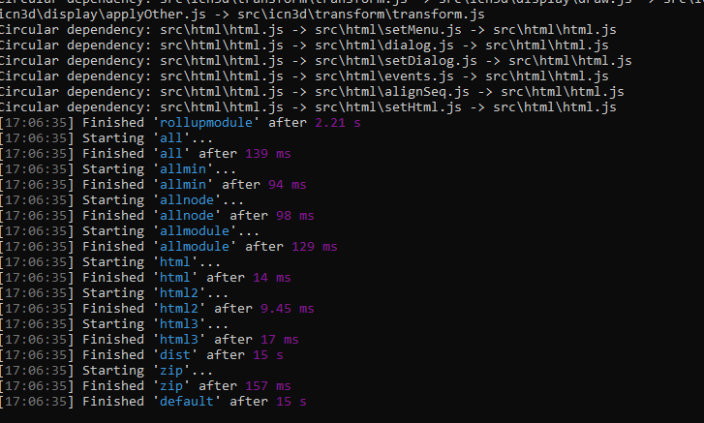
Gulp Error Fixed

Slide 3
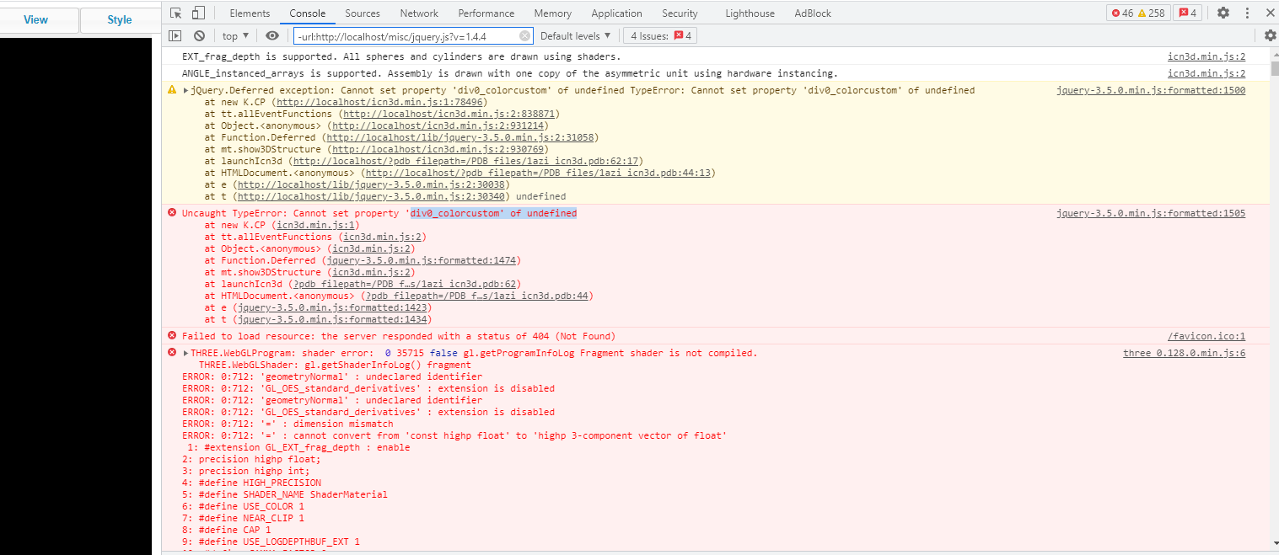
Imported new Files From Dist

Slide 4
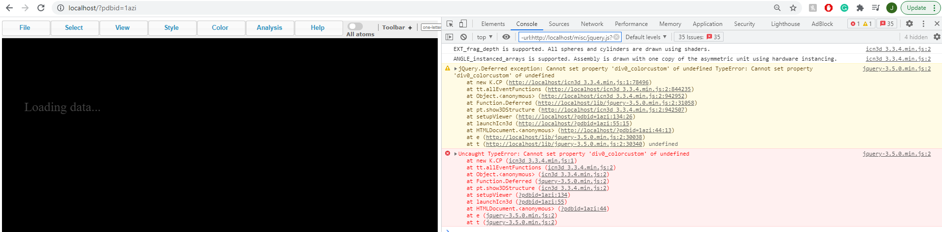
Gulp icn3d_3.3.4.min.js

Slide 5

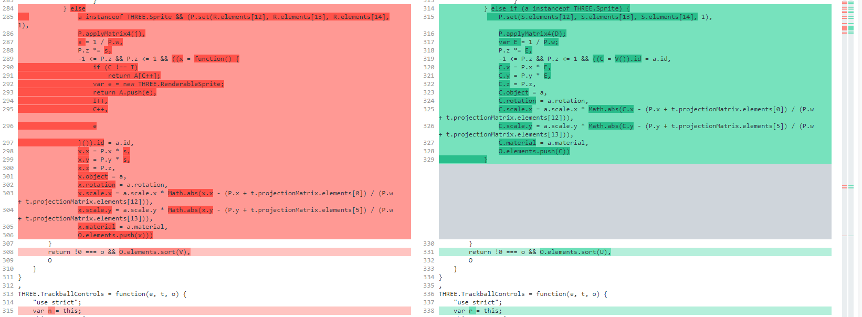
ncbI cOMPARISON

Slide 6
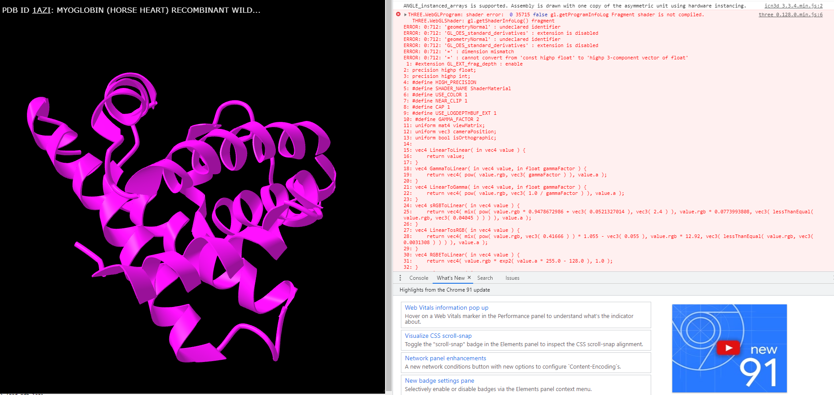
GULP Three_0.128.0.min.js

Slide 7
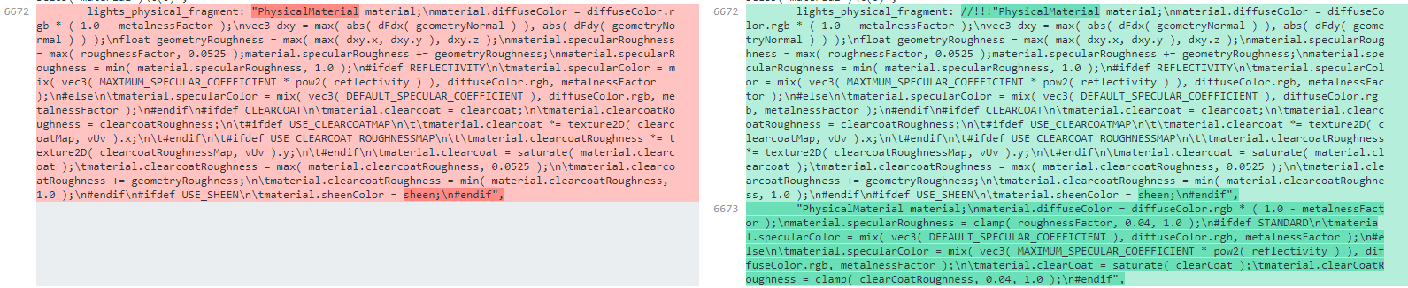
Ncbi cOMPARISON

Slide 8
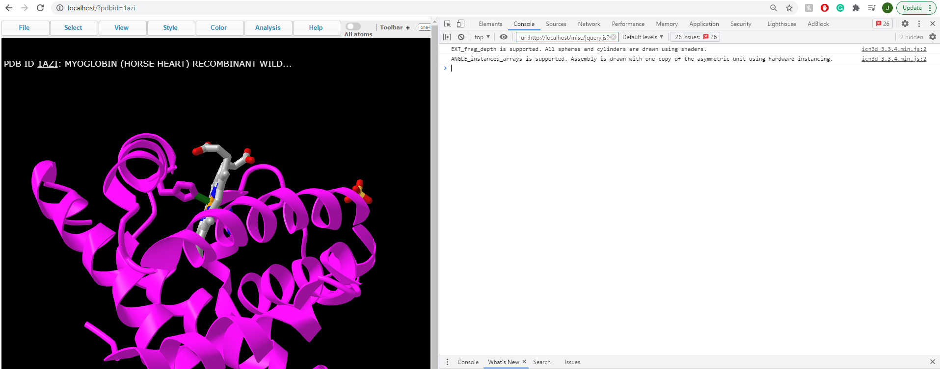
Final Result After debugging

Slide 9
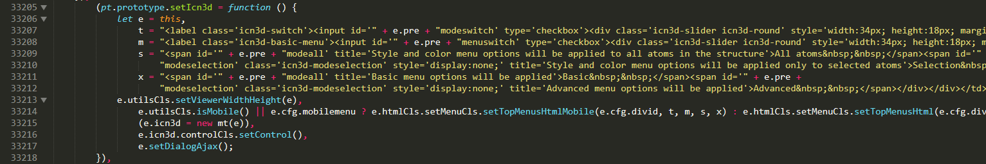
Reconfiguring seticn3d

Slide 10
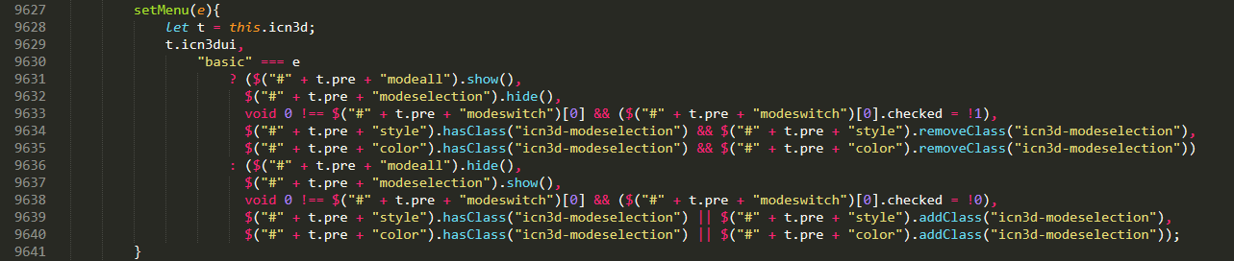
Create function setMenu(e)

Slide 11
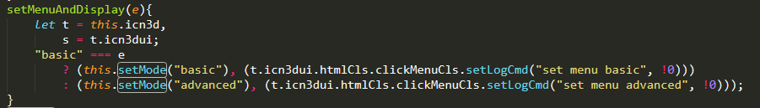
Create Function SetMenuAndDisplay

Slide 12
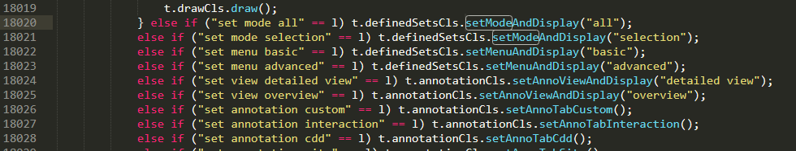
Update apply command

Slide 13
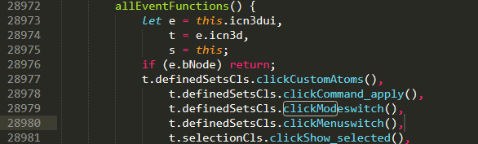
Update allEventFunctions

