Slide 1
Microservices

Slide 2
Monolithic application view
Using a “monolith” architecture
All-in-One application
Client
Web
Mobile
Server
Shopping Application
Store, Config, Cart...
DB

Slide 3
Microservices view
Main application divided into a set of sub-applications
Called microservices
Client
Web
Mobile
Server
API Gateway(s)
Shopping
Service
Store
Catalog
Cart
StoreDB
ProductsDB
CartDB

Slide 4
Two key features of Microservices
Loose coupling
Effect of the change is isolated
Hence can change independently
Tight cohesion
Deals with single view of the data
Code performs a single well defined task

Slide 5
Microservices advantages
Smaller code base is easy to maintain
Easy to scale
Scale individual component
Technology diversity
Mix libraries, frameworks, data storage, languages
Fault Isolation
Component failure should not bring whole system down
Better support for smaller, parallel teams
Independent deployment

Slide 6
2 components of Microservices
Microservices is an ecosystem of several components and out-of-the-box services working together
Two of the basic components in an Spring based microservices development world are:
Service discovery
Client side load balancing

Slide 7
Spring cloud ecosystem
Spring Cloud
Spring Cloud
Connectors
Spring Cloud
Config
Spring Cloud
Netflix *
Spring Cloud
Security
Spring Cloud
Data Flow
Spring Cloud
Cloud Foundry
Spring Cloud
Bus
Spring Cloud
Consul
Spring Cloud
CLI
Spring Cloud
Modules
Spring Cloud
For AWS
Spring Cloud
Cluster
Spring Cloud
Stream
IaaS
Integration
Dynamic
Reconfiguration
Service Infrastructure
Utilities
Data
Ingestion

Slide 8
Need for service discovery
Multiple instances
for throughput
and resilience
Product
Catalog
Service
Cart
Service
Checkout
Service
REST request
Cart
Service
Cart
Service
JSON
Need Service Discovery
Order
DB
Cart
DB
Which
Instance?

Slide 9
Need of discovery service
Discovery
Server(s)
2. Register
Cart
Service
1. Register
Checkout
Service
Discovery
Server(s)
register
3. Find Cart
Service
Cart URL(s)
register
consult
Product
Catalog
Service
Cart
Service
Checkout
Service
REST request
Cart
Service
Cart
Service
JSON
4. Make a request
Cart
DB
Products
DB

Slide 10
Client side load balancing
Discovery server may return the location of multiple instances
Client needs to pick one
We will use Netflix Ribbon
Provides several algorithms for client-side load-balancing
Spring provides a smart RestTemplate
Service-discovery and load-balancing built-in
@LoadBalanced

Slide 11
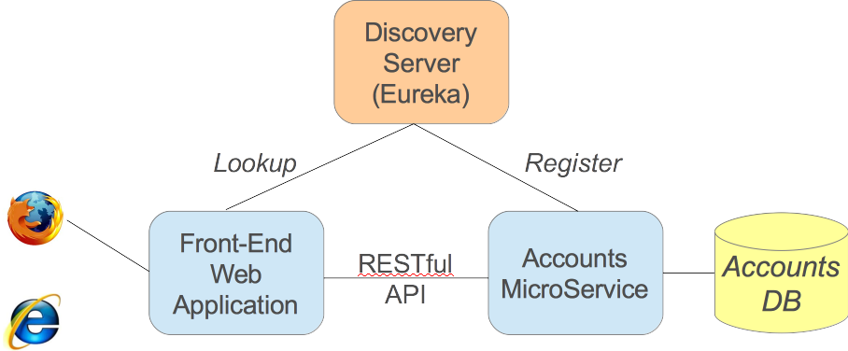
A sample microservice environment
A
C
B
Consumer
Producer
requests
data from

Slide 12
Steps in building the sample setup
A) We will run a Discovery Service
We will see how to create a Eureka Discovery Service
B) Then, run a Microservice (the Producer)
Ensure it registers itself with the Discovery Service
Registers its logical service name with A
C) Consumer to find the producer through discovery service
Discovery client using a “smart” RestTemplate
Spring performs service lookup for you
Uses logical service names in URLs

Slide 13
Maven dependencies
<parent>
<groupId>org.springframework.cloud</groupId>
<artifactId>spring-cloud-starter-parent</artifactId>
<version>Brixton.SR4</version>
</parent>
<dependencies>
<dependency>
<groupId>org.springframework.boot</groupId>
<artifactId>spring-boot-starter-web</artifactId>
</dependency>
<dependency>
<groupId>org.springframework.cloud</groupId>
<artifactId>spring-cloud-starter</artifactId>
</dependency>
<dependency>
<groupId>org.springframework.cloud</groupId>
<artifactId>spring-cloud-starter-eureka</artifactId>
</dependency>
</dependencies>

Slide 14
Eureka server
server:
port: 8761
eureka:
instance:
hostname: localhost
client: # Not a client
registerWithEureka: false
fetchRegistry: false
application.yml
@SpringBootApplication
@EnableEurekaServer
public class EurekaApplication {
public static void main(String[] args) {
SpringApplication.run(EurekaApplication.class, args);
}
}
main.java
pom.xml
<dependency>
<groupId>org.springframework.cloud</groupId>
<artifactId>spring-cloud-starter-eureka-server</artifactId>
</dependency>

Slide 15
Producer microservice
@SpringBootApplication
@EnableDiscoveryClient
public class AccountsApplication {
public static void main(String[] args) {
SpringApplication.run(Application.class, args);
}
}
spring:
application:
name: accounts-microservice
eureka:
client:
serviceUrl:
defaultZone: http://localhost:8761/eureka/
Service name
Eureka Server URL

Slide 16
Consumer service
@SpringBootApplication
@EnableDiscoveryClient
public class FrontEndApplication {
public static void main(String[] args) {
SpringApplication.run(Application.class, args);
}
// Will use this template to access the microservice
// Spring will enhance this to do service discovery
@Bean @LoadBalanced
public RestTemplate restTemplate() {
return new RestTemplate();
}
}

Slide 17
Consumer service
@Service
public class RemoteAccountManager implements AccountService {
// Spring injects the “smart” service-aware template
// defined on previous slide
// It performs a load-balanced lookup (see next slide)
@Autowired
@LoadBalanced
RestTemplate restTemplate;
public Account findAccount(String id) {
// Fetch data
return restTemplate.getForObject
("http://accounts-microservice/accounts/{id}",
Account.class, id);
}
}

Slide 18
Conditional creation of bean
Create using @LoadBalanced – an @Qualifier
Spring enhances it to do service lookup & load-balancing
Inject using same qualifier
If there are multiple RestTemplates you get the right one
Can be used to access multiple microservices
@Bean @LoadBalanced
public RestTemplate restTemplate() {
return new RestTemplate();
}
@Autowired
@LoadBalanced
RestTemplate restTemplate;

Slide 19
Feign client
Feign clients are declarative web service clients which remove the need for boiler plates related to client objects (Rest Template etc.)
Following are key elements of a Feign client implementation:
Contract for the target web service (interface annotated with @FeignClient)
Feign client application which is annotated with @EnableFeignClients (this is the client spring boot application which needs to talk with the target remote web service)

Slide 20
Circuit breaker
The Circuit breaker pattern’s objective is to prevent catastrophic cascading failure across multiple systems. The circuit breaker pattern helps to build a fault tolerant and resilient system that can survive gracefully when key services are either unavailable or have high latency.
There are 3 different states:
Closed
Open
Half open

