Slide 1
Spring Data

Slide 2
Spring JDBC – The basic advantage
Steps Required
-Access a data source and establish a connection
-Begin a transaction
-Do the work – execute business logic
-Commit or rollback the transaction
-Close the connection
Spring Advantages
-No code to implement (classic cross-cutting concern)
-No connection or session leakage
-Throws own exceptions, independent of underlying API

Slide 3
Templates – A very powerful way to integrate
Widely used and useful pattern
http://en.wikipedia.org/wiki/Template_method_pattern
Define the outline or skeleton of an algorithm
-Leave the details to specific implementations later
-Hides away large amounts of boilerplate code
Spring provides many template classes
-JdbcTemplate
-JmsTemplate, RestTemplate, WebServiceTemplate …
-Most hide low-level resource management

Slide 4
JDBC – Traditional code
public List findByLastName(String lastName) {
List personList = new ArrayList();
Connection conn = null;
String sql = "select first_name, age from PERSON where last_name=?";
try {
DataSource dataSource = DataSourceUtils.getDataSource();
conn = dataSource.getConnection();
PreparedStatement ps = conn.prepareStatement(sql);
ps.setString(1, lastName);
ResultSet rs = ps.executeQuery();
while (rs.next()) {
personList.add(new Person(rs.getString("first_name"), ...));
}
} catch (SQLException e) { /* ??? */ }
finally {
try {
conn.close();
} catch (SQLException e) { /* ??? */ }
}
return personList;
}

Slide 5
JDBC – Boiler plate code
public List findByLastName(String lastName) {
List personList = new ArrayList();
Connection conn = null;
String sql = "select first_name, age from PERSON where last_name=?";
try {
DataSource dataSource = DataSourceUtils.getDataSource();
conn = dataSource.getConnection();
PreparedStatement ps = conn.prepareStatement(sql);
ps.setString(1, lastName);
ResultSet rs = ps.executeQuery();
while (rs.next()) {
personList.add(new Person(rs.getString(“first_name”), ...));
}
} catch (SQLException e) { /* ??? */ }
finally {
try {
conn.close();
} catch (SQLException e) { /* ??? */ }
}
return personList;
}

Slide 6
Error classes for various error codes
Select iddd from T_ACCOUNT
Plain JDBC
Spring
java.sql.SQLException
Message: Column not found:
IDDD in statement
errorCode: -28
java.sql.SQLException
Message: Column not found:
IDDD in statement
errorCode: -28
Error code mapping
BadSqlGrammarException
Message: PreparedStatementCallback;
bad SQL grammar … Column not found:
IDDD in statement

Slide 7
Embedded database builder
@Bean
public DataSource dataSource() {
EmbeddedDatabaseBuilder builder = new EmbeddedDatabaseBuilder();
return builder.setName("testdb")
.setType(EmbeddedDatabaseType.HSQL)
.addScript("classpath:/testdb/schema.db")
.addScript("classpath:/testdb/test-data.db").build();
}

Slide 8
JDBC Template
Requires a DataSource
Create a template once and re-use it
Do not create one for each thread
Thread safe after construction
JdbcTemplate template = new JdbcTemplate(dataSource);

Slide 9
Query for simple object
public Date getOldest() {
String sql = "select min(dob) from PERSON";
return jdbcTemplate.queryForObject(sql, Date.class);
}
public long getPersonCount() {
String sql = "select count(*) from PERSON";
return jdbcTemplate.queryForObject(sql, Long.class);
}

Slide 10
Using binding variables
private JdbcTemplate jdbcTemplate;
public int getCountOfNationalsOver(Nationality nationality, int age) {
String sql = "select count(*) from PERSON " +
"where age > ? and nationality = ?";
return jdbcTemplate.queryForObject
(sql, Integer.class, age, nationality.toString());
}

Slide 11
RowMapper
Spring provides a RowMapper interface for mapping a single row of a ResultSet to an object
-Can be used for both single and multiple row queries
-Parameterized as of Spring 3.0
public interface RowMapper<T> {
T mapRow(ResultSet rs, int rowNum) throws SQLException;
}

Slide 12
Querying for domain objects
public Person getPerson(int id) {
return jdbcTemplate.queryForObject(
"select first_name, last_name from PERSON where id=?",
new PersonMapper(), id);
}
No need to cast
Maps rows to Person objects
Parameterizes return type
class PersonMapper implements RowMapper<Person> {
public Person mapRow(ResultSet rs, int rowNum) throws SQLException {
return new Person(rs.getString("first_name"),
rs.getString("last_name"));
}
}

Slide 13
Insert or update
public int insertPerson(Person person) {
return jdbcTemplate.update(
“insert into PERSON (first_name, last_name, age)” +
“values (?, ?, ?)”,
person.getFirstName(),
person.getLastName(),
person.getAge());
}
public int updateAge(Person person) {
return jdbcTemplate.update(
“update PERSON set age=? where id=?”,
person.getAge(),
person.getId());
}

Slide 14
JPA, Spring data

Slide 15
Persistent unit
Describes a group of persistent classes (entities)
Defines provider(s)
Defines transactional types (local vs JTA)
Multiple Units per application are allowed
Defined by the file: persistence.xml

Slide 16
Entity manager and factory
EntityManager
Manages a unit of work and persistent objects therein: the PersistenceContext
Lifecycle often bound to a Transaction (usually container-managed)
EntityManagerFactory
thread-safe, shareable object that represents a single data source / persistence unit
Provides access to new application-managed EntityManagers

Slide 17
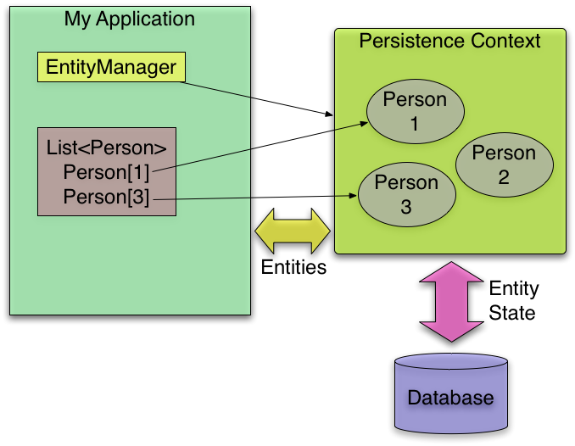
Entity manager and factory integration
Entity
Manager
Factory
creates

Slide 18
Entity
@Entity
@Table(name= “T_CUSTOMER”)
public class Customer {
@Id
@Column(name=“cust_id”)
private Long id;
@Column(name=“first_name”)
private String firstName;
@Transient
private User currentUser;
...

Slide 19
JPA Querying using JPQL
Long customerId = 123L;
Customer customer = entityManager.find(Customer.class, customerId);
// Query with named parameters
TypedQuery<Customer> query = entityManager.createQuery(
“select c from Customer c where c.address.city = :city”, Customer.class);
query.setParameter(“city”, “Chicago”);
List<Customer> customers = query.getResultList();
// … or using a single statement
List<Customer> customers2 = entityManager.
createQuery(“select c from Customer c ...”, Customer.class).
setParameter(“city”, “Chicago”).getResultList();

Slide 20
Spring Data
Spring Data
Core project
JPA
Pivotal
Gemfire
MongoDB
Apache
Hadoop
JDBC
extensions
Sub-projects
Solr
Neo4j
Redis
And more ...

Slide 21
Defining JPA repository
public interface CustomerRepository
extends CrudRepository<Customer, Long> {
public Customer findFirstByEmail(String someEmail); // No <Op> for Equals
public List<Customer> findByOrderDateLessThan(Date someDate);
public List<Customer> findByOrderDateBetween(Date d1, Date d2);
@Query(“SELECT c FROM Customer c WHERE c.email NOT LIKE '%@%'”)
public List<Customer> findInvalidEmails();
}

Slide 22
Configuration class
@Configuration
@EnableJpaRepositories(basePackages="com.acme.repository")
public class CustomerConfig {
@Autowired
public CustomerRepository customerRepository;
@Bean
public CustomerService customerService() {
return new CustomerService( customerRepository );
}
}

