Slide 1
Spring Core – Introduction

Slide 2
Collection of utility, convention, methodology which helps us to ease repeated and duplicate work, hence improving productivity and efficiency in development, testing and deployment: FRAMEWORK

Slide 3
A brief history prior to Spring
The early years:
1995 – Java introduced, Applets are popular
1997 – Servlets introduced
Efficient, dynamic web pages become possible.
1999 – JSP introduced
Efficient, dynamic web pages become easy.
Questions arise regarding “Enterprise” applications
How should a Servlet / JSP application handle:
- persistence, transactions, security, business logic etc.?

Slide 4

Birth of Spring framework
Rod Johnson publishes J2EE Development without EJB
2004 - Spring Framework 1.0 released
Champions dependency injection
Encourages POJOs
Uses XML files to describe application configuration
Becomes popular quickly as an EJB alternative

Slide 5
Spring and Pivotal – The partnership
- SpringSource, the company behind Spring
- acquired by VMware in 2009
- transferred to Pivotal joint venture 2013
- Spring projects key to Pivotal's big-data and cloud strategies
- Cloud Foundry PaaS
- Deploy to private, public, hybrid clouds
- Microservices, Spring Cloud
- Real-time analytics, IoT
- Spot trends as they happen
- Spring Data, Spring Hadoop, Spring Cloud Data Flow

Slide 6
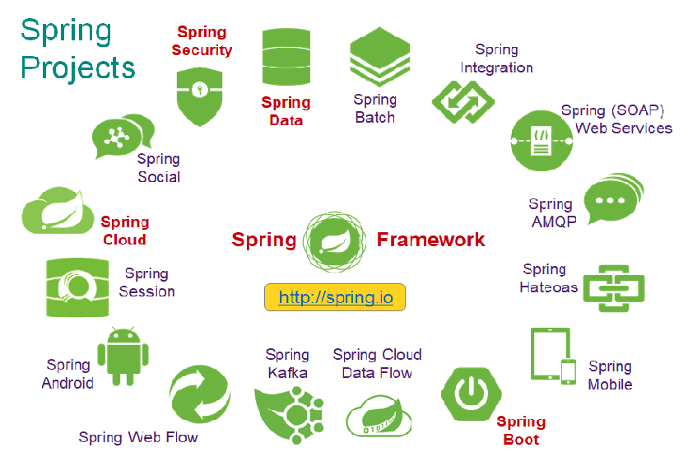
Spring Project Ecosystem

Slide 7
Spring is an open source, lightweight, container and framework for building Java Enterprise class applications: SPRING

Slide 8
Spring Framework – key elements
Open Source
Light weight
Container
Framework

Slide 9
Spring – A lightweight framework
Spring applications do not require a Java EE application server
But they can be deployed on one
Spring is not invasive
Does not require you to extend framework classes or implement framework interfaces for most usage
We write our code as POJOs
Low overhead
Spring jars are relatively small
JARs used in this course are < 8 MB

Slide 10
Spring – A container
Spring serves as a container for your application objects
Our objects do not have to worry about finding / connecting to each other.
Spring instantiates and dependency injects your objects
Serves as a lifecycle manager

Slide 11
Spring – A framework
applications must deal with a wide variety of Enterprise technologies / resources
JDBC, JMS, AMQP, Transactions, ORM / JPA, NoSQL, Security, Web, Tasks, Scheduling, Mail, Files, XML/JSON Marshalling, Remoting, REST services, SOAP services, Mobile, Social, ...
Spring provides framework classes to simplify working with lower-level technologies

Slide 12
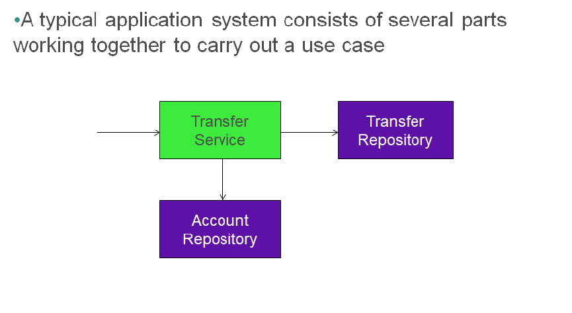
Application Configuration

Slide 13
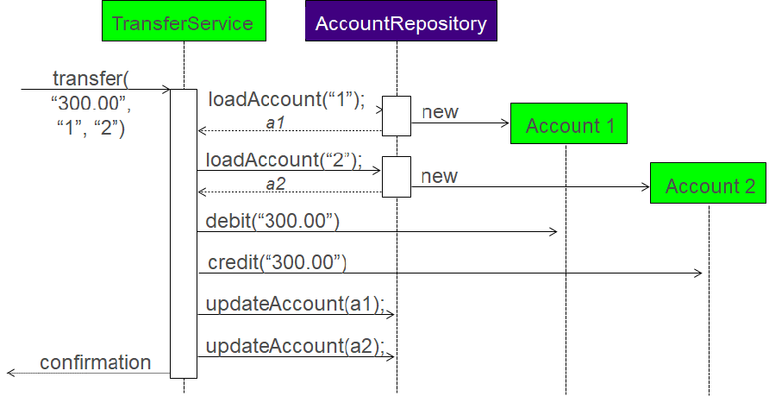
A sample transfer service

Slide 14
Spring’s configuration support
Spring provides support for assembling such an application system from its parts
- Parts do not worry about finding each other
- Any part can easily be swapped out

Slide 15
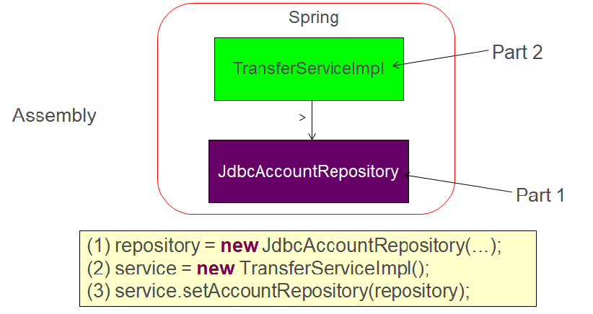
Money transfer example assembly

Slide 16
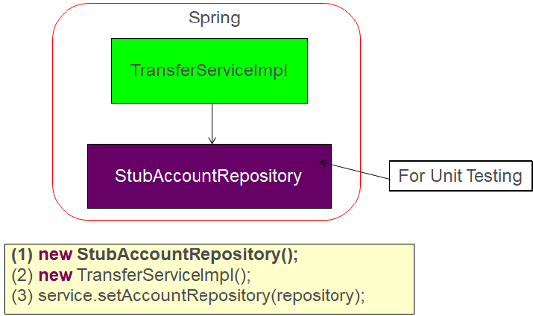
The advantage of swapping out dependency

Slide 17
Configuration

Slide 18
Scopes for creating beans
singleton | A single instance is used
prototype | A new instance is created each time the bean is referenced
session | A new instance is created once per user session (only inside web application)
request | A new instance is created once per request (only inside web application)

Slide 19
Java configuration

Slide 20
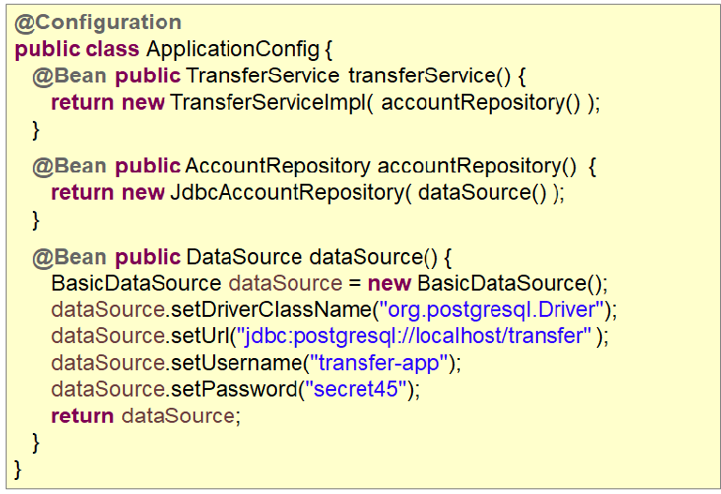
Configuration Class

Slide 21
Accessing a Bean
ApplicationContext context = //acquire application context
// we need to cast to the interface type
TransferService ts1 = (TransferService) context.getBean(“transferService”);
// Using the type parameter
TransferService ts2 = context.getBean(“transferService”, TransferService.class);
// Assuming that service interface is cast by type
TransferService ts3 = context.getBean(TransferService.class );

Slide 22
Multiple configuration classes
@Configuration
@Import({InfrastructureConfig.class, DBConfig.class })
public class PrimaryApplicationConfig {
...
}
@Configuration
public class InfrastructureConfig {
...
}
@Configuration
public class DBConfig {
...
}

Slide 23
Constructor based injection
@Configuration
@Import( InfrastructureConfig.class )
public class PrimaryApplicationConfig {
@Bean
public AccountRepository accountRepository( DataSource dataSource ) {
return new JdbcAccountRepository( dataSource );
}
}
Dependency injection using constructor
@Configuration
public class InfrastructureConfig {
@Bean public DataSource dataSource() {
DataSource ds = new BasicDataSource();
...
return ds;
}
}

Slide 24
What does singleton bean mean?
@Configuration
@Import( InfrastructureConfig.class )
public class PrimaryApplicationConfig {
@Bean
@Scope(“singleton”)
public AccounService accountService() {
return new AccountRepository();
}
}
AccountService service1 = (AccountService) context.getBean(“accountService”);
AccountService service2 = (AccountService) context.getBean(“accountService”);
assert service1 == service2; // True – same objects

Slide 25
Annotation based configuration

Slide 26
After annotation configuration
@Configuration
@ComponentScan(“com.spring”)
public class AnnotationBasedConfig {
}
Component scan to scan through the package and sub packages
@Component
public class TransferServiceImpl implement ITransferService {
@Autowire
public TransferServiceImpl(AccountRepository repository) {
this.repository = repository;
}
}

Slide 27
After annotation configuration
Constructor auto wiring
@Autowired
public TransferServiceImpl(AccountRepository repository) {
}
Setter auto wiring
@Autowired
public void setAccountRepository(AccountRepository repository) {
}
Property auto wiring
@Autowired
private AccountRepository repository;

Slide 28
Constructor vs setter dependency injection
Constructor | Setter
Mandatory dependencies | Optional/changeable dependencies
Immutable dependencies | Circular dependencies
Several parameters at once | Inherited automatically
 | If the constructor requires too many parameters

Slide 29
Auto wiring required or not?
@Autowired (required=false)
public void setAccountRepository(AccountRepository repository) {
}
By default required is true. This means that exception will be thrown if the dependency does not exists.
Making required as false, will inject the dependency only if it exists

Slide 30
Rules for resolving ambiguation
Auto wiring rules for resolving ambiguity are:
Unique bean of required type
Assume @Qualifier if given
Trying to match the bean by name

Slide 31
PostConstruct and PreDestroy
@PostConstruct and @PreDestroy are call back methods invoked during the initialization phase (after constructor and setter)
These annotations are defined by the JSR-250 standard.
Spring’s equivalent for the these annotations is to use @Bean annotations’s initMethod and destroyMethod attributes.
These annotations are being registered and managed by CommonAnnotationPostProcessor (BPP).

Slide 32
Bean life cycle

Slide 33
After annotation configuration
for-each bean ...
Bean Definitions Loaded
Post Process
Bean Definitions
Instantiate Beans
Load Bean Definitions
Setters
Called
Dependency
Injection
Bean
Ready
For Use
Initializer
BPP
BPP
BPP
BPP
Bean Post Processors
Create and Initialize Beans

Slide 34
Profiles

Slide 35
Profiles
ApplicationContext
Beans with
no profile always
available
Transfer
Service
Account
Service
web
Customer
Repository
Account
Repository
Other
Error Handler
Other
Other
dev
Other
data Source
prod
connection
Factory
qa
data Source
data Source
connection
Factory
performance
Monitor
connection
Factory

Slide 36
How to define a profile?
@Configuration
@Profile("dev")
public class DevConfig {
@Bean
public DataSource dataSource() {}
…

Slide 37
Profile at Bean level
@Configuration
public class DataSourceConfig {
@Bean(name="dataSource")
@Profile("dev")
public DataSource devDS() {
}
@Bean(name="dataSource")
@Profile("prod")
public DataSource productionDS() {
}
…

Slide 38
Having one configuration class for all beans
Using system property
-Dspring.profiles.active=dev,pdc
Using system property programmatically
System.setProperty(“spring.profiles.active”,”dev,pdc”)
Using @ActiveProfiles for unit testing

Slide 39
REST

Slide 40
REST
REST is an architectural style that describes best practices to expose web services over HTTP
- REpresentational State Transfer, term by Roy Fielding
- HTTP as application protocol, not just transport
- Emphasizes scalability
- Not a framework or specification

Slide 41
REST principles
Expose resources through URIs
- Model nouns, not verbs
- http://springbank.io/banking/accounts/123456789
- Resources support limited set of operations
GET, PUT, POST, DELETE in case of HTTP
- All have well-defined semantics
- Example: update an order
PUT to /orders/123
don't POST to /order/edit?id=123

Slide 42
Using @RequestMapping
@RequestMapping(path="/orders", method=RequestMethod.DELETE)
public void updateOrders( ... ) {
// delete all Orders
}
@RequestMapping(path="/orders/{id}", method=RequestMethod.PUT)
public void updateOrder( ... ) {
// update order using data from the request
}
Can map HTTP requests based on method
- Allows same URL to be mapped to multiple Java methods
RequestMethod enumerators are
- GET, POST, PUT, PATCH, DELETE, HEAD, OPTIONS, TRACE

Slide 43
Produces and consumes attribute
@RequestMapping(path="/orders", method=RequestMethod.DELETE, produces={“application/xml”}, consumes={“application/json”})
public Order updateOrder( String orderId ) {
// update order and returned updated order
}

Slide 44
Simpler annotations
Alternative handler mapping shortcuts
@RequestMapping(path="/accounts”, method=RequestMethod.GET)
Or @GetMapping("/accounts");
Exist for these HTTP methods
@GetMapping
@PostMapping
@PutMapping
@DeleteMapping
@PatchMapping

