Slide 1
Spring – Java Configuration

Slide 2
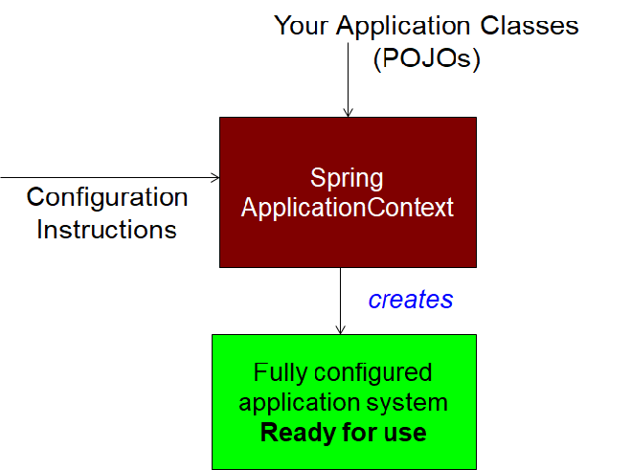
How Spring works

Slide 3
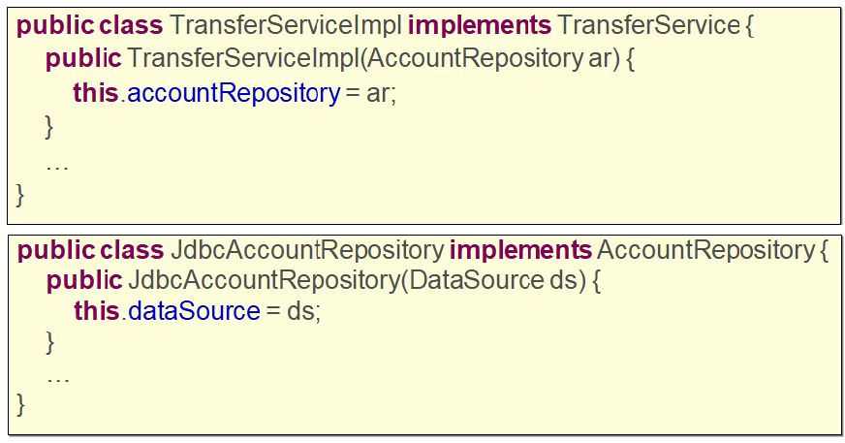
Our Application Classes

Slide 4
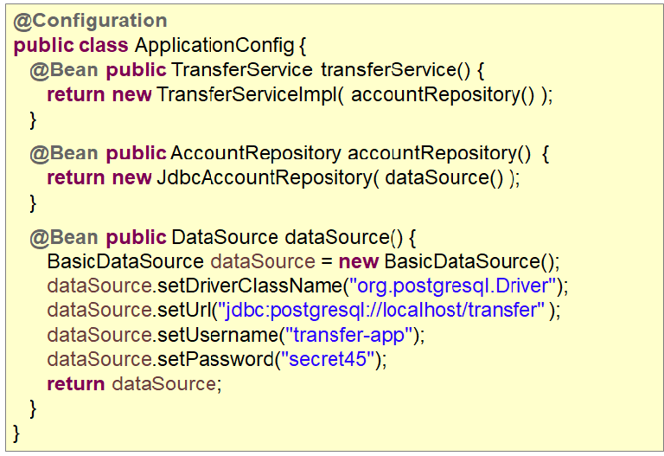
Configuration Class

Slide 5
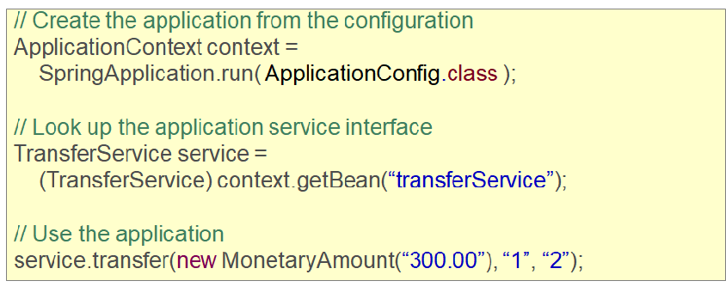
Using the Bean

Slide 6
Accessing a Bean
ApplicationContext context = //acquire application context
// we need to cast to the interface type
TransferService ts1 = (TransferService) context.getBean(“transferService”);
// Using the type parameter
TransferService ts2 = context.getBean(“transferService”, TransferService.class);
// Assuming that service interface is cast by type
TransferService ts3 = context.getBean(TransferService.class );

Slide 7
Application context and its composition
Application context contains the bean and its dependencies
Application Context
TransferServiceImpl
JdbcAccountRepository
BasicDataSource

Slide 8
Ways to create application context
Standalone application
Web application
Junit test cases

Slide 9
Application context for unit test case
public class UnitTestCase {
private TransferService service;
@Before public void setUp() {
ApplicationContext context =
SpringApplication.run( ApplicationConfig.class );
service = context.getBean(TransferService.class);
}
@Test public void testGetBalance() {
service.getBalance(new AccountInfo(“10000000”));
}

Slide 10
Having one configuration class for all beans
@Configuration
public class PrimaryApplicationConfig {
@Bean public TransferService transferService()
{ return new TransferServiceImpl( accountRepository() ); }
@Bean public AccountRepository accountRepository()
{ return new JdbcAccountRepository( dataSource() ); }
@Bean public DataSource dataSource() {
BasicDataSource dataSource = new BasicDataSource();
dataSource.setDriverClassName("org.postgresql.Driver");
dataSource.setUrl("jdbc:postgresql://localhost/transfer" );
dataSource.setUsername("transfer-app");
dataSource.setPassword(“secret45” );
return dataSource;
}
}
Having multiple beans inside one configuration file makes it difficult to decouple and test

Slide 11
Multiple configuration classes
@Configuration
@Import({InfrastructureConfig.class, DBConfig.class })
public class PrimaryApplicationConfig {
...
}
@Configuration
public class InfrastructureConfig {
...
}
@Configuration
public class DBConfig {
...
}

Slide 12
Multiple configuration classes
@Configuration
@Import( InfrastructureConfig.class )
public class PrimaryApplicationConfig {
@Bean
public AccountRepository accountRepository( DataSource dataSource ) {
return new JdbcAccountRepository( dataSource );
}
}
Dependency injection using constructor
@Configuration
public class InfrastructureConfig {
@Bean public DataSource dataSource() {
DataSource ds = new BasicDataSource();
...
return ds;
}
}

Slide 13
Scopes for creating beans
singleton | A single instance is used
prototype | A new instance is created each time the bean is referenced
session | A new instance is created once per user session (only inside web application)
request | A new instance is created once per request (only inside web application)

Slide 14
What does singleton bean mean?
@Configuration
@Import( InfrastructureConfig.class )
public class PrimaryApplicationConfig {
@Bean
@Scope(“singleton”)
public AccounService accountService() {
return new AccountRepository();
}
}
AccountService service1 = (AccountService) context.getBean(“accountService”);
AccountService service2 = (AccountService) context.getBean(“accountService”);
assert service1 == service2; // True – same objects

