Slide 1
Spring – Java Configuration – other topics

Slide 2
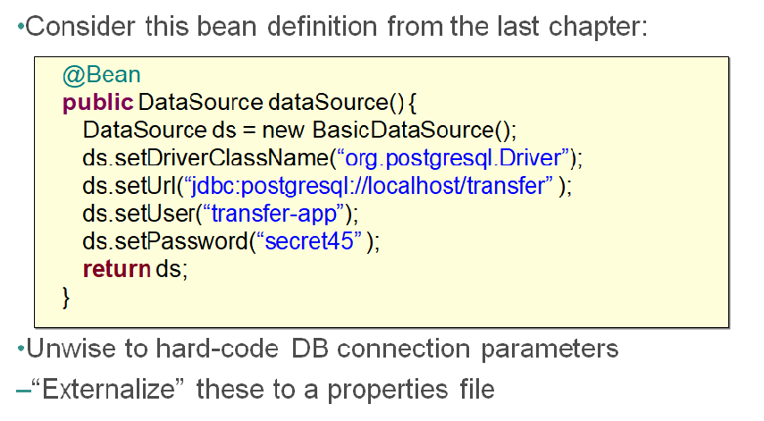
Need to externalize

Slide 3
Environment variables abstraction
In Spring, Environment variable is used as an abstraction to fetch variables from the following places:
JVM system property
Java property file
Servlet context parameters
System environment variables
JNDI

Slide 4
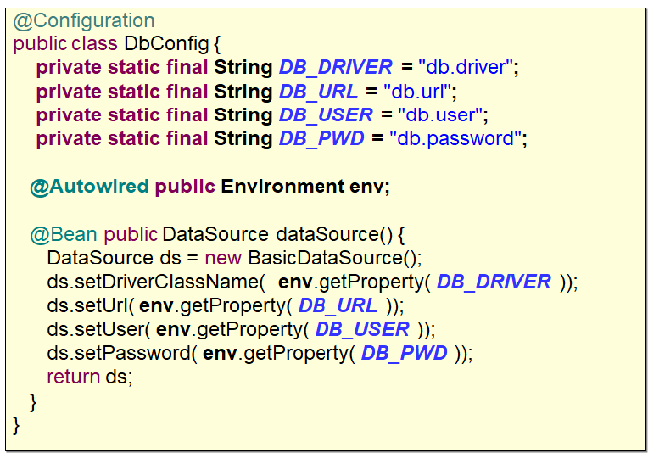
Referring to environment variables

Slide 5
@PropertySource annotation
@Configuration
@PropertySource ( “classpath:/com/spring/sample/app.properties” )
@PropertySource ( “file:config/local.properties” )
public class PrimaryApplicationConfig {
...
}

Slide 6
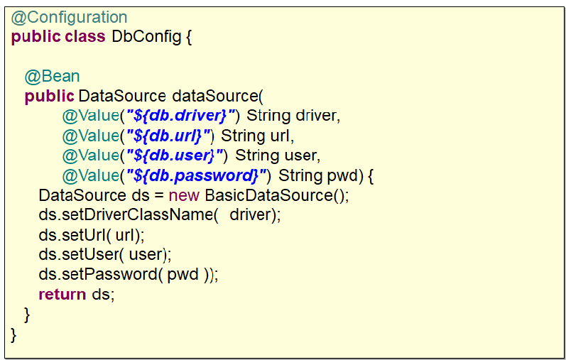
@Value annotation to fetch from environment

Slide 7
PropertySourcePlaceholderConfigurer
@Bean
public static PropertySourcesPlaceholderConfigurer pspc() {
return new PropertySourcesPlaceholderConfigurer();
}
PropertySourcePlaceholderConfigurer is a bean factory post processor responsible for filling the dynamic placeholders (${})

Slide 8
${ } – Placeholders for different environment
@PropertySource (“classpath:/com/spring/app-${ENV}.properties”)
ENV can be input using any of the environment variables

Slide 9
Profiles
ApplicationContext
Beans with
no profile always
available
Transfer
Service
Account
Service
web
Customer
Repository
Account
Repository
Other
Error Handler
Other
Other
dev
Other
data Source
prod
connection
Factory
qa
data Source
data Source
connection
Factory
performance
Monitor
connection
Factory

Slide 10
How to define a profile?
@Configuration
@Profile("dev")
public class DevConfig {
@Bean
public DataSource dataSource() {}
…

Slide 11
Profile at Bean level
@Configuration
public class DataSourceConfig {
@Bean(name="dataSource")
@Profile("dev")
public DataSource devDS() {
}
@Bean(name="dataSource")
@Profile("prod")
public DataSource productionDS() {
}
…

Slide 12
Having one configuration class for all beans
Using system property
-Dspring.profiles.active=dev,pdc
Using system property programmatically
System.setProperty(“spring.profiles.active”,”dev,pdc”)
Using @ActiveProfiles for unit testing

Slide 13
Proxying
@Bean
public AccountRepository accountRepository() {
return new JdbcAccountRepository();
}
@Bean
public TransferService transferService() {
TransferServiceImpl service = new TransferServiceImpl();
service.setAccountRepository(accountRepository());
return service;
}
@Bean
public AccountService accountService() {
return new AccountServiceImpl( accountRepository() );
}
How many times is accountRepository() invoked?

Slide 14
Proxying
@Configuration
public class AppConfig {
@Bean public AccountRepository accountRepository() { ... }
@Bean public TransferService transferService() { ... }
}
inherits
public class AppConfig$$EnhancerByCGLIB$ extends AppConfig {
public AccountRepository accountRepository() { // ... }
public TransferService transferService() { // ... }
}

