Slide 1
Spring – JPA

Slide 2
Spring JPA – An intro
The Java Persistence API is designed for operating on domain objects
Defined as POJO entities
No special interface required
Replaces previous persistence mechanisms
EJB Entity Beans
Java Data Objects (JDO)
A common API for object-relational mapping
Derived from experience with existing products such as JBoss Hibernate and Oracle TopLink (now EclipseLink)

Slide 3
Persistent unit
Describes a group of persistent classes (entities)
Defines provider(s)
Defines transactional types (local vs JTA)
Multiple Units per application are allowed
Defined by the file: persistence.xml

Slide 4
Entity manager and factory
EntityManager
Manages a unit of work and persistent objects therein: the PersistenceContext
Lifecycle often bound to a Transaction (usually container-managed)
EntityManagerFactory
thread-safe, shareable object that represents a single data source / persistence unit
Provides access to new application-managed EntityManagers

Slide 5
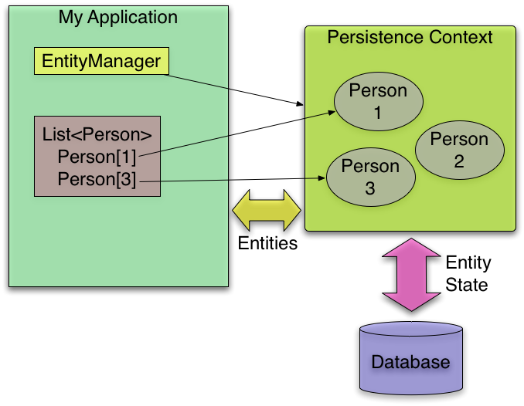
Entity manager and factory integration
Entity
Manager
Factory
creates

Slide 6
JPA Providers
Several major implementations of JPA spec
Hibernate EntityManager
Used inside JBoss
EclipseLink (RI)
Used inside Glassfish
Apache OpenJPA
Used by Oracle WebLogic and IBM Websphere
Data Nucleus
Used by Google App Engine
Can all be used without application server as well
Independent part of EJB 3 spec

Slide 7
JPA Providers
Hibernate adds JPA support through an additional library
The Hibernate EntityManager
Hibernate sessions used behind JPA interfaces
Custom annotations for Hibernate specific extensions not covered by JPA

Slide 8
JPA
JPA requires metadata for mapping classes/fields to database tables/columns
Usually provided as annotations
XML mappings also supported (orm.xml)
Intended for overrides only – not shown here
JPA metadata relies on defaults
No need to provide metadata for the obvious

Slide 9
Entity
@Entity
@Table(name= “T_CUSTOMER”)
public class Customer {
@Id
@Column(name=“cust_id”)
private Long id;
@Column(name=“first_name”)
private String firstName;
@Transient
private User currentUser;
...

Slide 10
JPA Querying using JPQL
Long customerId = 123L;
Customer customer = entityManager.find(Customer.class, customerId);
// Query with named parameters
TypedQuery<Customer> query = entityManager.createQuery(
“select c from Customer c where c.address.city = :city”, Customer.class);
query.setParameter(“city”, “Chicago”);
List<Customer> customers = query.getResultList();
// … or using a single statement
List<Customer> customers2 = entityManager.
createQuery(“select c from Customer c ...”, Customer.class).
setParameter(“city”, “Chicago”).getResultList();

Slide 11
Creating entity manager factory
@Bean
public LocalContainerEntityManagerFactoryBean entityManagerFactory() {
HibernateJpaVendorAdapter adapter = new HibernateJpaVendorAdapter();
adapter.setShowSql(true);
adapter.setGenerateDdl(true);
adapter.setDatabase(Database.HSQL);
Properties props = new Properties();
props.setProperty("hibernate.format_sql", "true");
LocalContainerEntityManagerFactoryBean emfb =
new LocalContainerEntityManagerFactoryBean();
emfb.setDataSource(dataSource);
emfb.setPackagesToScan("rewards.internal");
emfb.setJpaProperties(props);
emfb.setJpaVendorAdapter(adapter);
return emfb;
}

Slide 12
Creating the rest
@Bean
public LocalContainerEntityManagerFactoryBean entityManagerFactory() {
LocalContainerEntityManagerFactoryBean emfb =
new LocalContainerEntityManagerFactoryBean();
emfb.setDataSource(dataSource());
...
return emfb;
}
@Bean
public PlatformTransactionManager
transactionManager(EntityManagerFactory emf) {
return new JpaTransactionManager(emf);
}
@Bean
public DataSource dataSource() { // Lookup via JNDI or create locally. }

Slide 13
EntityManagerFactoryBean configuration
DataSource
CustomerServiceImpl
JPA
CustomerRepository
Entity Manager Factory
LocalContainer
EntityManager
FactoryBean
creates
EntityManager
Proxy automatically finds entity-manager for current transaction
Spring Proxy

Slide 14
EntityManager and Factory injection
Spring defines where transactions occur
-Delegates to a JPA EntityManager to implement them
-Supports local or global (JTA) transactions
Inject EntityManager “proxy” via @PersistenceContext
-JPA's equivalent to @Autowired
-At runtime the proxy resolves to current EntityManager for current transaction in current thread

Slide 15
EntityManager injection
public class JpaCustomerRepository implements CustomerRepository {
private EntityManager entityManager;
@PersistenceContext
public void setEntityManager (EntityManager entityManager) {
this. entityManager = entityManager;
}
public Customer findById(long orderId) {
return entityManager.find(Customer.class, orderId);
}
}

Slide 16
Jpa transaction manager and factory
Spring AOP Proxy
invoke(input)
Spring
TransactionInterceptor
CustomerServiceImpl
Service
proxy handles
transaction
begin
commit
get order
data
Repository's EM
Proxy gets EM
for current thread
JpaTransactionManager
create entity
manager
commit
txn
CustomerRepository
begin
txn
EntityManager
Factory
Entity
Manager (EM)
find order
Entity Manager Proxy
get EM

Slide 17
Overview with JTA
Spring AOP Proxy
invoke(input)
Spring
TransactionInterceptor
CustomerServiceImpl
Service
proxy handles
transaction
get order
data
begin
commit
Proxy gets EM
for current txn
JtaTransaction
Manager
CustomerRepository
find
order
Entity Manager Proxy
begin
txn
commit
txn
get EM
JTA
join
txn
Entity
Manager (EM)
create
EntityManager
Factory

Slide 18
Spring Data
Spring Data
Core project
JPA
Pivotal
Gemfire
MongoDB
Apache
Hadoop
JDBC
extensions
Sub-projects
Solr
Neo4j
Redis
And more ...

Slide 19
Instant repository
Step 1: Annotate domain class
define keys & enable persistence
Step 2: Define your repository as an interface
Spring will implement it at run-time
Scans for interfaces extending Spring's Repository<T, K>
CRUD methods auto-generated
Paging, custom queries and sorting supported
Variations exist for most Spring Data sub-projects

Slide 20
CRUD repository
public interface CrudRepository<T, ID
extends Serializable> extends Repository<T, ID> {
public <S extends T> save(S entity);
public <S extends T> Iterable<S> save(Iterable<S> entities);
public T findOne(ID id);
public Iterable<T> findAll();
public void delete(ID id);
public void delete(T entity);
public void deleteAll();
}

Slide 21
Defining JPA repository
public interface CustomerRepository
extends CrudRepository<Customer, Long> {
public Customer findFirstByEmail(String someEmail); // No <Op> for Equals
public List<Customer> findByOrderDateLessThan(Date someDate);
public List<Customer> findByOrderDateBetween(Date d1, Date d2);
@Query(“SELECT c FROM Customer c WHERE c.email NOT LIKE '%@%'”)
public List<Customer> findInvalidEmails();
}

Slide 22
Enable JPA repository
@Configuration
@EnableJpaRepositories(basePackages="com.acme.repository")
public class CustomerConfig { … }
<jpa:repositories base-package="com.acme.repository"/>

Slide 23
Configuration class
@Configuration
@EnableJpaRepositories(basePackages="com.acme.repository")
public class CustomerConfig {
@Autowired
public CustomerRepository customerRepository;
@Bean
public CustomerService customerService() {
return new CustomerService( customerRepository );
}
}

