Slide 1
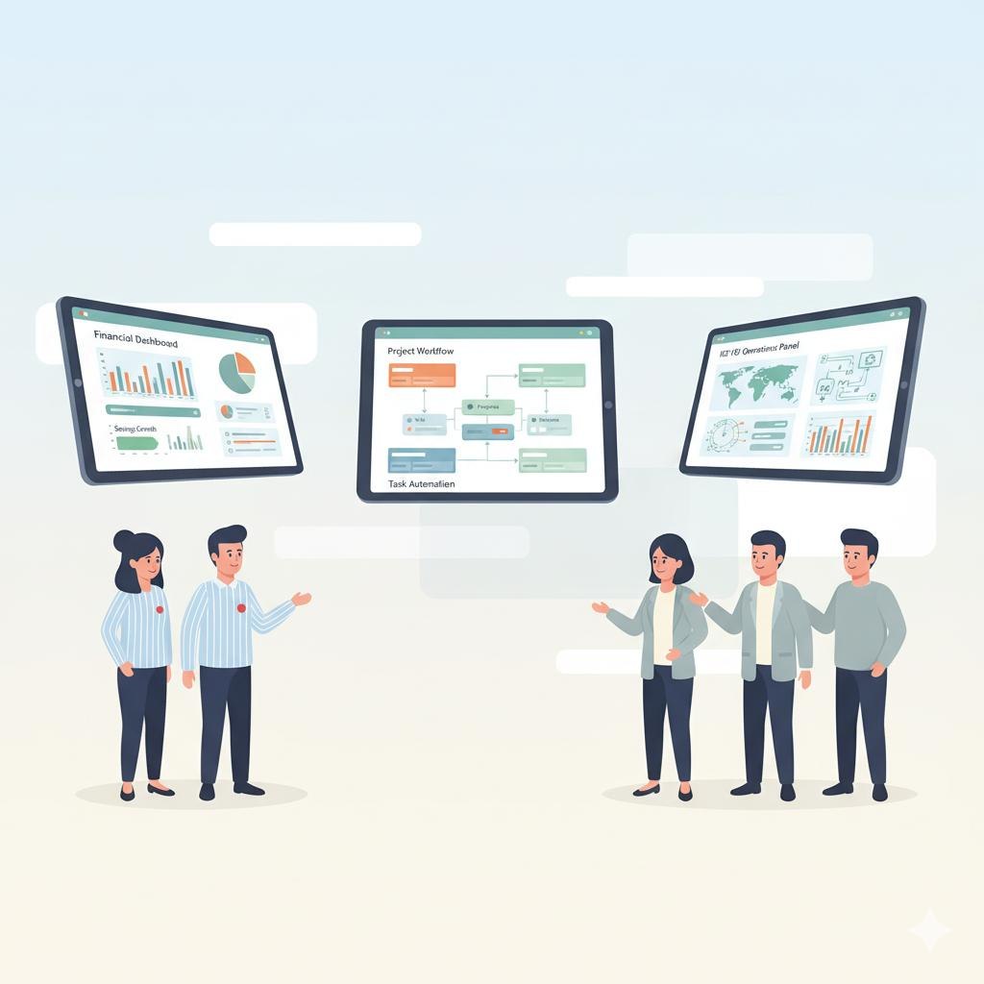
The Past Approach - Third-Party Solutions
Approach: One problem statement, one distinct software solution.
Challenges:
Processes adjusted to in built standard software
Lack of flexibility, high lead time.
Development cost involved.

Slide 2
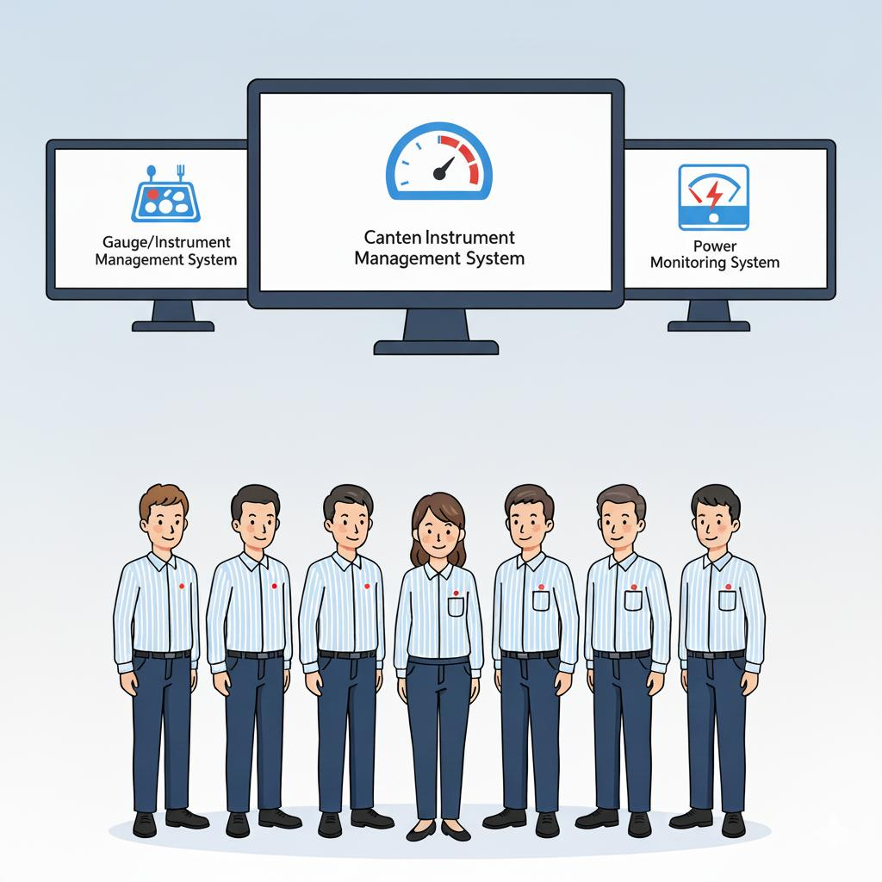
Formation of In-House Digitization Team
Solution: Developed applications in-house.
Benefits:
Software built around existing workflows.
More control, faster results, cost savings.

Slide 3
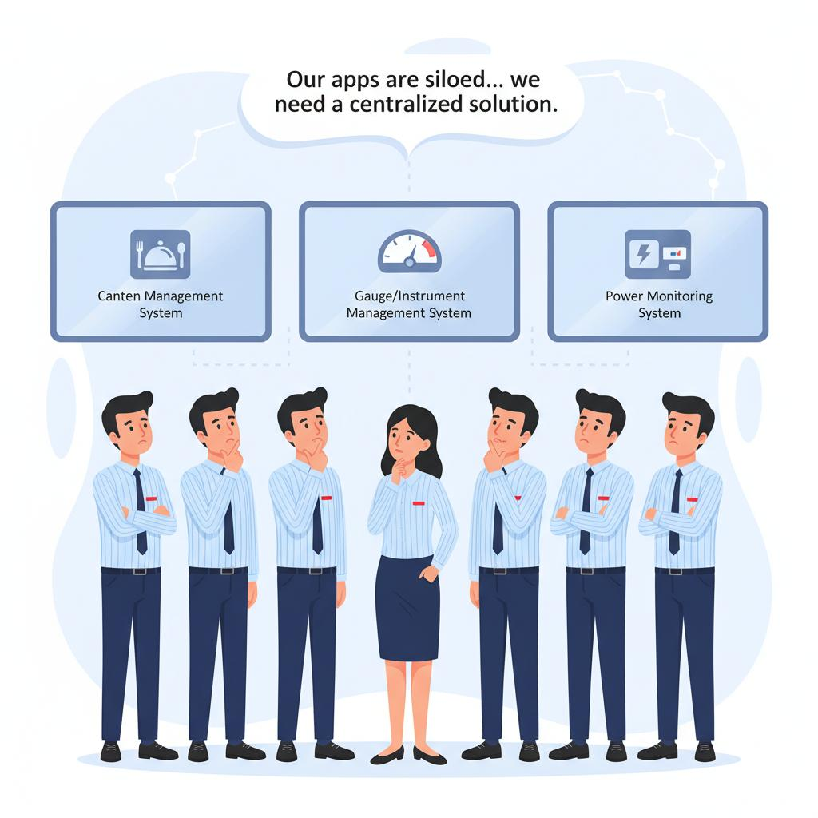
The New Challenge - Siloed In-House Solutions
Realization: Still one application per problem.
Issue: Siloed solutions, lack of centralization.

Slide 4
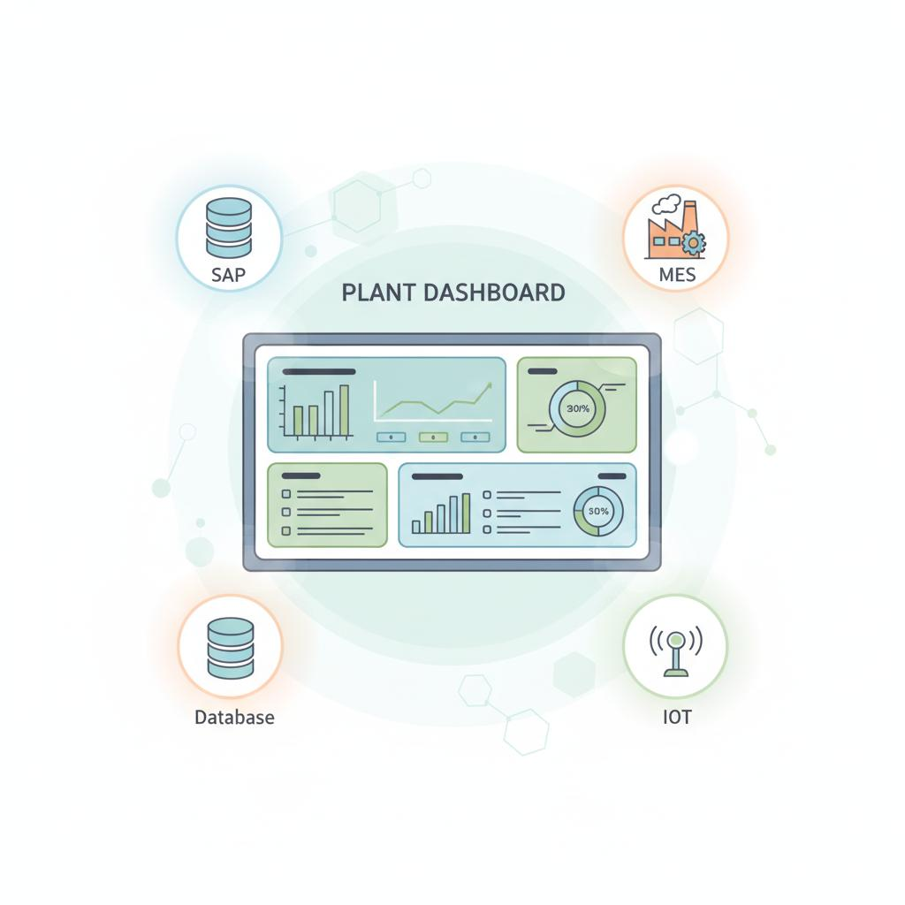
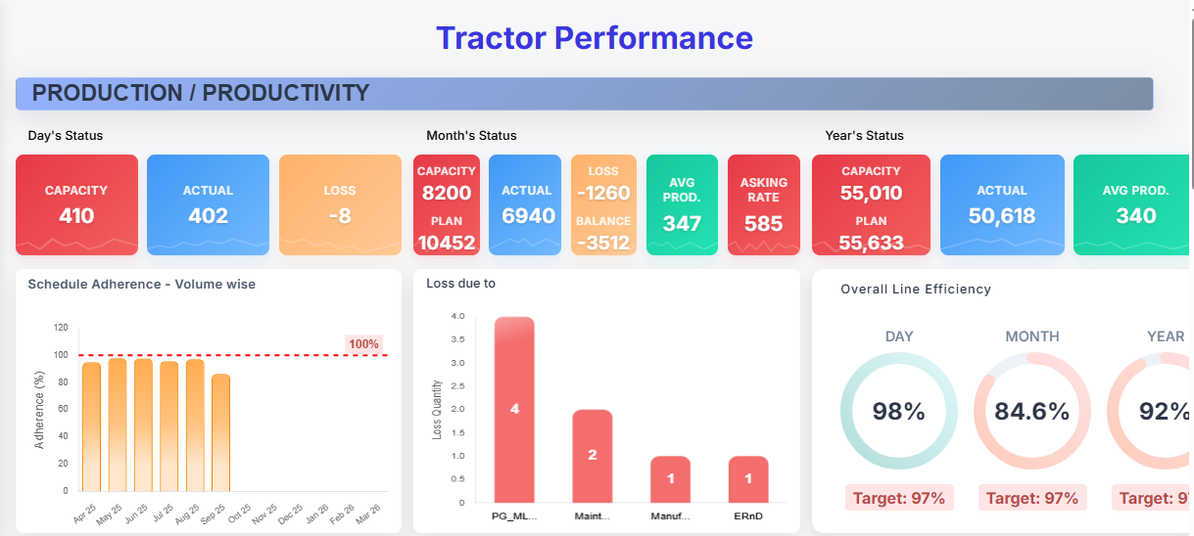
Introducing the Plant Dashboard: Our Integrated Core
The New Concept: Multiple problem statements within a single, unified platform.

Slide 5
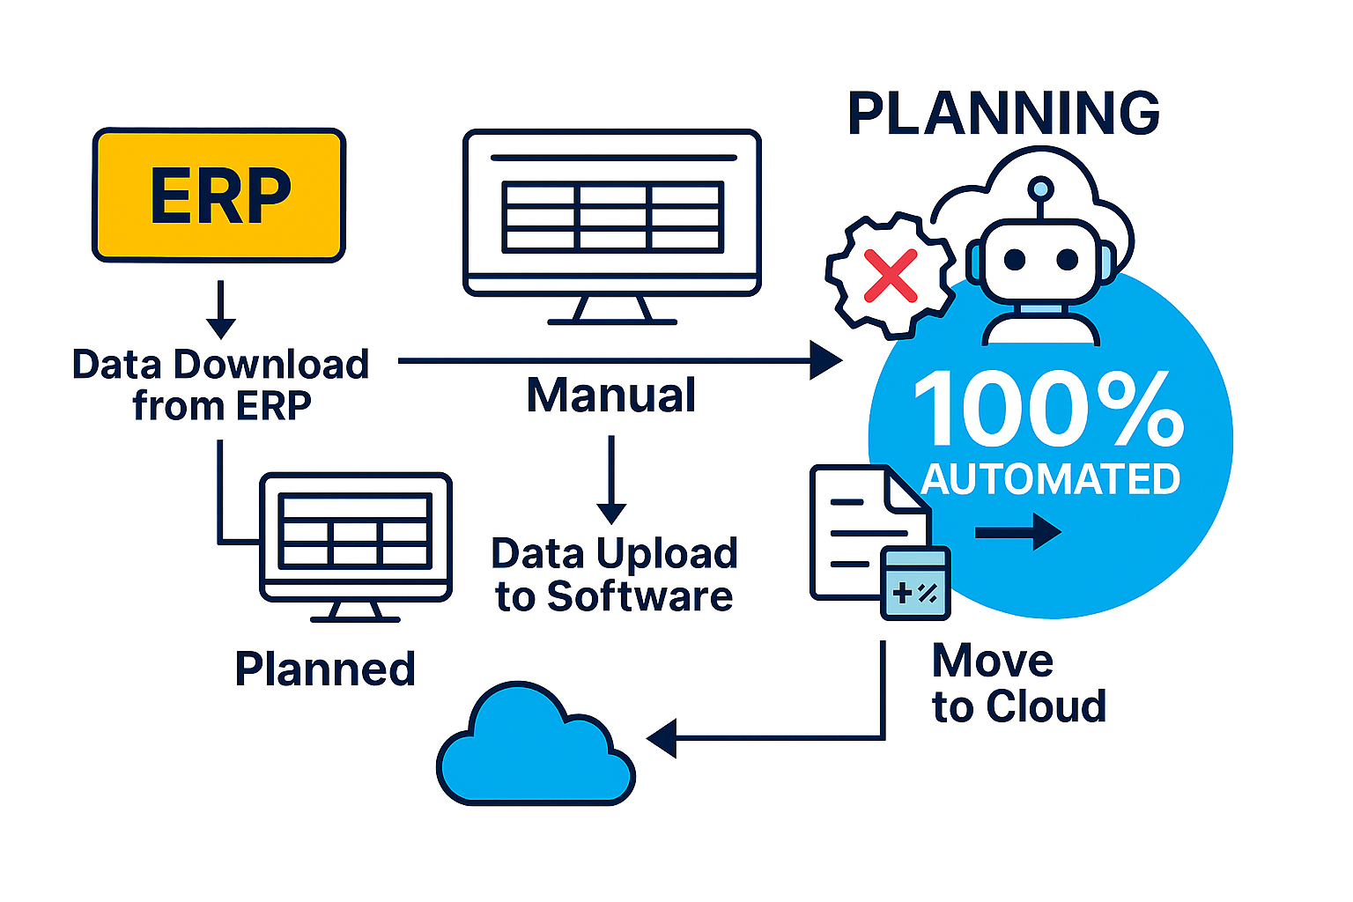
Our Target:
Key Milestones:
Dec 2024: Concept & Strategic Vision Defined.
Apr 2025: Pilot areas successfully integrated and live on the Dashboard,
demonstrating early impact.

Slide 6
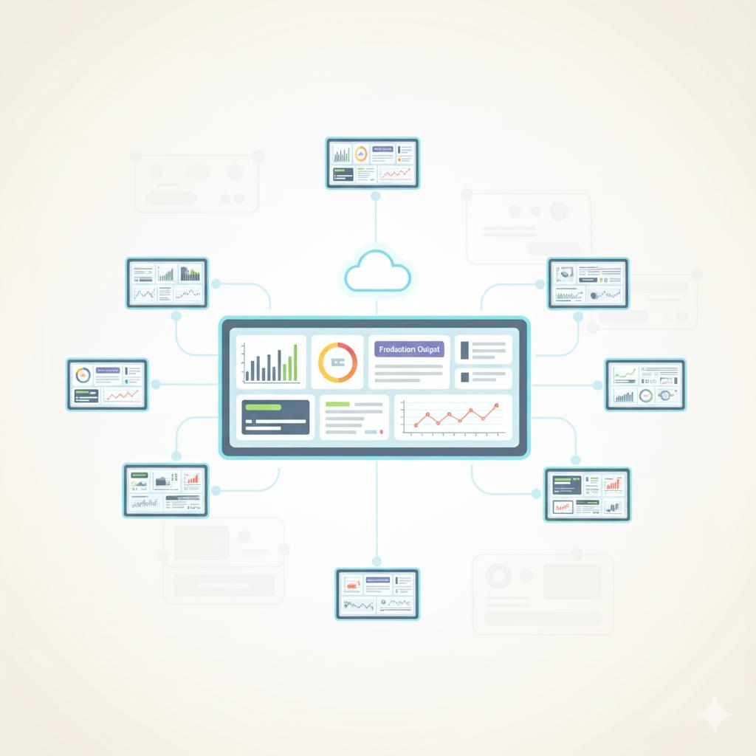
Customized but Scalable!
Horizontal Deployment in all FD

Slide 7
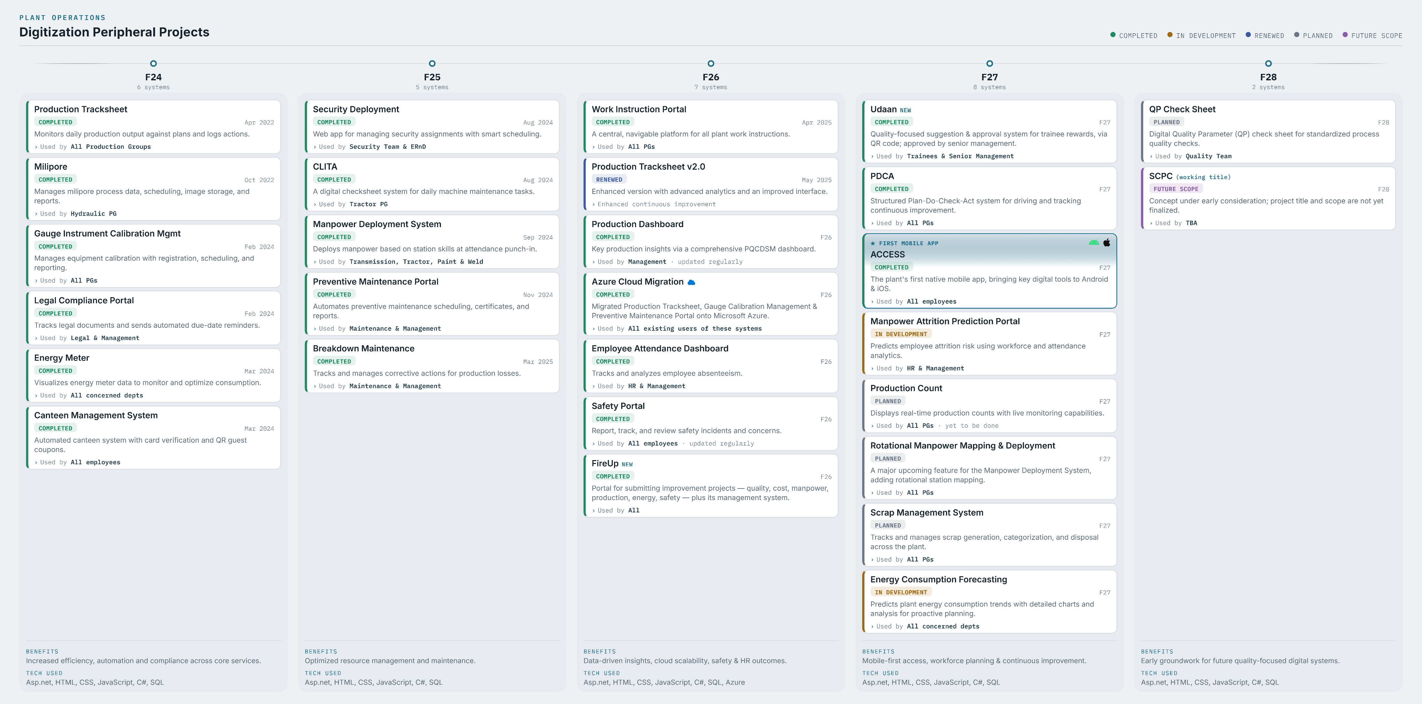

Slide 8
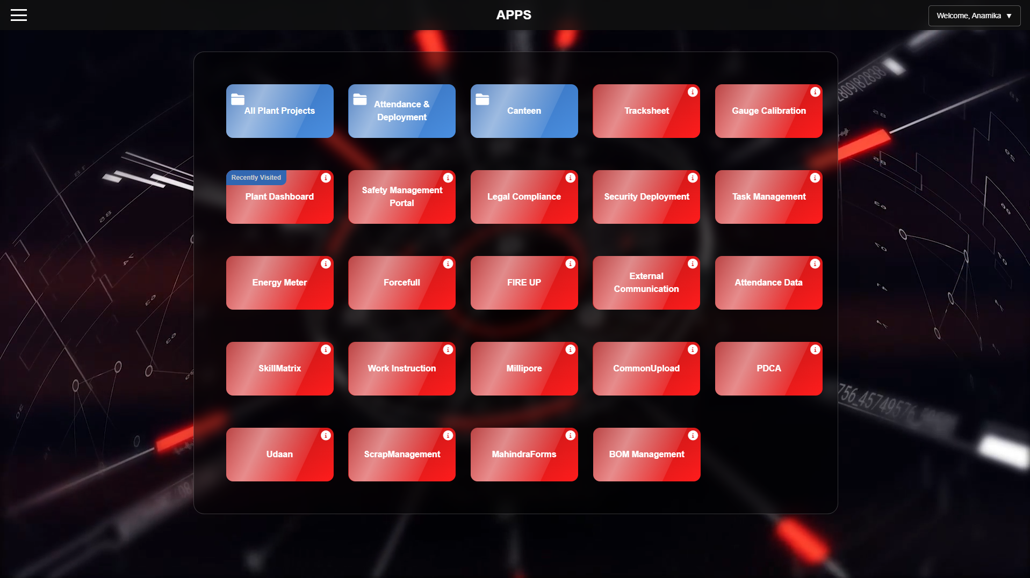

Slide 9
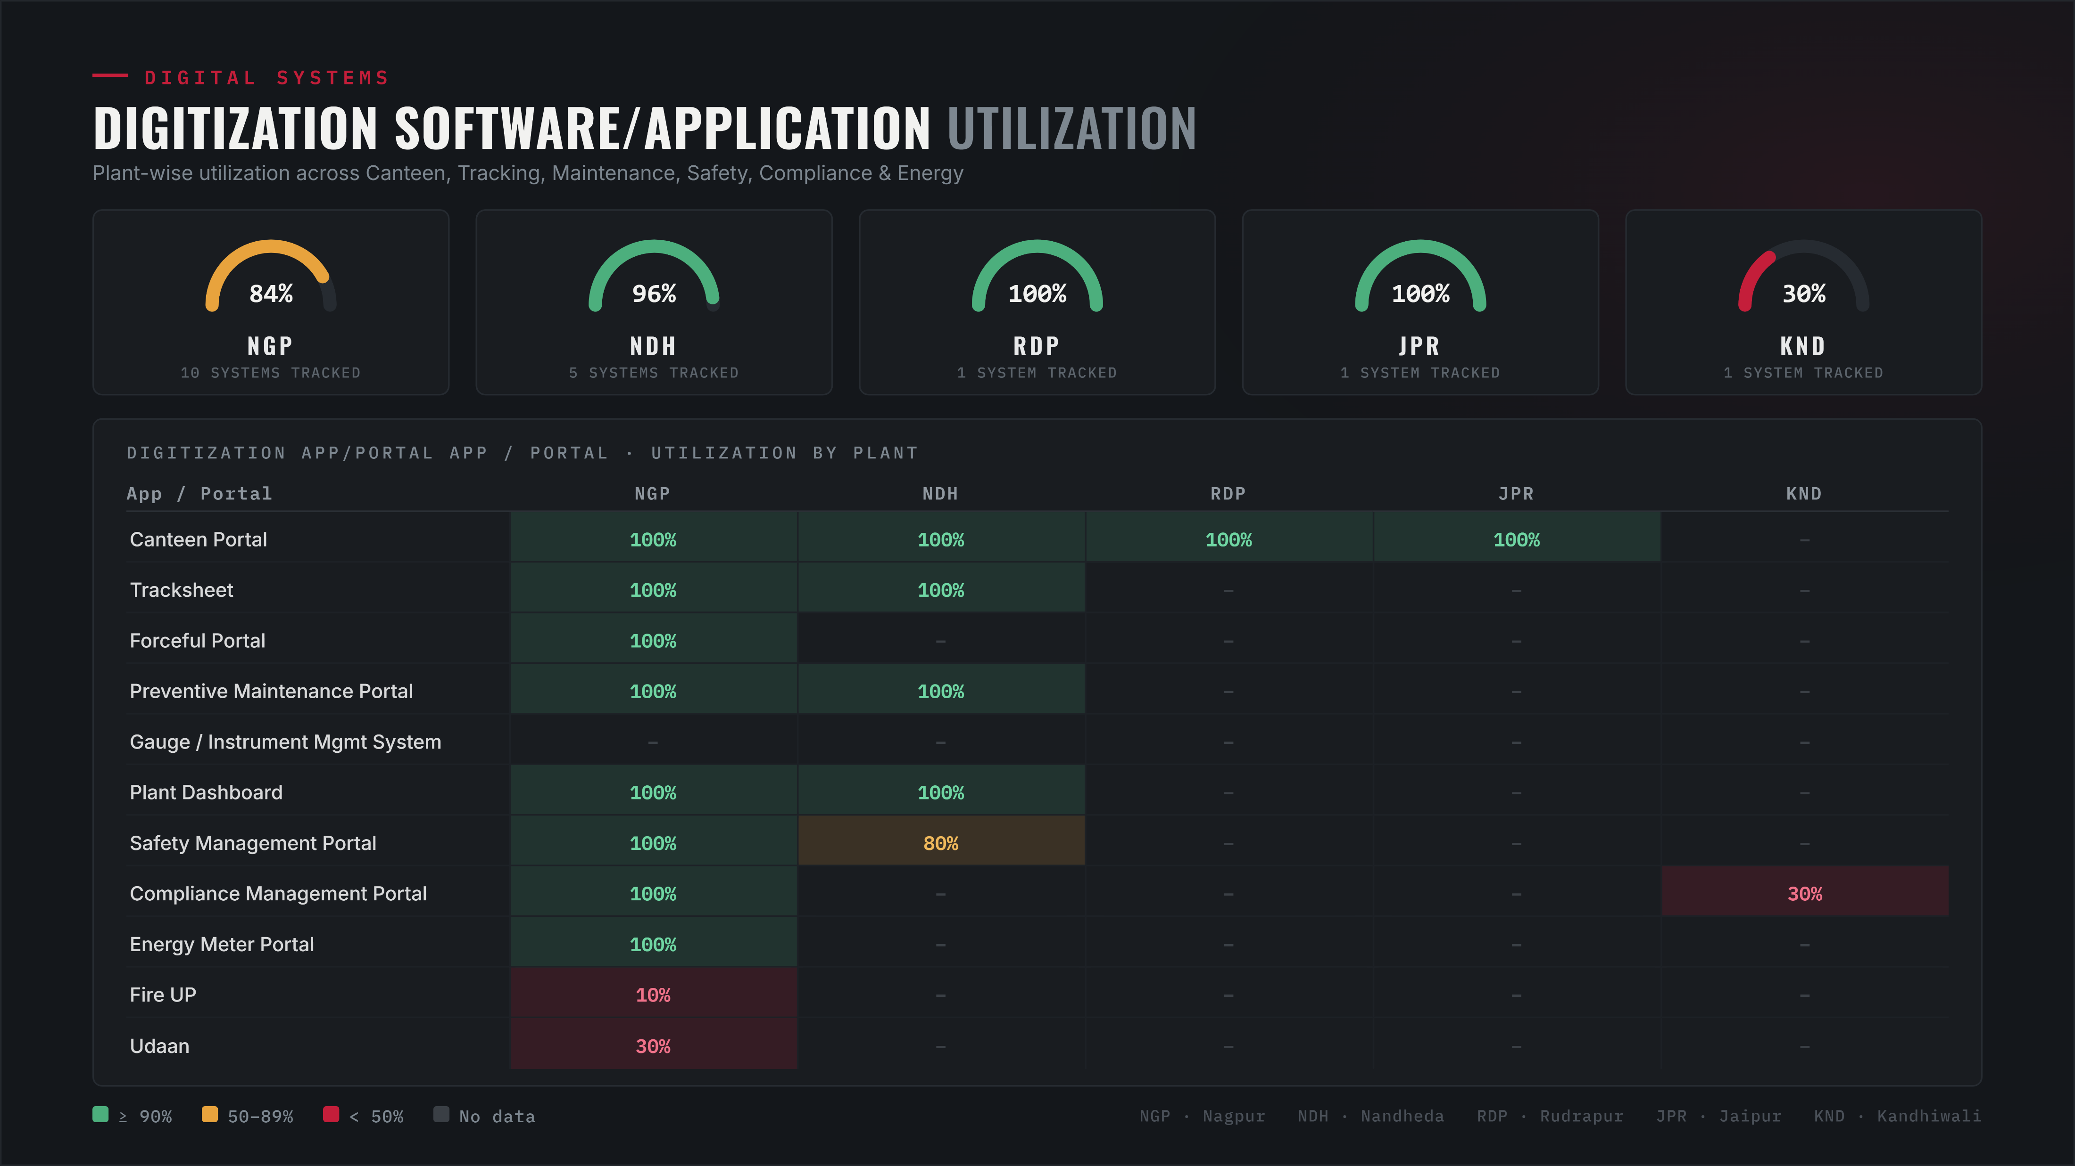
Application Utilization

