Slide 1
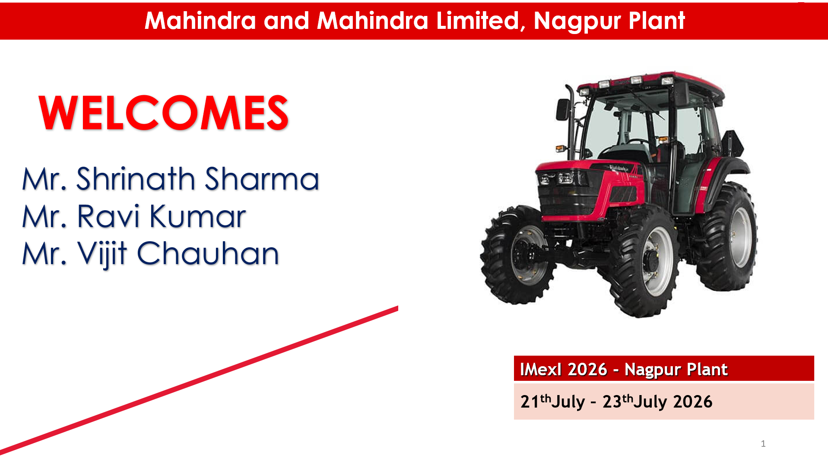

Slide 2
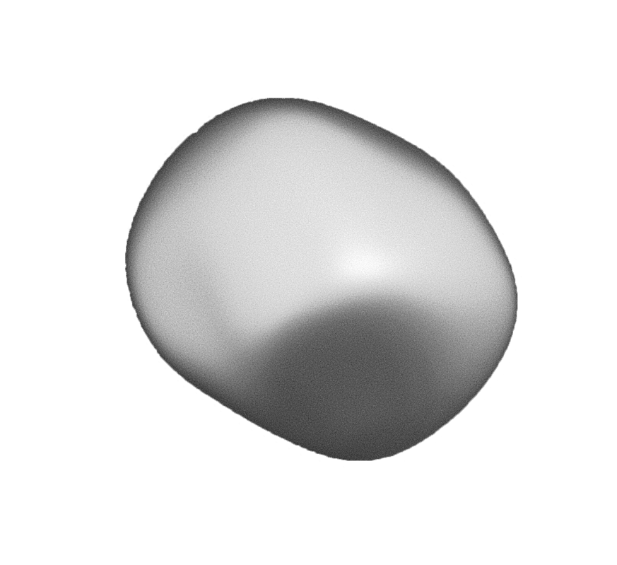


Digitization for Peripheral Systems
Driving smarter plants by digitizing production data into real‑time, tamper‑proof insights.

Slide 3

The Past Approach - Third-Party Solutions
Approach: One problem statement, one distinct software solution.
Challenges:
Processes adjusted to in built standard software
Lack of flexibility, high lead time.
Development cost involved.

Slide 4
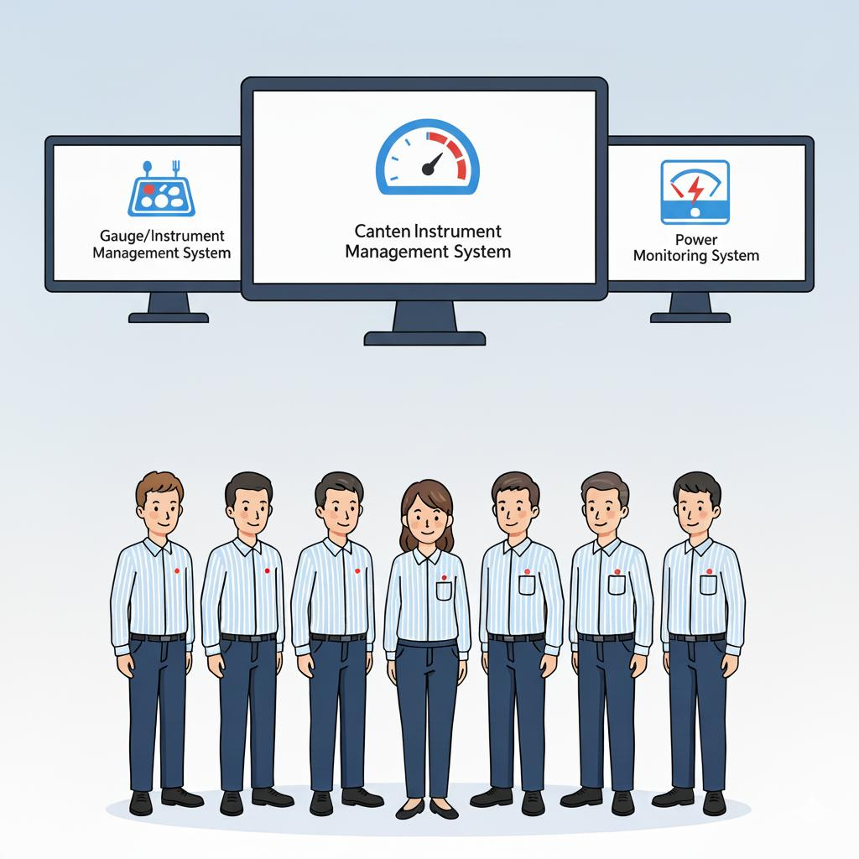
Formation of In-House Digitization Team
Solution: Developed applications in-house.
Benefits:
Software built around existing workflows.
More control, faster results, cost savings.

Slide 5
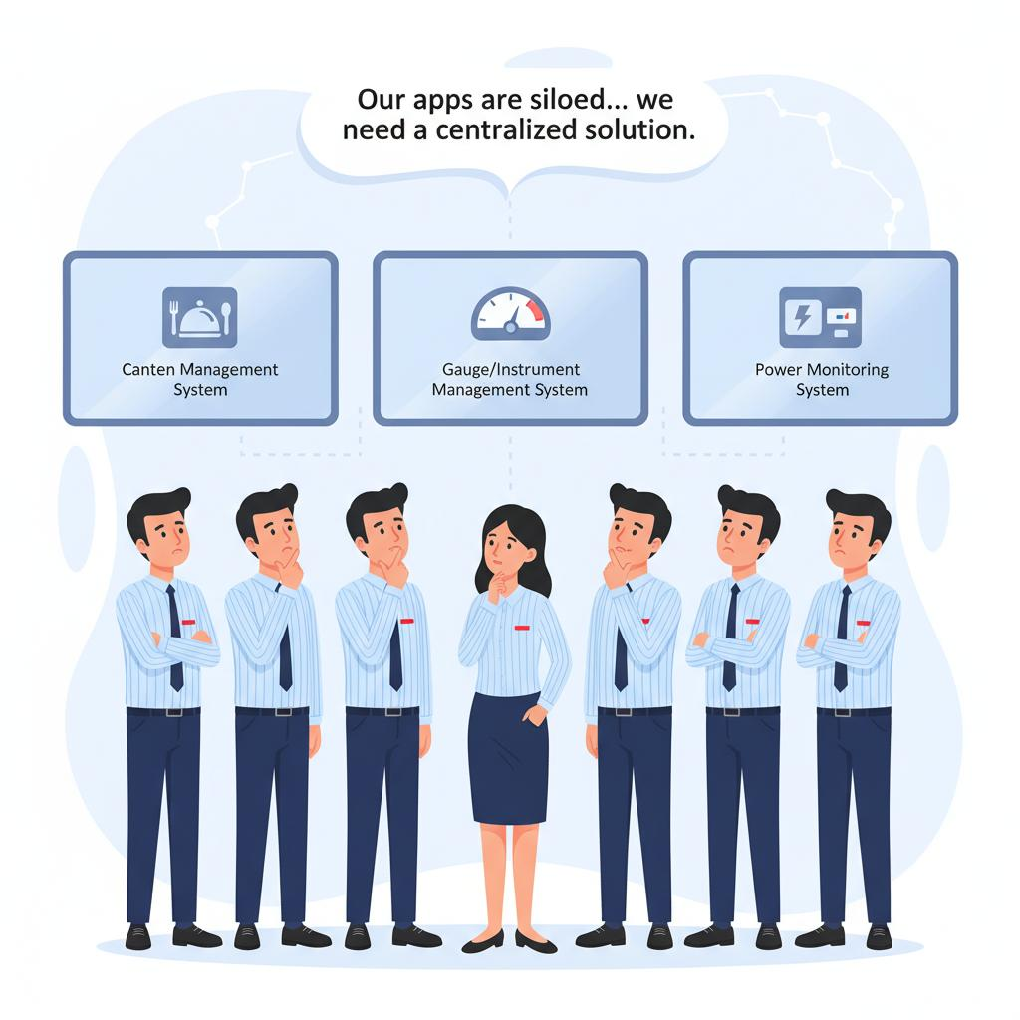
The New Challenge - Siloed In-House Solutions
Realization: Still one application per problem.
Issue: Siloed solutions, lack of centralization.

Slide 6
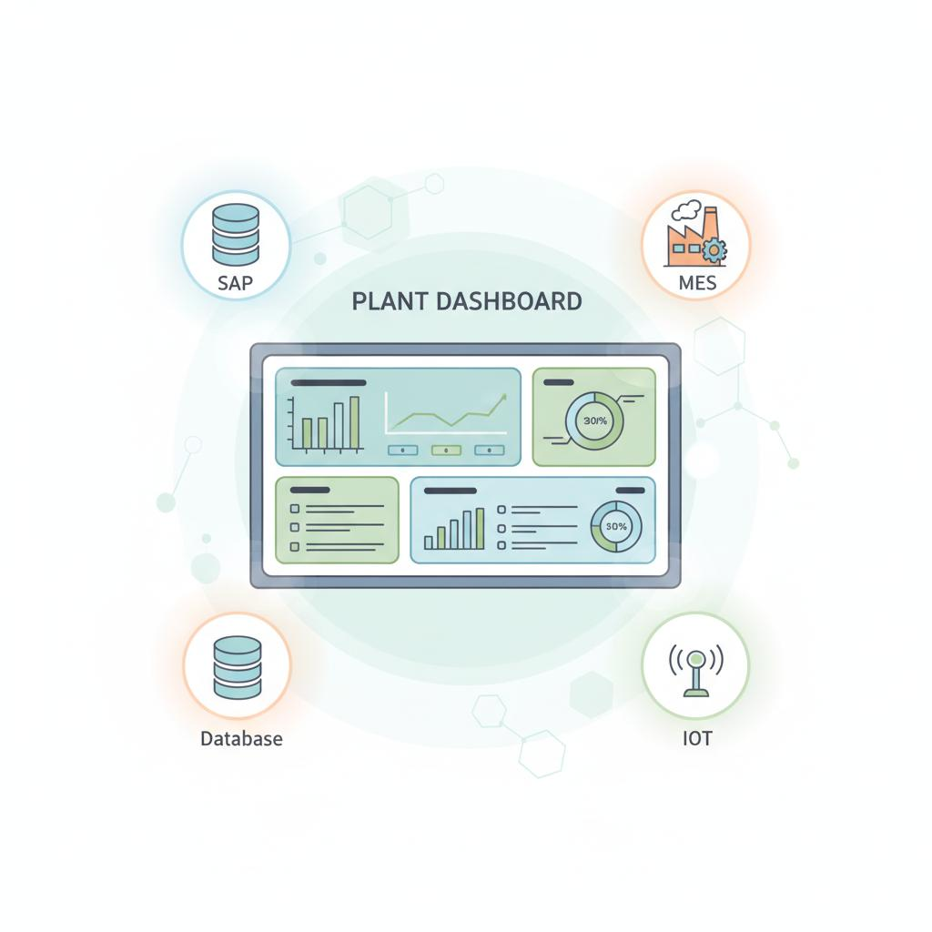
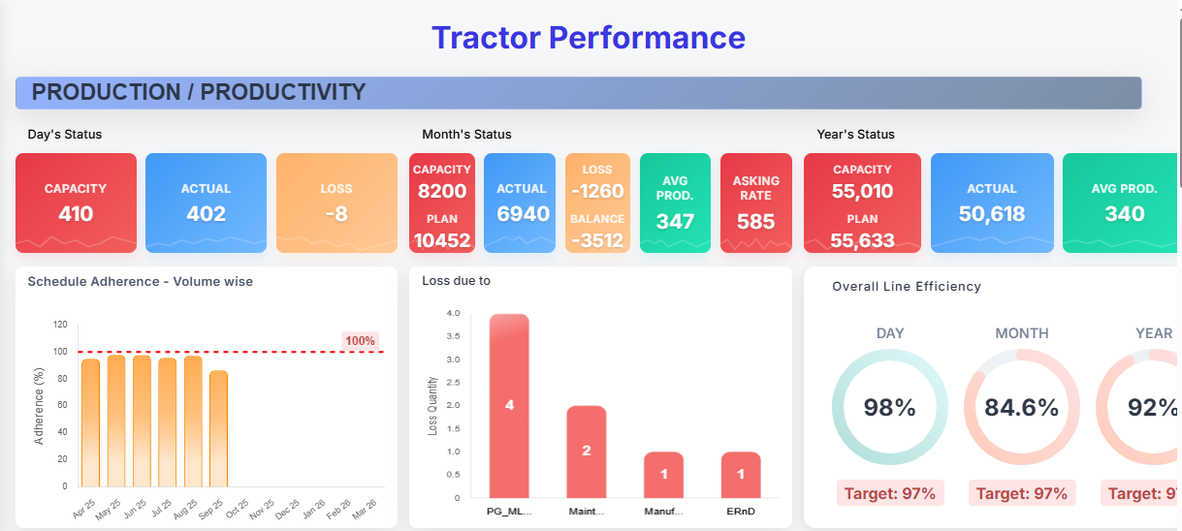
Introducing the Plant Dashboard: Our Integrated Core
The New Concept: Multiple problem statements within a single, unified platform.

Slide 7






What We Do
Software Architecture
Android App development
ML and Analytics
Software Development
Testing
Internet of Things

Slide 8
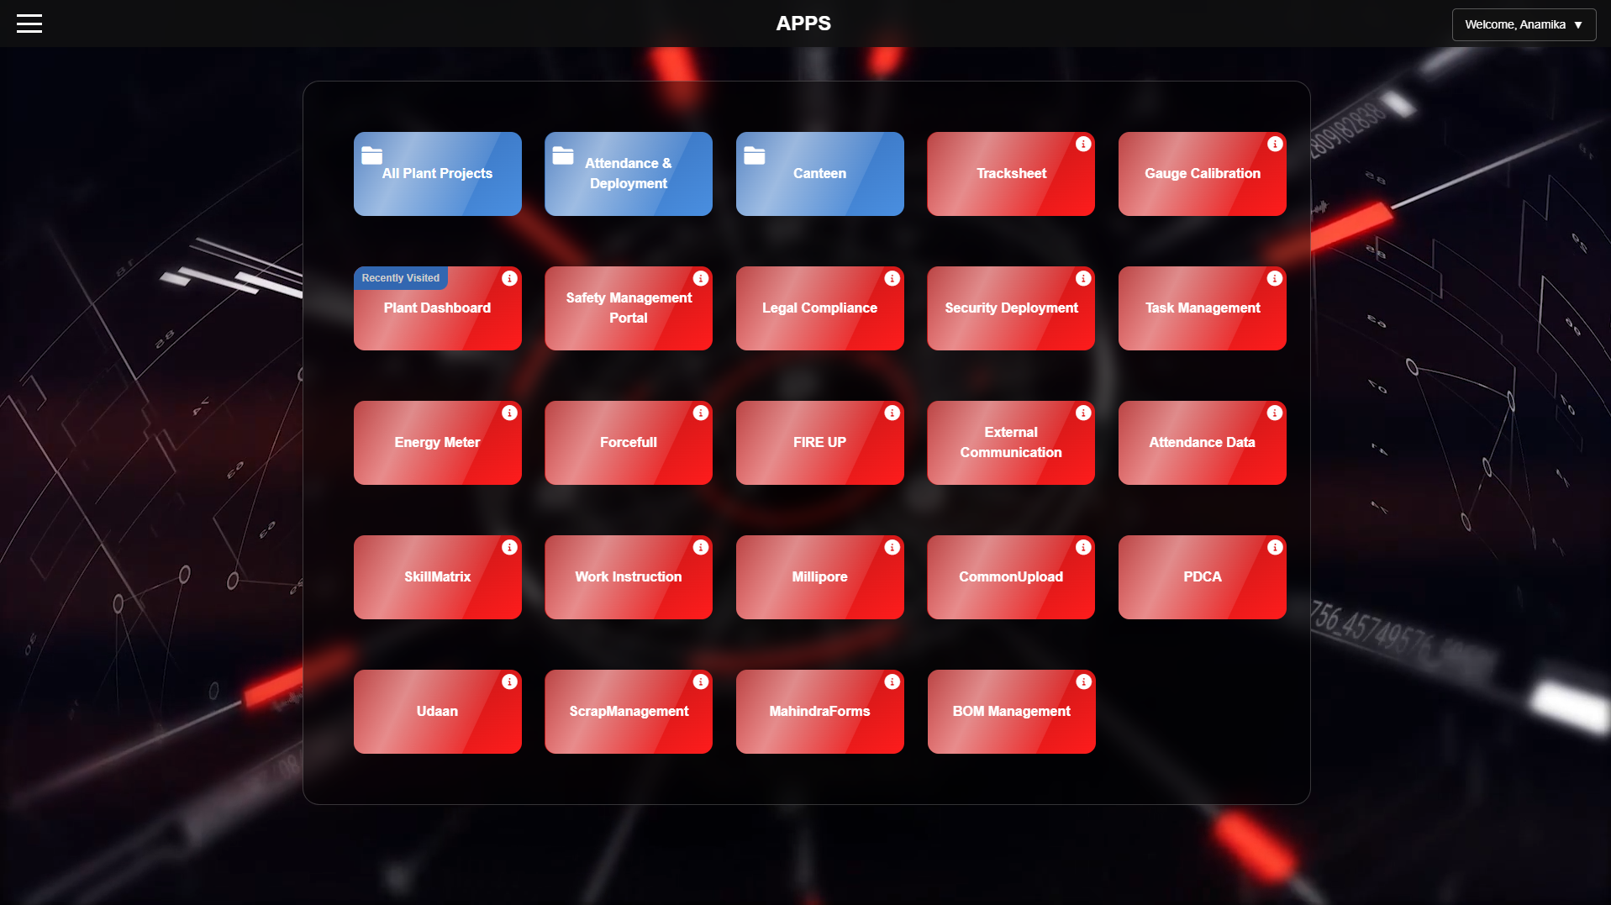

Slide 9
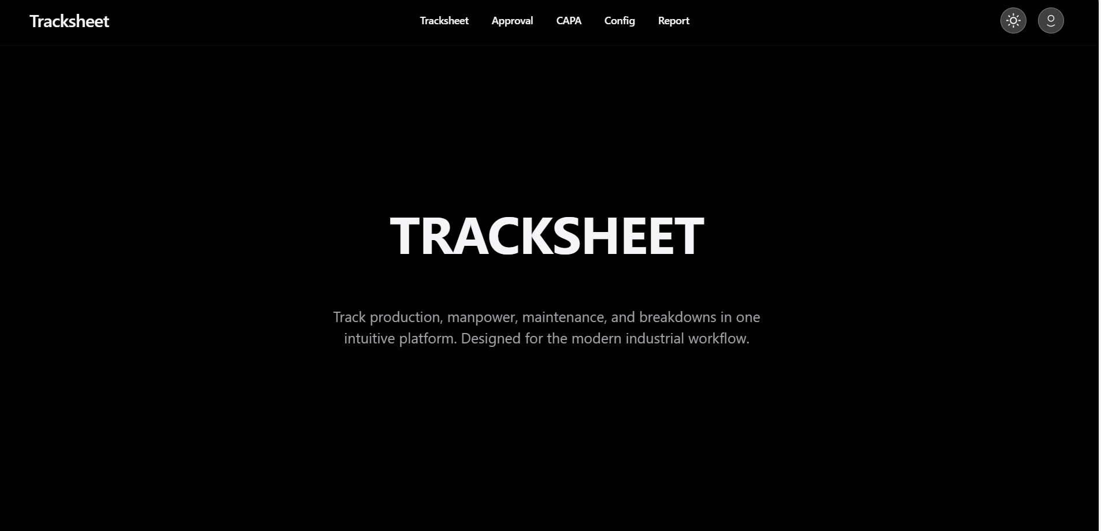
F26 – Project-Timeline
April
May
June
July
August
Sep
October
November
December
January
February
March

Slide 10
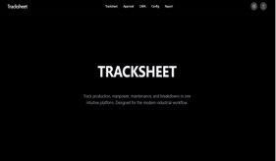
F26 – Project-Timeline
April
May
June
July
August
Sep
TRACKSHEET
October
November
December
January
February
March

Slide 11
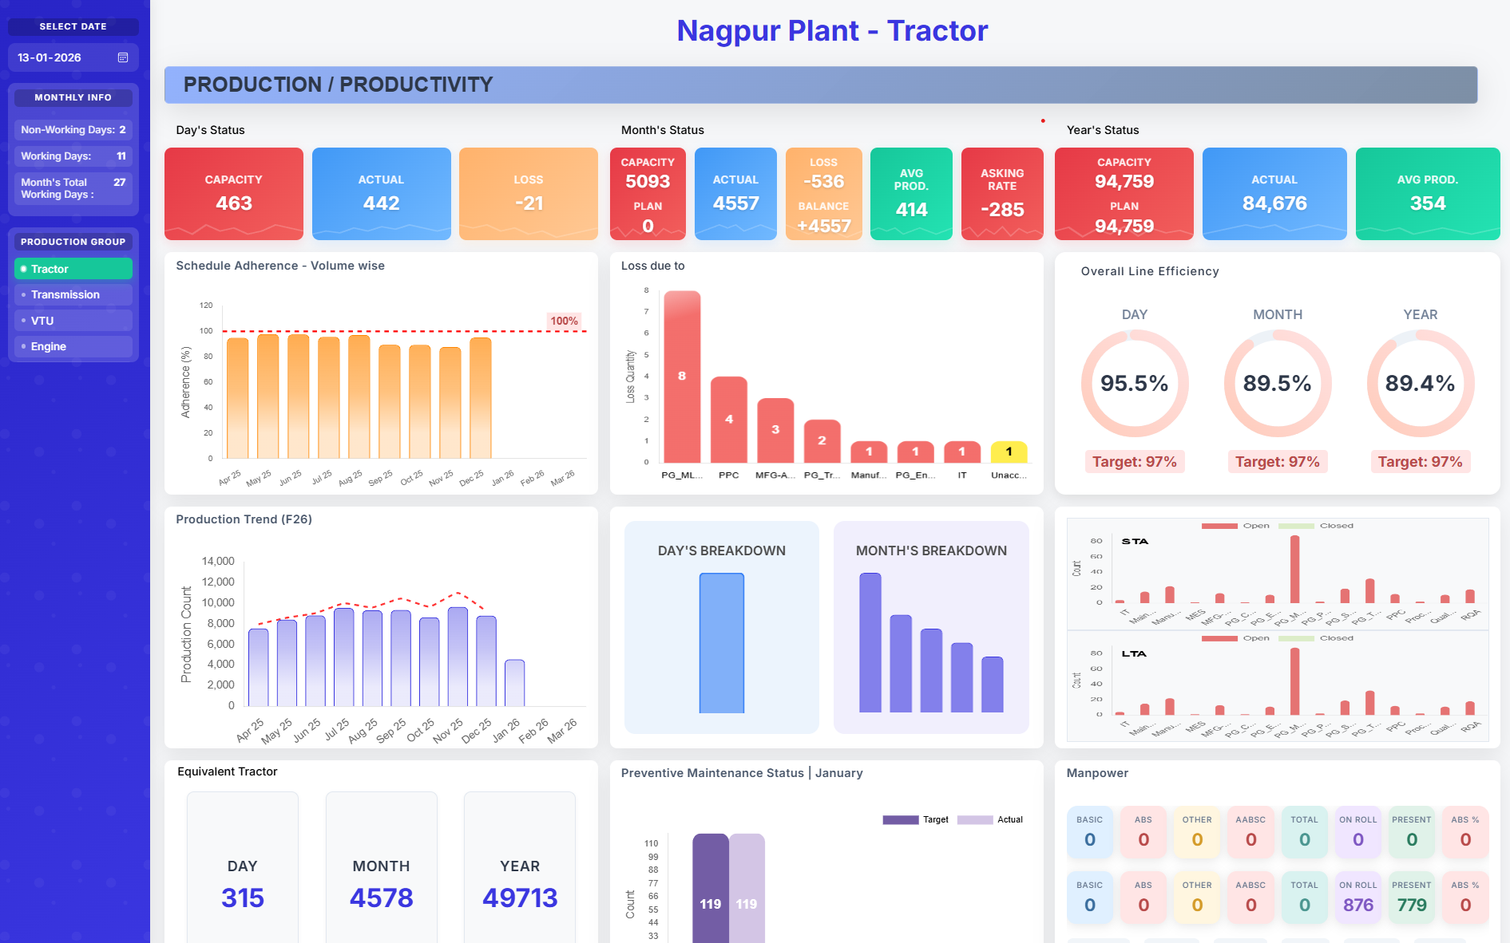
F26 – Project-Timeline
April
May
June
July
August
Sep
TRACKSHEET
October
November
December
January
February
March

Slide 12

F26 – Project-Timeline
April
May
June
July
August
Sep
TRACKSHEET
PLANT DASHBOARD
October
November
December
January
February
March

Slide 13

F26 – Project-Timeline
April
May
June
July
August
Sep
TRACKSHEET
PLANT DASHBOARD
October
November
December
January
February
March

Slide 14

F26 – Project-Timeline
April
May
June
July
August
Sep
TRACKSHEET
PLANT DASHBOARD
SAFETY MANAGEMENT PORTAL
October
November
December
January
February
March

Slide 15
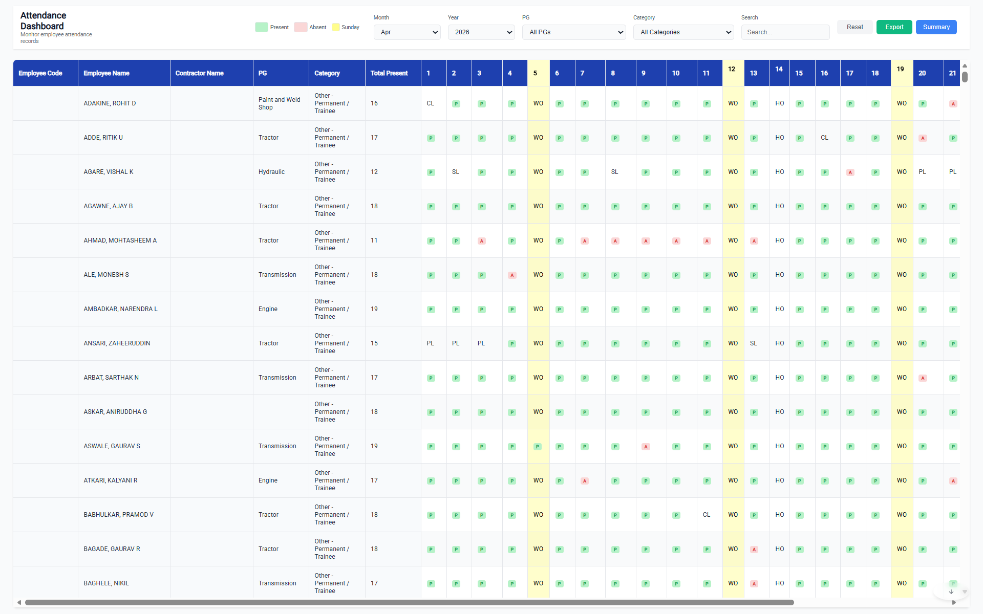
F26 – Project-Timeline
April
May
June
July
August
Sep
TRACKSHEET
PLANT DASHBOARD
SAFETY MANAGEMENT PORTAL
October
November
December
January
February
March

Slide 16
F26 – Project-Timeline
April
May
June
July
August
Sep
TRACKSHEET
PLANT DASHBOARD
SAFETY MANAGEMENT PORTAL
October
November
December
January
February
March
MANPOWER ATTENDANCE DASHBOARD

Slide 17

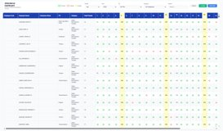
F26 – Project-Timeline
April
May
June
July
August
Sep
TRACKSHEET
PLANT DASHBOARD
SAFETY MANAGEMENT PORTAL
October
November
December
January
February
March
MANPOWER ATTENDANCE DASHBOARD

Slide 18

F26 – Project-Timeline
April
May
June
July
August
Sep
TRACKSHEET
PLANT DASHBOARD
SAFETY MANAGEMENT PORTAL
October
November
December
January
February
March
MANPOWER ATTENDANCE DASHBOARD
FIRE UP PORTAL

Slide 19
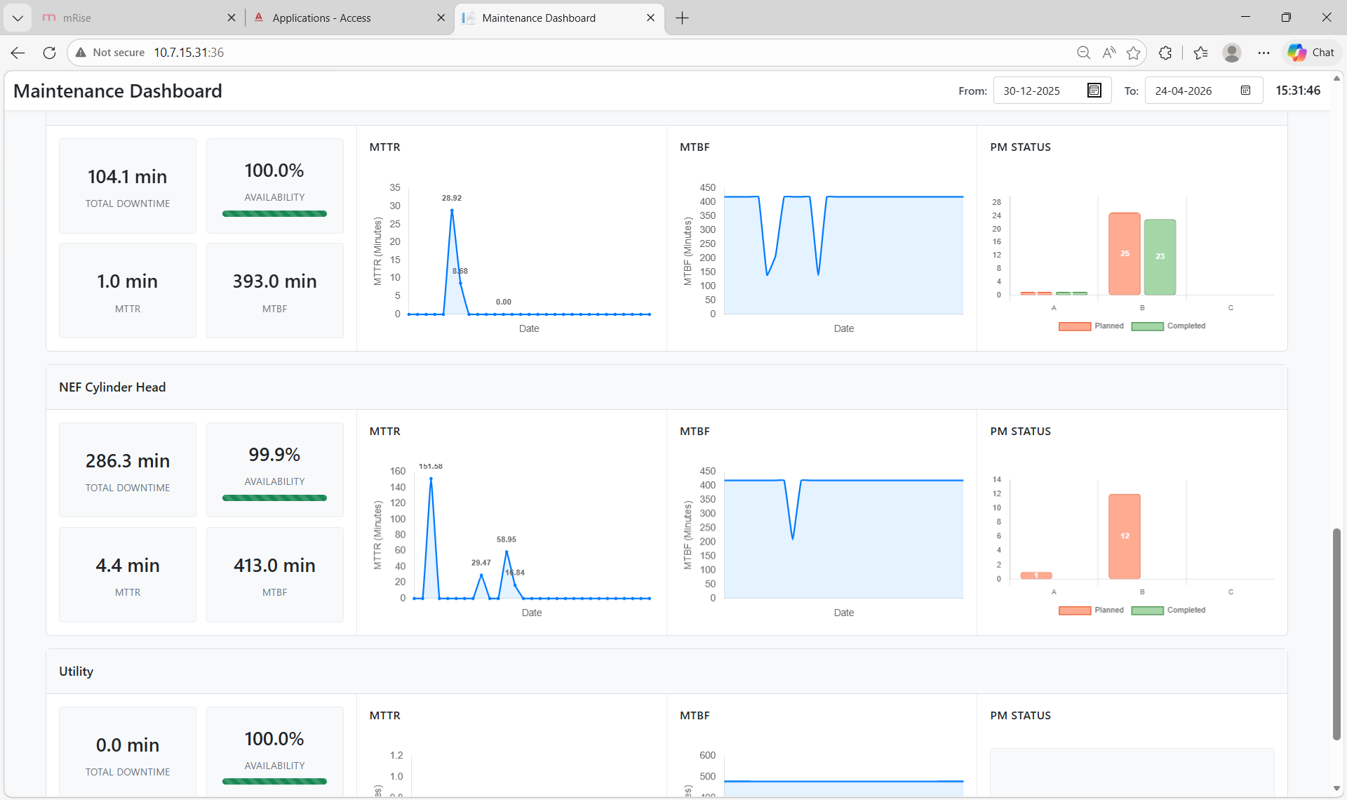
F26 – Project-Timeline
April
May
June
July
August
Sep
TRACKSHEET
PLANT DASHBOARD
SAFETY MANAGEMENT PORTAL
October
November
December
January
February
March
MANPOWER ATTENDANCE DASHBOARD
FIRE UP PORTAL

Slide 20
F26 – Project-Timeline
April
May
June
July
August
Sep
TRACKSHEET
PLANT DASHBOARD
SAFETY MANAGEMENT PORTAL
October
November
December
January
February
March
MANPOWER ATTENDANCE DASHBOARD
FIRE UP PORTAL
PLANT MAINTENANCE DASHBOARD

Slide 21
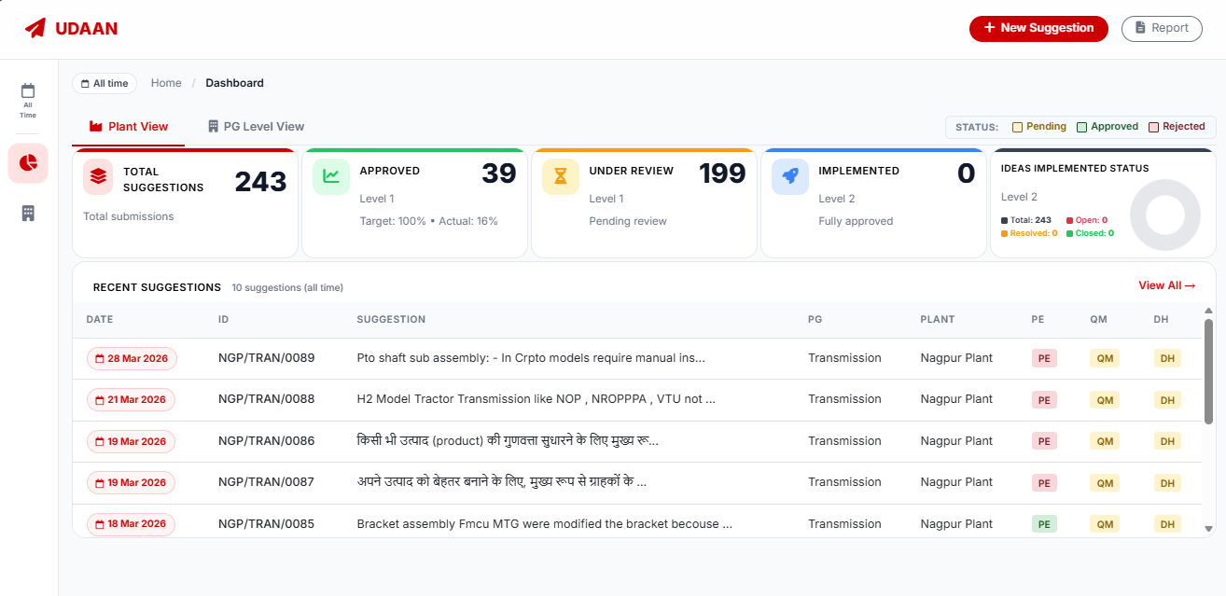
F26 – Project-Timeline
April
May
June
July
August
Sep
TRACKSHEET
PLANT DASHBOARD
SAFETY MANAGEMENT PORTAL
October
November
December
January
February
March
MANPOWER ATTENDANCE DASHBOARD
FIRE UP PORTAL
PLANT MAINTENANCE DASHBOARD

Slide 22
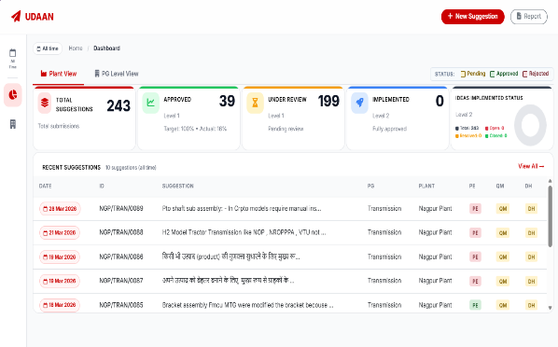
F26 – Project-Timeline
April
May
June
July
August
Sep
TRACKSHEET
PLANT DASHBOARD
SAFETY MANAGEMENT PORTAL
October
November
December
January
February
March
MANPOWER ATTENDANCE DASHBOARD
FIRE UP PORTAL
PLANT MAINTENANCE DASHBOARD
UDAAN PORTAL

Slide 23





Apps Migration to Cloud
Vulnerability Assessment and Penetration Testing
[VAPT]
Intranet – Plant Network
Local Premises Database
AZURE – Cloud

Slide 24






SAP integration to DATABASE
MEETING WITH SAP TEAM
BRD SUBMISSION
RECEIVED API
USING API – DATA IN DATABASE
SAP INTEGRATED IN APPS

Slide 25
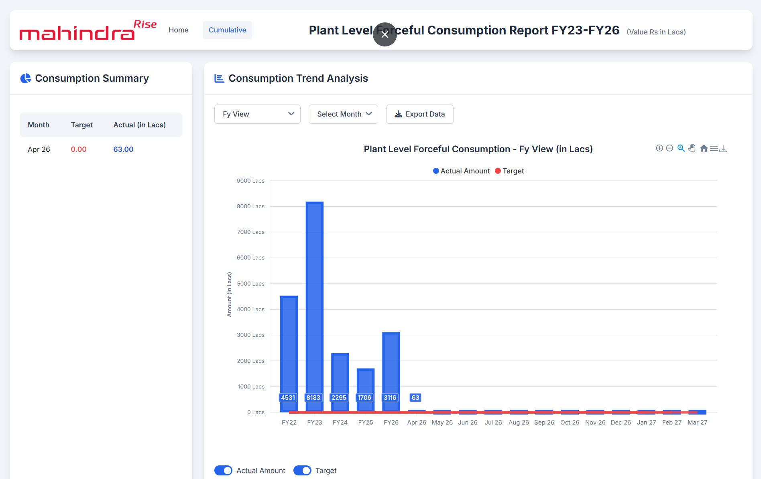
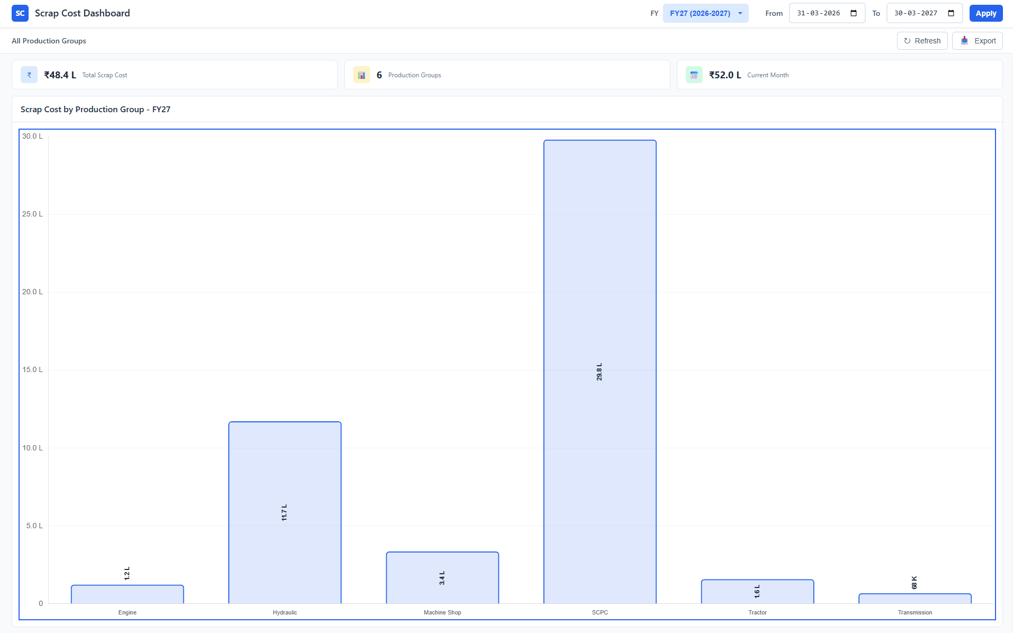
SAP integration to DATABASE
Forceful Dashboard
Scrapcost Dashboard
SAP Integrated Dashboards

Slide 26

Our Access Android App

Slide 27
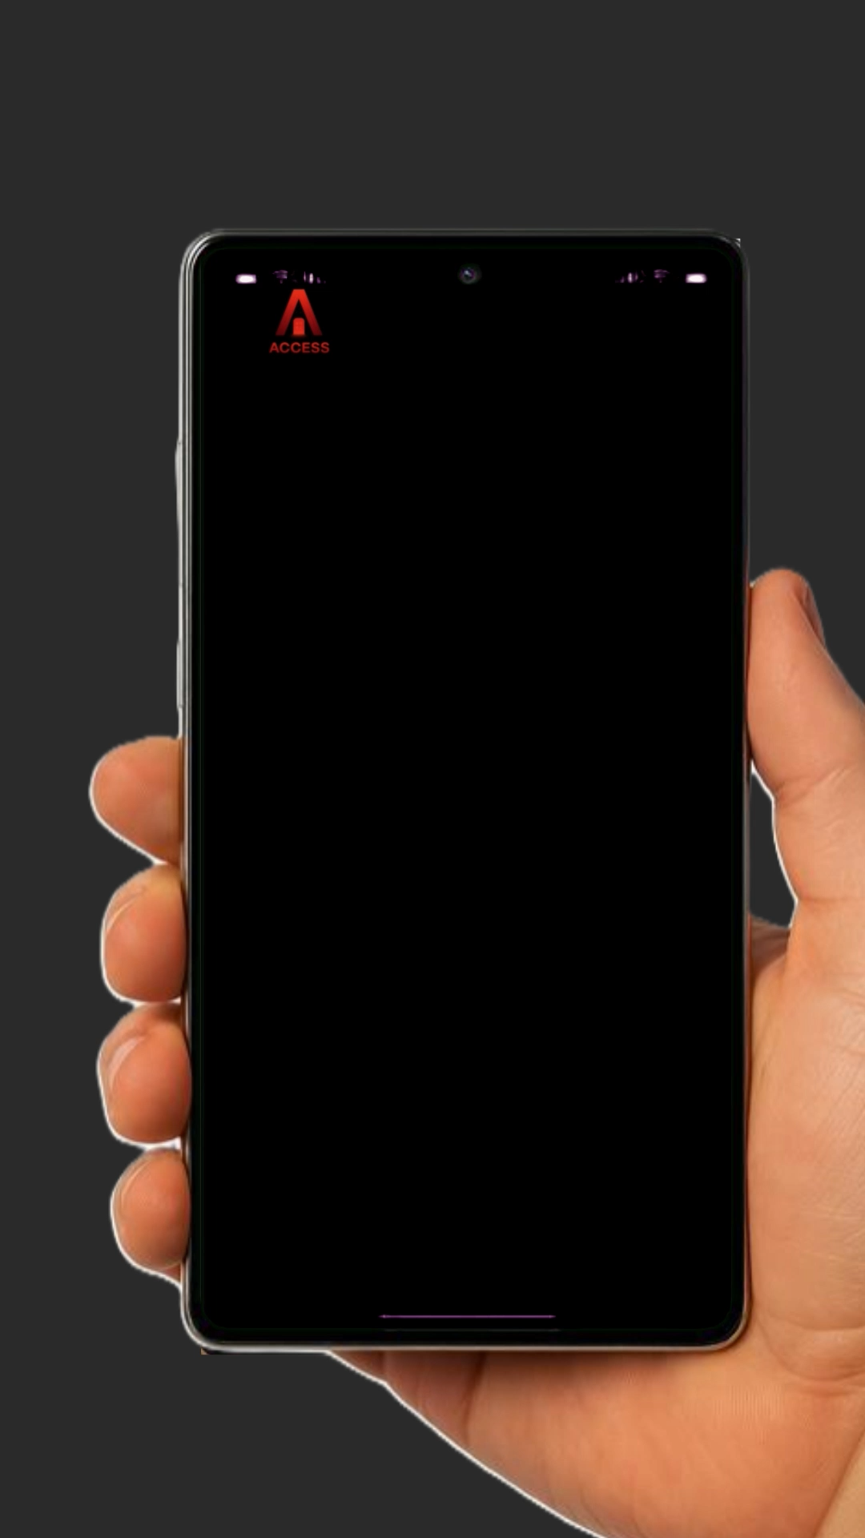
Our Access Android App

Slide 28
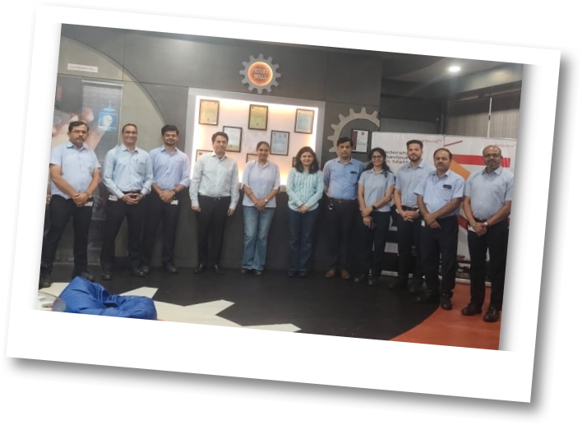
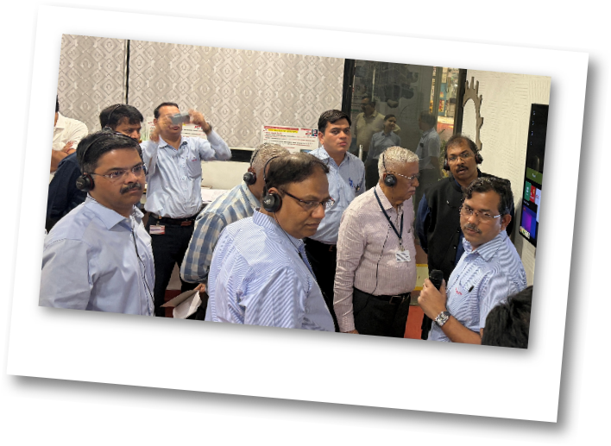
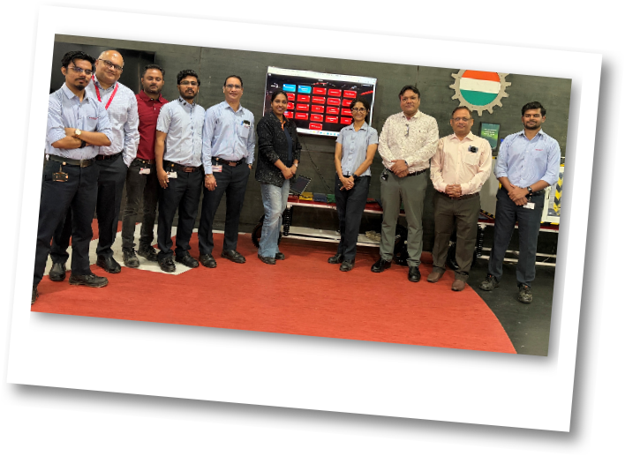
Visits at Incubation
Appreciation by Rohit Thakur
Appreciation by Accessors
Appreciation by IT HEAD

Slide 29
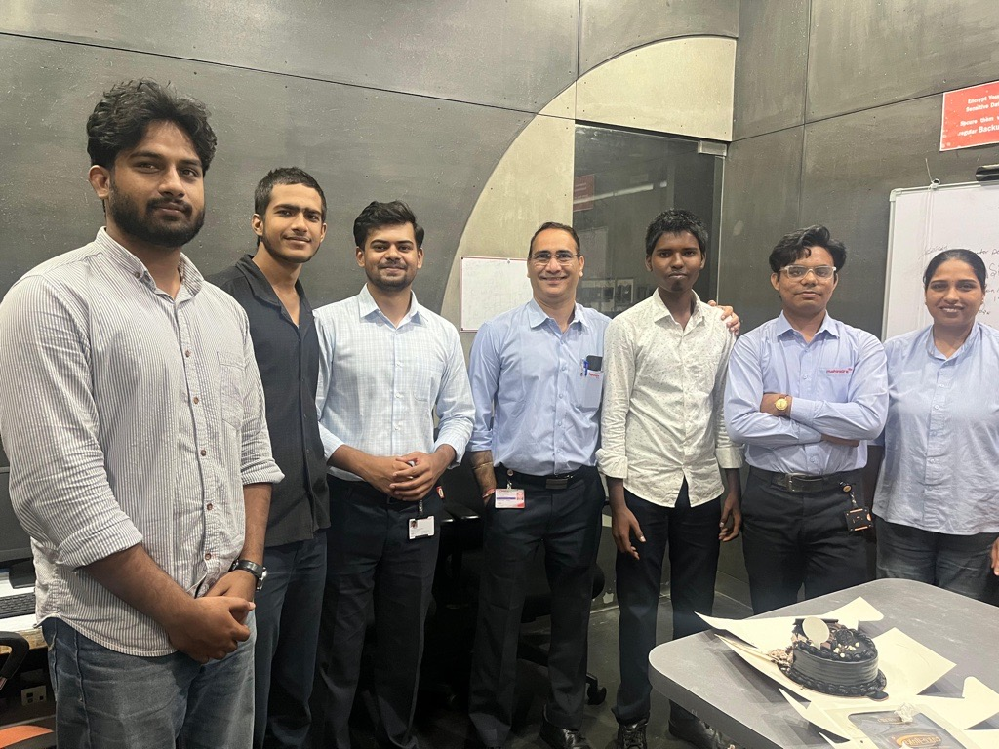
Our Team

Slide 30
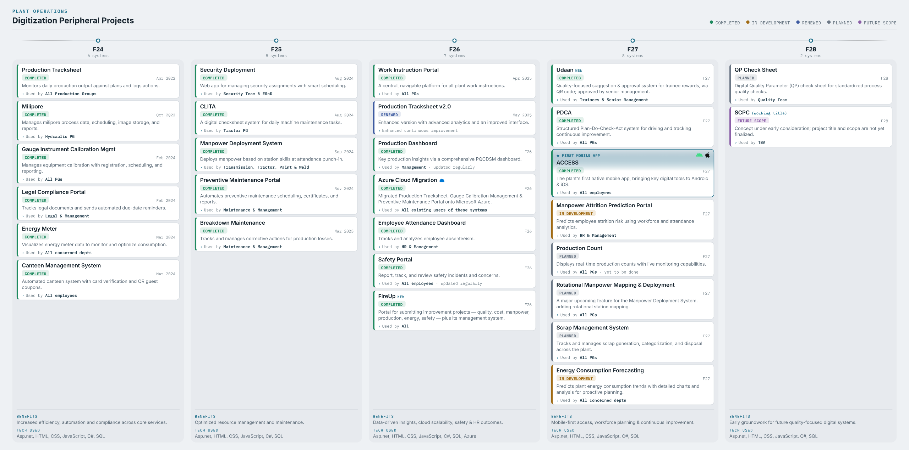

Slide 31
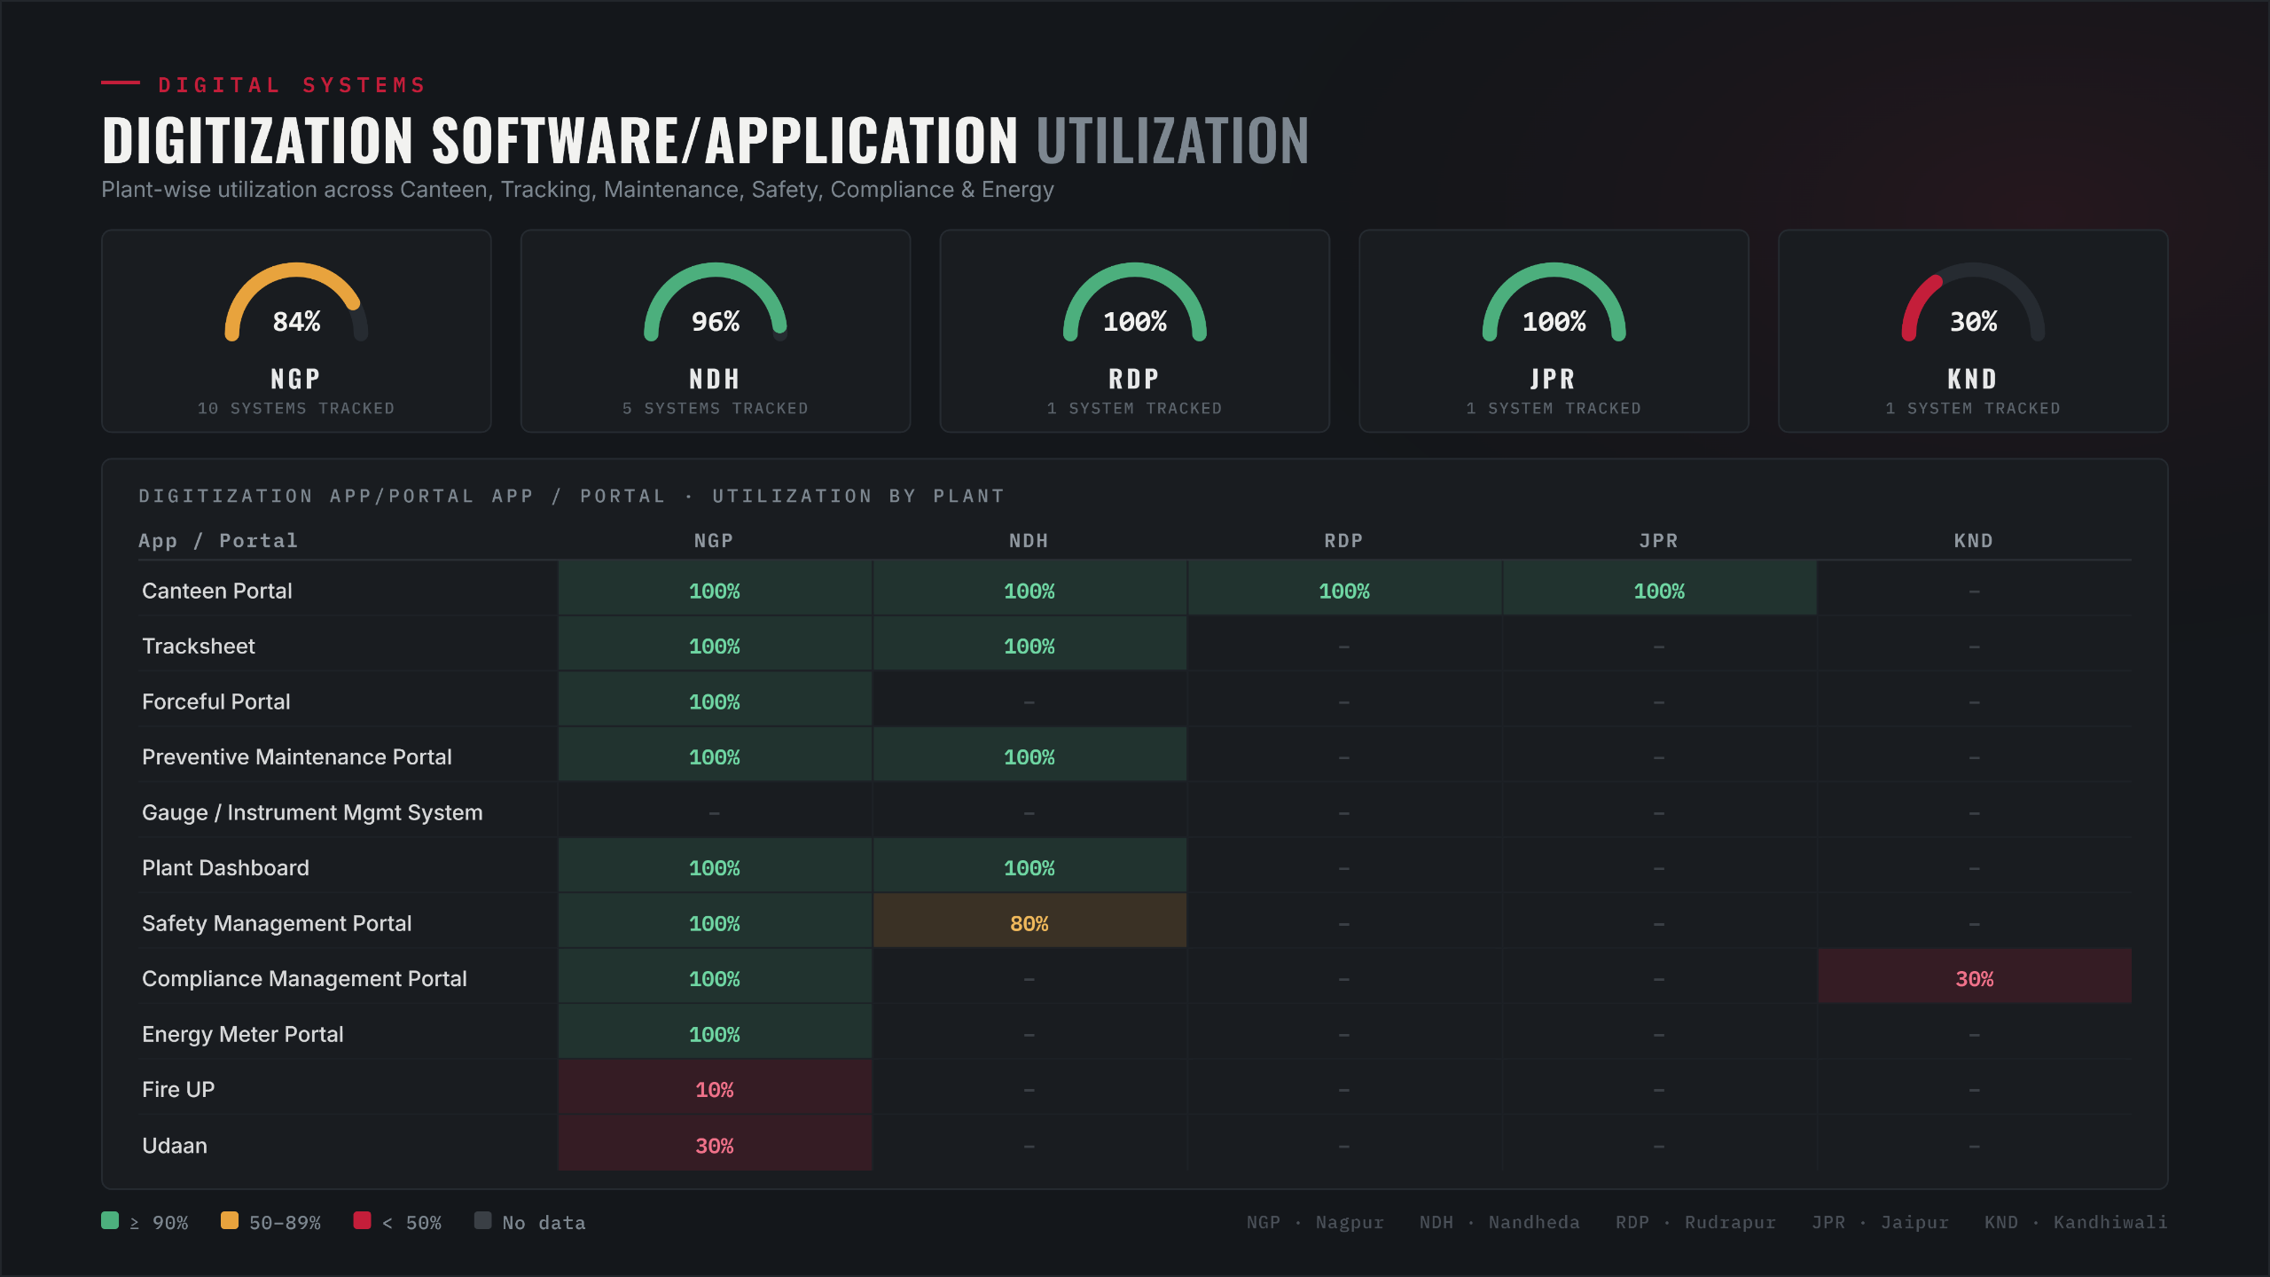
Application Utilization

