Slide 1

 Thursday, July 8th, 2021
 Salt Mine Productive Workspace

Slide 2


Today’s speakers
Sheng Slogar
Founder, Diglactic

Slide 3
agenda
6:40 P | • | Pizza & Networking
7:00 P | • | Laravel Performance Pitfalls Sheng Slogar
7:30 P | • | Open Mic / Lightning Talks Anyone
7:50 P | • | Q & A
7:55 P | • | Wrap Up

Slide 4
Laravel Performance Pitfalls
Things to keep an eye on to boost server speed.

Slide 5
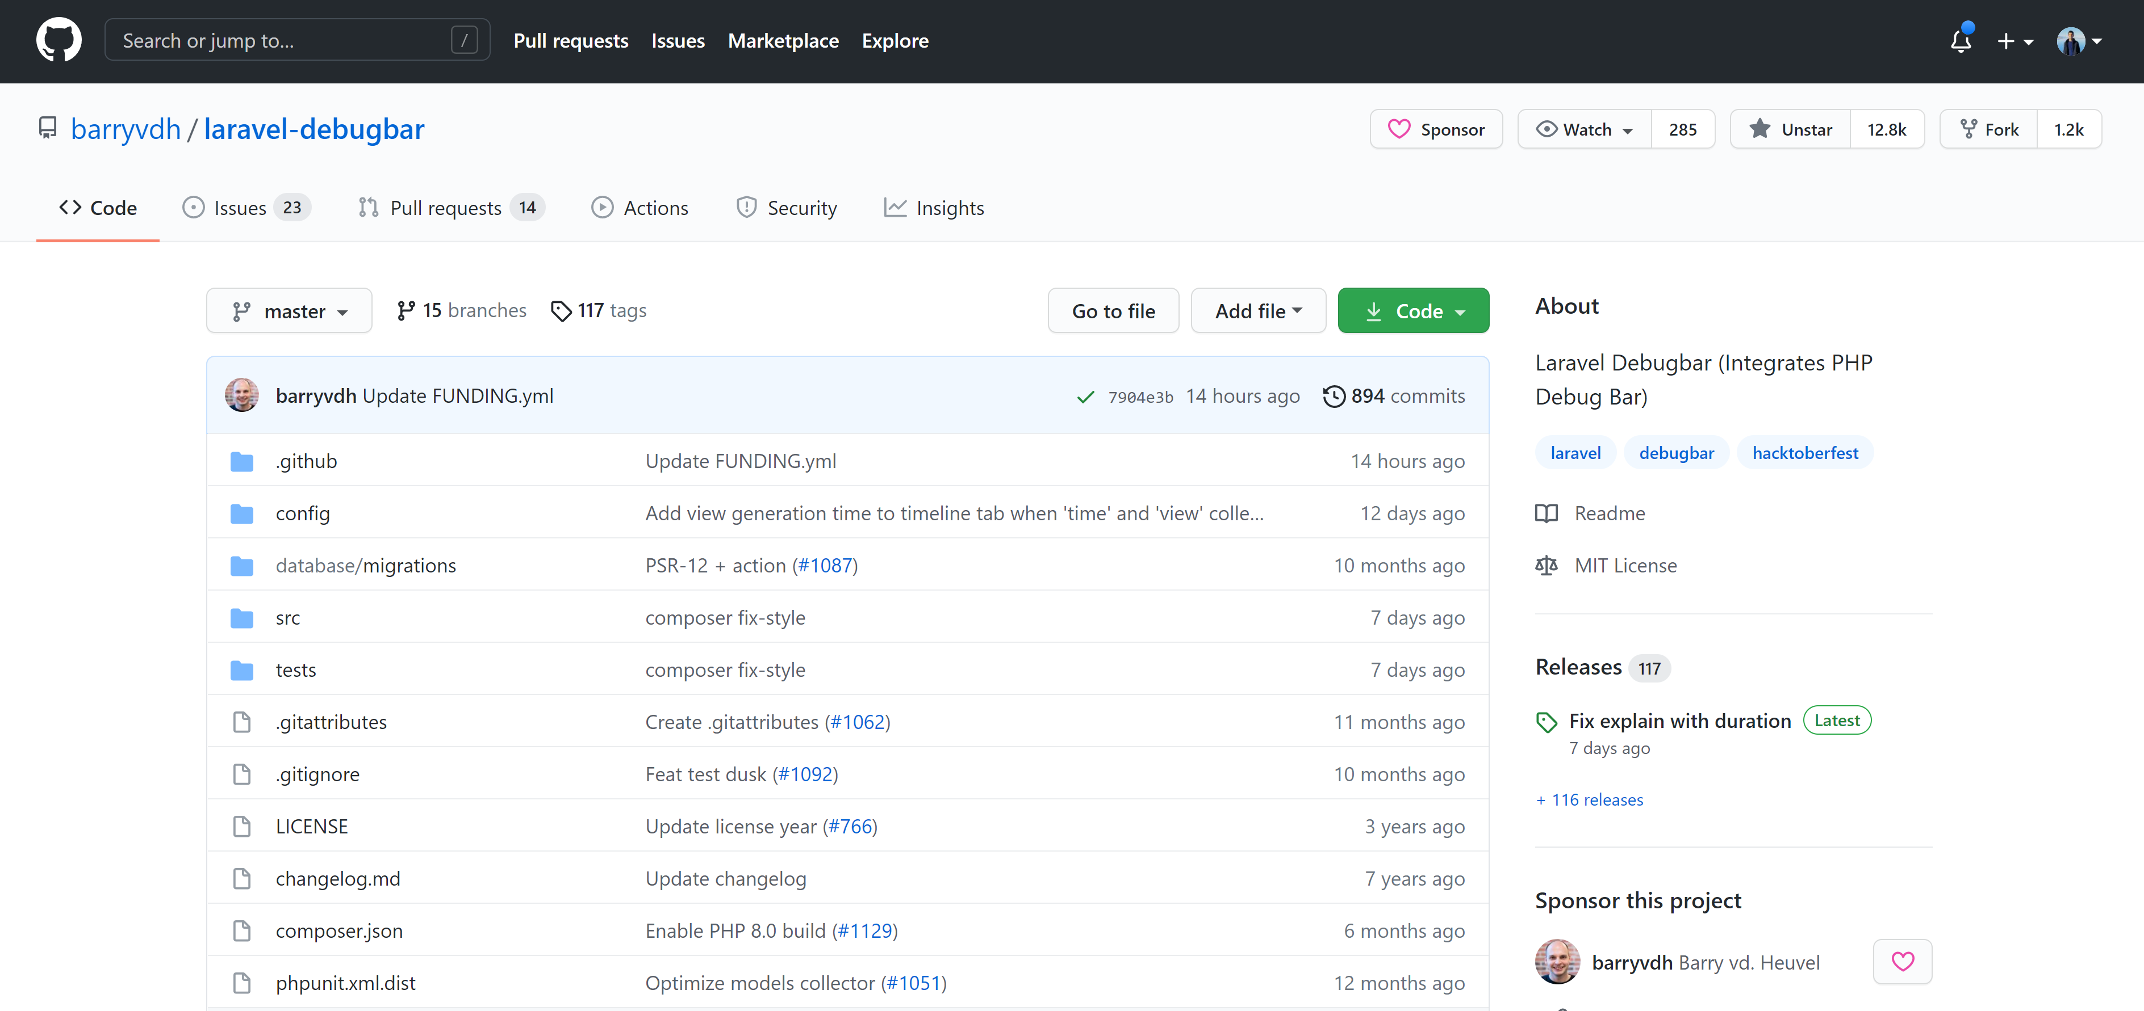
Laravel Debugbar
Things to watch out for, and some handy shortcuts.

Slide 6
Sql Indices
When to use an index or a combined index.

Slide 7
Query builder vs. collections
Things to watch out for, and some handy shortcuts.

Slide 8
Avoid unnecessary PHP logic
PHP is fast, but it’s no database.

Slide 9
Lazy, cursor, & chunks
Memory usage slows down PHP a LOT.

Slide 10
To Eager Load (or Not To Eager Load)
Fetch things ASAP.
This works on relationships!
if ($post->author()->is($user)) {
//
}

Slide 11
Pagination
Limit the things!

Slide 12
Use Transactions for lots of work
If one thing fails, everything fails.

Slide 13
queues! And priority queues.
Don’t make your server process everything at once.

Slide 14
Route, view, and config caching
The right way. Env()

Slide 15
Cache models (wisely)
The right way. Env()

Slide 16
Cache frequently accessed methods
The right way. Env()

