Slide 1

Department of Electronics and Communication (Advanced Communication Technology)
IOT Based Wireless Charging System For EV
Academic Year: 2024-25
Under the guidance of
Shridhar Sahu
By
1. Dignag Pakhare PRN No. 124BTAC2007
2. Harsh Kawthankar PRN No. 124BTAC2013
3. Gaurav Panchal PRN No. 124BTAC2012
4. Krishna Prajapati PRN No. 124BTAC2014
.

Slide 2
Outline
Introduction
Comparative Study
Problem Statement
Sustainable Development Goal (SDG)
Block Diagram
Flow Chart
Circuit Diagram
Simulation Result
Applications
References

Slide 3
Introduction
The IoT-based wireless charging system for electric vehicles integrates advanced technologies to enhance the charging experience by eliminating the need for physical connections. This innovative approach utilizes wireless power transfer and IoT connectivity to monitor and manage charging processes, ensuring efficiency and convenience for users.
[3]

Slide 4
Comparative Study
A comparative study of IoT-based wireless charging systems for electric vehicles reveals significant advantages over traditional wired charging methods. Wireless charging systems utilize inductive coupling to transfer energy, allowing for seamless charging without the need for physical connectors, which can wear out over time. IoT integration enhances these systems by enabling real-time monitoring, remote diagnostics, and automated charging management, optimizing energy consumption and reducing downtime.

Slide 5
Problem Statement
The necessity for effective and practical charging infrastructure has arisen from the explosive expansion of electric cars (EVs) in recent years. Conventional plug-in charging techniques have drawbacks in terms of physical connector wear and tear, possible safety risks, and user convenience. Inductive power coil-based wireless charging systems have surfaced as a viable remedy for these issues. Nevertheless, there are a number of issues that need to be resolved when integrating Internet of Things (IoT) capabilities with inductive power coil-based wireless EV charging systems

Slide 6
Sustainable Development Goal (SDG)
Goal 9 focuses on building resilient infrastructure and promoting sustainable industrialization and innovation. It emphasizes the importance of developing quality, reliable, and sustainable infrastructure to support economic growth and enhance social well-being. This goal aims to encourage industries to adopt sustainable practices and technologies, thereby reducing their environmental impact. It aims for inclusive growth that benefits everyone while balancing economic development with environmental sustainability.

Slide 7
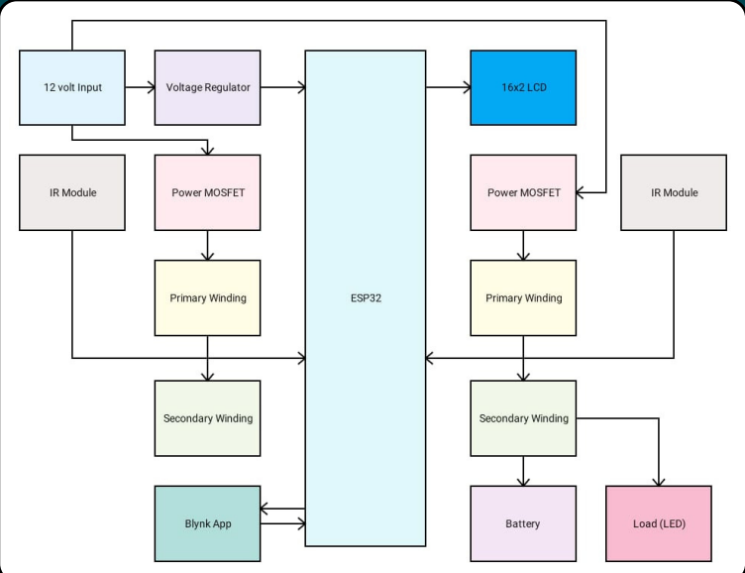
Block Diagram

Slide 8
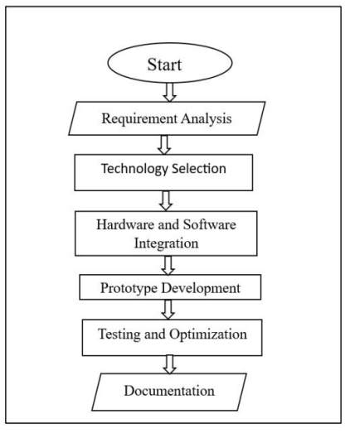
Flow Chart

Slide 9
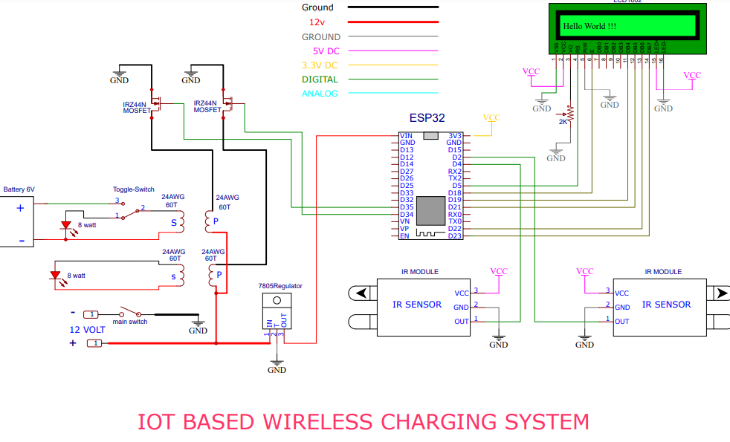
Circuit Diagram
Circuit Diagram
[1]

Slide 10
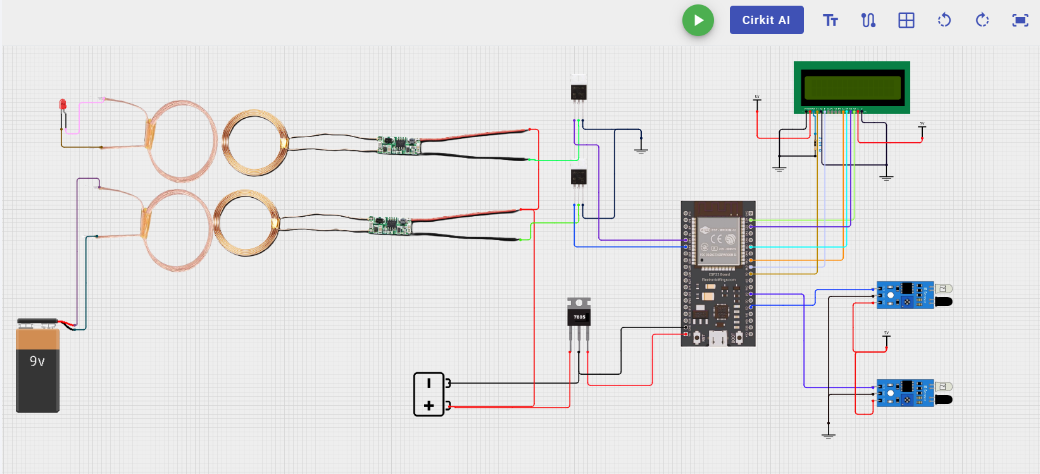
Simulation Result

Slide 11
Applications
Smart Charging Stations
Integration with Smart City Infrastructure
Enhanced Safety Features
Automated Charging

Slide 12
References
https://r.search.yahoo.com/_ylt=AwrKFYI8ZbtnCQIA_9K7HAx.;_ylu=Y29sbwNzZzMEcG9zAzEEdnRpZAMEc2VjA3Ny/RV=2/RE=1741543997/RO=10/RU=https%3a%2f%2fwww.ijarst.in%2fpublic%2fuploads%2fpaper%2f617121712731541.pdf/RK=2/RS=maDiZJLrJ6PVTT0vjdsC34zfgec-
https://r.search.yahoo.com/_ylt=AwrKFYI8ZbtnCQIA_9K7HAx.;_ylu=Y29sbwNzZzMEcG9zAzEEdnRpZAMEc2VjA3Ny/RV=2/RE=1741543997/RO=10/RU=https%3a%2f%2fwww.ijarst.in%2fpublic%2fuploads%2fpaper%2f617121712731541.pdf/RK=2/RS=maDiZJLrJ6PVTT0vjdsC34zfgec-

