Slide 1

HOT Inside
The Technical Architecture
Pavan Deolasee
May 22, 2008

Slide 2

Overview
PostgreSQL MVCC
Motivation for Improvement
HOT Basics
HOT Internals
Limitations
Performance Numbers and Charts

Slide 3
What Does HOT Stand For ?
Heap Organized Tuples
Heap Optimized Tuples
Heap Overflow Tuples
Heap Only Tuples

Slide 4
Credits
Its not entirely my work
Several people contributed, some directly, many indirectly
  Simon Riggs – for writing initial design doc and getting me involved
  Heikki – for code review, idea generation/validation and participating in several long discussions.
  Tom Lane – for patch review and code rework
  Korry – for extensive code review within EnterpriseDB
  Dharmendra, Siva, Merlin – for testing correctness/performance
  Florian, Gregory – for floating ideas
  Denis, Bruce – for constant encouragement and making me rework HOT thrice ☺
  Faiz, Hope – for excellent project management within EnterpriseDB
  Nikhil – for hearing to all my stupid ideas and helping with initial work
The list is so long that I must have missed few names – apologies and many thanks to them

Slide 5
Some Background - MVCC
PostgreSQL uses MVCC (Multi Version Concurrency Control) for transaction semantics
The good things:
  Readers don’t wait for writers
  Writer doesn’t wait for readers
  Highly concurrent access and no locking overhead
The bad things:
  Multiple versions of a row are created
  The older, dead versions can not be easily removed because indexes don’t have visibility information
  Maintenance overhead to reduce table/index bloat

Slide 6
MVCC - UPDATE
Index
Heap
Transaction T1 Updates V1
V1
V1
T1
Transaction T1 Commits
V2
V1 is dead, but still visible to older transactions,
so we call it RECENTLY DEAD
V2
T1
T3
V3
T3
Transaction T3 Updates V2
Transaction T3 Commits
V2 is dead, but still visible to older transactions,
It’s also RECENTLY DEAD
Live
Retiring Transaction/xmax
Recently Dead
Creating Transaction/xmin

Slide 7

MVCC - Visibility
time line
T0
Index
Heap
Transaction T0
T1
V1
T1
V2
T1
T3
T3
V3
T2
T3
T4
T0 started before T1 committed
T0 can only see V1

Slide 8

MVCC - Visibility
time line
T0
Index
Heap
Transaction T2
T1
V1
T1
Transaction T2
V2
T1
T3
T3
V3
T2
T3
T4
T2 started after T1 committed, but before T3 committed
T2 can only see V2

Slide 9
MVCC - Visibility
time line
T0
Index
Heap
Transaction T4
T1
V1
T1
V2
Transaction T4
T1
T3
T3
Transaction T4
V3
T2
T3
T4
T4 started after T3 committed
T4 can only see V3

Slide 10
MVCC – Tuple States
Index
Heap
V1 and V2 are RECENTLY DEAD, V3 is
the most current and LIVE version
V1
T1
V1 and V2 can not be removed, because
T0 and T2 can still see them
V2
T1
T3
T0 finishes, V1 becomes DEAD
V3
T3
T2 finishes, V2 becomes DEAD
Only V3 remains LIVE
Live
Recently Dead
Dead

Slide 11
Removing DEAD Tuples
Index
Heap
V1 is DEAD. If it’s removed, we would have
a dangling pointer from the index.
V1 can not be removed unless
the index pointers pointing to it are also
removed
Note: Index entries do not have any visibility
Information
Near impossible to reliably find index pointers
of a given tuple.
V1
V2

Slide 12
MVCC - Index/Heap Bloat
Updates
Inserts
Deletes
Heap
Index A
Index B

Slide 13
MVCC - Index/Heap Bloat
VACUUM
Heap
Index A
Index B

Slide 14
Vacuum – Two Phase Process
Heap
Index A
Index B

Slide 15
Vacuum
VACUUM can release free space only at the
end of the heap. Tuples are not reorganized
to defragment the heap
Fragmented free space is recorded in the
Free Space Map (FSM)
Heap
Index A
Index B

Slide 16
Motivation
Frequent Updates and Deletes bloat the heap and indexes resulting in performance degradation in long term – spiral of death
Each version of a row has it’s own index entry, irrespective of whether index columns changed or not – index bloat
Retail VACUUM is near impossible (dangling index pointers)
Regular maintenance is required to keep heap/index bloat in check (VACUUM and VACUUM FULL)
  Normal VACUUM may not shrink the heap, VACUUM FULL can but requires exclusive lock on the table
  VACUUM requires two passes over the heap and one or more passes over each index.
  VACUUM generates lots of IO activity and can impact the normal performance of the database.
  Must be configured properly

Slide 17
Pgbench Results
scale = 90, clients = 30, transactions/client = 1,000,000
two CPU, dual core, 2 GB machine
separate disks for data (3 disks RAID0) and WAL (1 disk)
shared_buffers = 1536MB
autovacuum = on
autovacuum_naptime = 60
autovacuum_vacuum_threshold = 500
autovacuum_vacuum_scale_factor = 0.1
autovacuum_vacuum_cost_delay = 10ms
autovacuum_vacuum_cost_limit = -1

Slide 18
Heap Bloat (# blocks)
 | Postgres 8.2 |  | Postgres 8.3 Pre HOT |  | Postgres 8.3 Post HOT
 | Original Size | Increase in Size | Original Size | Increase in Size | Original Size | Increase in Size
Branches | 1 | 49,425 | 1 | 166 | 1 | 142
Tellers | 6 | 18,080 | 5 | 1,021 | 5 | 171
Accounts | 155,173 | 243,193 | 147,541 | 245,835 | 147,541 | 5,523
In 8.2, the heap bloat is too much for small and large tables

Slide 19
Postgres 8.3 – Multiple Autovacuum
 | Postgres 8.2 |  | Postgres 8.3 Pre HOT |  | Postgres 8.3 Post HOT
 | Original Size | Increase in Size | Original Size | Increase in Size | Original Size | Increase in Size
Branches | 1 | 49,425 | 1 | 166 | 1 | 142
Tellers | 6 | 18,080 | 5 | 1,021 | 5 | 171
Accounts | 155,173 | 243,193 | 147,541 | 245,835 | 147,541 | 5,523
Multiple autovaccum processes helped small tables, but not large tables

Slide 20
Postgres 8.3 – HOT (Retail Vacuum)
 | Postgres 8.2 |  | Postgres 8.3 Pre HOT |  | Postgres 8.3 Post HOT
 | Original Size | Increase in Size | Original Size | Increase in Size | Original Size | Increase in Size
Branches | 1 | 49,425 | 1 | 166 | 1 | 142
Tellers | 6 | 18,080 | 5 | 1,021 | 5 | 171
Accounts | 155,173 | 243,193 | 147,541 | 245,835 | 147,541 | 5,523

Slide 21
Several Ideas
Update In Place
  The first design. Replace old version with the new version and move old version somewhere else
  It was just too complicated!
Heap Overflow Tuple
  That’s what HOT used to stand for
  A separate overflow relation to store the old versions.
  Later changed so that the new version goes into the overflow relation and pulled into the main relation when old version becomes dead.
  Managing overflow relation and moving tuples around was painful.
Heap Only Tuple
  That’s what HOT stands for today
  Tuples without index pointers

Slide 22
HOT Update
Necessary Condition A: UPDATE does not change any of the index keys
Example:
CREATE TABLE test (a int, b char(20));
CREATE UNIQUE INDEX textindx ON test(a);
INSERT INTO test VALUES (1, ‘foo’);
UPDATE test SET b = ‘bar’ WHERE a = 1;
UPDATE test SET a = a + 1 WHERE a = 1;
First UPDATE changes the non-index column – candidate for HOT update
Second UPDATE changes the index column – HOT update not possible

Slide 23
HOT Update
Index
Heap
V1 is updated – no index key change
Single Index Entry Update Chain
V2 is updated – no free space in block
V1
V2
HOT
V3
Necessary Condition B: The new version should fit in the same old block – HOT chains can not cross block boundary.

Slide 24
HOT Update – Necessary Conditions
Necessary Condition A: UPDATE does not change any of the index keys
Necessary Condition B: The new version should fit in the same old block – HOT chains can not cross block boundary.

Slide 25
Inside A Block
Page Header
Page Header followed by line pointers
Line pointers point to the actual tuples
Indexes always point to the line pointers
and not to the actual tuple
HOT chains originate at Root LP and
may have one or more HOT tuples
HOT tuples are not referenced by the
indexes directly.
1
2
3
4
5
6
N
pd_upper
Free Space
pd_lower
tuple N
Used Space
tuple 6
tuple 5
tuple 3
tuple 4
tuple 2
tuple 1
Root Tuples/LP
HOT Tuples/LP

Slide 26
HOT – Heap Scan
Index Ref
No change to Heap Scan
Each tuple is examined separately and
sequentially to check if it satisfies the
transaction snapshot
V1
V2
V3
V4

Slide 27
HOT – Index Scan
Index Ref
Index points to the Root Tuple
If the Root tuple does not satisfy the
snapshot, the next tuple in the HOT chain
is checked.
Continue till end of the HOT chain
The Root tuple can not be removed even
if it becomes DEAD because index scan
needs it
V1
V2
V3
V4

Slide 28
Pruning – Shortening the HOT Chain
Index Ref
V1 becomes DEAD
V1 is removed, but it’s line pointer (LP)
can not be removed – index points to it
Root LP is redirected to the LP of
next tuple in the chain
V1
V2
V3
V4

Slide 29
Pruning – Shortening the HOT Chain
Index Ref
Root LP is a redirected LP
V2 becomes DEAD
V2 and it’s LP is removed – HOT tuple
Root LP now redirects to the next
tuple in the chain
V2
V3
V4

Slide 30
Pruning – Shortening the HOT Chain
Index Ref
Root LP is a redirected LP
V3 becomes DEAD
V3 and it’s LP is removed – HOT tuple
Root LP now redirects to the next
tuple in the chain
V3
V4

Slide 31
Pruning – Shortening the HOT Chain
Index Ref
Root LP is a redirected LP
V4 becomes DEAD
V4 and it’s LP is removed – HOT tuple
Root LP is now DEAD – still can’t
be removed
V4

Slide 32
Pruning – Normal UPDATEs and DELETEs
Index Ref
Normal UPDATEd and DELETEd
tuples are removed and their LPs
are marked DEAD – LPs can’t be
removed
A very useful side-effect of HOT
V1

Slide 33
Pruning and Defragmentation
Page Header
1
2
3
4
5
6
N
pd_upper
Free Space
pd_lower
tuple N
Used Space
tuple 6
tuple 5
tuple 3
tuple 4
tuple 2
tuple 1
Root Tuples/LP
HOT Tuples/LP

Slide 34
Pruning – Recovering Dead Space
Page Header
1
2
3
4
5
6
N
Free Space
tuple N
Used Space
tuple 6
tuple 5
tuple 3
tuple 4
tuple 2
tuple 1

Slide 35
Defragmentation – Collecting Dead Space
Page Header
1
2
5
6
N
Free Space
tuple N
Used Space
tuple 6
tuple 5

Slide 36
Billion $ Question – When to Prune/Defragment ?
Pruning and defragmentation (PD) happens together – requires cleanup lock on the buffer and shuffles tuples in a page.
Too frequent PD may conflict with other backends accessing the buffer.
Too infrequent PD may slow down reclaiming dead space and create long HOT chains.
Page level hint bits and transaction id is used to optimize PD operations.

Slide 37
Page Level Hints and Xid
If UPDATE does not find enough free space in a page, it does COLD UPDATE but sets PD_PAGE_FULL flag
The next access to page may trigger prune/defrag operation if cleanup lock is available.
PD never waits for cleanup lock
Page Xid is set to the oldest transaction id which deleted or updated a tuple in the page. PD is usable only if RecentGlobalXmin is less than the Page Xid.

Slide 38
Lazy Vacuum / Vacuum Full
Lazy Vacuum is almost unchanged.
DEAD line pointers are collected and reclaimed.
Vacuum Full clears the redirected line pointers by making them directly point to the first visible tuple in the chain.
V
V

Slide 39
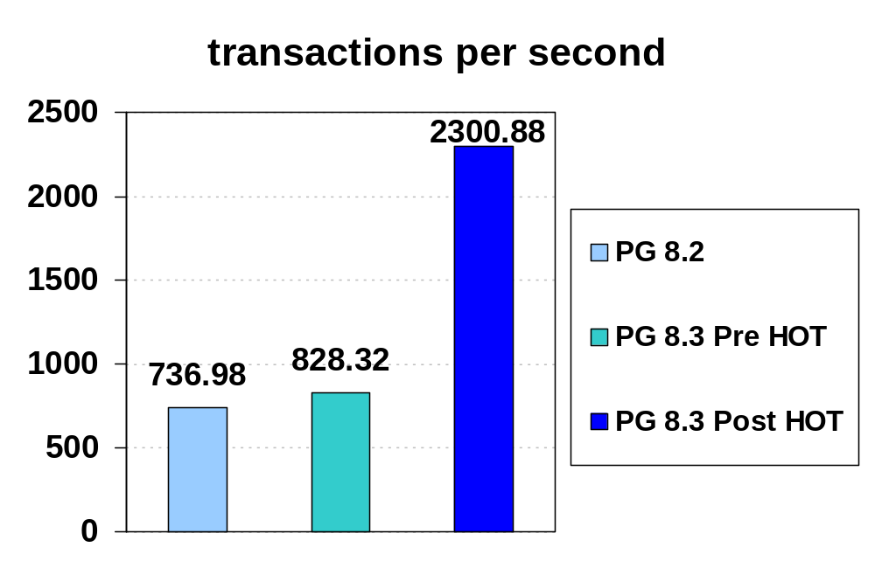
Headline Numbers - Comparing TPS
That’s a good 200% increase in TPS

Slide 40
Comparing Heap Bloat (# blocks)
 | Postgres 8.2 |  | Postgres 8.3 Pre HOT |  | Postgres 8.3 Post HOT
 | Original Size | Increase in Size | Original Size | Increase in Size | Original Size | Increase in Size
Branches | 1 | 49,425 | 1 | 166 | 1 | 142
Tellers | 6 | 18,080 | 5 | 1,021 | 5 | 171
Accounts | 155,173 | 243,193 | 147,541 | 245,835 | 147,541 | 5,523
HOT significantly reduces heap bloat; for small and large tables

Slide 41
Comparing Index Bloat (# blocks)
 | Postgres 8.2 |  | Postgres 8.3 Pre HOT |  | Postgres 8.3 Post HOT
 | Original Size | Increase in Size | Original Size | Increase in Size | Original Size | Increase in Size
Branches | 2 | 1,023 | 2 | 588 | 2 | 4
Tellers | 5 | 353 | 5 | 586 | 5 | 19
Accounts | 24,680 | 24,679 | 24,680 | 24,677 | 24,680 | 0
HOT significantly reduces index bloat too; for small and large tables

Slide 42
Comparing IO Stats
 |  | Postgres 8.2 |  | Postgres 8.3 Pre HOT |  | Postgres 8.3 Post HOT
 |  | Blks Read | Blks Hit | Blks Read | Blks Hit | Blks Read | Blks Hit
Branches | H | 576,949 | 810,688,147 | 8,595 | 2,904,470,056 | 784 | 74,640,567
 | I | 7,540 | 330,165,668 | 68,992 | 254,298,111 | 7 | 56,184,941
Tellers | H | 685,599 | 219,033,182 | 7,710 | 452,528,173 | 678 | 62,275,473
 | I | 366 | 135,684,700 | 599 | 210,984,757 | 28 | 60,655,207
Accounts | H | 20,138,195 | 167,902,036 | 19,065,032 | 173,465,111 | 162,867 | 101,354,726
 | I | 464,641 | 266,747,533 | 482,835 | 270,662,463 | 49,327 | 181,307,038

Slide 43
Comparing IO Stats
 |  | Postgres 8.2 |  | Postgres 8.3 Pre HOT |  | Postgres 8.3 Post HOT
 |  | Blks Read | Blks Hit | Blks Read | Blks Hit | Blks Read | Blks Hit
Branches | H | 576,949 | 810,688,147 | 8,595 | 2,904,470,056 | 784 | 74,640,567
 | I | 7,540 | 330,165,668 | 68,992 | 254,298,111 | 7 | 56,184,941
Tellers | H | 685,599 | 219,033,182 | 7,710 | 452,528,173 | 678 | 62,275,473
 | I | 366 | 135,684,700 | 599 | 210,984,757 | 28 | 60,655,207
Accounts | H | 20,138,195 | 167,902,036 | 19,065,032 | 173,465,111 | 162,867 | 101,354,726
 | I | 464,641 | 266,747,533 | 482,835 | 270,662,463 | 49,327 | 181,307,038

Slide 44
Comparing IO Stats
 |  | Postgres 8.2 |  | Postgres 8.3 Pre HOT |  | Postgres 8.3 Post HOT
 |  | Blks Read | Blks Hit | Blks Read | Blks Hit | Blks Read | Blks Hit
Branches | H | 576,949 | 810,688,147 | 8,595 | 2,904,470,056 | 784 | 74,640,567
 | I | 7,540 | 330,165,668 | 68,992 | 254,298,111 | 7 | 56,184,941
Tellers | H | 685,599 | 219,033,182 | 7,710 | 452,528,173 | 678 | 62,275,473
 | I | 366 | 135,684,700 | 599 | 210,984,757 | 28 | 60,655,207
Accounts | H | 20,138,195 | 167,902,036 | 19,065,032 | 173,465,111 | 162,867 | 101,354,726
 | I | 464,641 | 266,747,533 | 482,835 | 270,662,463 | 49,327 | 181,307,038
Significant reduction in IO improves the headline numbers

Slide 45
What Should I Do ?
Nothing! HOT is always enabled and there is no way to disable it.
It works on user and system tables
A heap fill factor less than 100 may help
A significantly smaller heap fill factor (as low as 50) is useful for heavy updates where most of the updates are bulk updates
Non index key updates is a necessary condition for HOT – check if you don’t need one of the indexes.
Prune-defrag reclaims COLD UPDATEd and DELETEd DEAD tuples by converting their line pointers to DEAD
You still need VACUUM – may be less aggressive

Slide 46
Limitations
Free space released by defragmentation can only be used for subsequent UPDATEs in the same page – we don’t update FSM after prune-defragmentation
HOT chains can not cross block boundaries
Newly created index may remain unusable for concurrent transactions
Normal vacuum can not clean redirected line pointers

Slide 47
Create Index
This was one of the most interesting challenges in HOT development.
The goal was to support CREATE INDEX without much or no impact on the existing semantics.
Did we succeed ? Well, almost

Slide 48
Create Index - Challenges
Handling broken HOT chains
New Index must satisfy HOT properties
  All tuples in a HOT chain must share the same index key
  Index should not directly point to a HOT tuple.
Create Index should work with a ShareLock on the relation

Slide 49
Create Index – Sane State
1
All HOT chains are in sane state
Every tuple in a chain shares the
same index key
Index points to the Root Line Pointer
2
1, a, x
1, a, y
3
4
2, c, y
2, b, x
indexA(col1)
3, d, x
4, e, x
4, f, y
Create Table test (col1 int, col2 char, col3 char);
Create Index indexA ON test(col1);

Slide 50
Create Index – Broken HOT Chains
1
Create a new Index on col2
Second and fourth HOT chains,
marked with , are broken
w. r. t. new Index
tuples are recently dead, but
may be visible to concurrent txns
2
1, a, x
1, a, y
3
4
2, c, y
2, b, x
indexA(col1)
3, d, x
4, e, x
4, f, y
indexB(col2)
Create Index indexB ON test(col2);

Slide 51
Create Index – Building Index with Broken HOT Chains
1
Recently Dead tuples are not indexed
Index remains unusable to the
transactions which can potentially
see these skipped tuples, including
the transaction which creates the
index
Any new transaction can use the index
xmin of pg_class row is used to check
index visibility for transactions
2
1, a, x
1, a, y
3
4
2, c, y
2, b, x
indexA(col1)
a
3, d, x
c
d
4, e, x
4, f, y
f
indexB(col2)
Create Index indexB ON test(col2);

Slide 52
Thank you pavan.deolasee@gmail.com pavan.deolasee@enterprisedb.com

