Slide 1
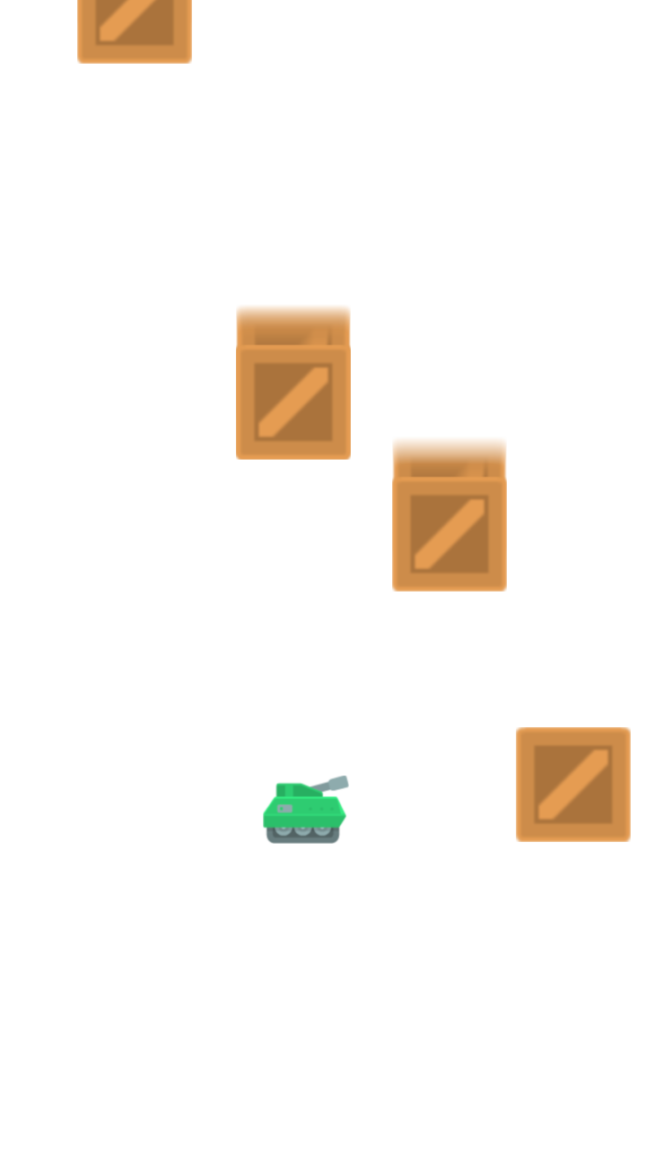
BOXES ARE FALLING
A game about shooting
and avoiding boxes.

Slide 2
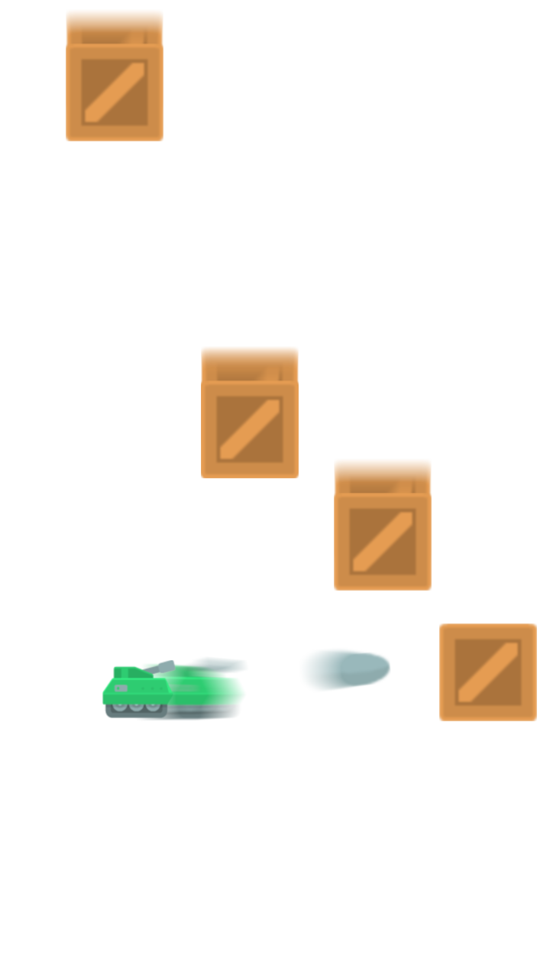
TOUCH THE SCREEN TO SHOOT

Slide 3
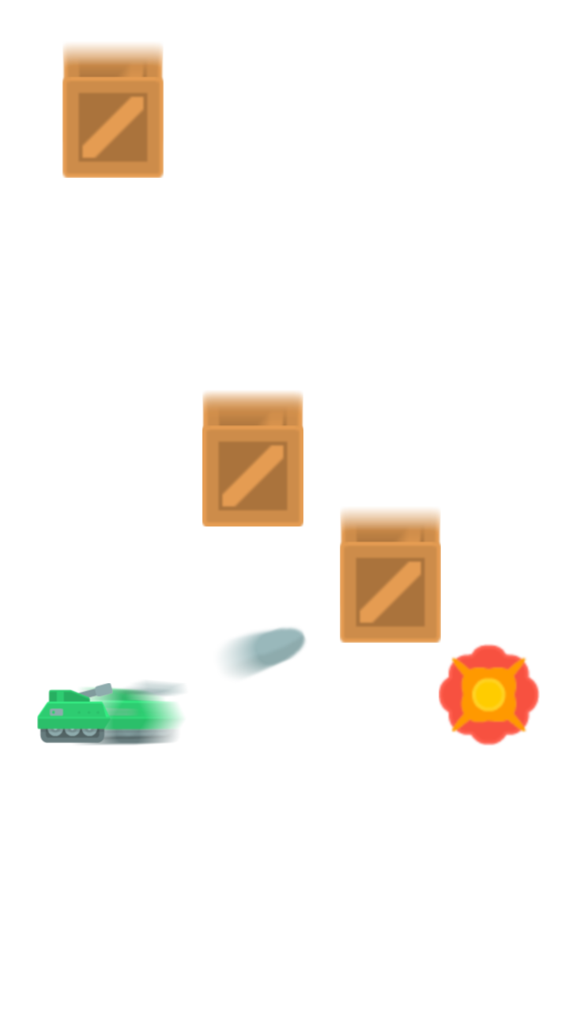
SHOOT TO
DESTROY BOXES

Slide 4
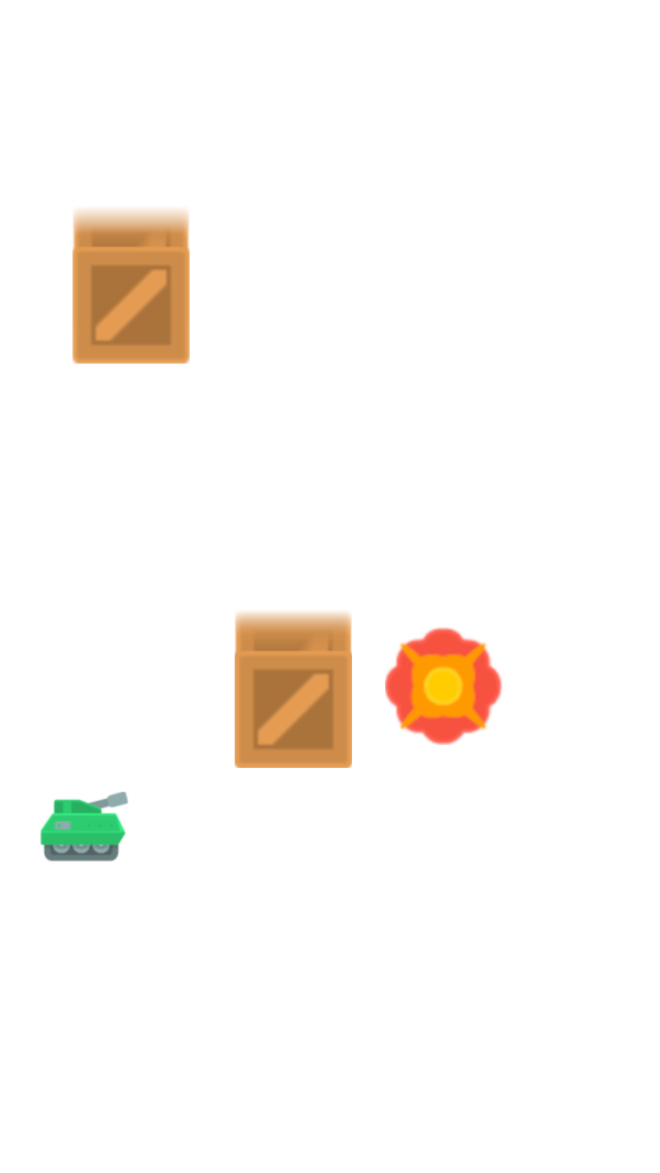
SHOOT TO
AVOID BOXES

Slide 5

BOXES ARE FALLING
A game by SpiceFrogg
Art by kenney.nl

