Slide 1
TRANSMISSION OF BULK DATA OVER USB TO SD CARD
ECE 337:Thursday 2:30 PM Lab
TA: Kyle Ziga
Apoorv Vidhu Sharma Kunwar Digraj Singh Jain Pushkal Vaid Pujitha Desiraju

Slide 2
Overview
Data is essential in every aspect of industry solutions and technological advances.
Important to have a mechanism to transfer blocks of data in large quantities over reliable transmissions to a safe storage device.
The proposed project will be designed as a peripheral to computers. The design works bidirectionally.
The design will have dedicated hardware for data which is sent/received over a USB and finally written to/read from an SD card. This will prevent unnecessary memory and processor transactions.

Slide 3
System Design

Slide 4
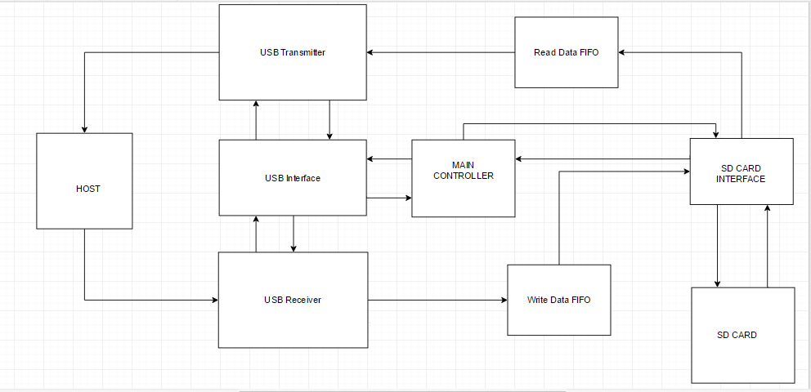
System Architecture
D+, D- lines
D+, D- lines

Slide 5
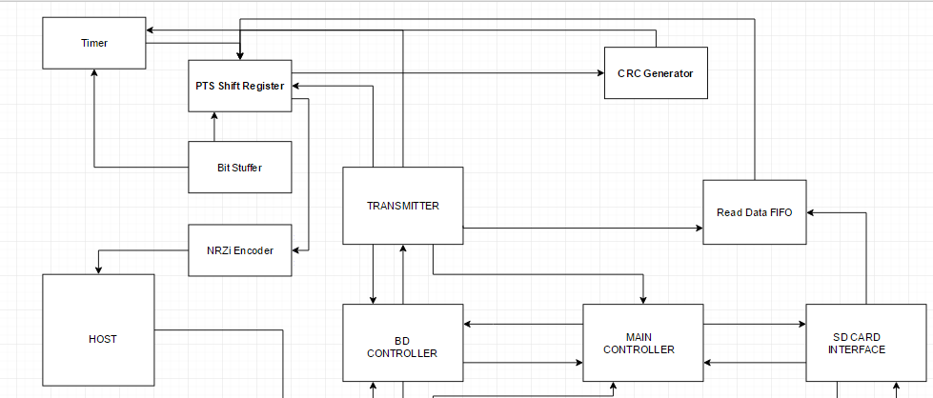
USB Transmitter
Crc_data[15:0]
pause
read_en
D+, D- lines
trans
tx_en
Write_done
Read_done
En_write
En_read

Slide 6
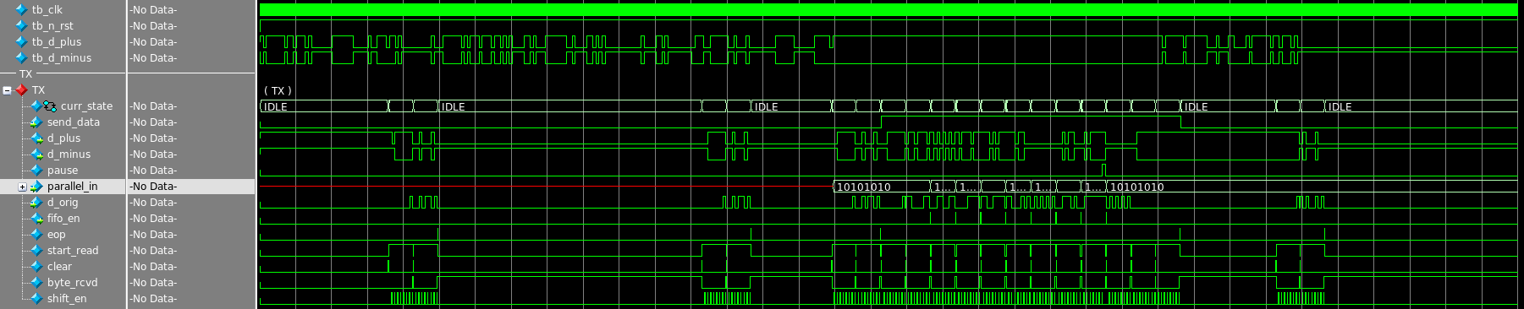
Design Specific Success Criteria
Demonstrate through the use of a Verilog test bench that the design's USB 1.1 Transmitter module is able to correctly handle sending of the packet types that must be sent by a USB 1.1 slave device in order to support Bulk Transport Protocol. (2pt) [Partially Demonstrated]

Slide 7
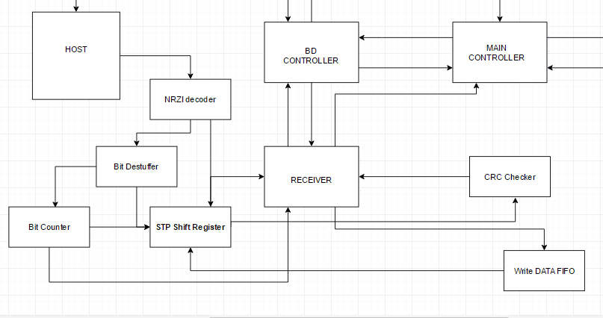
USB Receiver
Write_done
Read_done
D+, D- lines
En_write
En_read
SD Interface
rcving
Rx_en
pause
Crc_status
Write_en
data

Slide 8
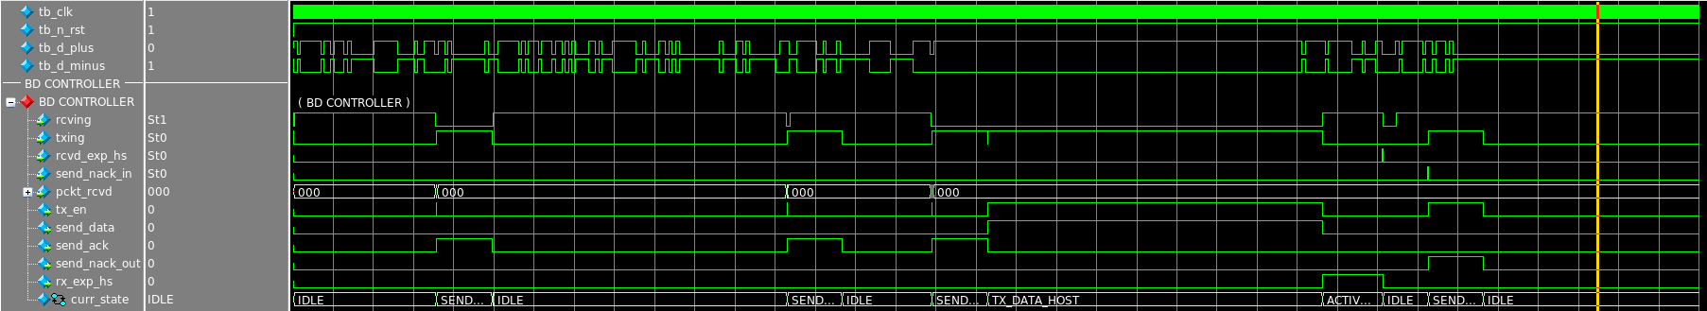
Design Specific Success Criteria
Demonstrate through the use of a Verilog test bench that the design's USB 1.1 Slave interface portion of the design is able to correctly handle Bulk Transport Sequences. (1pt) [Demonstrated]

Slide 9
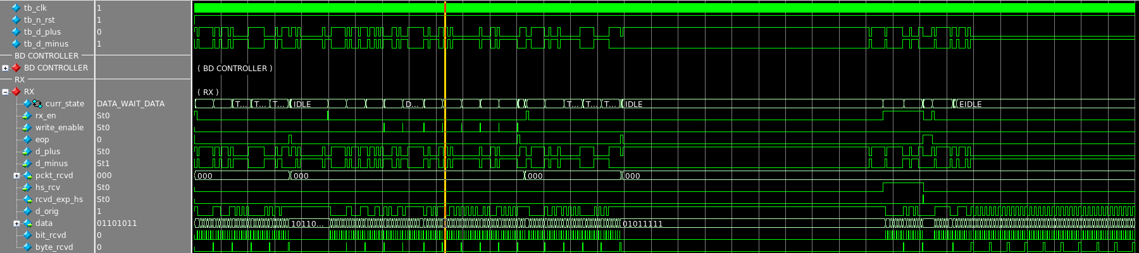
Design Specific Success Criteria
Demonstrate through the use of a Verilog test bench that the design's USB 1.1 Receiver module is able to correctly handle reception of the packet types that must be received by a USB 1.1 slave device in order to support Bulk Transport Protocol. (2pt) [Partially Demonstrated]

Slide 10
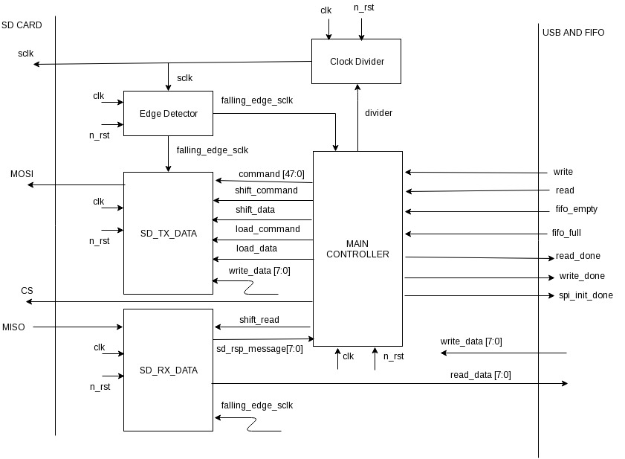
SD Card Interface Design

Slide 11
Design Specific Success Criteria
Demonstrate through the use of a Verilog test bench that the SD card interface module is able to correctly Initialize the SD Card. (1pt) [Demonstrated]

Slide 12
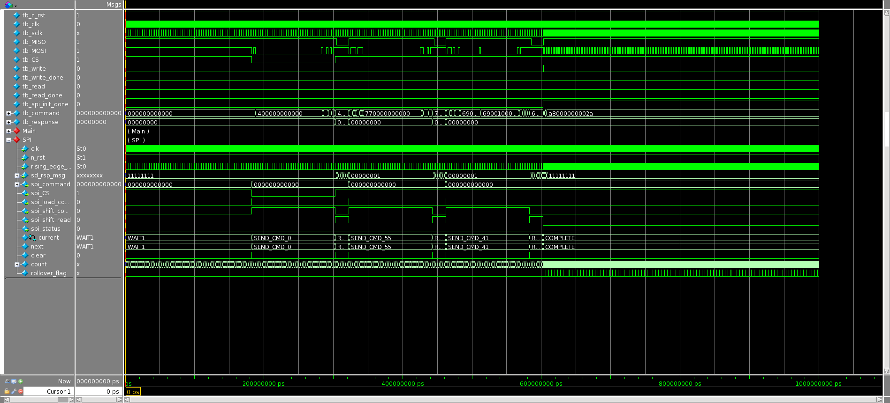
SD Card Waveform

Slide 13
Results

Slide 14
Fixed Success Criteria
Test benches exist for all top-level components and the entire design. The test benches for the entire design can be demonstrated or documented to cover all of the functional requirements given in the design specific success criteria. (2 pts) [Demonstrated] *Testbenches exists for all relevant files
Entire design synthesizes completely, without any inferred latches, timing arcs, and, sensitivity list warnings. (4 pts)[Demonstrated] *Synthesizes without errors
Source and mapped version of the complete design behave the same for all test cases. The mapped version simulates without timing errors except at time zero. (2 pts) [Demonstrated] * Successfully presented during project demo

Slide 15
Timing Analysis
The entire design complies with targets for area, pin count and clock rate.
*Passed through all geometry and connectivity checks
Starting Component | Combinational Logic | Propagation Delay (ns) | Ending Component | Setup Time or Propagation Delay (ns) | Total Path Delay (ns) | Target Clock Period (ns) | Functional Block name
Inputs | - | - | Reg | 1 | 6 | 10 | Receiver CU
Inputs | Flex Counter | 10 | byte_recieved | 0 | 10 | 10 | RCV Timer
curr_state_reg[0]/Q → count_out_reg[2]/D (10.851)

Slide 16
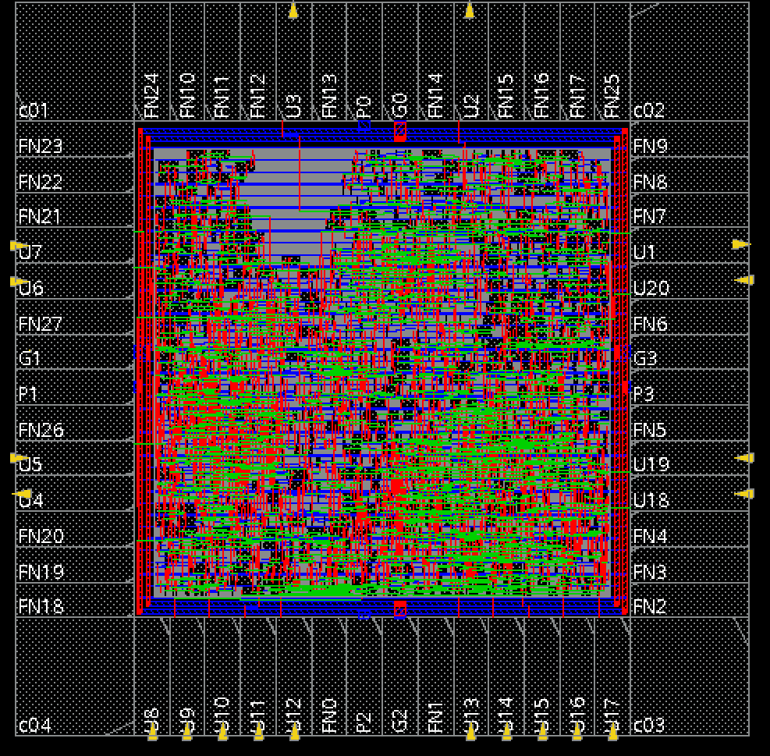
Layout
Area: 1.86 mm x 1.86 mm

Slide 17
Conclusions
Challenges:
Challenges faced during design was thorough testing using testbenches and integration of complete project
Looking ahead:
More detailed integration of USB and SD card
Improve individual functionality of USB and SD Card modules

