Slide 1


CAWT – COM Automation With Tcl
CAWT Use Cases
CAWT
=
+
European Tcl/Tk User Meeting 2015, Cologne

Slide 2
CAWT Use Cases – Contents
CAWT Overview
Architecture
History
Use Cases@Home
Use of CAWT in poApps
Use of CAWT to document itself
Use Cases@Work
Lazy man‘s documentation tool
Poor man‘s requirement tool

Slide 3
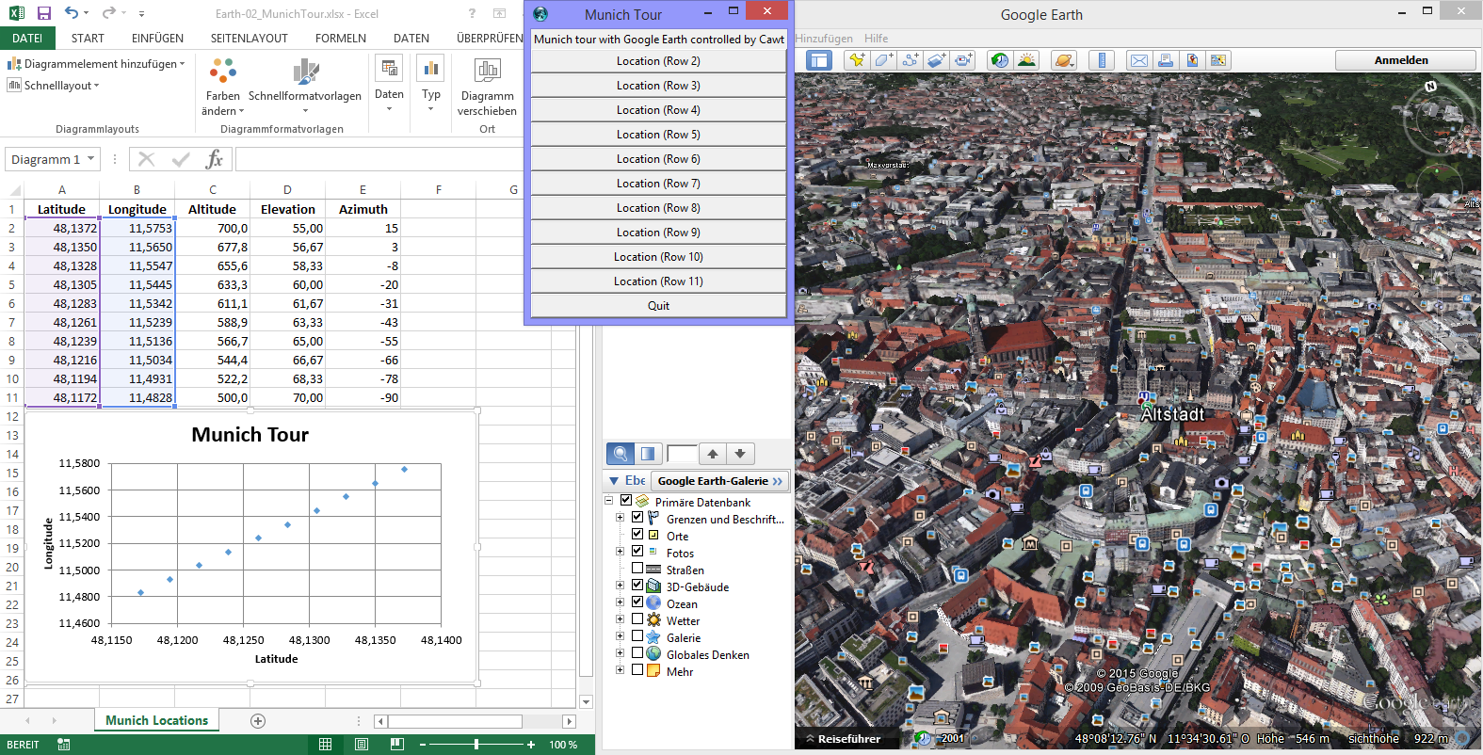
CAWT Overview – What it is good for?
High-level Tcl interface for scripting Windows applications having a COM interface:
Excel
Word
PowerPoint
Outlook
Ocr
GoogleEarth
Matlab
IExplorer
Note, that only Office modules Excel, Word and PowerPoint are in active development.

Slide 4
CAWT Overview – Architecture
Microsoft Office packages
CawtExcel
Microsoft Excel
CawtOutlook
Microsoft Outlook
CawtPpt
Microsoft PowerPoint
CawtWord
Microsoft Word
CawtEarth
Google Earth
CawtExplorer
MS Internet Explorer
CawtOcr
MS Document Imaging
CawtMatlab
MathWorks Matlab
CawtCore
Basic Automation
Twapi
Tcl Windows API extension

Slide 5
CAWT Overview - History
2008/09/11 TcomExcel 0.1 Use of Tcom for COM access. Support for Excel only.
...
2011/07/17 TcomOffice 0.4.0 New module TcomWord for Word automation.
...
2012/01/21 TcomOffice 0.5a3 Use Twapi for COM access instead of Tcom.
2012/07/08 EuroTcl 2012 Work-In-Progress Report.
2012/12/23 CAWT 1.0.0 Major rewrite using Twapi for COM access.
...
2014/03/30 Added SourceForge project for CAWT.
...
2015/03/31 CAWT 2.0.0 Namespaces ensembled. Office enumerations as strings.

Slide 6
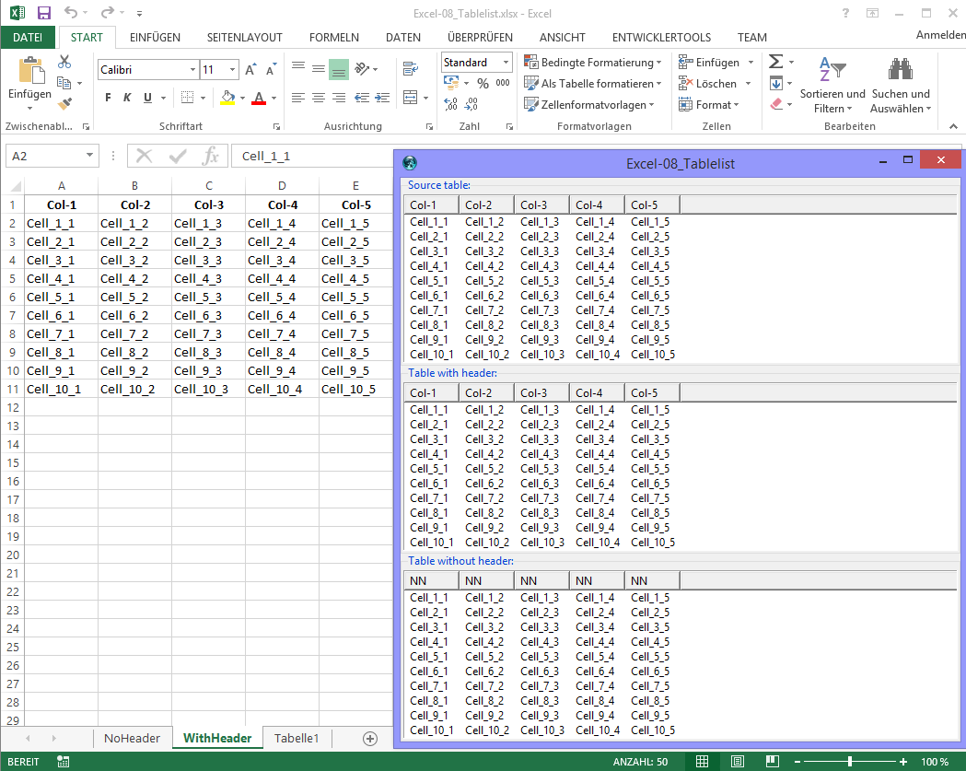
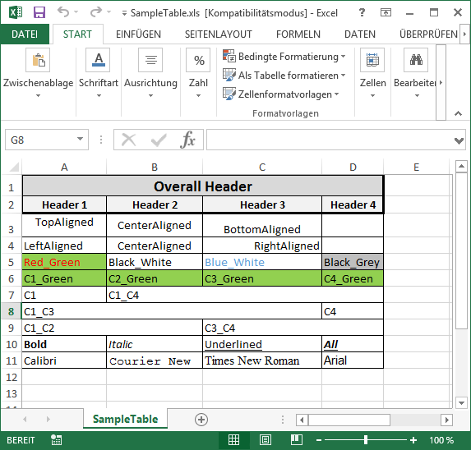
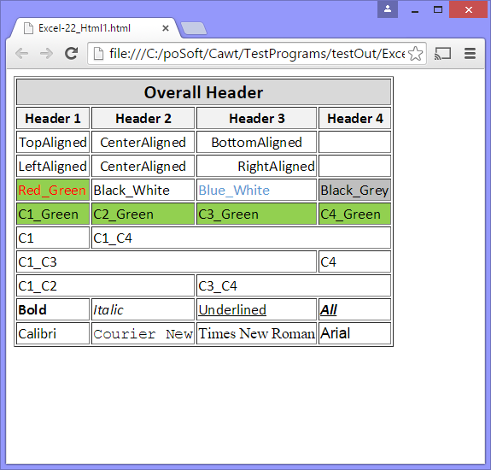
Use Cases@Home – Handling of Tabular Data
Exchange of tabular data:
Excel tables
Word tables
Tablelist
Raw images
Matlab MAT-files
CSV files
MediaWiki tables
Wikit tables
HTML tables

Slide 7
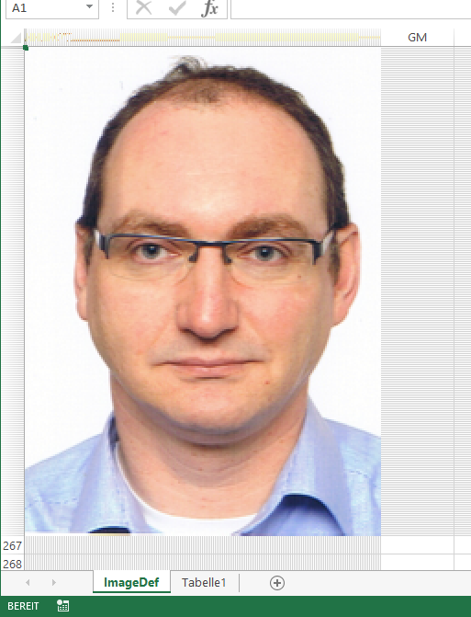
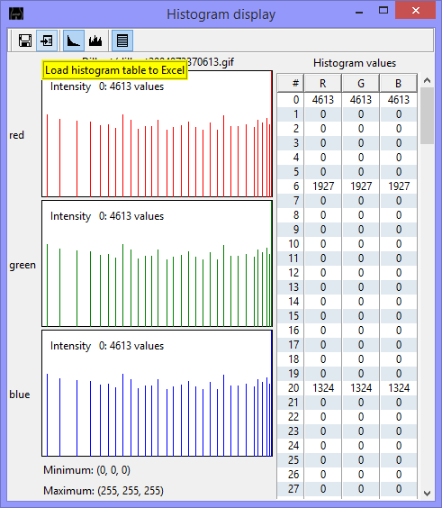
Use Cases@Home– poApps Image Viewer
Features using CAWT:
Color count table to Excel
Histogram to Excel
Image to Excel as background cell colors.

Slide 8
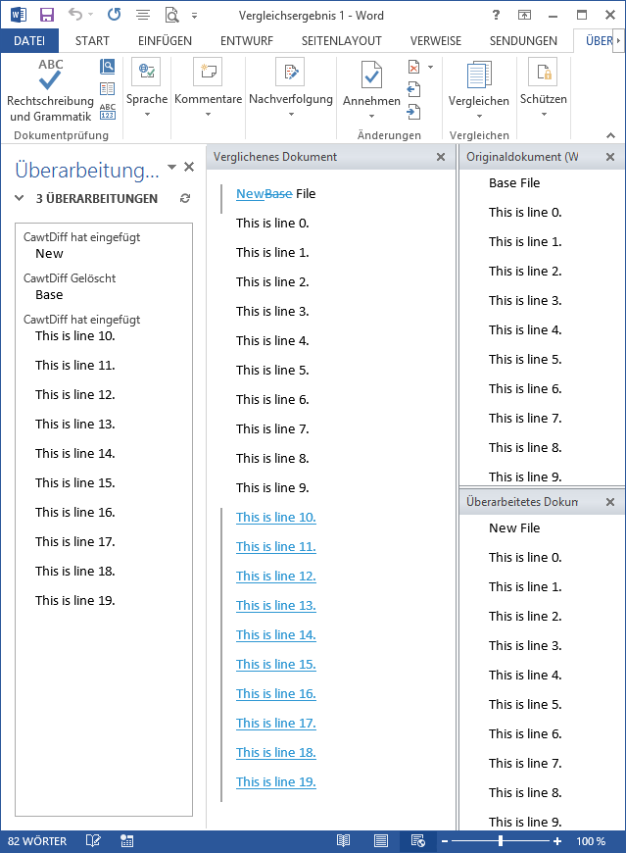
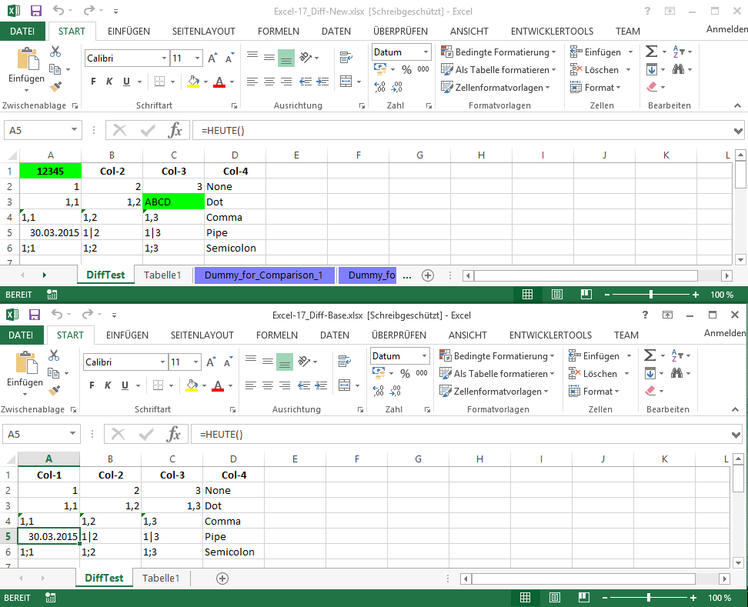
Use Cases@Home – poApps Directory Diff
Features using CAWT:
Comparison of Excel files.
Comparison of Word files.

Slide 9
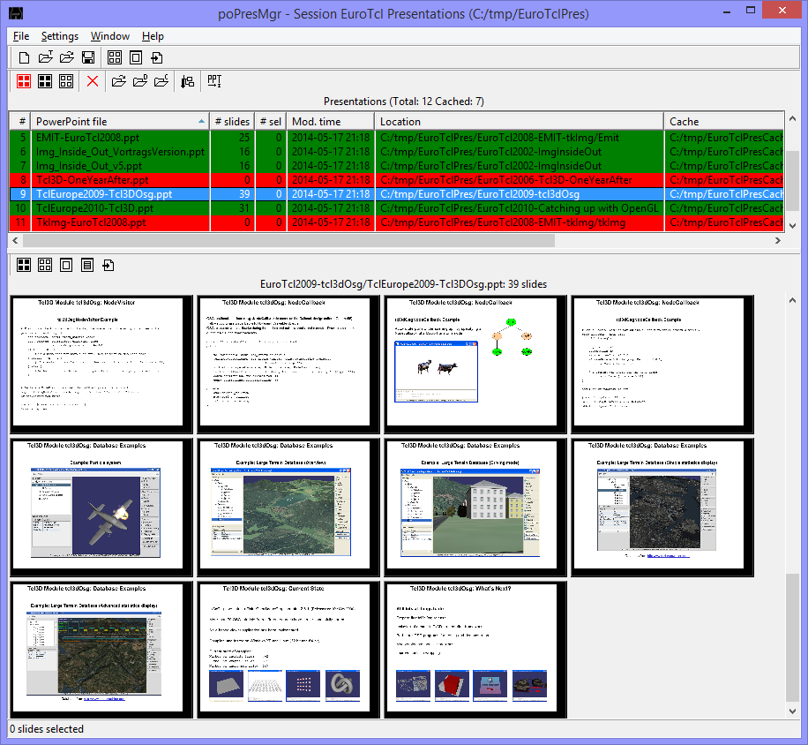
Use Cases@Home – poApps Presentation Manager
Manage PowerPoint presentations:
Export presentations as preview images.
Quick overview.
Build new presentations from preview images.

Slide 10


Use Cases@Home – CAWT Document Generation
Input
Tcl Scripts
Output
UserManual Template
CawtManualTemplate.doc
User Manual
CawtManual-VERSION.doc
UserManual Pictures
CawtFigures.ppt
Gen. UserManual Doc.
genCawtDoc.tcl
User Manual
CawtManual-VERSION.pdf
CAWT Source
Tcl Files
%VERSION%
%DATE%
%YEAR%
%FIGURE Figure-01%
%TABLE Excel%
%TABLE TestPrograms%
CAWT Reference
HTML Files

Slide 11
Use Cases@Work – Poor and Lazy man‘s tools
Goal: Fulfill minimal needed formalism for an internal project
Needed documents in Word with company specific formatting:
Requirement specification.
User Manual.
Assessment instruction.
Assessment protocol.
Software Architecture.
New feature
New methods
New tests
New assessment with QA / CM

Slide 12
Use Cases@Work – Poor and Lazy man‘s tools
Input
Tcl-Scripts
Output
Requirements List
Excel
Gen. Specification Doc.
Specification Document
Word
Specification Template
Word
Assessment Template
Word
Gen. Assessment Doc.
Assessment Instruction
Word
Report Template
Word
Execute Tests
(RunAndCheck)
Assessment Report
Word
UserManual Template
Word
User Manual
Word
UserManual Pictures
PpwerPoint
Gen. UserManual Doc.
User Manual
PDF
Doxygen Reference
(HTML files)

Slide 13
Use Cases@Work – Poor and Lazy man‘s tools
Test Input
Test Scripts
Test Output
RunAndCheck
Test Configurations
Tcl procedure calls
Execute Test Suites
Image files
Execute Test Case
Log files
CheckSystem.log
runTests.log
Check Criteria
Tcl procedure calls
Check Test Results
Log files
Check Image
checkTests.log
checkTests.cawt
Report Template
Word
Generate Report
Assessment Report
Word

Slide 14
CAWT – COM Automation With Tcl
CAWT is available on SF and poSoft
http://sourceforge.net/projects/cawt
http://www.poSoft.de
European Tcl/Tk User Meeting 2015, Cologne

